Slide 1
CLONING OF PCR PRODUCTS
MRS.S.AMIRTHAM
ASSISTANT PROFESSOR
PG & Research department of biotechnology
Bon secours college for women
Thanjavur.

Slide 2
Introduction
◆
PCR Cloning differs from traditional Cloning in that the DNA fragment of interest, and even the vector, can be amplified by the polymerase chain reaction (PCR) and ligated together, without the use of restriction enzymes.
A little amount of DNA is necessary.
◆

Slide 3
PCR cloning is rapid method for cloning genes, and is often used for projects that require higher throughput than traditional cloning methods can accommodate.
It allows for the cloning of DNA fragments that are not available in large amounts.

Slide 4
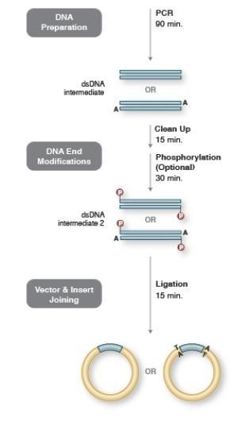

Slide 5
Discovery of PCR
◆
◆
PCR was invented by kary Mullis. Born on 28th December 1944,kary
Mullis is a noble prize winning biochemist, author and lecturer.
Started working at citus corporation, California in 1973.
◆

Slide 6
How PCR was invented?
◆ Thinking to use simpler method for DNA sequencing.
◆ planning to use Sanger method called
“dideoxytechnique”.
◆ Use dideoxy bases (ie., O removed from 2prime position of carbon ring) & polymerase.
◆ Stop further addition of bases.

Slide 7
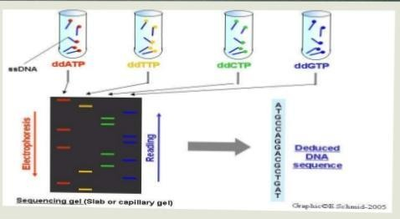

Slide 8
Working of PCR
The basic protocol of a PCR require following ingredients :
Template DNA Pair of primers
DNA polymerase (usually Taq polymerase)
dNTPs(ie., four bases A T G C) Some ions and salts are also used.
◆
◆
◆

Slide 9
Types
There are many different types of polymerase chain reaction on the basis of their principles.
Real time PCR
Reverse transcriptase PCR
Quantitative real-time PCR
Multiplex PCR
Nested PCR

Slide 10
1.Real time PCR
◆ Real time PCR is introduced by Higuchi and fellows in 1992.
◆ In Real time PCR we find out an accurate quantification of DNA sequence in a complex mixture.
◆ Real time PCR is divided into two types:
◆ Non-specific detection using binding dyes
◆ Specific detection target specific probes.

Slide 11
Specific detection target specific probes
Oligonucleotides probe are used for the specific detection.
Oligonucleotides are labelled with fluorescent dye.
Different types of probe are used:
◆ Taq man probes
◆ FRET hybridization probes
◆ Molecular beacons.

Slide 12
Non-specific detection using binding dyes
◆ In real time PCR,DNA binding dyes are used as fluorescent protein work as reporter molecules.
Fluorescent reporter molecules increase as the reaction proceeds.
Different dyes are used but SYBR green is commonly used dye in real time PCR.
It is the specific dowble stranded DNA dye.

Slide 13
2.Reverse Transcriptase PCR
Reverse transcriptase PCR is a modified technique used for the detection of RNA expression In this technique,RNA is used for rather than DNA.
In Real time PCR, transcriptase enzyme is used for converting mRNA into cDNA.
DNA strands are now denatured then add two primers for the synthesis of cDNA.

Slide 14
Procedure
PCR nucleotide sequence of child and suspected father is run on the gel by applying electric current.
The nucleotide sequence of PCR products may resemble to either father 1 or 2.
If the sequence match this show the relatedness between the child and the parent.

Slide 15
PCR Mechanisms
Three stages :
◆ Denaturation 90°c-100°c
Denaturation of DNA Annealing
30°c-65°c
primer binds to both strands,antiparallel Extension
60°c-75°c
Addition of dNTPs at 3prime end.
◆
◆

Slide 16
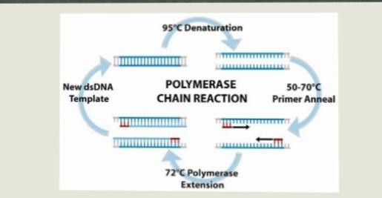

Slide 17
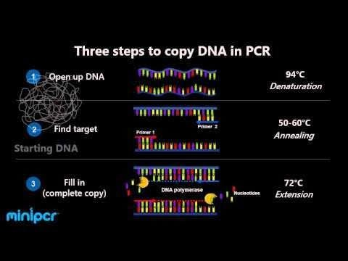

Slide 18
PCR applications
Paternity Testing:
◆ Genetic material is inherited from both parents,half from mother and half from father.
◆ DNA sample from buccal saliva or blood is collected and extracted from the alleged child.
◆ Then the extracted DNA is subjected to PCR, thousands of copies of amplified DNA is obtained.

Slide 19
Mutation detection in inherited disease
Any point mutation,a deletion or an insertion and expanded tandem trinucleotide repeat can be detected by PCR.
Somatic mutations in oncogenes or tumor repressor genes can also be detected by PCR with primers flanking the insertions or deletions.

Slide 20
T-vectors
T-vectors pMD20 and pMD19:
◆
pMD20 & pMD19(simple) T-vectors are linearized PCR Cloning vectors (cleaved by EcoRV) with single 3’-terminal thymidine residues (dT) at both ends. These T- overhangs at the Cloning site improve the efficiency of ligation of Pcr products that CONTAIN dA – overhangs. The inclusion of lacZ allows screening for the detection of successful libations.

Slide 21
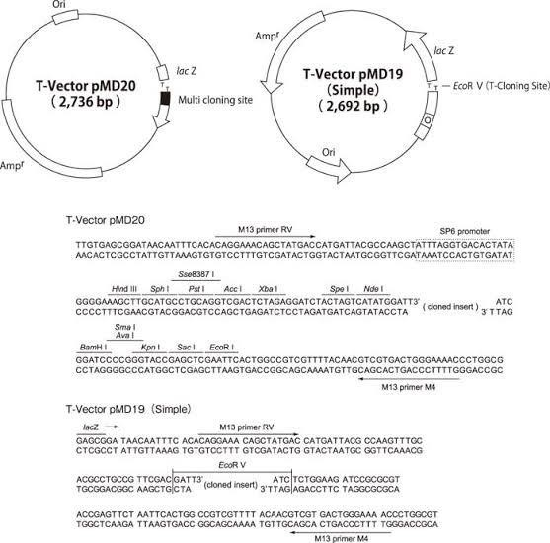

Slide 22
Proofreading enzymes
A repair mechanism that helps to ensure faithful DNA replication in living cells. It is a function of the enzyme DNA polymerase, which catalyses the replication process.
◆ This enzyme identifies and excises mismatched bases at the end of the growing strand, leaving the end free to accept the correct nucleotide instead, thereby restoring the correct complementary base sequence.
◆

Slide 23
Why are Proofreading enzymes Important?
It allows the enzyme to check each nucleotide during DNA synthesis and excise mismatched nucleotides in the 3’to 5’ direction. The Proofreading domain also enables a polymerase to remove unpaired 3’overhanging nucleotides to create blunt ends.

Slide 24
Different types of proofreading
Bilingual proofreading
Monolingual proofreading
Stylistic proofreading
Pre-print proofreading
Other types of proofreading.

Slide 25
How do proofreading enzymes work?
◆ DNA polymerases are the enzymes that build DNA in cells. During DNA replication (copying),most DNA
polymerase can “Chech their work” with
each base that they add. This process is called proofreading... Polymerase uses 3’ to 5’ exonuclease activity to remove the incorrect T from the 3’end of the new strand.

Slide 26
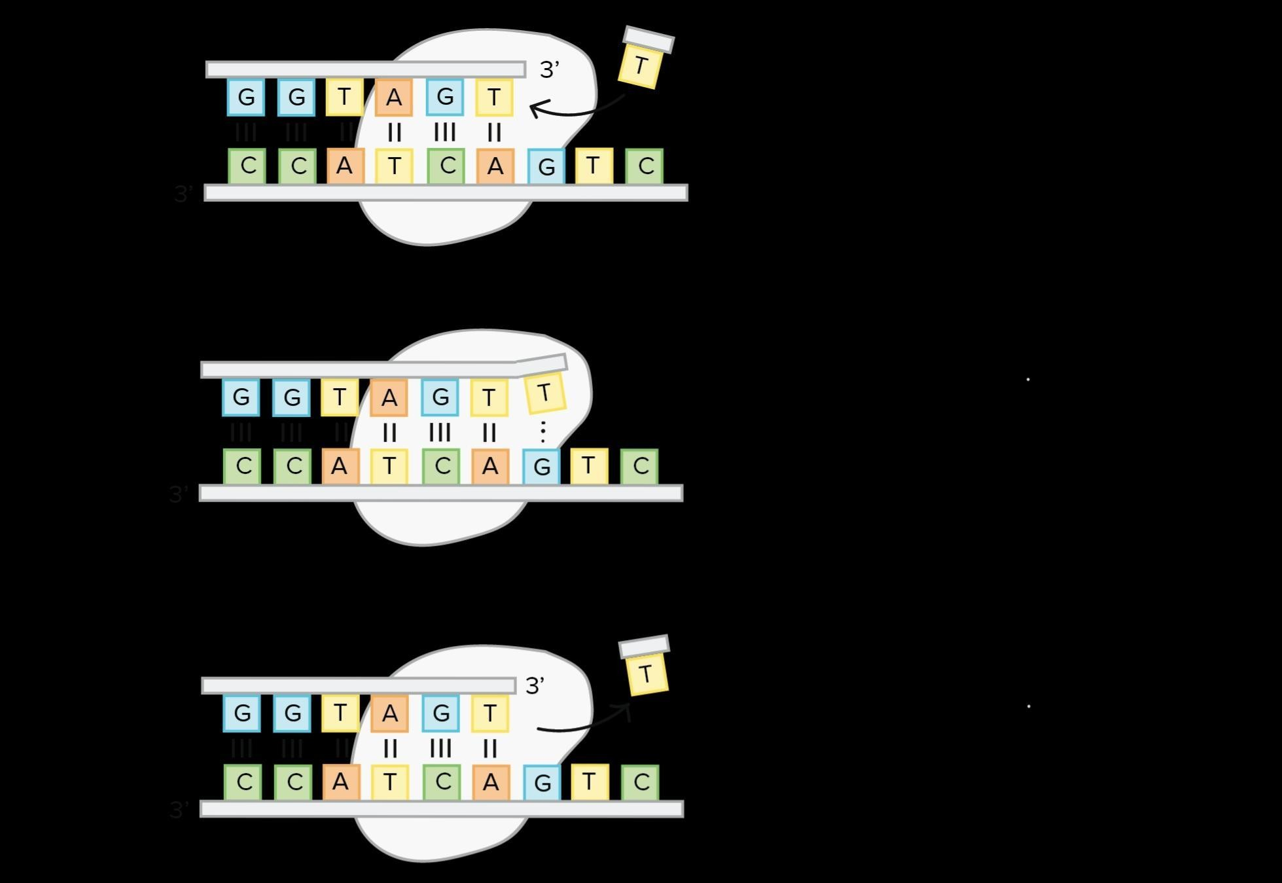
Polymerase adds an incorrect nucleotide to the new strand of DNA
Polymerase detects th bases are mispaired.
Polymerase uses 3’- 5‘exonuclease activity to remove incorrect nucleotide.

Slide 27
PCR in gene recombination
Gene splicing by overlap extension (gene SOEing) is a sequence – independent method for site-directed mutagenesis and recombination of DNA molecules.
It is based on the idea that a PCR product can be engineered by adding or changing sequences at its ends
so that the product can itself be used to prime DNA synthesis in a subsequent overlap – extension reaction to create mutant or recombinant molecules.
•

Slide 28
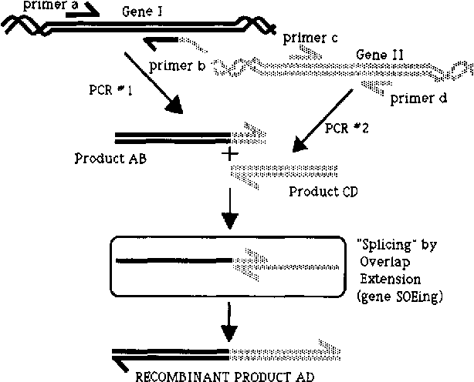

Slide 29
Deletion
◆ The PCR mediated plasmid DNA deletion method is a simple approach to delete DNA sequence from plasmids using only one round of PCR, with two primers, and without ligation or purification prior to the invivo recombination. By using only PCR, the method is sequence independent and, as shown in this study, is applicable to various sizes of plasmids.

Slide 30
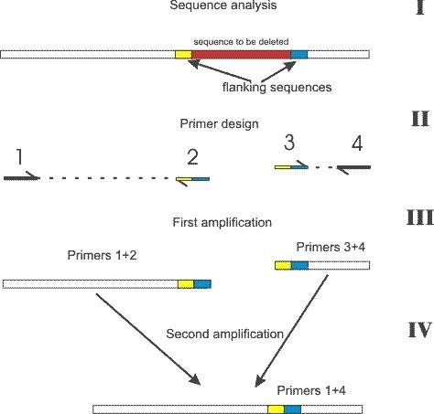

Slide 31
Addition
Before adding the overhangs it is very important to remove all the Proofreading DNA polymerase by purifying the PCR product carefully (eg.,with a commercial PCR purification kit or phenol extraction and DNA precipitation) ;since the Proofreading activity of DNA polymerase will degrade the A overhangs, creating blunt ends again.

Slide 32
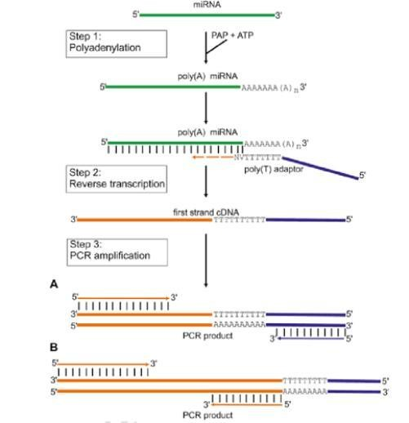

Slide 33
Site specific mutagenesis
◆ Site – directed mutagenesis is an in vitro method in a known sequence. While often performed using PCR based methods, the availability of custom – designed, synthetic, double – stranded DNA (dsDNA) fragments can drastically reduce the time and steps required to obtain the same sequence changes.
◆ primers designed with mutations can introduce small sequence changes, and primer extension or inverse PCR can be used to achieve longer mutant regions.

Slide 34
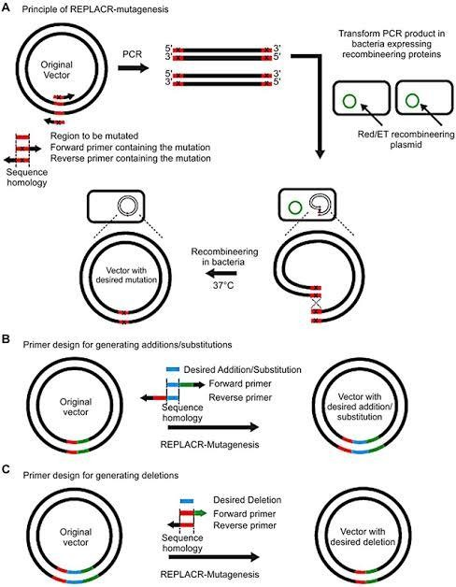

Slide 35
Thank you

