Slide 1
Gene SiLENCING
BY
Mrs. S. Amirtham
Assistant professor
Pg & research department of biotechnology
Bon secours college for women
thanjavur

Slide 2
Gene silencing
Gene silencing is one of the most efficient and promising functional genomics tools which down regulates the expression of a gene in a very precise manner and has significant impact on crop improvement.

Slide 3
Silencing achieved at two levels
Silencing of a target gene can be achieved at two levels; transcriptional and post-transcriptional stages.

Slide 4
Types of gene silencing methods
Post transcriptional modification
Transcriptional
Genomic imprinting
Paramutation
Transposons silencing.
Transgene silencing.
RNA directed DNA methylation
Antisence RNA technology
RNAi technology
Mi RNA
Sh RNA
Si RNA.

Slide 5
TraNscriptional Modification
Transcriptional gene silencing occurs through the repression of the process of transcription while the post transcriptional gene silencing can occur through the degradation of the mRNA.

Slide 6
Transcriptional gene silencing is the result of histone modifications, creating an environment of heterochromatin around a gene that makes it inaccessible to transcriptional machinery (RNA polymerase, transcriptional factors, etc.).
GENOME IMPRINTING.
Genomic imprinting is a process of silencing genes through DNA methylation. The repressed allele is methylated, while the active allele is unmethylated. ... Both of these syndromes can be caused by imprinting or other errors involving genes on the long arm of chromosome 15

Slide 7
PARAMUTATION
Paramutation is an interaction between alleles that leads to a mitotically and meiotically heritable change in gene expression.
Paramutation was first described as an interaction between two distinct alleles of the same gene, recent findings indicate that paramutation-like interactions can occur between two homologous transgenes (Meyer et al., 1993), or a transgene and a homologous endogenous gene.
TRANSPOSONS SILENCING
Transposon silencing, roles for DNA methylation in regulating genes important for both cancer and development have been established.
Transposons are mobile elements that can get transferred and interspersed between different genomic locations, generating insertions, deletions, and other chromosomal aberrations.

Slide 8
TRANSGENE SILENCING POSITION EFFECT
Silencing position effects are characterized by progressive silencing of the transgene at a rate characteristic of the site of integration.
During the process of silencing, expression occurs in only a fraction of the cell population and can therefore be described as heterocellular.
RNA DIRECTED DNA METHYLATION
RNA-directed DNA methylation (RdDM) is prevalent in flowering plants and induces transcriptional silencing at repetitive DNA, including all types of transposons.

Slide 9
Post transcriptional modification
Post-transcriptional gene silencing (PTGS) in plants is an RNA-degradation mechanism that shows similarities to RNA interference (RNAi) in animals.
Involve double-stranded RNA (dsRNA), spread within the organism from a localised initiating area, correlate with the accumulation of small interfering RNA (siRNA).
In plants, post-transcriptional gene silencing (PTGS) protects the genome from foreign genes and restricts the expression of certain endogenous genes for proper development.

Slide 10
INTRODUCTION TO siRNA
Small interfering RNA (siRNA), sometimes known as short interfering RNA or silencing RNA, is a class of double-stranded RNA non-coding RNA molecules, 20-25 base pairs in length, similar to miRNA, and operating within the RNA interference (RNAi) pathway. It interferes with the expression of specific genes with complementary nucleotide sequences by degrading mRNA after transcription, preventing translation.
Structure.
siRNAs have a well-defined structure: a short (usually 20 to 24-bp) double-stranded RNA (dsRNA) with phosphorylated 5’ ends and hydroxylated 3’ ends with two overhanging nucleotides. The Dicer enzyme catalyzes production of siRNAs from long dsRNAs and small hairpin RNAs.

Slide 11
siRNA TECHNOLOGY
Long dsRNA (which can come from hairpin, complementary RNAs, and RNA-dependent RNA polymerases) is cleaved by an endo-ribonuclease called Dicer. Dicer cuts the long dsRNA to form short interfering RNA or siRNA; this is what enables the molecules to form the RNA-Induced Silencing Complex (RISC).
Once siRNA enters the cell it gets incorporated into other proteins to form the RISC.
Once the siRNA is part of the RISC complex, the siRNA is unwound to form single stranded siRNA.
Once the siRNA is part of the RISC complex, the siRNA is unwound to form single stranded siRNA.
The strand that is thermodynamically less stable due to its base pairing at the 5´end is chosen to remain part of the RISC-complex

Slide 12
The single stranded siRNA which is part of the RISC complex now can scan and find a complementary mRNA.
Once the single stranded siRNA (part of the RISC complex) binds to its target mRNA, it induces mRNA cleavage.
The mRNA is now cut and recognized as abnormal by the cell. This causes degradation of the mRNA and in turn no translation of the mRNA into amino acids and then proteins. Thus silencing the gene that encodes that mRNA.

Slide 13
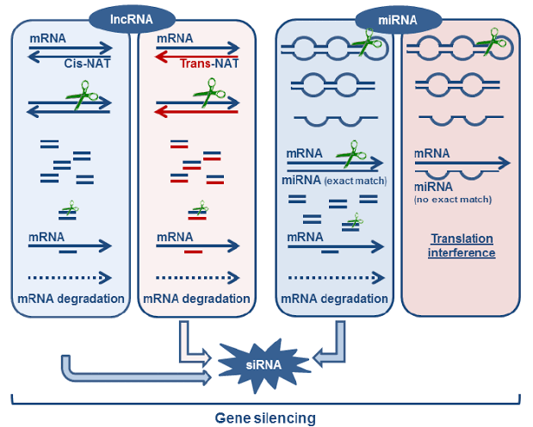

Slide 14
MICRO RNA
MicroRNAs (miRNAs) repress the expression of mRNA targets by promoting translational repression and mRNA degradation.
In animals, target degradation is initiated by accelerated deadenylation, which is normally followed by decapping and subsequent degradation of the mRNA body. However, some deadenylated targets may not be further degraded.
In plants, target degradation is initiated by endonucleolytic cleavage catalysed by the Argonaute proteins.Although translational repression and mRNA degradation have both been reported in animals and plants, recent evidence indicates that target degradation provides a major contribution to silencing in both kingdoms.

Slide 15
An important difference between the mechanisms of miRNA-mediated silencing in animals and plants is the requirement, in animals, for proteins of the GW182 family.
GW182 proteins are essential for silencing in animal cells. They interact with Argonaute proteins through an amino-terminal domain and with the cytoplasmic poly(A)-binding protein (PABPC) through a carboxy-terminal silencing domain.
Moreover, the contribution of translational repression to silencing in plants remains unknown.

Slide 16
Construction of shRNA expression vectors
The following steps were used to construct a human U6promoter-driven shRNA vector with a recommended loopsequence of 5’-TTCAAGAGA-3’ as proof of principle.
Step 1: Primer designTwo short primers were designed for PCR with the tem-plate pGsilG. The sequence of the forward primer was 5’-TTC AAG AGA N(19–23)TTT TTT CCC GGG ACG-3’ andthat of the reverse primer was 5’-TCT CTT GAA N(19–23)GGA TCC CGC GTC C-3’.
The 3’ annealing primersequences, which are complementary to the template,could be shorter than that recommended for a lowerannealing temperature.
The 5’ loop sequences are neces-sary for recombination in vivo. For instance, if the targetsequence is 5’-CCA CAC AAC CTG GTA GCA T-3’, theshRNA structure should be of the form 5’-CCA CAC AACCTG GTA GCA TTT CAA GAG AAT GCT ACC AGG TTGTGT GGT TTT

Slide 17
Step 2 PCR processTo obtain abundant and reliable products, high-qualityand high-fidelity DNA polymerase was used. In this exper-iment, KOD-Plus Taq polymerase (Toyobo) or Pfu DNApolymerase (Promega) was used for PCR in a volume of 50 μL, with annealing at 38°C.
Step 3 Purification of PCR products and transformationAfter authentication, the PCR products were purifiedusing a Montage™ PCR centrifugal filter device (Milli-pore). Then the purified PCR products are transformed in to chemical competent of E.coli.

Slide 19
Principle and application Of gene silencing
Gene silencing is defined as an epi genetic modification does not alter the DNA sequence and, although it is heritable, variable frequencies of reversions to expression are observed.
Gene silencing is used in the course of normal development and differentiation to repress genes whose products are not required in specific cell types or tissues.
This may apply to individual genes or larger chromosome regions. In some special situations, such as chromosome dosage compensation in mammals, one of the two female X chromosomes is almost completely repressed.
Repression of genes involve changes in chromatin structure and levels of DNA methylation, or destabilization of mRNA.

Slide 20
Aberrant silencing of genes may lead to disease in mammals and generate developmental variants in plants.
For example, methylation of tumor suppressor genes contributes to the onset and progression of cancer, while methylation of genes controlling flower development results in heritable changes of flower morphology.
A fundamental mechanism by which REST abundance is regulated in the transition from pluripotent stem cells.

Slide 21
Perturbation of REST expression during embryogenesis causes cellular apoptosis, aberrant differentiation and patterning, and lethality.
Gene silencing in ES cells, the shRNA ES cell lines are used for the production of corresponding shRNA transgenic mouse lines via blastocyst injection.
Recent studies of gene silencing in plants have revealed two RNA-mediated epigenetic processes, RNA-directed RNA degradation and RNA-directed DNA methylation

Slide 22
These natural processes have provided new avenues for developing high-efficiency, high-throughput technology for gene suppression in plants.
Gene silencingDNA methylationRNA interferencevirus resistanceinverted repeat transgenedouble-stranded RNA antisensefunctional genomics

Slide 23
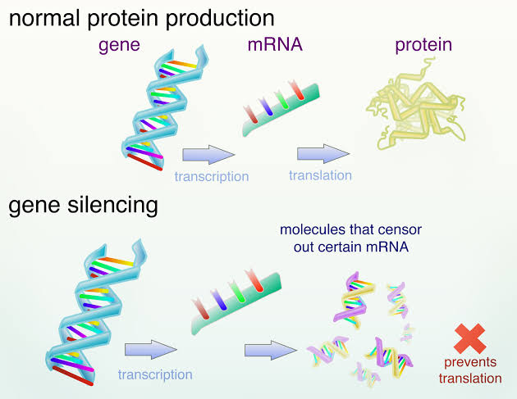
Gene silencing is also currently being used in drug discovery efforts, such as synthetic lethality, high-throughput screening, and miniaturized rnai screens. Gene silencing techniques have also been used to target other viruses, such as the human papilloma virus, the west nile virus, and the tulane virus

