Slide 1
CONCEPTION OF A BUSINESS LETTER IN MS WORD
Dr.C.SAFFINA,
DEPARTMENT OF COMMERCE CA,
BON SECOURS COLLEGE FOR WOMEN, THANJAVUR

Slide 2
BUSINESS LETTER
A business letter is a formal document often sent from one company to another or from a company to its client or employees…etc.
It is a professional correspondence between the individuals.
Correspondence means communication by exchanging letters.
A business letter should always follow a certain format or structure to ensure it is received as professional and up to standard.

Slide 3
Parts/ Structure of a Business Letter
Heading / letter head of sender
Date
Address of Recipient
Salutation
Reference (option)
Body of the letter
Complimentary close
Signature

Slide 4
Format of Sender details in business letter
A person who writes/sends the professional or business letter is known as sender.
Senders name
Senders company name
Street address
Senders city
Contact number
email id

Slide 5
Receiver/ Recipient details
A person who receives the professional or business letter is known as receiver.
Recipient name
Recipient company name
Street address
Recipient city
Contact number
email id

Slide 6
TYPES OF BUSINESS LETTER
A business letter may be a :
Order letter
Sales letter
Complaint letter
Inquiry letter
Recommendation letter
Follow up letter
Acknowledgement letter

Slide 7
ORDER LETTER
An order letters are sent by consumers or company to a manufacturer, wholesaler or retailer to order a particular product or service. These letter should contain specific information such as:
Date of order
Name of the product / model number
Quantity needed
Expected price
Mode of payment
Mode of delivery.

Slide 8
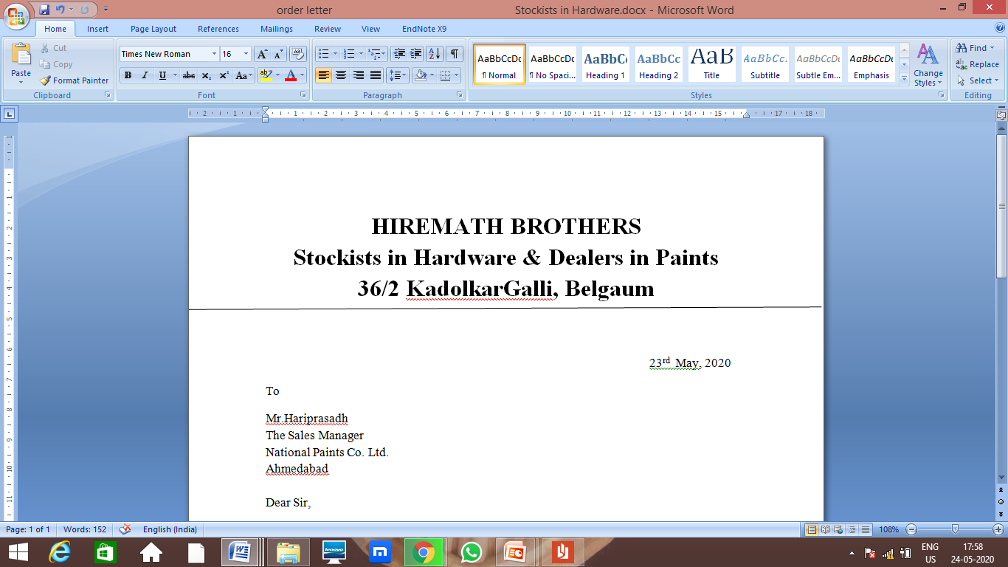
Step 1: Creation of heading or letter head in MS Word

Slide 9
Step 2:Insertion of Date & Recipient Address in Order Letter

Slide 10
Step 3:Salutation & Body of the letter, Complimentary close & Signature

Slide 11
Step 4: Created an order letter in Ms Word

Slide 12
THANK YOU

