Slide 1
JAVA PACKAGES
Presented By,
Ms.M.Jancypriya,
Asst. Prof., Dept. of CA,
Bon Secours College for Women,
Thanjavur.

Slide 2
PACKAGES
Packages in Java is a mechanism to encapsulate a group of classes, interfaces and sub packages.
In java there are already many predefined packages that we use while programming.
For example:
java.lang, java.io, java.util etc.

Slide 3
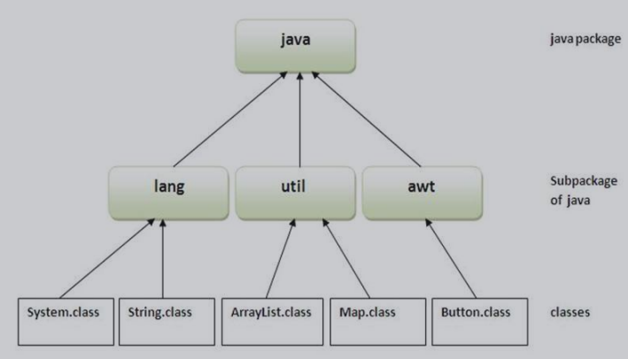
Package Hierachy

Slide 4
TYPES OF PACKAGES
There are basically only 2 types of java packages.
Built-inPackages or Java API
User Defined Packages.

Slide 5
Built-in Packages
java.lang
java .util
java.io
java.awt
java.net
java.applet

Slide 6
USER DEFINED PACKAGES
Creating User Defined Packages
Syntax :
package packageName;
public class className
{ - - - - - - - - - - - - -
// Body of className
- - - - - - - - - - - - }

Slide 7
Example
package myPackage;
public class class1
{- - - - - - - - - - - - -
// Body of class1
}

Slide 8
Advantages of Packages
Packages are useful to arrange related classes and interface into a group.
Packages hide the classes & interfaces in a seprate
subdirectory.
The classes & interfaces of a packages are isolated form the classes & interfaces of another packages.
Reusability of code is one of the most important requirements in the software industry.

Slide 9
THANK YOU...

