Slide 1
OBJECT ORIENTED ANALYSIS AND DESIGN
Prepared
by
R. Gomathijayam
Assistant Professor of CA
Bon Secours College for Women

Slide 2
Object-oriented analysis and Design
Object-oriented analysis and design (OOAD) is a popular technical
approach for
  analyzing,
  designing an application, system, or business
  by applying the object oriented paradigm and
  visual modeling throughout the development life cycles for better communication
and product quality.
Object-oriented programming (OOP) is a method
  based on the concept of “objects",
  which are data structures that contain data,
  in the form of fields,
  often known as attributes;
  and code, in the form of procedures,
  often known as methods.

Slide 3
Continued…
What is OOAD?- Object-oriented analysis and design (OOAD) is a software engineering approach that models a system as a group of interacting objects .
Analysis — understanding, finding and describing concepts in the problem domain.
Design — understanding and defining software solution/objects that represent the analysis concepts and will eventually be implemented in code.
OOAD - A software development approach that emphasizes a logical solution based on objects.

Slide 4
Continued…
Software development is dynamic and always undergoing major change.
System development refers to all activities that go into producing
information system solution.
System development activities consist of
  system analysis,
  modelling,
  design,
  implementation,
  testing and maintenance.
A software development methodology → series of processes → can lead to the development of an application.
Practices, procedures, and rules used to develop software, totally
based on system requirements

Slide 5
ORTHOGONAL VIEWS OF THE SOFTWARE
Two Approaches,
  Traditional Approach
  Objected-Oriented Approach
TRADITIONAL APPROACH
Collection of programs or functions.
A system that is designed for performing certain actions.
Algorithms + Data Structures = Programs.
Software Development Models (Waterfall, Spiral, Incremental, etc..)

Slide 6
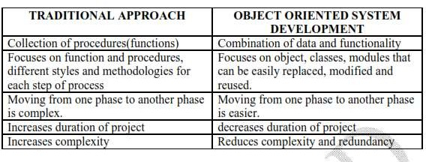
Difference between Traditional and Object Oriented Approach

Slide 7
Continued…
OBJECT ORIENTED APPROACH
  OO development offers a different model from the traditional software →
based on functions and procedures.
  software is a collection of discrete object that encapsulate their data as
well as the functionality.
  Each object has attributes (properties) and method (procedures).
  software by building self contained modules or objects that can be easily
REPLACED, MODIFIED AND REUSED.
  Objects grouped in to classes and object are responsible for itself.

Slide 8
BENEFITS OF OBJECT ORIENTATION
Faster development,
Reusability,
Increased quality
modeling the real world and provides us with the stronger equivalence of the real world‘s entities (objects).
Raising the level of abstraction to the point where application can be implemented in the same terms as they are described.

Slide 9
WHY OBJECT ORIENTATION
OO Methods enables to develop set of objects that work together →
software → similar to traditional techniques.
It adapts to
  Changing requirements
  Easier to maintain
  More robust
  Promote greater design
  Code reuse

Slide 10
Continued…
Others
  Higher level of abstraction
  Seamless transition among different phases of software
development.
  Encouragement of good programming technique.
  Promotion of reusability.

Slide 11
OVERVIEW OF UNIFIED APPROACH
The unified approach (UA) is a methodology for software development.
Booch, Rumbaugh, Jacobson methodologies gives the best practices, processes and guidelines for OO oriented software development.
Combines with the object management groups in unified modelling language.
UA utilizes the unified modeling language (UML) which is a set of notations and conventions used to describe and model an application.

Slide 12
Continued…
Layered Architecture
  UA uses layered architecture to develop applications.
  Creates object that represent elements to the user through
interface or physically stored in database.
  The layered approach consists of user interface, business, access layers.
  This approach reduces the interdependence of the user interface,
database access and business control.
  More robust and flexible system.

Slide 13
OBJECT BASICS
Goals:
The developer should
Define Objects and classes
Describe objects, methods, attributes and how objects respond to messages,
Define Polymorphism, Inheritance, data abstraction, encapsulation, and protocol,
Describe objects relationships,
Describe object persistence,

Slide 14
OBJECT ORIENTED PHILOSOPHY
The programming languages provide the programmers the way of
describing the process.
The ease of description, reusability, extensibility, readability, computational efficiency, and ability to maintain depends on languages used.
System Software – Machine Understandable language (Integers, floating point numbers, chars, Addressing Modes,….)
Eg., Financial Investment →Development of Financial Investment Machine directly would reduce translation.

Slide 15
Conti…
Object-Oriented Programming Concepts allows closer ideas and terms for the development of certain applications.
Financial Investment :
  Bond (data type) → character
  Buy operation on a bond (+) →operation on a number

Slide 16
TRADITIONALAPPROACH
The traditional approach to software development tends toward
writing a lot of code to do all the things that have to be done.
Algorithmic Centric Methodology – only the algorithm that can accomplish the task.
Data-Centric Methodology - think about the data to build a structure based on the algorithm
You are the only active entity and the code is just basically a lot of building materials.

Slide 17
OBJECT-ORIENTED APPROACH
OO approach is more like creating a lot of helpers
take on an active role, a spirit, that form a community whose
interactions become the application.
Reusable
Modified
Replaced

Slide 18
EXAMPLES OF OBJECT ORIENTED SYSTEMS
In OO system , “everything is object”.
A spreadsheet cell, bar chart, title in bar chart, report,
numbers, arrays, records, fields, files, forms,
an invoice, etc.
A window object is responsible for things like opening, sizing, and
closing itself.
A chart object is responsible for things like maintaining data and labels even for drawing itself.

Slide 19
WHAT IS AN OBJECT?
The term object was first formally utilized in the Simula language to
simulate some aspect of reality.
Attributes or properties describe object‘s state (data) and methods (properties or functions) define its behavior.
An object is an entity.
  It knows things (has attributes)
  It does things (provides services or has methods
  Examples in next Slide ……….

Slide 20
OBJECT’S ATTRIBUTES
Attributes represented by data type.
They describe objects states.
In the Car example the car’s attributes are:
color, manufacturer, cost, owner, model, etc.

Slide 21
OBJECT’S METHODS
Methods define objects behaviour and specify the way in which
an Object’s data are manipulated.
In the Car example the car’s methods are:
drive it, lock it, tow it, carry passenger in it.

Slide 22

IT KNOWS THINGS (ATTRIBUTES)
I am an Employee. I know my name,
social security number and my address.
Object-Oriented Systems Development
Bahrami
? Irwin/ McGraw-Hill

Slide 23
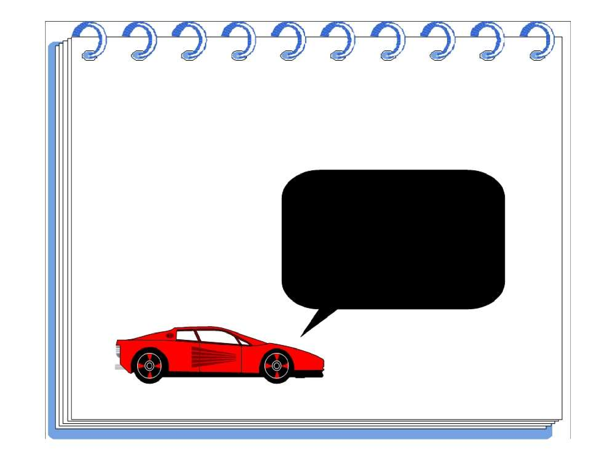
ATTRIBUTES
I am a Car.
I know my color, manufacturer, cost, owner and model.
Object-Oriented Systems Development
Bahrami
? Irwin/ McGraw-Hill

Slide 24

IT DOES THINGS (METHODS)
I know how to compute
my payroll.
Object-Oriented Systems Development
Bahrami
? Irwin/ McGraw-Hill

Slide 25
THANK YOU

