Slide 1
Introduction to Cloud Computing

Slide 2
Defining Cloud Computing
Buyya defines:
Cloud is a parallel and distributed computing system consisting of
a collection of inter-connected and virtualized computers that are
dynamically provisioned and presented as one or more unified
computing resources based on service-level agreements (SLA)
• Vanquero defines:
Clouds are a large pool of easily usable and accessible virtualized
resources (such as hardware, development platforms and/or
services). These resources can be dynamically reconfigured to
adjust to a variable load (scale), allowing also for an optimum
resource utilization

Slide 3
Cloud is a h/w based services offering compute, n/w and storage capacity where h/w management is highly abstracted from the buyer. Buyers incur infrastructure costs as variable OPEX, and infrastructure capacity is highly elastic
NIST-national institute of Standards & Technology characterise cc as “ as pay per use model for enabling available, convenient, on-demand n/w access to a shared pool of configurable computing resources.

Slide 4
Roots of Cloud Computing
Hardware
H/w virtualization Multi core chips
Autonomic computing
Data Center Automation
Utility & grid Computing
SOA
Web2.0
Web Services Mashups
Internet Technologies
Distributed Computing
Systems Management

Slide 5
Internet Technologies
Utility – Pay per use, elastic capacity, self service interface and virtualised
SOA – Service Oriented Architecture) software resources are packaged as a “ services” ook
WS – Powerful services that accessed on-demand, in a uniform way.
Service Mashups – web information and services may be programmatically aggregated, acting as a building blocks of complex compositions. Eg. Amazon, google, facebook.

Slide 6
Computing
Grid Computing
• aggregation of distributed resources
• transparently access
• Problems
• QoS, Lack of performance
• Availability, Virtualization
Utility Computing
• assign a “utility” value to users
• QoS constraints (deadline, importance, satisfaction)

Slide 7
Hardware Virtualization
Large scale data centers
Multiple OS and software stacks on a single physical platform
VMM-(Virtual machine monitor) also called hypervisor.
Workload migration also referred to as application mobility
VMM platforms exist that are the basis of many utility / cc environments. Eg. VMWare,Xen-hypervisor as a open source and KVM(Kernal based Virtual Machine)

Slide 8
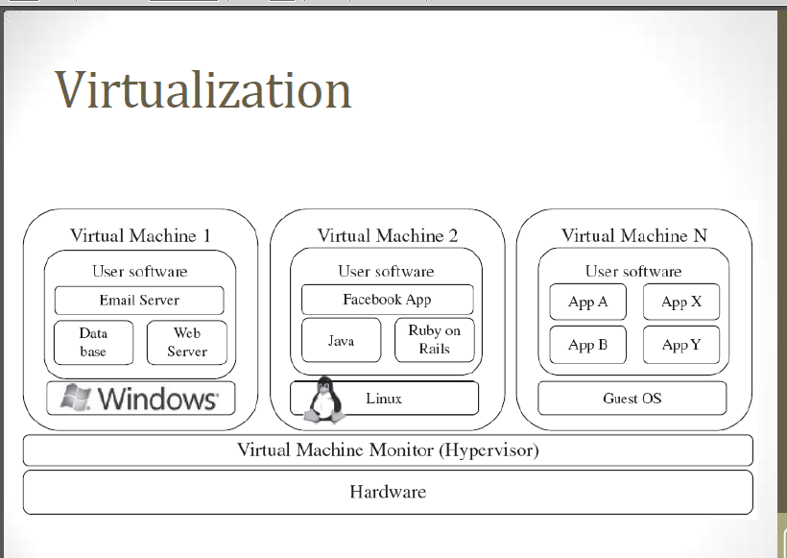

Slide 9
Autonomic Computing
Autonomic or self-managing systems rely on monitoring probes and sensors (gauges) on an adaption engine and on effectors to carry out changes on the system.
IBM’s defines self configuration, self healing, self optimization and self protection. It is also called MAPE-K(Monitor Analyze Plan Execute-Knowledge).

Slide 10
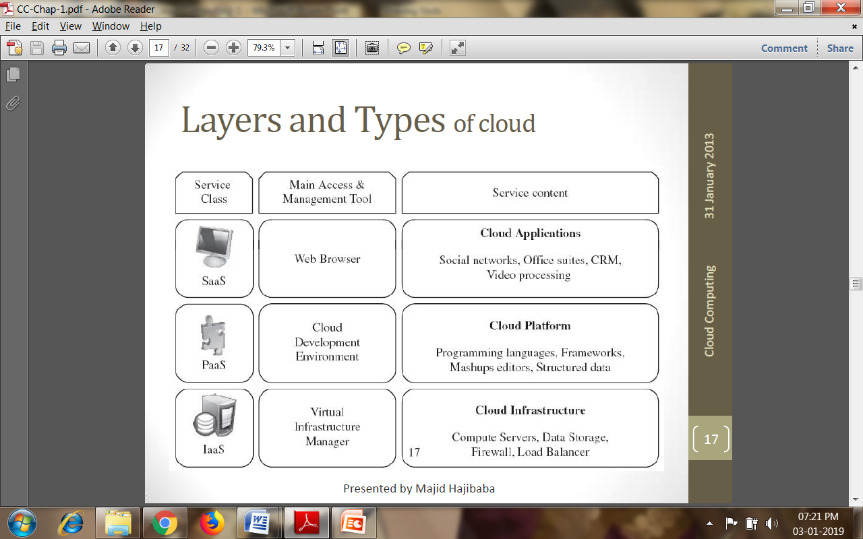
Layers and Types of Clouds

Slide 11
IaaS: Infrastructure as a Service
  A cloud infrastructure enables on demand provisioning of servers running several choices of OS and a customized software stack.
  It is considered as the bottom layer of cloud computing system.
  Eg. Amazon Web Services mainly offers IaaS
  PaaS: Platform as a Service
  It is a higher level of abstraction to make a cloud easily .
  Eg. Google AppEngine.
  Data access, authentication and payments.
  Python and java specific programming language

Slide 12
SaaS: software as a Service
Top of the cloud stack
On-line software services
Traditional desktop apps such as word and spreadsheet can now be access in the web.
Eg. Salesforce.com offers business productivityapplications(CRM)

Slide 13
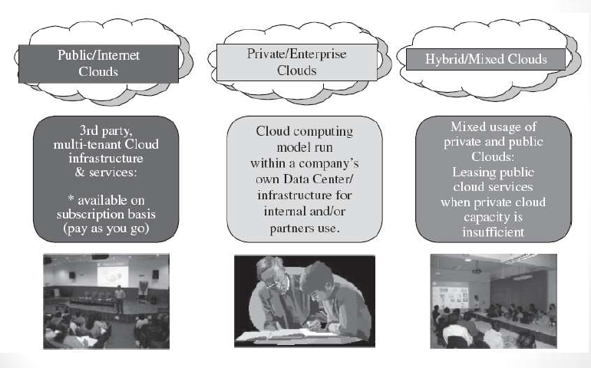
Deployment Models

Slide 14
Desired Features of a Cloud
This model satisfy expectations of consumers
Cloud offers
  Self service
  Per-Usage Metering and Billing
  Elasticity
  Customization

Slide 15
Cloud Infrastructure Management
The software toolkit responsible for this orchestration is called a VIM(virtual infrastructure manager)
This is a traditional OS
Two category of VIM
  Toolkits that’s expose a remote and sevure interface for creating, controlling and monitoring virtualize resources.
  Donot expose remote cloud like interfaces.

Slide 16
Features of VIM
Virtualization Support
Self service, on-demand resource provisioning
Multiple backend hypervisors
Storage virtualization
Interface to public clouds.
Virtual networking
Dynamic resource allocation
Virtual clusters

Slide 17
Features of IaaS
Geographic distribution of data centers
Variety of user interfaces and APIs to access the systems
Specialized components(firewalls)
Choice of virtualization platform and OS
Different billing methods
  Post paid, prepaid
  Hours, monthly

Slide 18
Features of PaaS
Programming Models, Languages, and Frameworks
Persistence Options

Slide 19
Challenges and Risks
Security, Privacy and Trust
Data Lock-in and standardization
Availability, fault tolerance and disaster recovery
Resource Management and Energy - Efficiency

Slide 20


