Slide 1
Cloud Computing - Part II
1
8-SECURE DISTRIBUTED DATA STORAGE IN CLOUD COMPUTING
Cloud Computing
Principles and Paradigms

Slide 2
Cloud Computing - Part II
2
Introduction
Data Storage
Distributed Storage
Considerations
unique issues
specific security requirements not been well-defined
Concerns about data in cloud
Privacy
Integrity

Slide 3
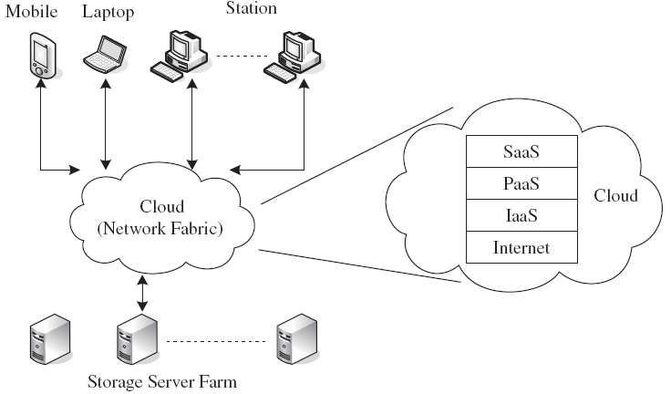
Cloud Computing - Part II
3
Cloud Storage
Distributed Storage
Types
SAN
NAS
Reliability
Security
Integrity
LAN
same authority
WAN
different authorities

Slide 4
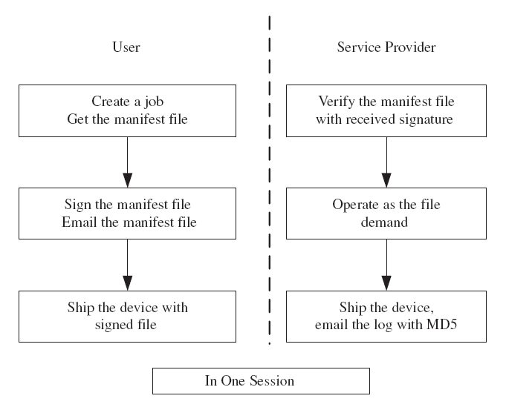
Cloud Computing - Part II
4
Amazon’s Web Service

Slide 5
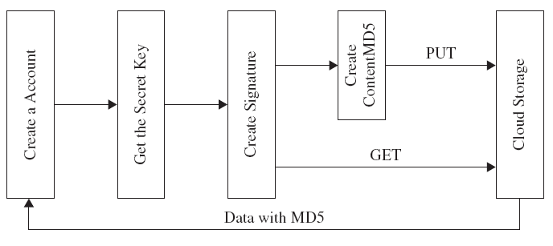
Cloud Computing - Part II
5
Microsoft Windows Azure
3 basic data items-blobs(upto50 GB), TABLES & queues

Slide 6
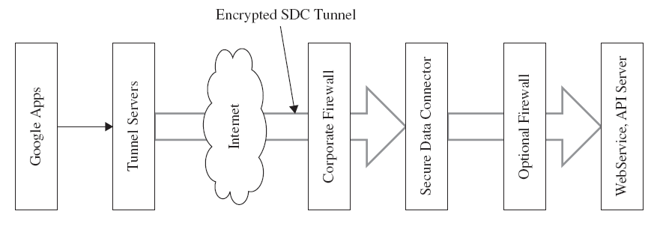
Cloud Computing - Part II
6
Google App Engine (GAE)
SDC-Secure data connector

Slide 7
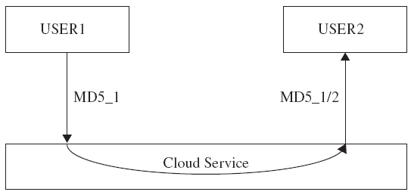
Cloud Computing - Part II
7
Vulnerabilities
Confidentiality(eve, bob &alice)
Integrity
Repudiation
Missing link between download and upload
Upload-to-Download Integrity
Repudiation Between Users and Service Providers

Slide 8
Cloud Computing - Part II
8
Solutions for missing link
Third authority certified (TAC)
Secret key sharing technique (SKS)
Solutions
Neither TAC nor SKS
With SKS but without TAC
With TAC but without SKS
With Both TAC and SKS

Slide 9
Cloud Computing - Part II
9
Neither TAC nor SKS (third authority certified, secret key sharing tech)
Uploading Session
User: Sends data to service provider with MD5 checksum and MD5 Signature by User (MSU).
Service Provider: Verifies the data with MD5 checksum, if it is valid, the service provider sends back the MD5 and MD5 Signature by Provider (MSP) to user.
MSU is stored at the user side, and MSP is stored at the service
provider side.
Downloading Session
User: Sends request to service provider with authentication code.
Service Provider: Verifies the request identity, if it is valid, the service provider sends back the data with MD5 checksum and MD5 Signature by Provider (MSP) to user.
User verifies the data using the MD5 checksum.

Slide 10
Cloud Computing - Part II
10
With SKS but without TAC
(third authority certified, secret key sharing tech)
Uploading Session
User: Sends data to service provider with MD checksum 5.
Service Provider: Verifies the data with MD5 checksum, if it is valid, the service provider sends back the MD5 checksum.
The service provider and the user share the MD5 checksum with SKS.
Downloading Session
User: Sends request to the service provider with authentication code.
Service Provider: Verifies the request identity, if it is valid, the service provider sends back the data with MD5 checksum.
User verifies the data through the MD5 checksum.

Slide 11
Cloud Computing - Part II
11
With TAC but without SKS (third authority certified, secret key sharing tech)
Uploading Session
User: Sends data to the service provider along with MD5 checksum and MD5 Signature by User (MSU).
Service Provider: Verifies the data with MD5 checksum, if it is valid, the service provider sends back the MD5 checksum and MD5 Signature by Provider (MSP) to the user.
MSU and MSP are sent to TAC.
Downloading Session
User: Sends request to the service provider with authentication code.
Service Provider: Verifies the request with identity, if it is valid, the service provider sends back the data with MD5 checksum.
User verifies the data through the MD5 checksum.

Slide 12
Cloud Computing - Part II
12
With Both TAC and SKS
(third authority certified, secret key sharing tech)
Uploading Session
User: Sends data to the service provider with MD5 checksum.
Service Provider: verifies the data with MD5 checksum.
Both the user and the service provider send MD5 checksum to TAC.
TAC verifies the two MD5 checksum values. If they match, the TAC distributes MD5 to the user and the service provider by SKS.
Downloading Session
User: Sends request to the service provider with authentication code.
Service Provider: Verifies the request identity, if it is valid, the service provider sends back the data with MD5 checksum.
User verifies the data through the MD5 checksum

Slide 13
Cloud Computing - Part II
13
TECHNOLOGIES FOR DATA
SECURITY IN CLOUD COMPUTING
Database Outsourcing and Query Integrity Assurance
Data Integrity in Untrustworthy Storage
Web-Application-Based Security
Multimedia Data Security

Slide 14
Cloud Computing - Part II
14
TECHNOLOGIES FOR DATA
SECURITY IN CLOUD COMPUTING
Database Outsourcing and Query Integrity Assurance
Data Integrity in Untrustworthy Storage
Web-Application-Based Security
Multimedia Data Security

Slide 15
Cloud Computing - Part II
15
Database Outsourcing
Security Concern –tera byte
2 security concerns are
Data privacy
Hacigumus et al.-to execute sql over encrypted db
Agrawal et al.- encryption scheme for numeric value
Query integrity
Correct and Complete
Merkle hash tree

Slide 16
Cloud Computing - Part II
16
TECHNOLOGIES FOR DATA
SECURITY IN CLOUD COMPUTING
Database Outsourcing and Query Integrity Assurance
Data Integrity in Untrustworthy Storage
Web-Application-Based Security
Multimedia Data Security

Slide 17
Cloud Computing - Part II
17
Data Integrity in Untrustworthy Storage
Remote data storage possession checking protocol
Requirements
Partial copy of the data
Robust protocol
High communication overhead
Computationally efficient
Unlimited verification
Technologies
A PDP-Based Integrity Checking Protocol
An Enhanced Data Possession Checking Protocol

Slide 18
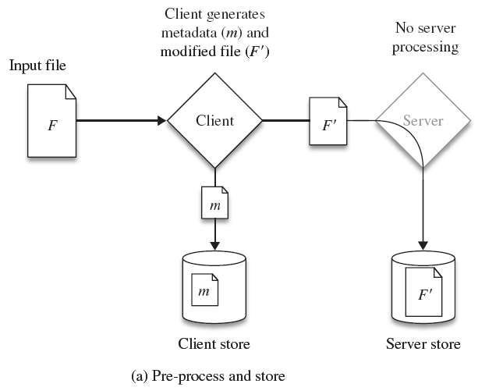
Cloud Computing - Part II
18
A PDP-Based Integrity Checking
Protocol

Slide 19
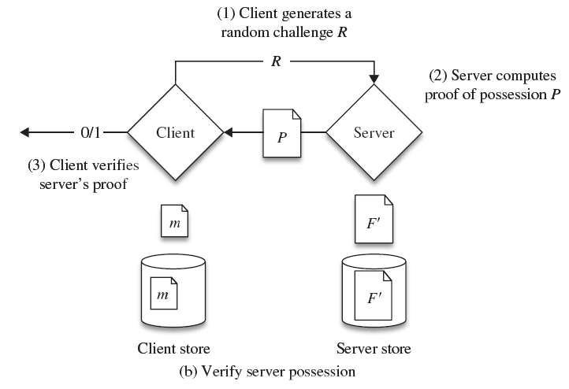
Cloud Computing - Part II
19
A PDP-Based Integrity Checking
Protocol

Slide 20
Cloud Computing - Part II
20
An Enhanced Data Possession
Checking Protocol
Enhance PDP-based protocol
Satisfy Requirement #2 with 100% probability
Computationally more efficient
Verification time has been shortened
Trade-offs between
the computation times required by the prover
the storage required at the verifier

Slide 21
Cloud Computing - Part II
21
TECHNOLOGIES FOR DATA
SECURITY IN CLOUD COMPUTING
Database Outsourcing and Query Integrity Assurance
Data Integrity in Untrustworthy Storage
Web-Application-Based Security
Multimedia Data Security

Slide 22
Cloud Computing - Part II
22
Web-Application-Based Security
Web attack techniques
Authentication
Brute force, Insufficient Authentication, Weak password recovery
Authorization
Insufficient Authorization, Session attacks
Client-Side Attacks
Content Spoofing, XSS, CSRF
Command Execution
Like code injection or denial of service via buffer overflow
Information Disclosure
Path Traversal
Logical Attacks
DoS attack

Slide 23
Cloud Computing - Part II
23
TECHNOLOGIES FOR DATA
SECURITY IN CLOUD COMPUTING
Database Outsourcing and Query Integrity Assurance
Data Integrity in Untrustworthy Storage
Web-Application-Based Security
Multimedia Data Security

Slide 24
Cloud Computing - Part II
24
Multimedia Data Security
Protection from Unauthorized Replication
Advantage
improve system performance
Disadvantage
contents copyright
waste of replication cost
extra control overheads
Protection from Unauthorized Replacement
Limited storage capacity
Remove stored content to make space
Protection from Unauthorized Pre-fetching
Just pre-fetch necessary content

Slide 25
Cloud Computing - Part II
25
Concerns at Different Levels
The cloud infrastructure providers (back-end)
The cloud service providers
The cloud consumers (front-end)
Application developer
End user

Slide 26
Cloud Computing - Part II
26
Challenges
Technical
Open security profiling
Remote control
Security compliance with standards
Certificates
Non-Technical
User’s fear of losing control

