Slide 1
ARTIFICIAL INTELLIGENCE
S.MANIMOZHI
ASSISTANT PROFESSOR,
DEPARTMENT OF CA
BON SECOURS COLLEGE FOR WOMEN,
THANJAVUR

Slide 2
Chapter 5: Using Predicate Logic
Representing simple facts in Logic
Representing Instance and Isa relationships
Slide 1

Slide 3
Using Predicate Logic
Logic
Logic is concerned with the truth of statements about the world. Generally each statement is either TRUE or FALSE.
Logic includes :Syntax , Semantics and Inference Procedure.
Syntax :
Specifies the symbols in the language about how they can be co mbined to form sentences. The facts about the world are repre sented as sentences in logic.
Slide 2

Slide 4
Using Predicate Logic
Semantic :
Specifies how to assign a truth value to a sentence based on its meaning in the world.
It Specifies what facts a sentence refers to.
A fact is a claim about the world, and it may be TRUE or FALSE.
Inference Procedure :
Specifies methods for computing new sentences from the existing sentences
.
Slide 2

Slide 5
Representing Simple Facts in Logic
Using propositional logic
–Real-world facts are represented as logical propositions wr itten as well-formed formulas (wff’s)
–Example 1:
It is raining | RAINING
It is sunny | SUNNY
It is Windy | WINDY
If it is raining, then it is not sunny | RAINING → ¬SUNNY

Slide 6
Representing Simple Facts in Logic
Example 2:
Socrates is a man | SOCRATESMAN
Plato is a man | PLATOMAN
All men are mortal | MORTALMAN
=> Since the assertions are separate, it is not possible to dra w any conclusion about similarities between Socrates and Pl ato.
Slide 6

Slide 7
Representing Simple Facts in Logic
It would be much better to represent these facts as
Socrates is a man | man(socrates)
Plato is a man | man(plato)
All men are mortal | mortalman
This fails to capture the relationship between any individual being a man and that individual being a mortal.
Therefore it is necessary to move to first order predicate logic as a way of representing knowledge because it permits representation o f things that cannot reasonably be represented in prepositional logi c.
In predicate logic, real world facts are represented as statements written as wff’s
.
Slide 5

Slide 8
Representing Simple Facts in Logic
Q Propositional logic vs. predicate logic
–Using propositional logic
Theorem proving is decidable
Cannot represent objects and quantification
–Using predicate logic
Can represent objects and quantification
Theorem proving is semi-decidable

Slide 9
Representing Simple Facts in Logic
Consider the following set of sentences.
Marcus was a man.
Marcus was a Pompeian.
All Pompeians were Romans.
Caesar was a ruler.
All Romans were either loyal to Caesar or hated him.
Every one is loyal to someone.
People only try to assassinate rulers they are not loyal to.
Marcus tried to assassinate Caesar

Slide 10

Representing Simple Facts in Logic
Marcus was a man. man(Mar cus)
Marcus was a Pompeian. Po mpeian(Marcus)
All Pompeians were Romans. x: Pompeian(x) Roman(x)
Caesar was a ruler. ruler(Cae sar)

Slide 11
Representing Simple Facts in Logic
5. All Romans were either loyal to Caesar or hated him.
In English the word ‘or’ means the logical inclusive-or and sometimes means the logical exclusive-or(XOR)
inclusive-or
x: Roman(x) loyalto(x, Caesar)
exclusive-or (XOR)
x: Roman(x) (loyalto(x, Caesar)
hate(x, Caesar)
hate(x, Caesar))
( loyalto(x, Caesar) hate(x, Caesar))

Slide 12
Representing Simple Facts in Logic
Every one is loyal to someone. x →y: loyalto(x, y)
People only try to assassinate rulers they are not loyal to.
x: y: person(x) ruler(y) tryassassinate(x, y) loyalto(x, y)
Marcus tried to assassinate Caesar. tryassassinate( Marcus, Caesar)

Slide 13
Representing Simple Facts in Logic
To answer the question
Was Marcus loyal to Caesar?
To produce a formal proof , reasoning backward from th e desired goal
loyalto(Marcus, Caesar)
To prove the goal, rules of inference are to be used to trans form into another goal that in turn be transformed and s o on, until there are no insatisfied goals remaining.

Slide 14
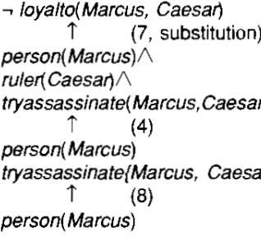
Representing Simple Facts in Logic
This attempt fails , since there is no way to satisfy the goal perso n(Marcus)with the statements available.
The problem is although its known that Marcus was a man there is no way to conclude it.
Therefore another representation is added namely

Slide 15

Representing Simple Facts in Logic
9.All men are people x:man(x)→person(x)
This satisfies the last goal and produce a proof that Marcus w as not loyal to ceasar.
Three important issues to be addressed in this process of converting English sentences to logical statements and the n using these statements to deduce new ones.
Many English sentences are ambiguous. Choosing the corre ct interpretation may be difficult.
There is often a choice of how to represent knowledge
Obvious information may be necessary for reasoning
Slide 13

Slide 16
Representing Instance & Isa Relationships
Attributes “ IsA ” and “ Instance ” support property inheritance and play important role in knowledge representation.
The ways these two attributes "instance" and "isa", are logically expresse d are shown in the example below :
Example : A simple sentence like "Joe is a musician"
Here "is a" (called IsA) is a way of expressing what logically is called a class-instance relationship between the su bjects represented by the terms "Joe" and "musician".
◊ "Joe" is an instance of the class of things called "musician". " Joe" plays the role of instance, "musician" plays the role of class in that sentence.
◊ Note : In such a sentence, while for a human there is no con fusion, but for computers each relationship have to be defined explicitly.
 |  | ^{Slide 14}

Slide 17
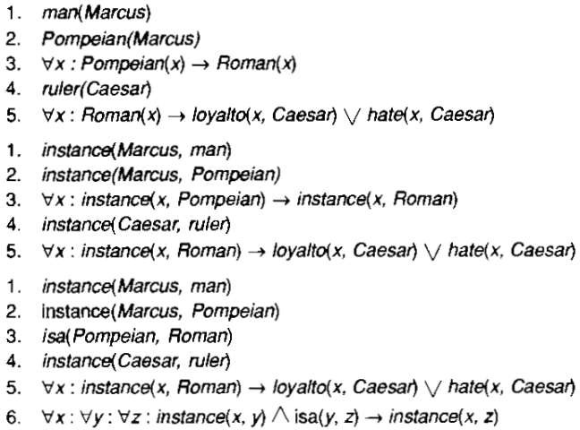
Representing Instance & Isa Relationships

Slide 18
Representing Instance & Isa Relationships
The first part of the figure contains the representations, in which the class membership is represented with unary predicates, each corresponding to a class. Asserting that p(x) is true is equi valent to asserting that X is an instance of p.
The second part uses the instance predicate explicitly. It is a b inary one, whose first argument is an object and whose second argument is a class to which the object belongs. The implicatio n rule in statement 3 states that object is an instance of the sub class pompeian then it is an instance of the superclass Roman.

Slide 19
Representing Instance & Isa Relationships
The third part contains representations that use both the instan ce and isa predicates explicitly. Use of isa simplifies the repres entation of sentence 3 but requires one additional axiom.It desc ribes how an instance relation and an isa relation combined to derive a new instance relation.

