Slide 1
WELCOME

Slide 2
TOOLS- SQOOP

Slide 3
Sub- topics
Introduction
Sqoop- definition
Architecture of sqoop
Working of sqoop
Sqoop import
Sqoop export
feATURES OF SQOOP
ADVANTAGES OF SQOOP
DISADVANTAGES OF SQOOP

Slide 4
INTRODUCTION
When Big Data storages and analyzers such as MapReduce, Hive, HBase, Cassandra, Pig, etc. of the Hadoop ecosystem came into picture.
They required a tool to interact with the relational database servers for importing and exporting the Big Data residing in them.
Sqoop occupies a place in the Hadoop ecosystem to provide feasible interaction between relational database server and Hadoop’ s HDFS.

Slide 5
SQOOP- DEFINITON
Sqoop: “SQL to Hadoop and Hadoop to SQL”.
Tool to transfer data from relational databases Teradata, MySQL, PostgreSQL, Oracle, Netezza.
It is provided by the Apache Software Foundation.

Slide 6
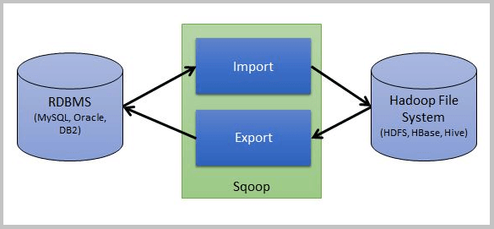
ARCHITECTURE OF SQOOP

Slide 7
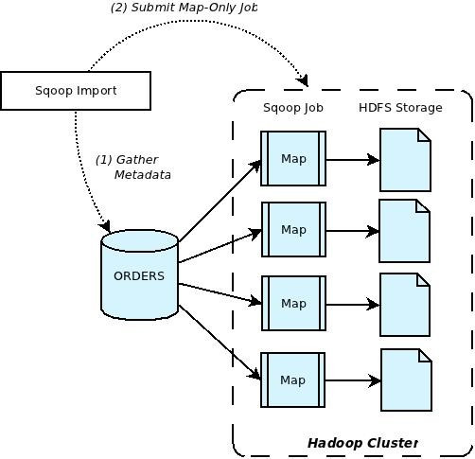
WORKING OF SQOOP

Slide 8
SQOOP IMPORT
The import tool imports individual tables from RDBMS to HDFS.
Each row in a table is treated as a record in HDFS.
All records are stored as text data in text files or as binary data in Avro and Sequence files.

Slide 9
SQOOP EXPORT
The export tool exports a set of files from HDFS back to an RDBMS.
The files given as input to Sqoop contain records, which are called as rows in table.
Those are read and parsed into a set of records and delimited with user-specified delimiter.

Slide 10
FEATURES OF SQOOP
Full Load.
Incremental Load.
Parallel import/export.
Import results of SQL query.
Compression.
Connectors for all major RDBMS Databases.
Kerberos Security Integration.

Slide 11
ADVANTAGES OF SQOOP
Allows the transfer of data with a variety of structured data stores like Postgres, Oracle, Teradata, and so on.
Sqoop can execute the data transfer in parallel, so execution can be quick and more cost effective.
Helps to integrate with sequential data from the mainframe.

Slide 12
DISADVANTAGES OF SQOOP
It uses a JDBC connection to connect with RDBMS based data stores, and this can be inefficient and less performant.
For performing analysis, it executes various map-reduce jobs and, at times, this can be time consuming when there are lot of joins if the data is in a denormalized fashion.

Slide 13
THANK YOU

