Slide 1
WORLD TRADE ORGANIZATION
Dr.A.ANTONYRAJ
Assistant Professor,
Department of Management studies,
Bon Secours College for women, Thanjavur.

Slide 2
The World Trade Organization
– WTO –
A rules-based, member-driven organization.
“Its main function is to ensure that trade flows as smoothly, predictably and freely as possible.”
Created in 1995 by 120 nations to supersede and extend the GATT.
Now:
  148 member nations (over 97% of world trade).
  32 ‘observer’ countries.

Slide 3
Origin: The General Agreement on Tariffs and Trade (GATT)
Before GATT: several joint declarations of free-trade ideals—and failed attempts to create an international trade institution.
Under US leadership, the GATT was created in 1947—as a step toward the “ITO.”
GATT: 19 original “contracting parties.”
(WTO has now 148 members.)
Regulated trade in goods, only.

Slide 4
GATT-Sponsored Trade Liberalization
– Negotiating Rounds: The First Seven –
Round Period Participants
Geneva 1947 23
Annecy 1949 13
Torquay 1951 38
Geneva 1956 26
Dillon 1960-61 26
Kennedy 1964-67 62
Tokyo 1973-79 102

Slide 5
Average Reduction in US Tariff Rates 1947-85
Index
Pre-Geneva
Tariff = 100
GATT Negotiating Rounds

Slide 6
Uruguay Round—the 8th Round
123 participating countries.
Most difficult—and most ambitious—among all rounds of negotiation.
Lasted almost 8 years (1986-1994, in effect since 1995): the longest round.
Created the WTO in 1995.
Ultimately, very successful.

Slide 7
Uruguay Round—Outcomes
Manufactured goods’ further liberalization:
  Cap on developed countries’ average tariff: not higher than 4%.
  Overall, tariffs reduced by more than 30%.
  Additional tariffs ‘bound.’
Extended GATT scope to many new areas:
  Agriculture.
  Textiles.
  Services (banking, insurance, telecommunications, transportation etc.): GATS.
  Intellectual property (copyrights, patents, trademarks): TRIPS.
Strengthened GATT dispute settlement procedures.

Slide 8
Agriculture
Main difficulty. Ultimately, plan to progressively reduce subsidies was approved.
Textiles
Plan to progressively reduce and eliminate the current quota system.
TRIPS
Agreement to provide enhanced protection to intellectual property.

Slide 9
GATS
Extension of GATT rules to services.
Negotiations continued after the conclusion of the Uruguay Round.
  Telecommunications (1997-98)
    69 countries (90% of world telecommunications revenues) involved.
  Financial Services (1997-99)
    102 countries (95% of trade in banking, insurance and financial information) involved.
In both cases, markets became more open to foreign competition and barriers to FDI were reduced.

Slide 10
WTO Current Structure
Goods
Services
Intellectual property
Disputes
Basic principles
GATT
GATS
TRIPS
Dispute settlement
Additional details
Other goods agreements and annexes
Services annexes
Market access commitments
Countries’ schedules of commitments
Countries’ schedules of commitments

Slide 11
GATT/WTO: Main Objective
To provide a legal framework for incorporating the results of negotiations directed toward
“reciprocal and mutually advantageous exchange of market access commitments on a non-discriminatory basis.”
Typically, such an outcome is obtained through reductions of tariffs and other barriers to trade.

Slide 12
Is free trade an explicit objective of the GATT/WTO?
- NO -
“The WTO does not tell governments how to
conduct their trade policies. Rather, the WTO is a
‘member-driven’ organization.”
In reality, free trade (or freer trade) depends on what countries are willing to bargain with each other.

Slide 13
GATT/WTO Negotiation Rules
Governments negotiate only if they want and what they want.
Consensus rule:
if all agree, agreement is implemented; otherwise, it is not.
Bottom line: All countries have a voice.

Slide 14
Why is There a Need for Trade Negotiations?
Typically, governments care primarily about the residents of their own country.
⇓
Whenever possible, they try to shift the cost of their policies to other countries.
This is especially easy to do with trade policies.

Slide 15
“Beggar-thy-Neighbor”
A government increases tariffs in a certain sector
⇓
local price rises
⇓ ⇓
domestic supply (S) ↑; domestic demand (D) ↓
⇓
import demand (M = D – S) ↓

Slide 16
The 2 Pillars of GATT/WTO Negotiations
Non-discrimination
Reciprocity
Most-Favored-Nation
Clause (MFN)
Any tariff concession
a country gives to
another must be
extended to all other
WTO members.
Negotiations are
“reciprocal:”
the market access
obtained must be
equivalent to the
market access
conceded.

Slide 17
Can these 2 guidelines deliver an efficient outcome?
According to recent, cutting-edge research,
- Yes -
“As long as bilateral negotiations abide by MFN and satisfy reciprocity, they can be presumed to produce Pareto improvements across governments.
But if either MFN or reciprocity is violated, then this presumption may not be warranted.”

Slide 18
How can governments enforce an agreement when each individual country has an incentive to disrespect what it had agreed upon?
WTO has no police power to enforce the agreements:
  The WTO cannot send any country to ‘jail.’
The WTO cannot even indirectly force countries to abide by previous agreement.
  By suspending loans, for instance, as the IMF can do.
⇒ Agreements need to be self-sustainable.

Slide 19
How, then, can cooperation be achieved?
Repeated interaction
+
Threat of retaliation
WTO members have agreed to confer to the WTO the right to set the rules governing retaliation, discipline it and keep it within bounds.

Slide 20
WTO Dispute Settlement—the Process
If a member believes their rights under the agreements are being infringed, it should bring the case to the WTO—instead of acting unilaterally.
Initially, governments try to settle their differences through consultation.
If the case is not settled during the consultation period, a stage-by-stage procedure is initiated.
A panel of independent experts, judging each case based on interpretations of the agreements and individual countries’ commitments, makes the final ruling.
Governments can appeal after the final ruling.

Slide 21
WTO Dispute Settlement:
Improvements Over Older System
Details the procedures and the timetable to be followed in resolving disputes.
Rulings harder to block.
  Rulings are automatically adopted unless there is a consensus to reject a ruling.
Stricter limits for the length of time a case should take to be settled.
  In normal cases, settlement should take less than a year; if the case is appealed, less than 15 months.

Slide 22
WTO Dispute Settlement—the Outcomes
From 1995 to 2004, 324 disputes were taken to the WTO. [GATT (1947-94 ): around 300.]
About 15% of the cases are resolved ‘out of court.’
Most others resolved after formal dispute resolution procedures were adopted.
Typically, involved parties have abided by the WTO recommendations.

Slide 23
Labor and Environmental Standards
‘Free trade is not compatible with reasonable labor standards and environment protection.’
In reality, international trade affects labor and environmental regulations only indirectly.
  And the effects have been, by all accounts, positive.
  Typically, as income grows, demand for tighter standards increases; since trade normally increases income, …

Slide 24
Environmental Performance and Income
Germany
7.0
Finland
Netherlands
Ireland
Bulgaria
6.5
Jamaica
Korea
China
S.Africa
India
Trinidad
Environmental Performance Index
Tunisia
6.0
Kenya
Nigeria
Egypt
Malawi
Thailand
5.5
Tanzania
Bangladesh
Bhutan
Ethiopia
5.0
6
7
8
9
10
11
Income Index

Slide 25
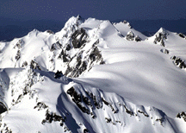
2 Standard Critiques of the Implications of the WTO Policies
“Regulatory-Chill”
“Race-to-the-Bottom”

Slide 26
Suppose that a government
has agreed to
hold its tariffs low
as a result of a WTO negotiation.

Slide 27
The “Race-to-the-Bottom” Problem
The government faces pressure from import-competing interests to offer additional protection from imports.
If its WTO commitments prevent the government from responding with a tariff increase, then it might instead choose to relax a labor or an environmental standard.
Race to the bottom

Slide 28
The “Regulatory-Chill” Problem
The government faces pressure from labor (environment) interests to introduce new and more stringent standards.
Those standards would enhance workplace safety while raising the costs of production of import-competing firms
⇓
Import-competing firms lobby for enhanced protection.
If WTO commitments prevent the government from raising its tariffs to offset the effects of the tighter standards on its firms, then the government might hesitate to introduce them.
Regulatory chill

Slide 29
Are the “Race-to-the-Bottom” and the “Regulatory-Chill” Problems Inevitable?
Not really:
If property rights over negotiated market access levels were sufficiently complete,
none of these problems would arise.

Slide 30
How can these property rights be completed?
A Simple Rule:
Once a government has agreed to lower its tariffs in a WTO negotiation:
  It should not be permitted to take subsequent unilateral policy actions that undercut its implied market access commitments;
but
  It should be otherwise allowed to configure its unilateral policies in anyway it desires.
Existing GATT/WTO principles are not that far away from approximating this simple rule.

Slide 31
The “Race-to-the-Bottom” Case
The government should not be permitted to offer protection to its import-competing industry by weakening its standards.
Instead, if it desires to provide additional protection from imports, it should be required to renegotiate with its trading partners to select higher tariff levels.
In principle, “non-violation” nullification-or-impairment complaints can guide governments toward such renegotiations—thereby preventing a race to the bottom.

Slide 32
The “Regulatory-Chill” Case
The government should be allowed to raise its tariff as it tightens its standards.
However, its tariff increase can do no more than offset the competitive effect of the tighter standards.
In principle, renegotiations could involve a commitment to higher standards as “compensation” for tariffs bound at higher levels—and thereby prevent a regulatory chill.

Slide 33
National Treatment
After entering in a country, imported and locally-produced goods (as well as services, trademarks, copyrights and patents) must be treated equally.

Slide 34
Anti-Dumping Provisions
Dumping:
A company exports a product at a price lower than the price it normally charges on its own home market.
The WTO “allows governments to act against dumping where there is genuine injury to the competing domestic industry.”
  Government has to:
    show that dumping has taken place;
    calculate the extent of dumping; and
    show that the dumping is causing injury.
Recently, have gained increased popularity.

Slide 35
Exceptions to MFN
Developing nations
  GSP (Generalized System of Preferences)
Preferential trade agreements (PTAs)
  Free Trade Areas
  Customs Unions

Slide 36
Forms of Economic Integration
Free Trade Area (FTA)
  Free trade among members.
  Each country has independent trade policies toward nonmembers.
Customs Union (CU)
  FTA + common external trade policy.
Common Market
  CU + free mobility of factors of production.
Economic Union
  Common Market + harmonization of other—monetary, fiscal—policies.

Slide 37
Preferential trade agreements
They are, by nature, discriminatory:
member countries’ concessions to each other are not extended to third parties.
Although PTAs are allowed by the WTO, the WTO has some guidelines governing the formation of PTAs.

Slide 38
WTO’s Guidelines for PTAs:
Bloc members cannot increase external trade barriers against imports from third countries.
* Provision aimed at securing interests of
WTO members not participating in the PTA.*
Bloc should eliminate—or “reduce substantially”—its internal trade barriers in a “reasonable” period of time.
* Provision aimed at avoiding partial PTAs—which
would lead to the practical elimination of the MFN rule.*

Slide 39
PTAs: The Facts
Over 200 regional trade arrangements are currently in force.
Nearly all WTO members participate in at least one regional free trade agreement.
Others to come – FTAA …

Slide 40
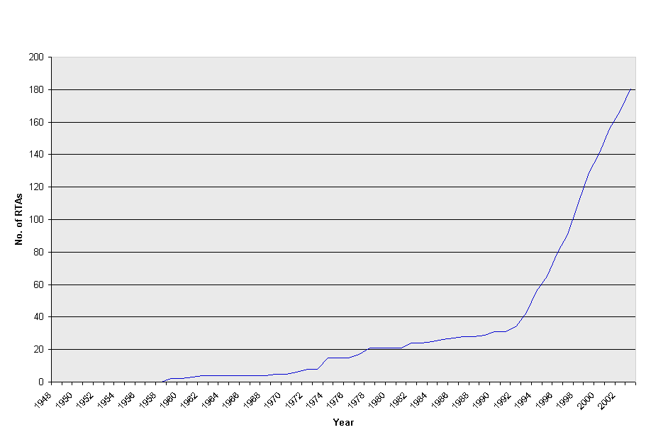

Slide 41
The European Union
Origin and evolution
  1957: Treaty of Rome establishes the European Economic Community (EEC)
  [Belgium, France, W. Germany, Italy, Luxembourg, Netherlands]
  1967: EEC becomes simply the European Communities (EC)
  Expansions:
    1973: Denmark, Ireland, UK
    1981: Greece
    1986: Portugal and Spain
    1995: Austria, Finland, Sweden
    2004: Czech Republic, Estonia, Cyprus, Latvia, Lithuania,
    Hungary, Malta, Poland, Slovenia and Slovakia
    Bulgaria and Romania expected to join in 2007. Turkey has also applied to become a member.
  Free trade agreements with many other countries.

Slide 42
EU (cont.)
The Treaty of Maastricht (1992):
  Changes name to European Union.
  Aimed at establishing a monetary union.
Development of a common currency (the euro):
  January 1, 1999: exchange rates fixed and euro launched for financial transactions.
  January 1, 2002: euro notes and coins start to circulate.
  July 1, 2002: national currencies fully eliminated.
Note: not all EU members have adopted the euro.
  Have not yet adopted it: UK, Sweden, Denmark.

Slide 43
PTAs in Europe:
The European Free Trade Association (EFTA)
Created in 1960.
Lost most of its members—and its importance—to the EU.
Current membership: Iceland, Liechtenstein, Norway, Switzerland.
Also have free trade agreements with several countries/blocs (including the EU).

Slide 44
PTAs in the Americas
NAFTA (1994)
  An FTA among Canada, Mexico and US.
Mercosur (1991)
  A CU among Argentina, Brazil, Paraguay and Uruguay.
Andean Community (effective since 1992)
  A CU among Bolivia, Colombia, Ecuador, Peru and Venezuela.
Other smaller groups (CACM, CARICOM).
Future: FTAA?

Slide 45
PTAs in the Rest of the World
ANZCERTA (1983)
  FTA between Australia and New Zealand.
Asia
  Several attempts but so far little intra-bloc free trade.
Africa
  More attempts and less results than in Asia.
A few intercontinental PTAs
  But the number of such arrangements are growing fast.

Slide 46
Is Regionalism good?
Large disagreement on this issue.
Supporters emphasize the trade liberalization aspect of PTAs: “trade creation.”
Critics emphasize the trade discrimination aspect of PTAs: “trade diversion.”
  When a country discriminates among distinct sources of imports, it may end up importing from a less efficient source, thus paying more for the same good.

Slide 47
But what has been the effect of PTAs?
Trade among members normally increases substantially.
Trade between members and non-members typically increases too—albeit not as much as intra-bloc trade.
How is that possible?
 External tariffs usually fall after the formation of a trading bloc.
⇒ Not as much discrimination as one would predict.
By most accounts, trade creation has been the rule, and trade diversion the exception in regional integration.

Slide 48
Other observed effects of PTAs:
Has not reduced (at least not clearly) the interest on liberalization at the multilateral level.
Flows of FDI normally increase after a PTA is created.
Empirical regularities suggest that PTAs can help “consolidate democracy.”
  Possible explanation: “rent dissipation.”

Slide 49
WTO: Recent Developments
Seattle’s Failed “Millennium Round”
Main reasons behind the failure
US vs. EU on agricultural subsidies.
US vs. developing countries on labor standards.
“Outside events.”

Slide 50
The Claims “Outside”
  ‘The WTO is not democratic.’
  ‘Trade pacts disregard the environment: race to the bottom.’
  ‘Trade pacts promote child labor and hazardous working conditions.
  ‘Free trade shifts jobs from high-wage-high-standard countries to low-wage-low-standard countries.’

Slide 51
The Future—The “Development Round”
Initiated in Doha, Qatar, in November 2001.
Initial deadline for negotiations: 1 January 2005…
Issues:
  Agriculture subsidies.
  Antidumping measures.
  Environmental and labor standards.
  Services.
  Competition policy.
  Government procurement.
  Intellectual property.
  Etc.

