Slide 1
HAEMODIALYSIS
M. KARTHIKA
Asst Professor,
Dept of Physics,
Bon Secours College for Women , Thanjavur Dt.

Slide 2
WHAT IS DIALYSIS?
A medical procedure to remove fluid and waste products from the blood and to correct electrolyte imbalances.
This is accomplished using a machine and a dialyzer, also referred to as an "artificial kidney."
Hemodialysis is used to treat both acute (temporary) and chronic (permanent) kidney failure.

Slide 3
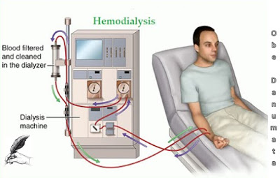
WHEN WE NEED DIALYSIS?
CHRONIC
FULLY DAMAGED
NEED KIDNEY TRANSPLANT
ACUTE
DISEASE
ACCIDENT
CHRONIC RENAL FAILURE- FULLY DAMAGE
ACUTE RENAL FAILURE- DAMAGED BY DISEASE

Slide 4
TYPES OF DIALYSIS
PERITIONATE DIALYSIS
HAEMODIALYSIS

Slide 5
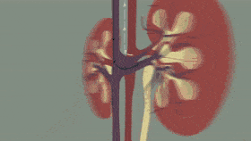
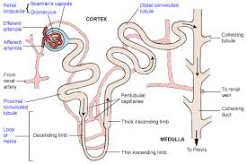
BASICS OF KIDNEY FUNCTION
The kidneys are a perfect filter which perform the function of removal of waste products through the urine.

Slide 6
FUNCTION OF THE NORMAL KIDNEY
BEAN SHAPED
12 CM LONG; 150G WEIGHT
MILLIONS OF NEPRONS
GLOMERULUS & TUBULE
PLASMA ----- GLOMERULLI ------ CAPILLARY LOOP (PASSIVE PROCESS)
60 TIMES PER DAY – URINE OUTPUT- ACTIVE PROCESS
ENERGY REQUIRED FOR ACTIVE PROCESS

Slide 7
CONCENTRATION OF ELECTROLYTES
ELECTROLYTES | CONCENTRATION mmol
SODIUM | 132-142
CHLORIDE | 100
BICARBONATE | 25
POTASSIUM | 3.9-5.0
CALCIUM | 2.5

Slide 8
DIALYSER?????
Sometimes, when the kidneys get infected and do not function properly, the person starts suffering which can lead to his/her death.
Such people are put on to artificial kidneys, also known as dialyser.
Dialyser is a machine that filters the blood of harmful substances.
Blood from a blood vessel is drawn into the dialyser and then purified to be fed into another blood vessel of the body.
Such people have to be dialysed after every 2-3 days.
Damaged kidneys are also replaced either from a donor or a dead person.

Slide 9
HISTORY OF DIALYSIS

Slide 10
TYPES OF DIALYSER
PARALLEL PLATE – BLOOD FLOWS BETWEEN PARALLEL SHEETS OF MEMBRANE-65-86mL
HOLLOW FIBRE- BLOODS FLOWS THROUGH HOLLOW FIBERS – 70-100mL

Slide 11
DIALYZER MEMBRANE
Cellulose:
Obtained form processed cotton (regenerated cellulose, cuprammonium cellulose, cuprammonium rayon and saponified cellulose)
Substituted cellulose:
Cellulose polymer has a large number of free hydroxyl group at its surface
Free hydroxyl group are responsible for blood cell activation causing bio-incompatibiltiy of the dialyzer (cellulose acetate, cellulose diacetate, triacetate)
Synthetic material e.g(polyacrylorinate, polysulfone)

Slide 12
PRINCIPLES OF HAEMODIALYSIS
Dialysis works on the principles of the diffusion of solutes and ultrafiltration of fluid across a semi-permeable membrane.
Diffusion is a property of substances in water substances in water tend to move from an area of high concentration to an area of low concentration.

Slide 13
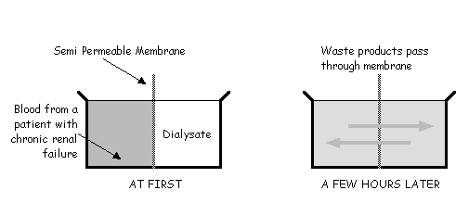
DIFFUSION
10-20 Micrometer thickness
Pores about 500nm
>5000 – pass easily
(5000- 40000)- pass slowly
Remove amino acids, some drugs

Slide 14
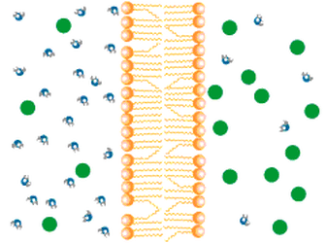
OSMOSIS
A process by which molecules of a solvent tend to pass through a semipermeable membrane from a less concentrated solution into a more concentrated one.

Slide 15
ULTRAFILTRATION
The movement of water across a membrane as a result of hydrostatic pressure is called Ultrafiltration.

Slide 16
Working of dialysis machine

Slide 17
Importance of Dialysis
The dialysis fluid
Mixing of dialysis fluid
Dialysate temperature
Blood leak detector
The extracorporeal blood circuit
Access of circulation

Slide 18
THANK YOU

