Slide 1
PERSONALITY
S.DELPHINA MARY
ASST. PROFESSOR
BON SECOURS COLLEGE FOR WOMEN
DEPARTMENT OF SOCIAL WORK

Slide 2
MEANING:
Personality is the total quality of an individual behavior as it is shown in his/her habits, thinking, attitudes, interests, his/her manner of acting and his/her personal philosophy of life.
It is the totality of his/her being. It includes his physical, mental, emotional and temperamental make-up and how it shows itself in behavior.

Slide 3
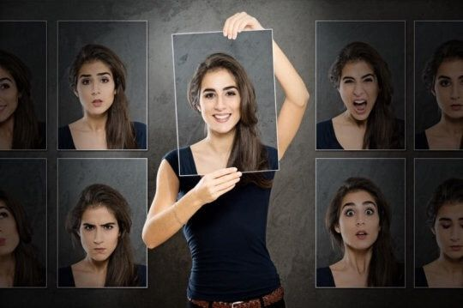

Slide 4
DEFINITION:
Macionis define as “It is the constant pattern of thinking, feeling and acting.”
Ogburn and Nimkoff define it as the totality of sentiments, attitudes, idea, habits, skills and behaviors of an individual.”

Slide 5
THEORIES OF PERSONALITY:
TRAIT THEORY
FREUD THEORY
JUNG THEORY
ADLER THEORY
MASLOW THEORY
ERICKSON THEORY
TYPE THEORY:
1.Ernest
2.Sheldon

Slide 6
TRAIT THEORY:
Traits are tendency to behave in relatively consistent and distinctive ways across situations.
These are the measurable aspects of personality.
For example : Friendliness, Honesty, Social Etc…
It includes ALLPORT and CATELL theories.

Slide 7
ALLPORT TRAIT
  He Identified Three Traits:
        Cardinal Traits(individual behaviours)
        Central Traits(It Describe A Person.Eg:honesty)
        Secondary Traits(small Range Of Traits And Not Strong)

Slide 8
RB CATELL TRAITS:
  Source Traits(sources That Determine Our Behaviour)
  Surface Traits(manifested In Our Behaviour)

Slide 9
TYPE THEORY:
1.ERNEST KRETSCHMAN’S THEORY
2.WILLIAM SHELDON THEORY

Slide 10
1.Ernest Kretschmer’s Theory
Ernest Is A German Psychologist
He Found That Certain Body Types Are Associated With Particular Types Of Mental Disorders.
He Classified Personalities Into three Types

Slide 11
Pyknic Type:
Short and round body
Extraverts
May have MDP(Manic Depressive psychosis)

Slide 12
B) Asthenic Type:
Slender or slim body
Introverts
May be suffer from Schizoprenia.

Slide 13
C) Athletic Type:
Strong body
More energetic and aggressive(ambiverts)
May be prone to suffer from MDP

Slide 14
2.William Sheldon’s Theory
He Correlating Temperament And Body Type.
He Has Divided People Into Three Types.

Slide 15
ENDOMORPH(pyknic type)
  They are sociable and relaxed
ECTOMORPH(asthenic type)
  They are shy , reserved , self-conscious
MESOMORPH(athletic type)
  They are physically active , noisy , adventurous

Slide 16
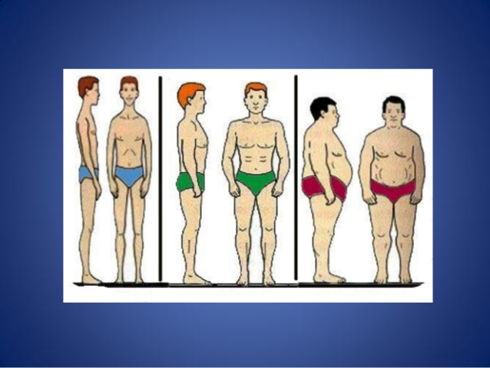
1 2 3

Slide 17
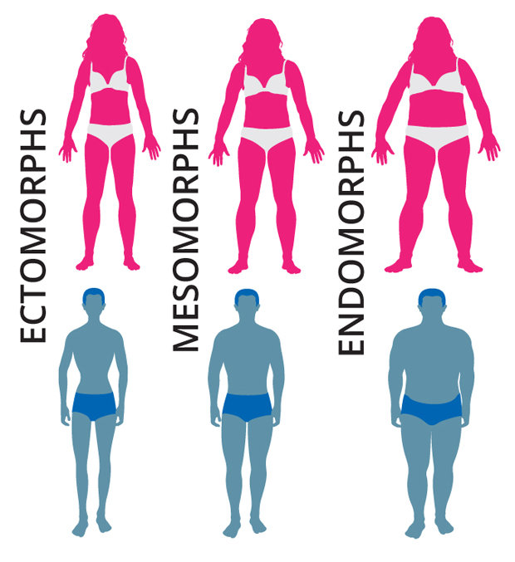
1 2 3

Slide 18
JUNG THEORY:
EXTROVERT
INTROVERT
AMBIVERT

Slide 19
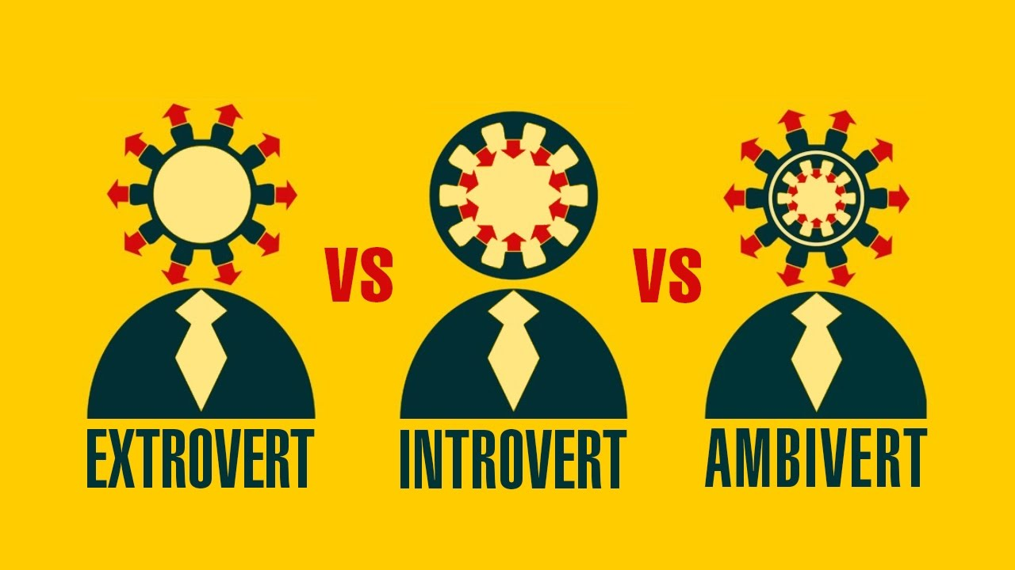
1 2 3

Slide 20
FREUD’S THEORY:
Id – Pleasure Principle – Unconscious Mind
Ego – Reality Principle – Sub-conscious Mind
Superego – Conscience Principle – Conscious Mind

Slide 21
FREUD’S PSYCHO SEXUAL DEVELOPMENT:
Oral
0 -1 (mouth sucking)
Weaning(from breast or bottle)
2-3(anus-expelling or retaining feces)
Toilet training
Phallic
4-5(genitals-masturbating)
Identifying adult role models
Anal

Slide 22
Continued...
Latency
6-12(sexually repressed)
Expanding social contacts
Genital
Puberty onwards(being sexually intimate)
Establish intimate relations

Slide 23
ERICKSON THEORY:
PERIOD OF TIME | VIRTUE | CONFLICTS
Infancy | Hope | Basic Trust Vs Mistrust
Years 1 - 3 | Will | Autonomy Vs Shame Or Doubt
Years 3 - 5 | Purpose | Initiative Vs Guilt
Years 5 - 12 | Competence | Inferiority
Adolescence | Fidelity ” being True To The Self ” | Identity Vs Role Confusion
Early Adulthood | Love | Intimacy Vs Isolation
Middle Adulthood | Care | Generatively Vs Stagnation
Late Adulthood | Wisdom | Ego Integrity Vs Despair

Slide 24
MASLOW THEORY:
SELF ACTUALISATION
SELF ESTEEM NEEDS
SOCIAL NEEDS
SAFETY NEEDS
PHYSIOLOGICAL NEEDS

Slide 25
FACTORS INFLUENCING PERSONALITY:
Biological Factors
Environmental Factors

Slide 26
BIOLOGICAL FACTORS
HEREDITY
ENDOCRINE GLANDS
PHYSIQUE
NERVOUS SYSTEM

Slide 27
ENVIRONMENTAL FACTORS:
FAMILY
SCHOOL
SIBLINGS
MASS MEDIA
PEER GROUP
TEACHER
BIRTH ORDER
CULTURE

Slide 28
THANK YOU

