Slide 1
HUMAN RESOURCE MANAGEMENT
P.MANICKA JOTHII Assistant Professor, Department of Social Work Bon Secours College for Women Thanjavur

Slide 7
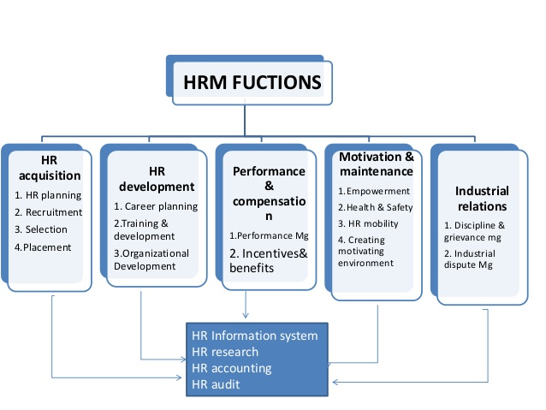

Slide 24
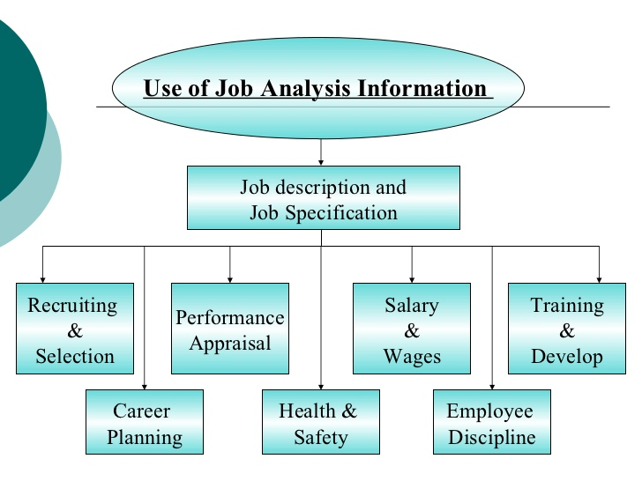

Slide 26
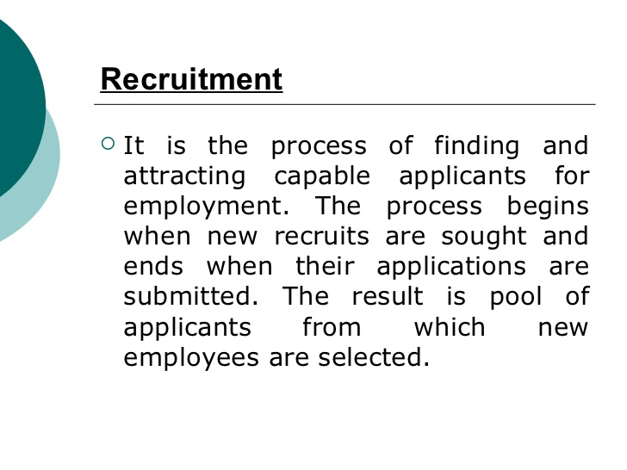

Slide 28
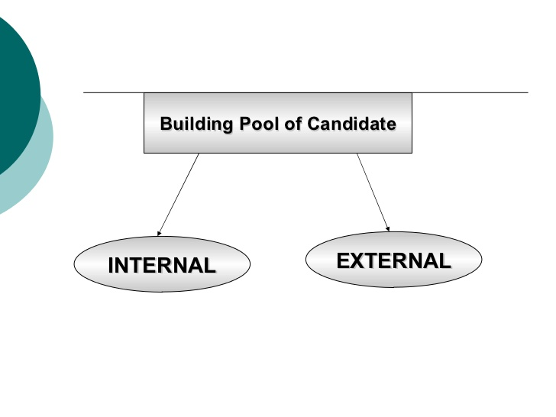

Slide 29
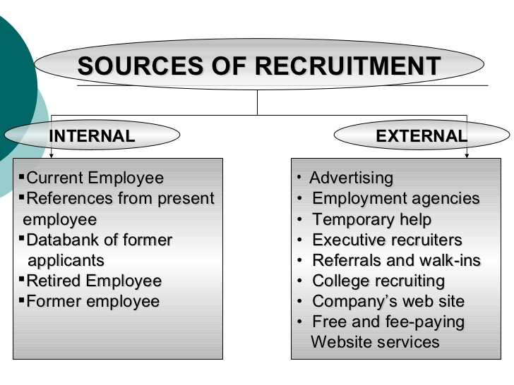

Slide 34
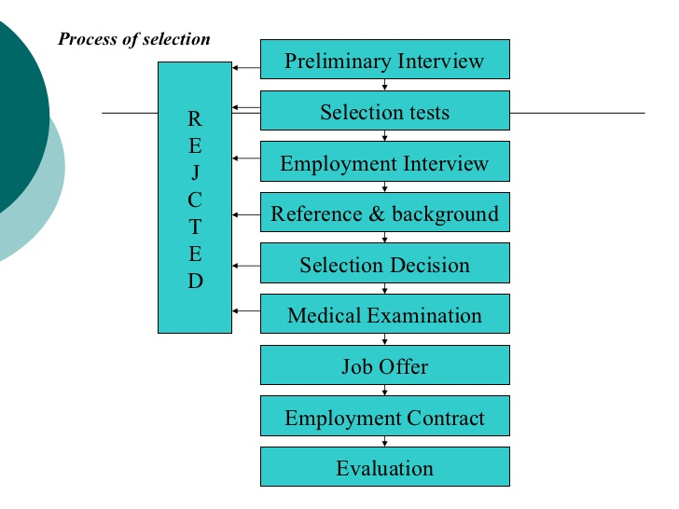

Slide 43
