Slide 1
VIVEKANANDHA COLLEGE OF ARTS AND SCIENCE (W) SIRKALI
D.VASUMATHI
ASSISTANT PROFESSOR OF CHEMISTRY
SUBJECT CODE: 16SCCCH2
UNIT-III: Chemistry of Benzene and Benzenoid compounds
TOPIC: Polynuclear Aromatic hydrocarbons-Naphthalene.

Slide 2
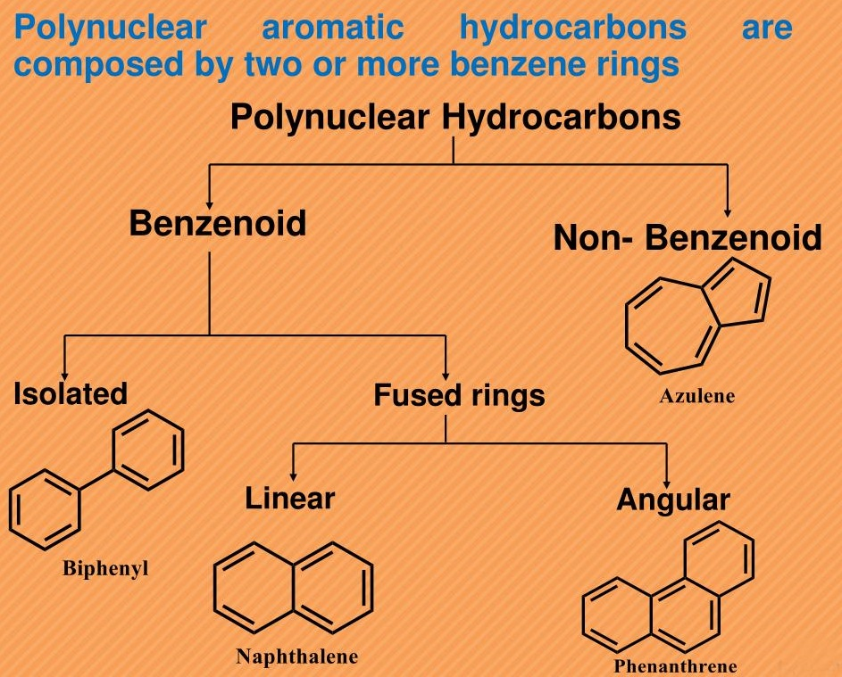

Slide 4
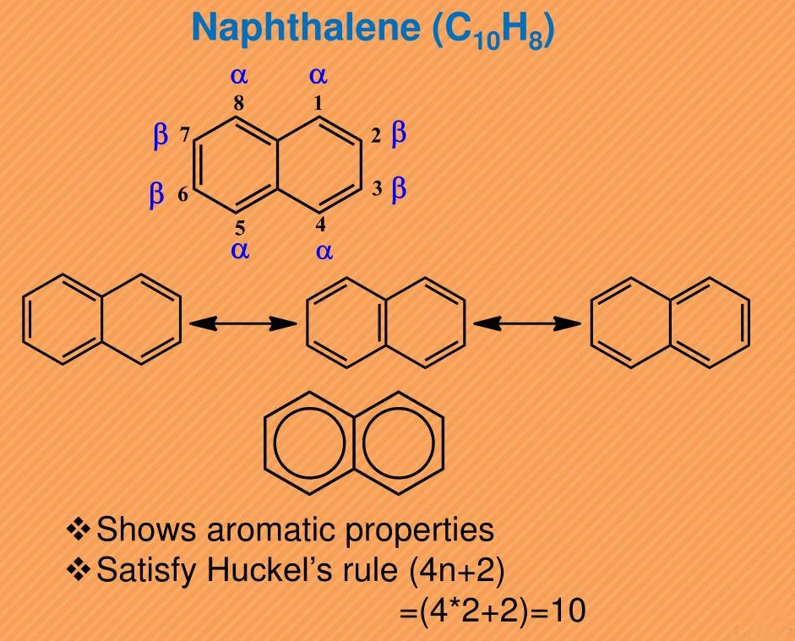

Slide 10
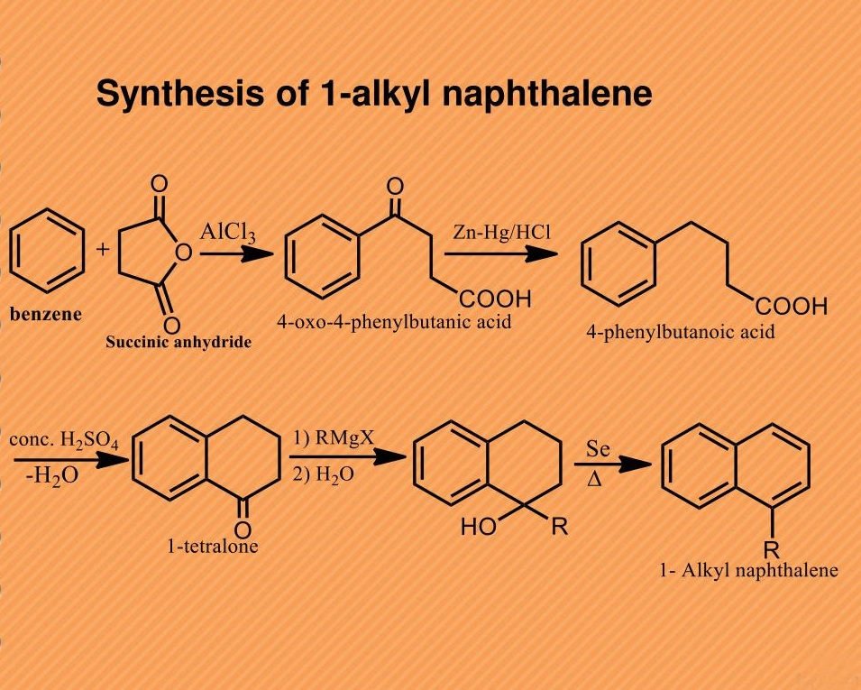

Slide 11
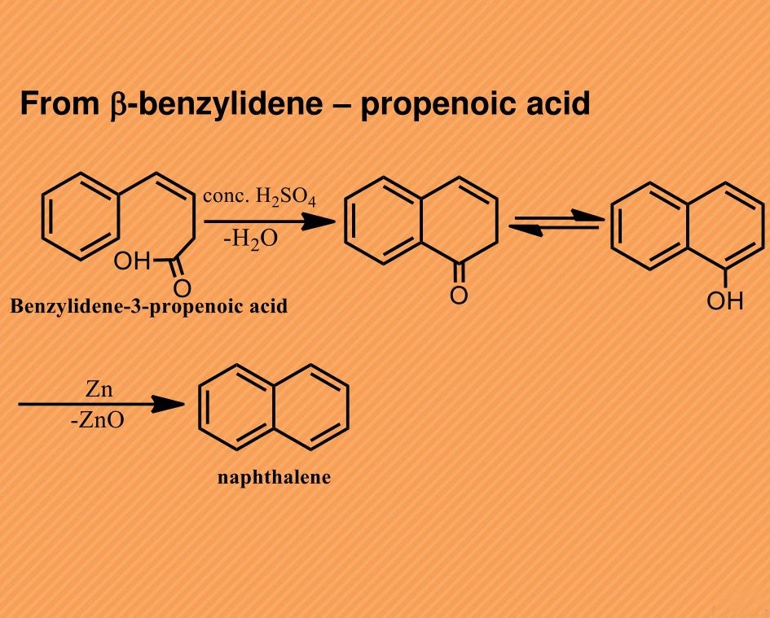

Slide 12
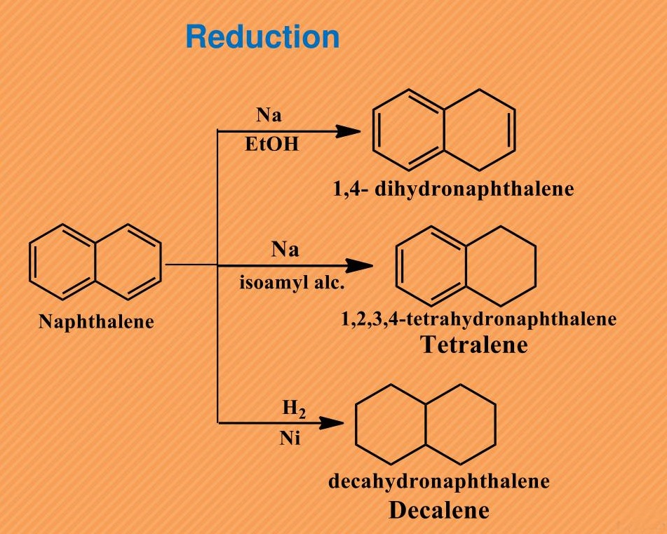

Slide 13
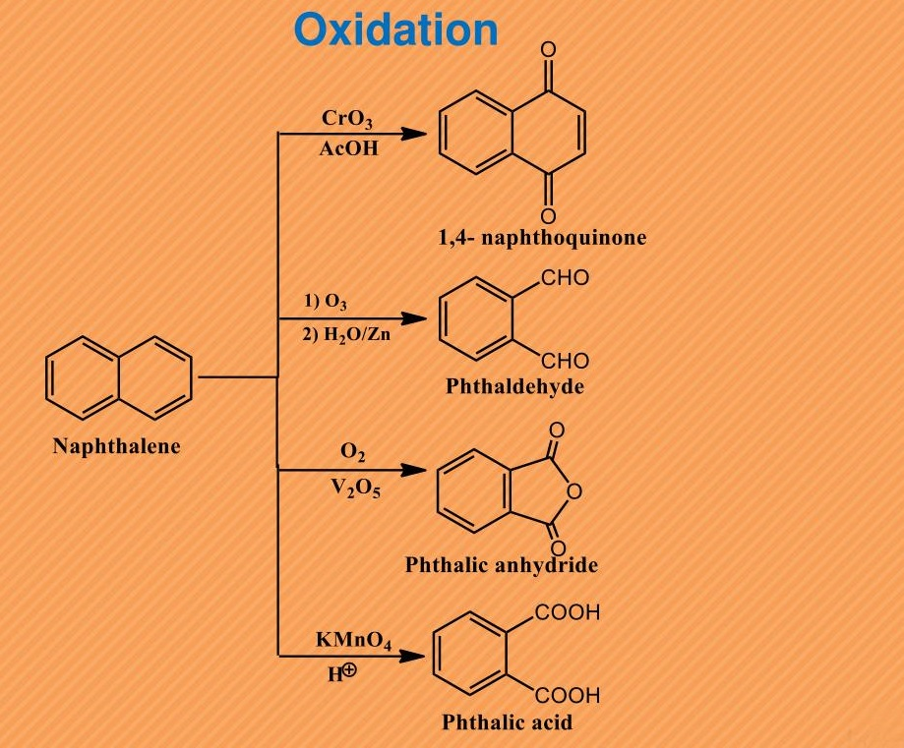

Slide 16
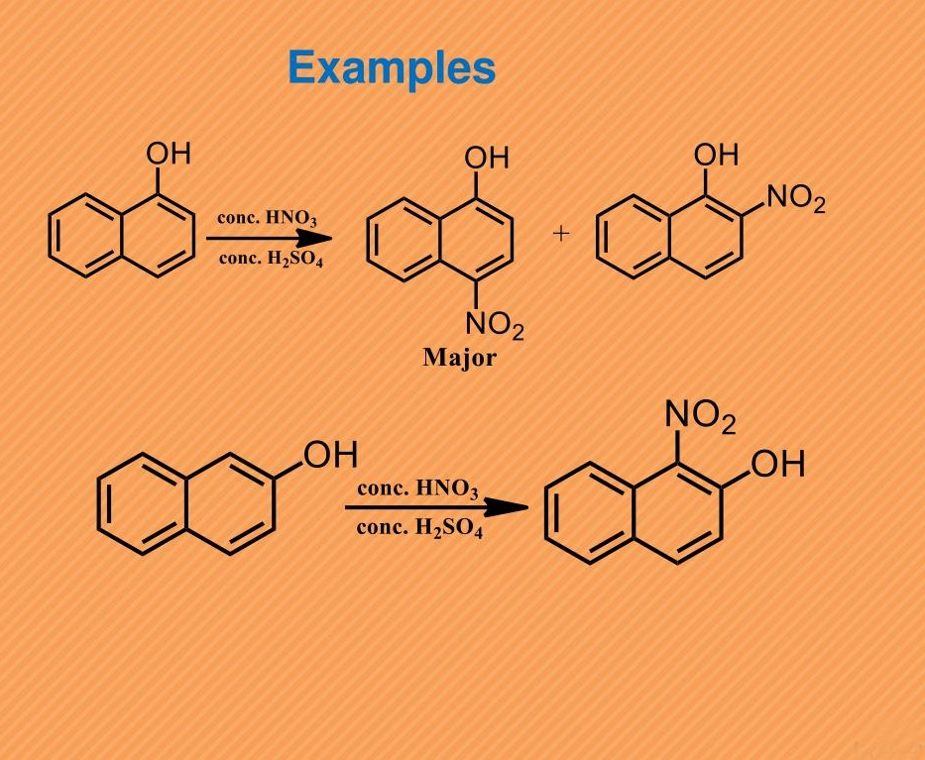

Slide 18
THANK YOU

