Slide 1
WELCOME
College name: vivekananda college of arts and science
for women-sirkali
Staff name : Dr.S.Sasikala
Designation : Assistant professor
Department : Chemistry
Subject : Physical Chemistry-II
Subject code : 16SCCCH9
Topic : Spectroscopy(UV, IR, NMR)

Slide 2
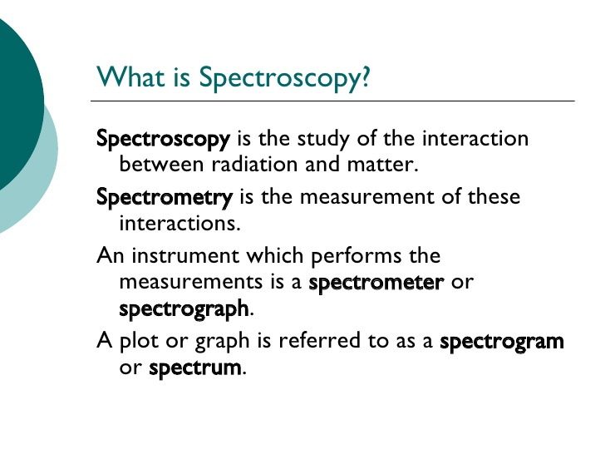
SPECTROSCOPY

Slide 3
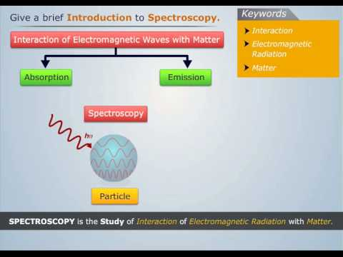

Slide 4
Types of spectroscopy
The nature of the interaction between radiation and matter may include
1. Absorption
2. Emission
3. Scattering

Slide 5
Absorption spectroscopy
• In absorption spectroscopy an electromagnetic radiation is absorbed by an atom or molecule Which undergoes transition from a lower energy state to a higher energy or excited state
• Absorption occurs only when the energy of radiation matches the difference in energy between two energy levels

Slide 6
Emission spectroscopy
• Atoms or molecules that are excited to high energy levels can decay to lower levels by emitting radiation
• The substance first absorbs energy and then emits this energy as light
• Emission can be induced by sources of energy such as flame or electromagnetic radiation

Slide 7
Scattering spectroscopy
• Scattering spectroscopy measures certain physical properties by measuring the amount of light that a substance scatters at certain wavelenths .
• One of the most useful applications of light scattering spectroscopy is RAMAN SPECTROSCOPY

Slide 8
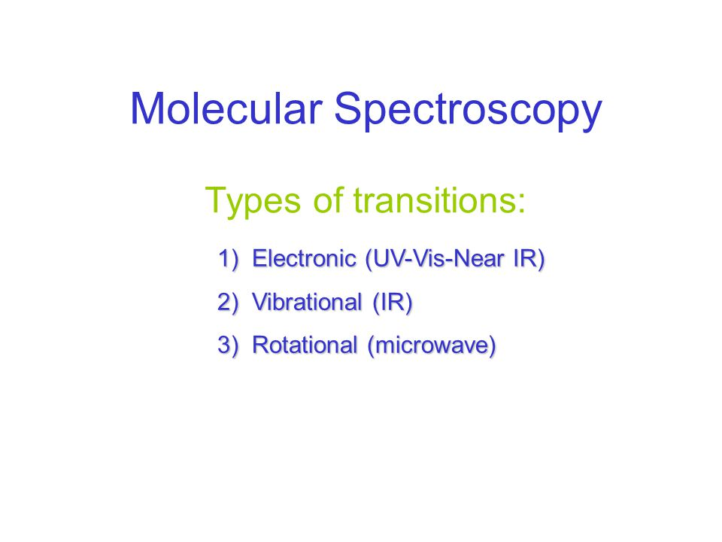

Slide 9
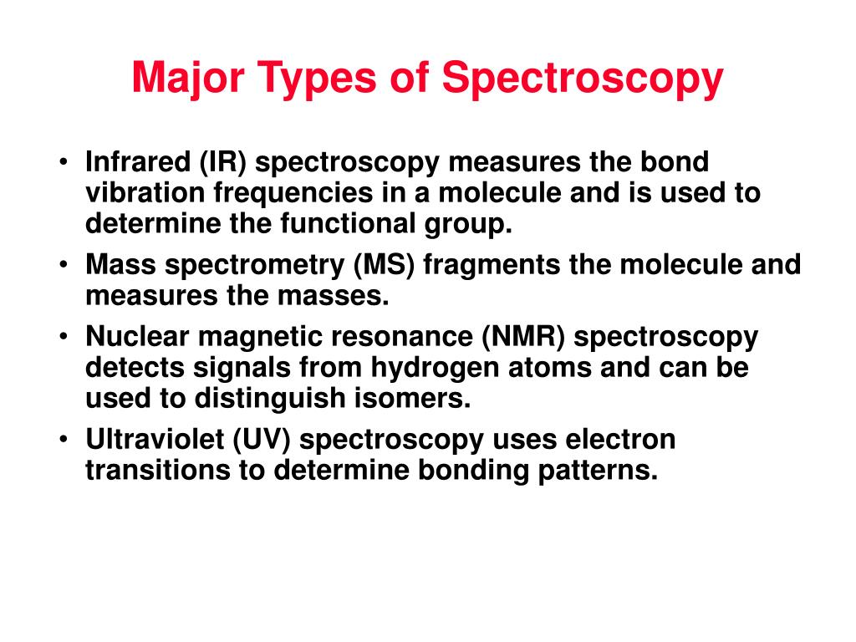

Slide 10
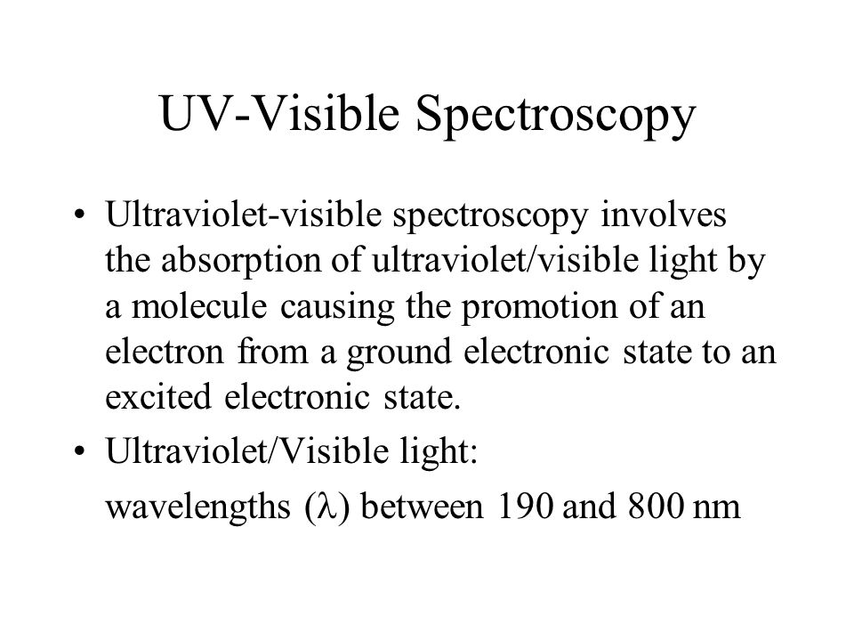

Slide 11
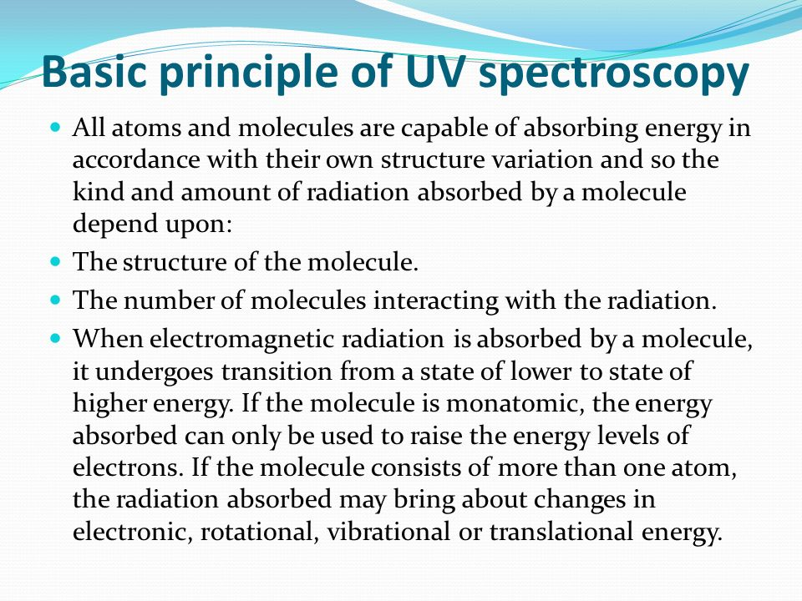

Slide 12
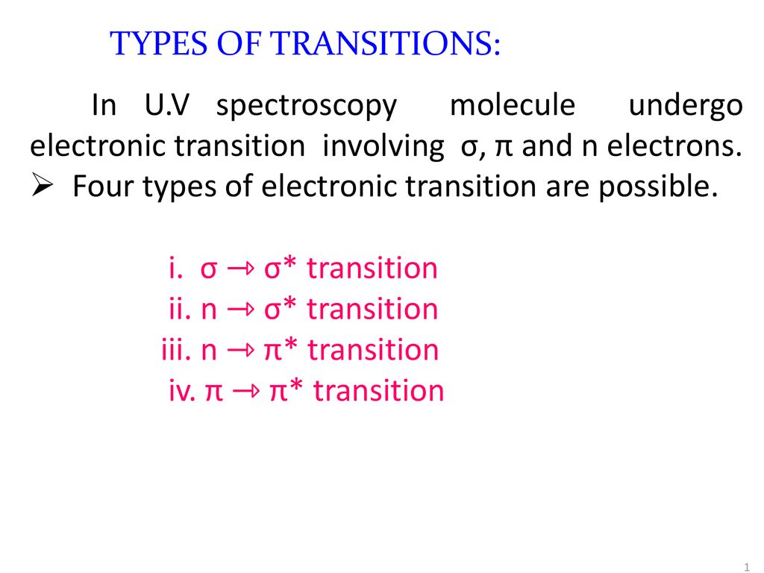

Slide 13
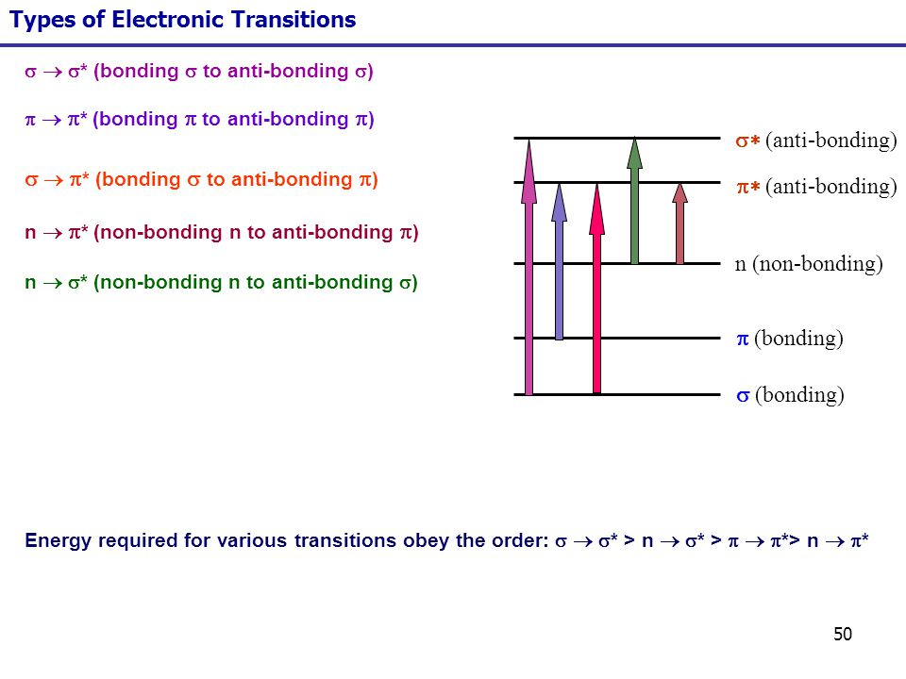

Slide 14
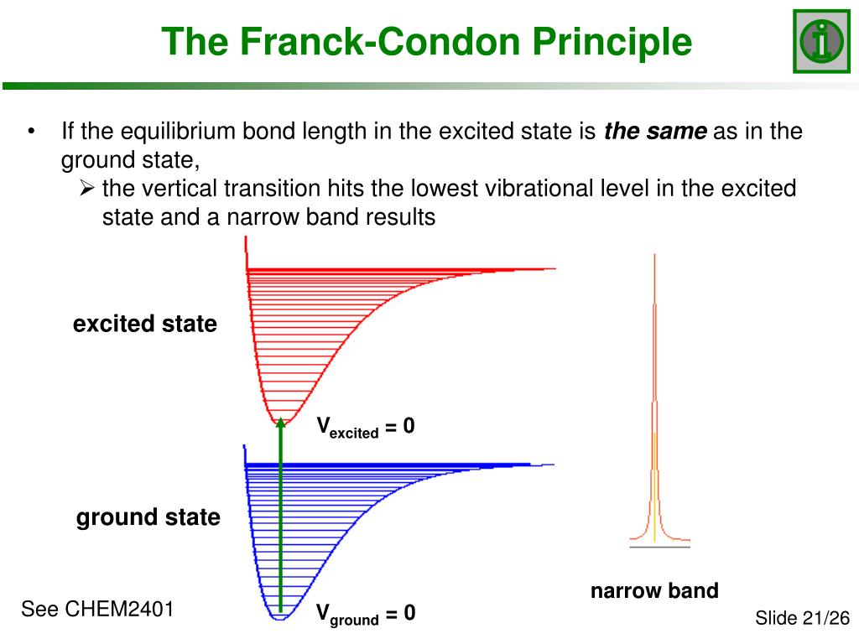

Slide 15
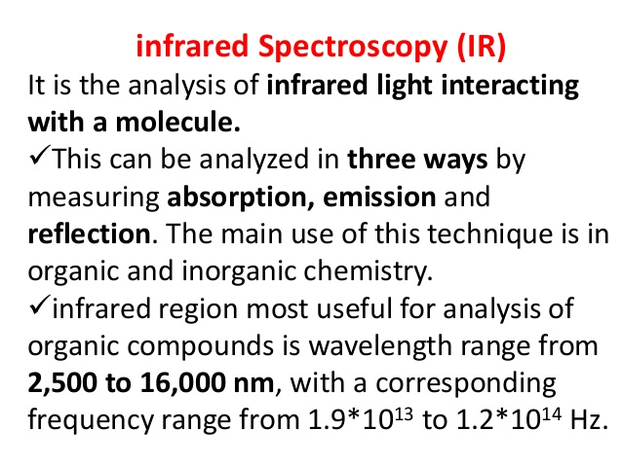
DEFINE INFRARED SPECTROSCOPY

Slide 16
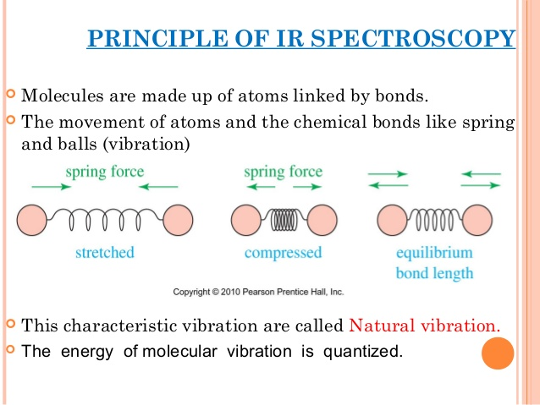

Slide 17
Condition for IR spectrum
The change in vibrational movements should produce a net dipole moment.
Homonuclear atoms containing molecules are IR inactive.
Heteronuclear atoms are IR active if their vibrations result in net dipole

Slide 18
Infrared Instrumentation
All modern instruments are Fourier Transform instruments.
In all transmission experiments radiation from a source is directed through the sample to a detector.
The measurement of the type and amount of light transmitted by the sample gives information about the structure of the molecules comprising the sample.

Slide 19
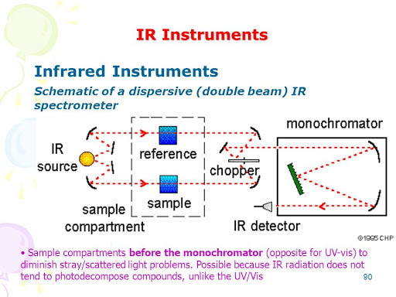

Slide 20
TYPES OF MOELCULAR VIBRATIONS
Stretching: Change in inter-atomic distance along bond axis
Bending: Change in angle between two bonds. There are four types of bend:
• Rocking
• Scissoring
• Wagging
• Twisting

Slide 21
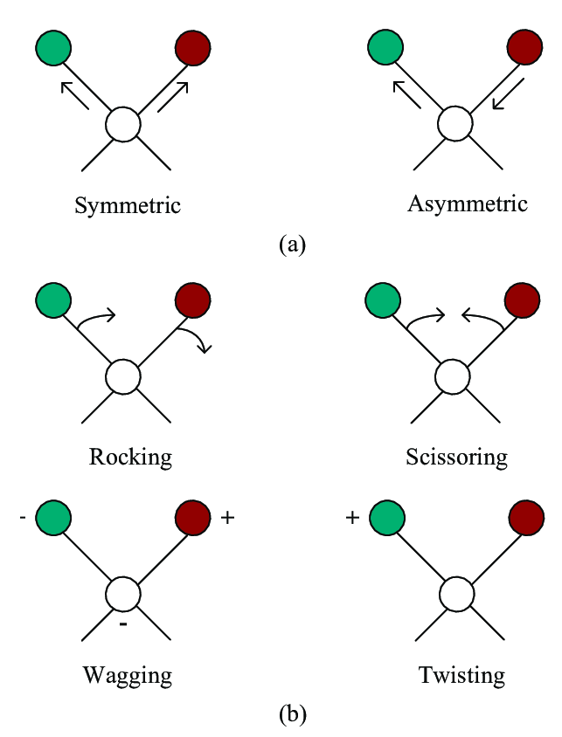

Slide 22
TYPES OF MOELCULAR VIBRATIONS
H
H
H
H
H
H
C
C
C
H
H
H
H
H
H
Asymmetrical stretching
Symmetrical stretching
Bending or scissoring
H
H
H
H
H
H
C
C
C
H
H
H
H
H
H
Rocking or in plane bending
Twisting or out-of-plane bending
Wagging or out-of-plane bending

Slide 23
overtones
Bands corresponding to integral multiple of fundamental vibration.
They are due to transition from ground state to higher vibrational states.
They are very weak bands.
An absorption band at 1050 cm-1 may well have an accompanying band at 2100 (2 ν) and 3150 (3 ν) cm-1 .

Slide 24
Bands
Combination bands:
Two vibrational frequencies in a molecule couple to give a new frequency within the molecule. This band is a sum of the two interacting bands.
Difference bands:
Similar to combination bands. The observed frequency is the difference between the two interacting frequencies.
Fermi resonance:
When a fundamental vibration couples with overtone or combination Band, the coupled vibration is called a Fermi resonance.

Slide 25
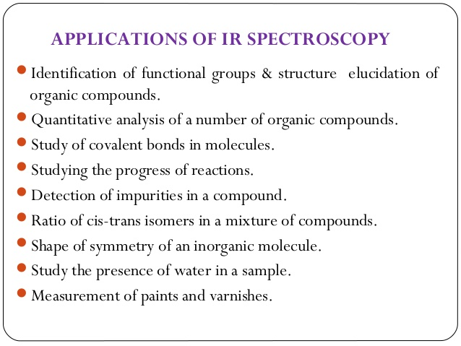

Slide 26
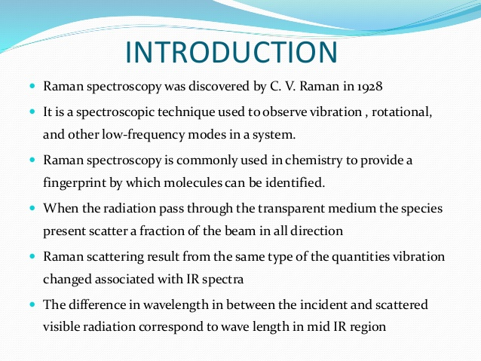
Raman Spectroscopy

Slide 27
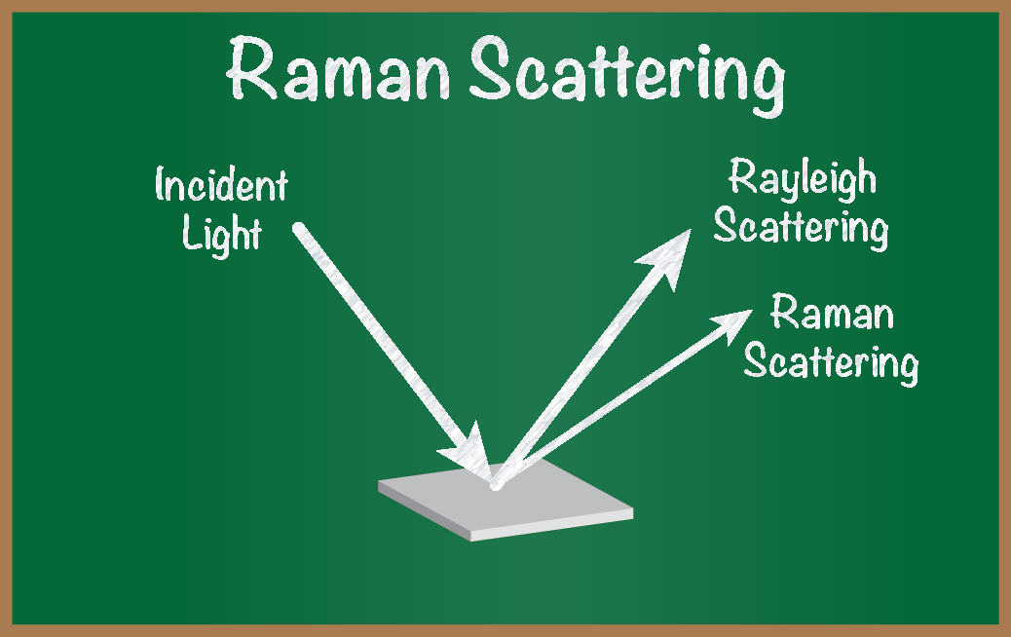

Slide 28
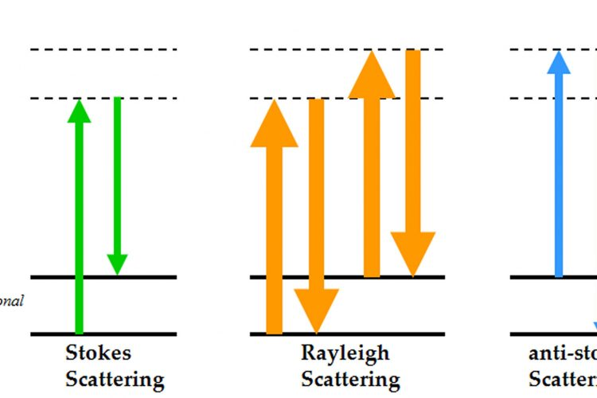
Raman and Rayleigh scattering

Slide 29
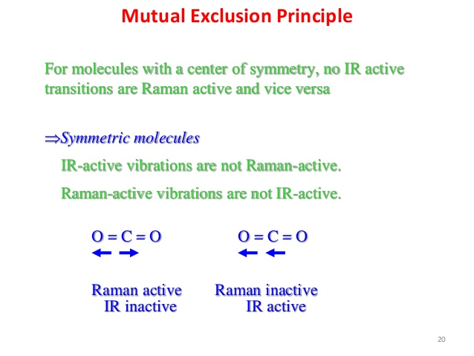

Slide 30
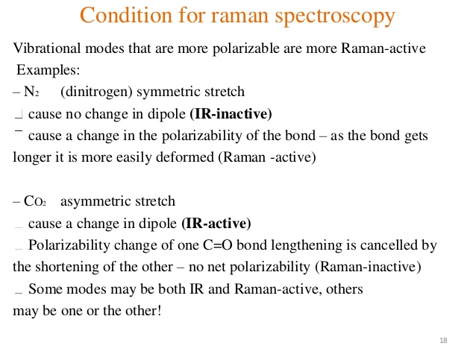

Slide 31
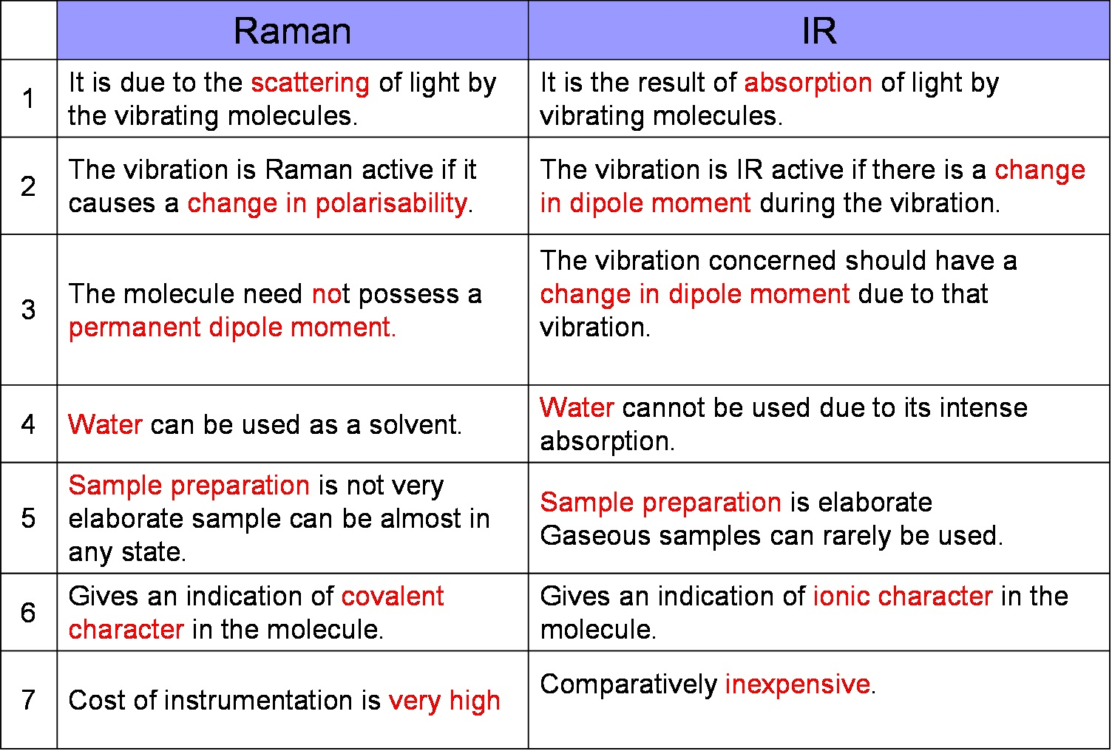

Slide 32
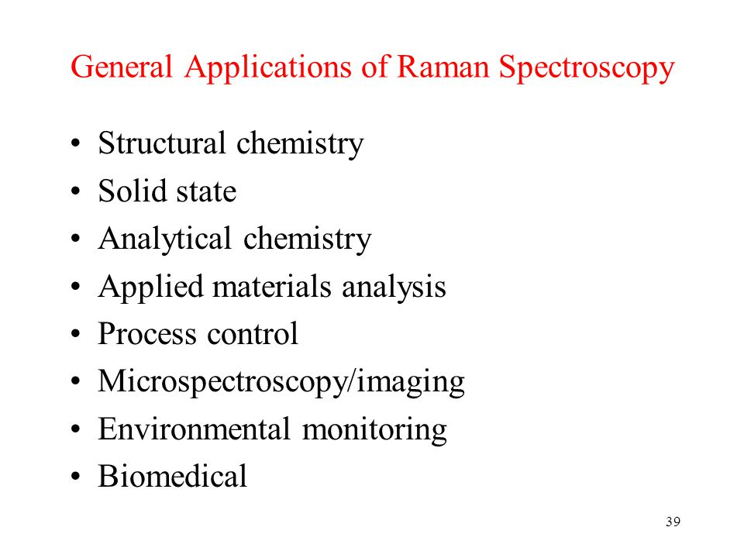

Slide 33
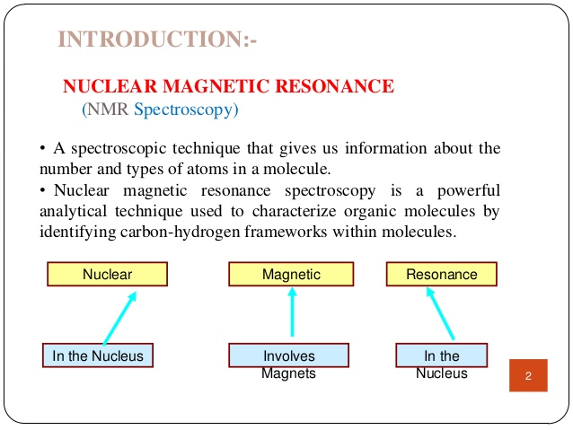

Slide 34
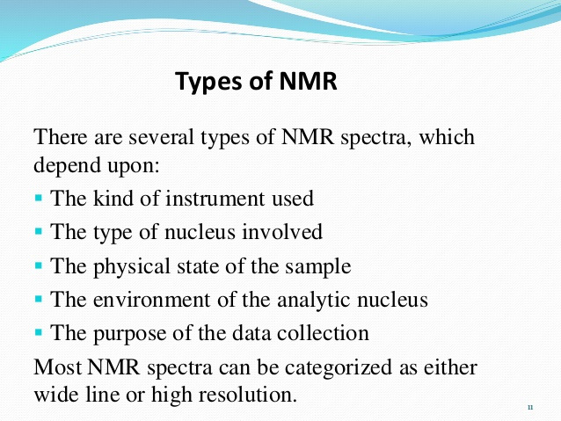

Slide 35
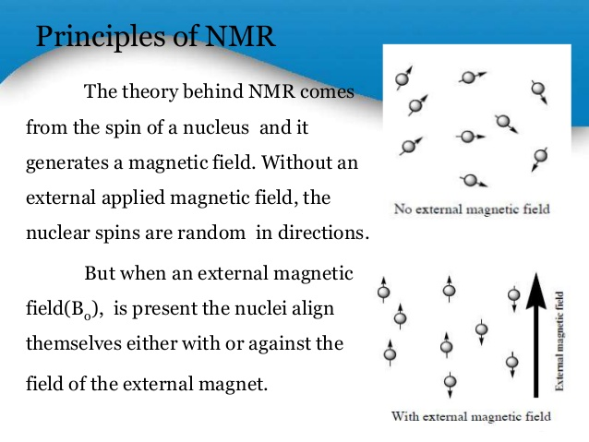

Slide 36
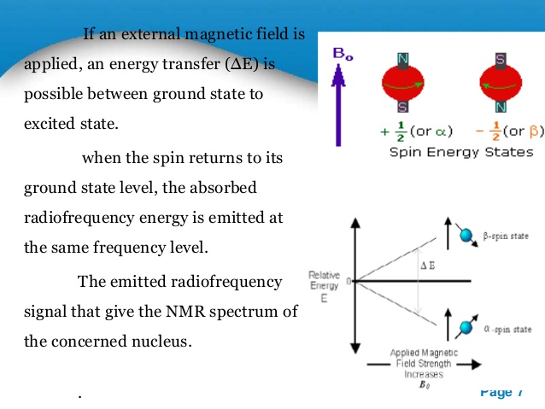

Slide 37
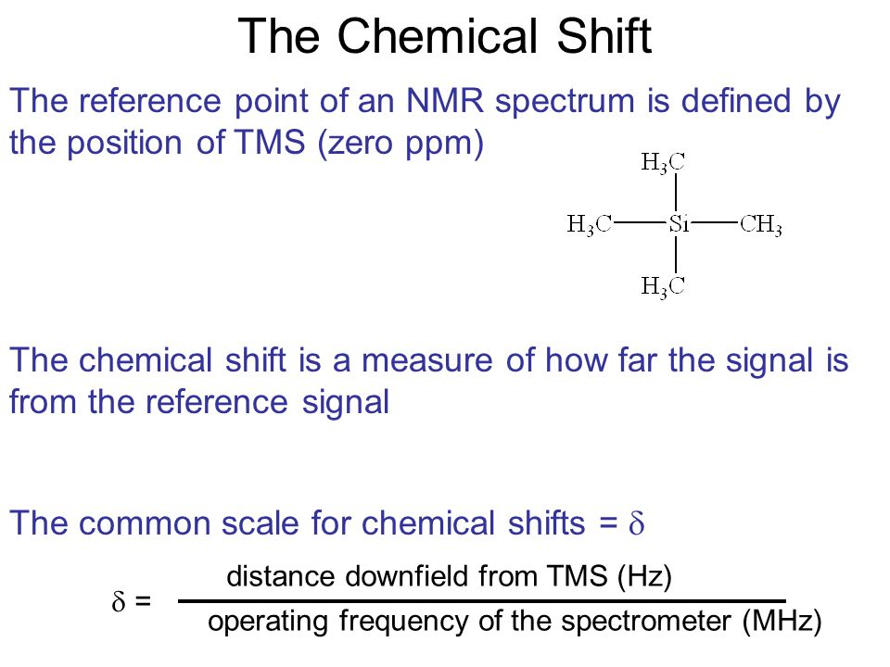

Slide 38
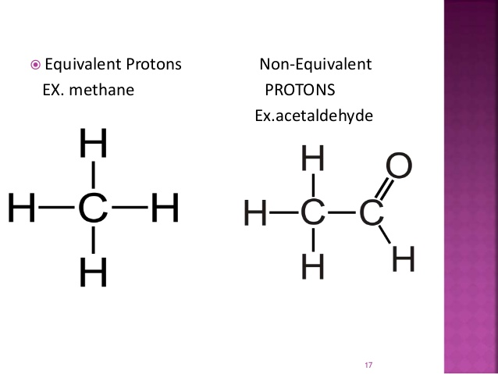
Equivalent and non equivalent protons

Slide 39
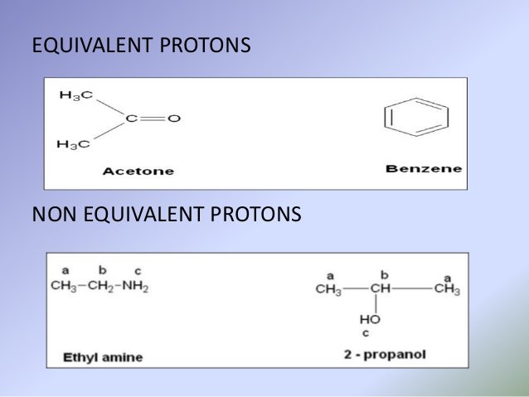

Slide 40
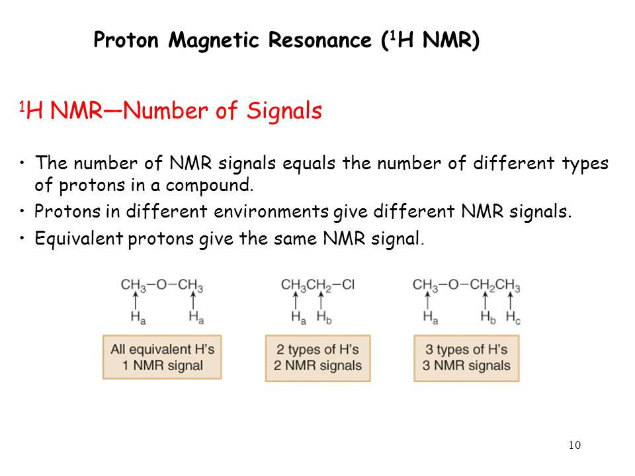

Slide 41
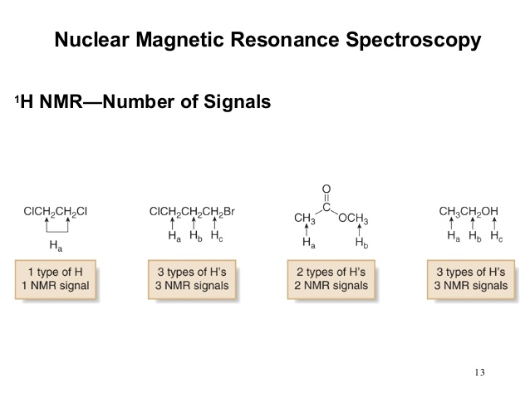

Slide 42
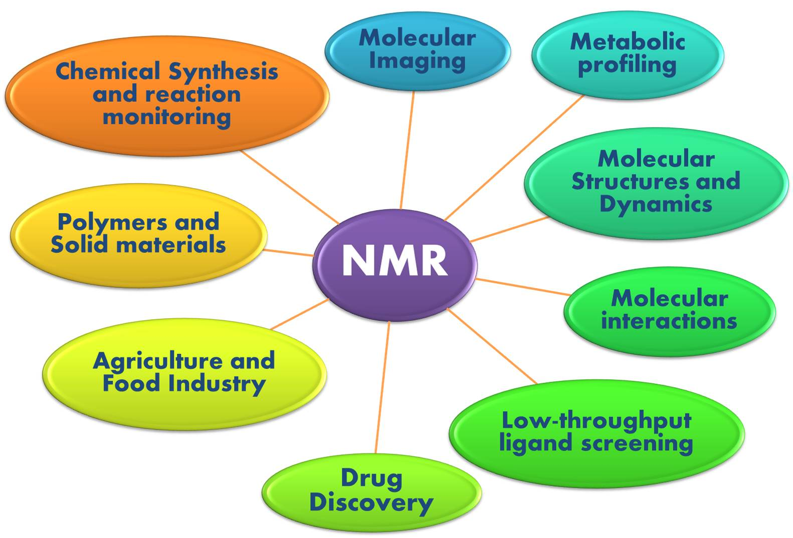
Application of NMR

Slide 43
THANK YOU

