Slide 1


Slide 2

MACBETH
Macbeth is one of the four best tragedies including Othello, Hamlet and King Lear, written by William Shakespeare
It was written when king of England was James I (he was James VI of Scotland) and Shakespeare ’s aim was to flatter him

Slide 3
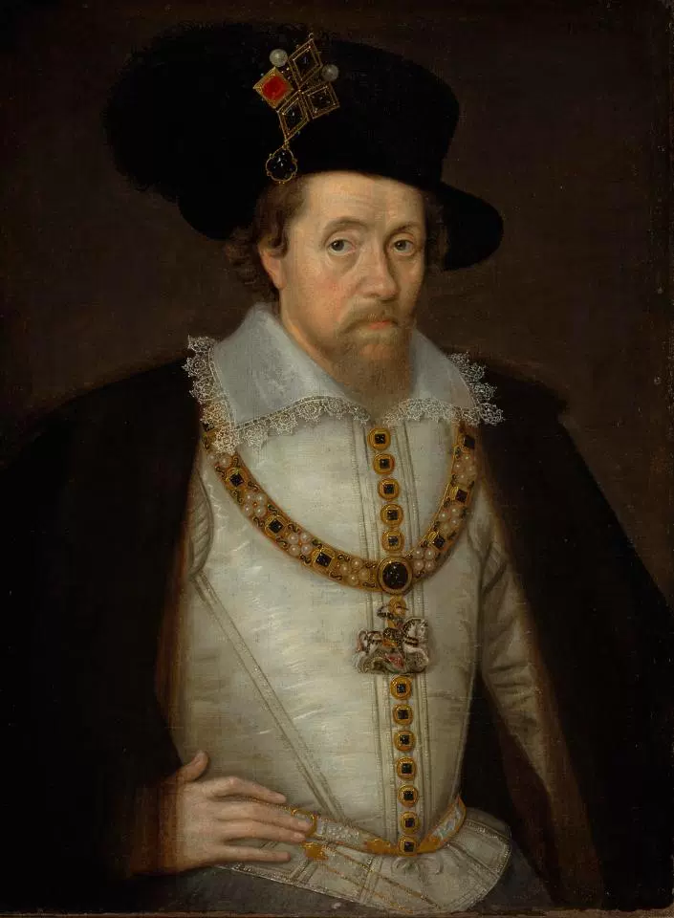
KING JAMES I
The company of William Shakespeare changed its name from The Lord Chamberlain’s men into The King’s men during James I ’ s reign
Macbeth is set in Scotland and James I was born in Scotland
In this tragedy the ancestors of James I can be identified with Banquo’s children

Slide 4
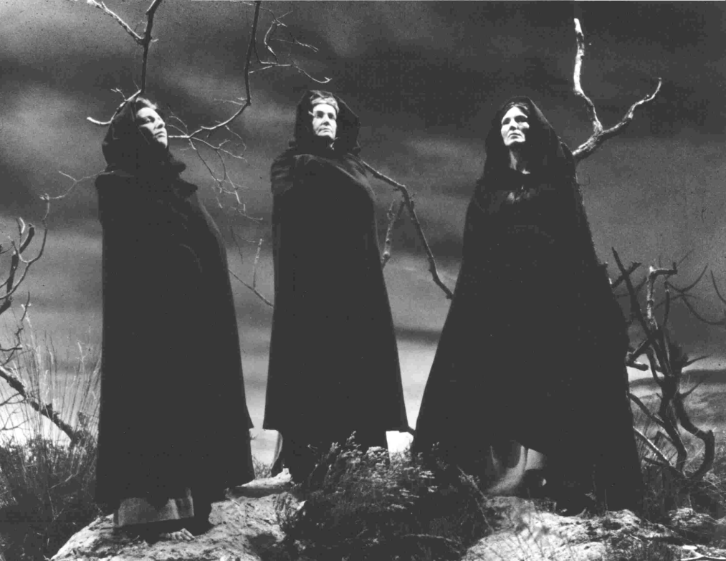
KING JAMES I
Moreover Shakespeare dealt with the themes of witchcraft and supernatural events because king James I was very interested in witchcraft and he practised it. So the theme of witchcraft is another example of flattery

Slide 5
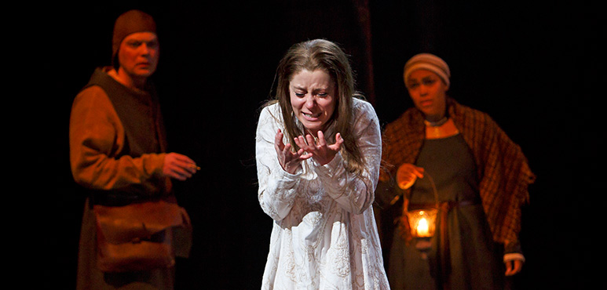
MACBETH
Macbeth is a very short tragedy and it is not even loved by companies of act0rs that perfom it, because it brings bad luck and actors avoid to repeat lines or even the title of the tragedy outside the stage.

Slide 6

THEMES
Macbeth is characterized by several themes such as:
Ambition
Witchcraft
Regicide

Slide 7
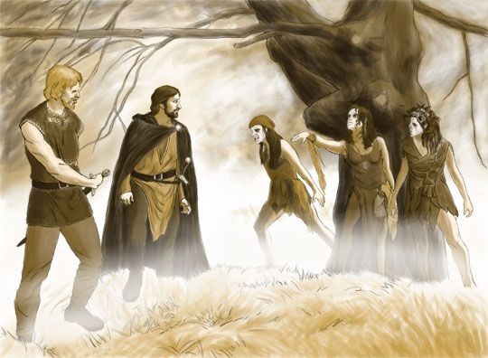
MACBETH: The plot
Macbeth is the thane of Glamis but after a battle coming back home with another thane whose name is Banquo, he meets three witches

Slide 8
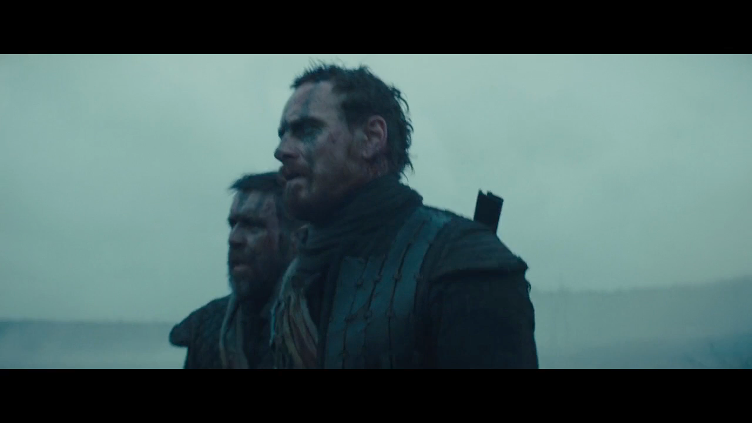
The first prophecy

Slide 9
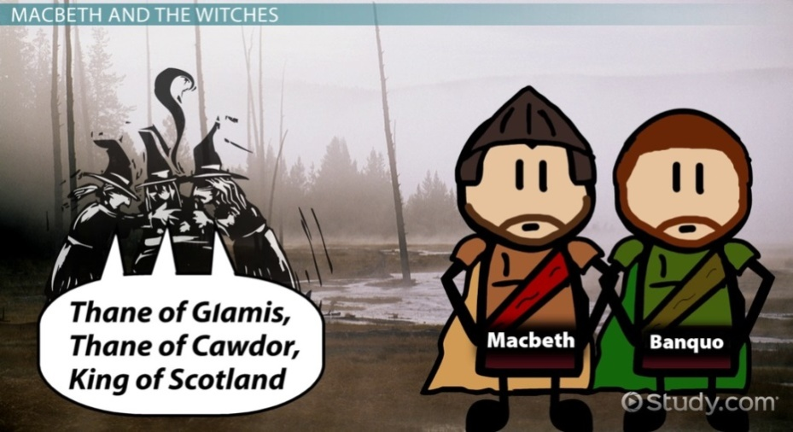
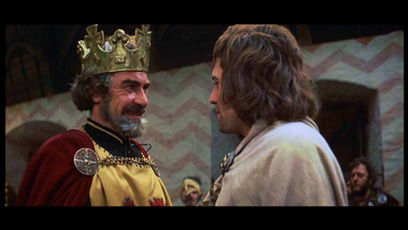
MACBETH: The plot
After the prophecy he is appointed thane of Cawdor by King Duncan. Thus Macbeth starts to believe that the prophecy may come true and that he may become king of Scotland.

Slide 10
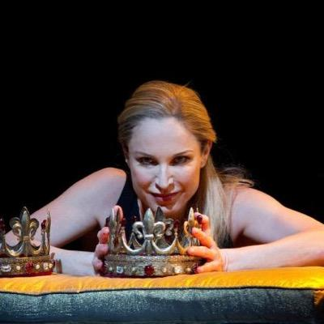
Lady Macbeth
Macbeth sends his wife a letter telling about the three witches and their prophecy . He plans with his wife the murder of king Duncan.
In the first part of tragedy Lady Macbeth is stronger and more ambitous than her husband. She stirs up Macbeth to kill the king, like Eve that led Adam to commit the original sin.

Slide 11
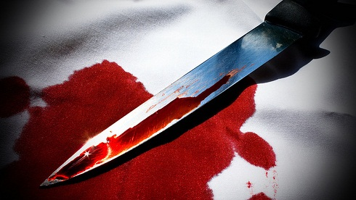

Duncan’ s murder
Lady Macbeth organises Duncan’s murder . Macbeth kills Duncan but he is worried, he is frightened by his crime and he takes his daggers with him.
He should go back to Ducan’s room and he should leave the bloody sword near Ducan’s servants but he refuses to do it His wife takes the bloody sword and puts it in the hands of the servants.

Slide 12
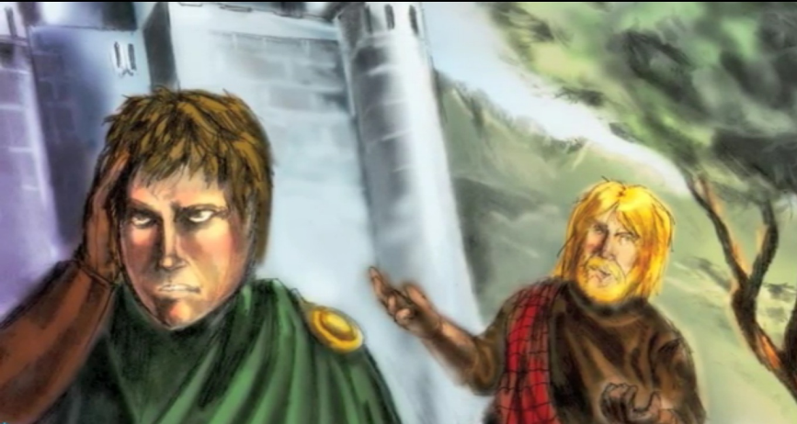
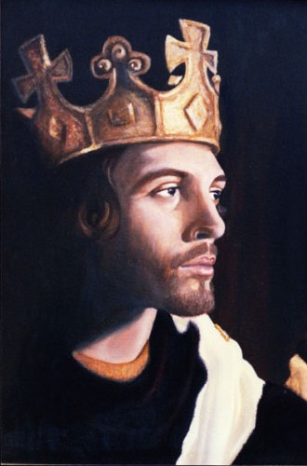
DUNCAN
Duncan has two sons: Donalbain and Malcom. They leave Scotland because they are considered guilty of their father’s murder. Thus Macbeth becomes king of Scotland and the prophecy comes true.

Slide 13
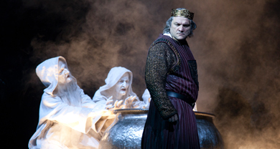
BANQUO
Macbeth is afraid of Banquo as he is the witness of the three witches ‘s prophecy.
He could suspect he has murdered the king, so he hires two killers to murder Banquo. They killed Banquo. But they didn’t kill Banquo’s son. Meanwhile there is the so-called coronation party during which Macbeth sees Banquo’s ghost and he is scared by it.

Slide 14
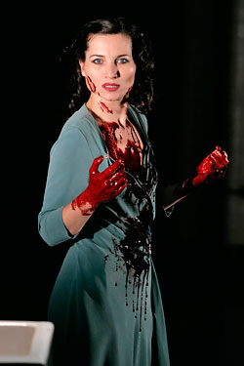
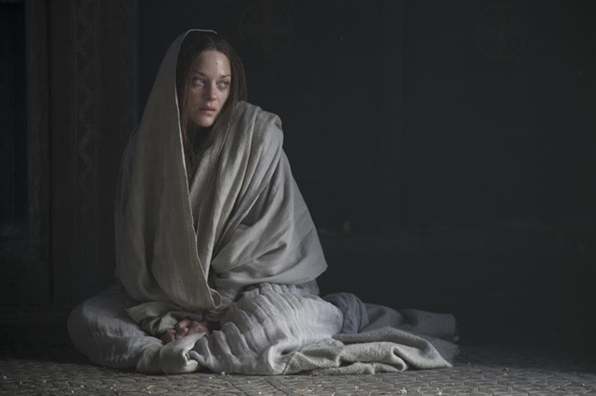
MACBETH: THE SECOND PART
In the second part of this tragedy Macbeth becomes stronger and stronger while his wife becomes weaker and weaker. She feels remorse , she can’t sleep any longer, she is a sleepwalker and she sees her hands stained with king Duncan’s blood, she becomes mad and she commits suicide

Slide 15
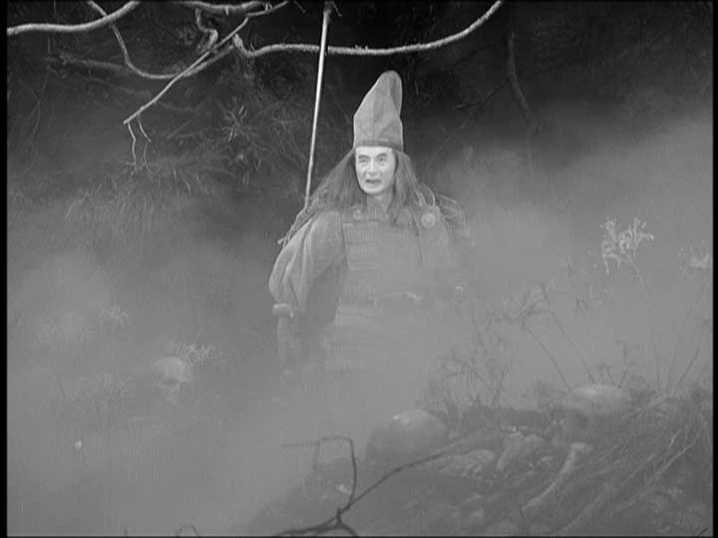
MACBETH: THE SECOND PART
Macbeth is more and more violent and ambitious . Meanwhile the thanes of Scotland doubt about his succession to the throne and join Malcom’s army against him. Macbeth goes back to the three witches and he wants them to tell him another prophecy.

Slide 16
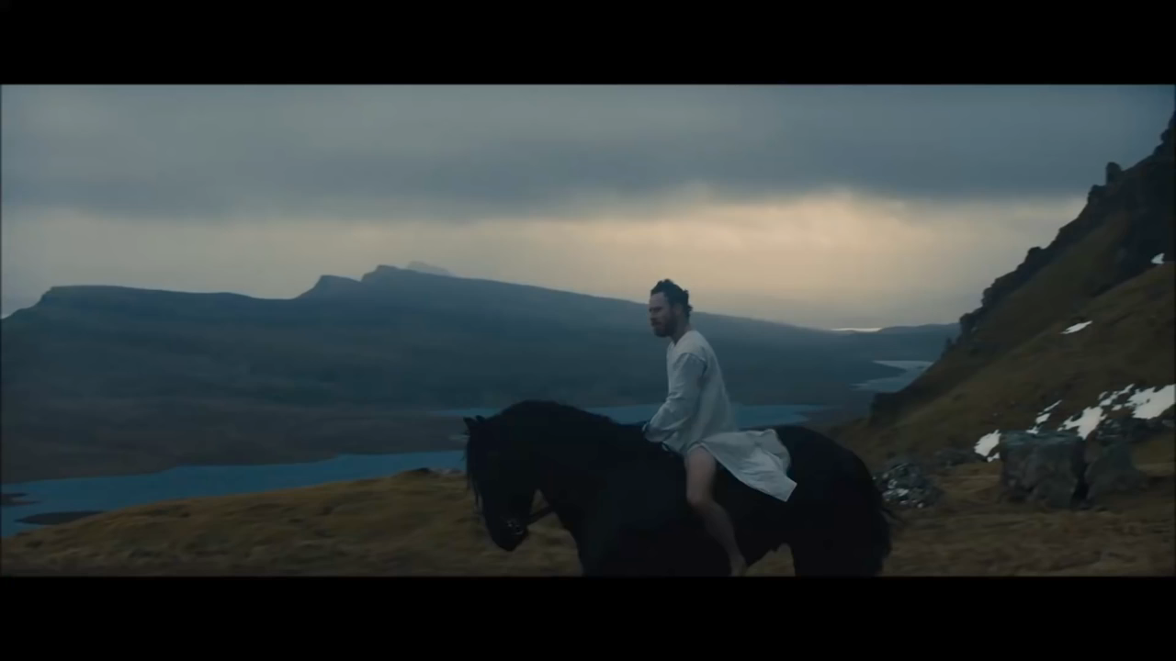
The second prophecy

Slide 17
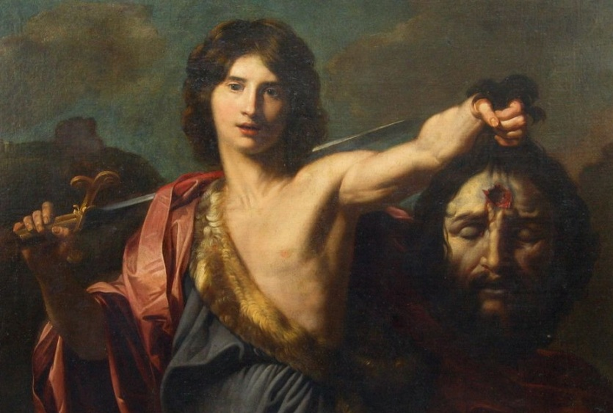
THE PROPHECY
The witches tell him that no one will kim him
if born from woman and he will never be killed until the Birnam wood will arrive at his castle

Slide 18
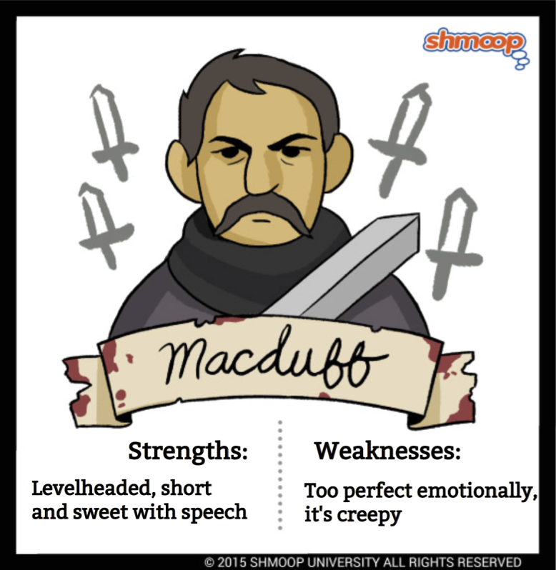
MACDUFF
Macbeth sends his soldiers to kill Macduff, another thane that is joining Malcom’s army to fight against him.
The soldiers don’t find him but they kill all his family, so Macduff must revenge it. Together with Malcolm and Donalbain they move towards Macbeth’s castle.

Slide 19
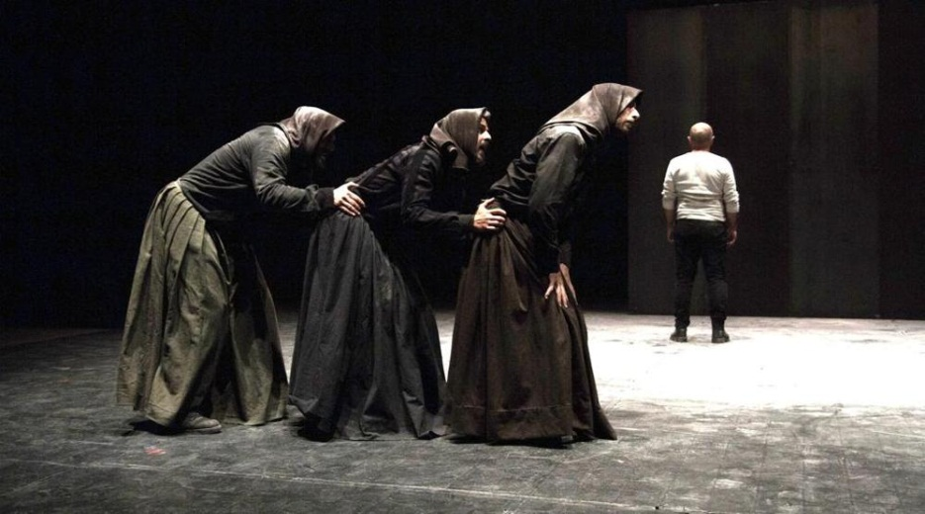
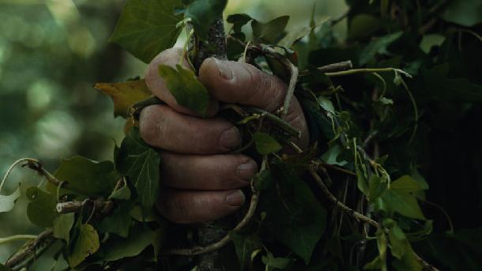
Macbeth sees from the top of his castle Macduff’s army arriving.
The soldiers have covered themselves with branches of the trees of the wood so it seems that the wood is moving towards his castle.

Slide 20
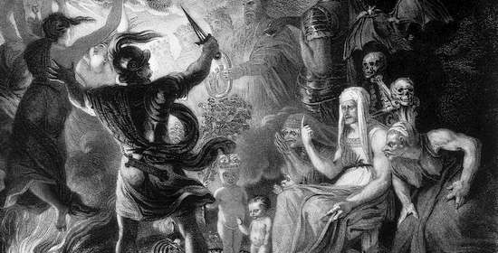

THE FINAL SCENE
Macduff wasn’t born from a woman in a natural way but with surgical instruments so, Macbeth is killed by Macduff.
Malcolm, Ducan’s son , becomes king of Scotland.

Slide 21
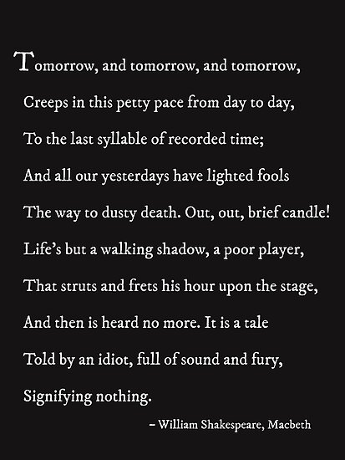
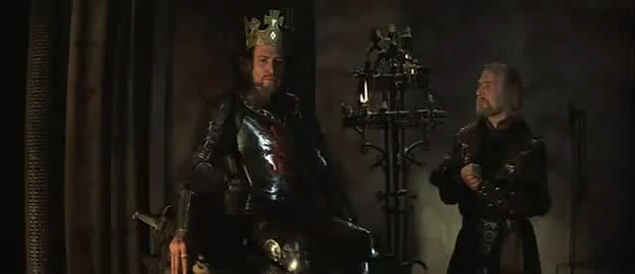
MACBETH : Tomorrow, and tomorrow, and tomorrow,

Slide 22
THE MONOLOGUE
In this soliloquy Macbeth demonstrates consistently the cold loneliness in his soul, a desolation and lack of hope in his being showing the entire trajectory of the character, who after committing the murder, goes from outrage and remorse to bitterness and gradually reaches a pathological stage of apathy
Tomorrow, and tomorrow, and tomorrow,… Life’s…It is a tale told by an idiot, full of sound and fury, Signifying nothing… Signifying nothing… Signifying nothing…

Slide 23
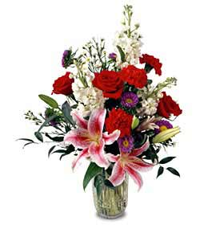

GOVT. ARTS COLLEGE, (Grade-I) ARIYALUR
DEPT. OF ENGLISH
Dr. VELUSAMY. A
Assistant Professor

