Slide 1
ENDOCRINOLOGY
THYROID HORMONE
3rd YEAR – BSc BIOCHEMISTRY
SUBJECT CODE-16SMBEBC2
ENDOCRINOLOGY (UNIT-1)
VI SEMESTER
BY
Dr.R.MOHANAMBAL
DEPT. OF BIOCHEMISTRY
GOVT. ARTS & SCIENCE COLLEGE (W)
ORATHANADU.

Slide 2
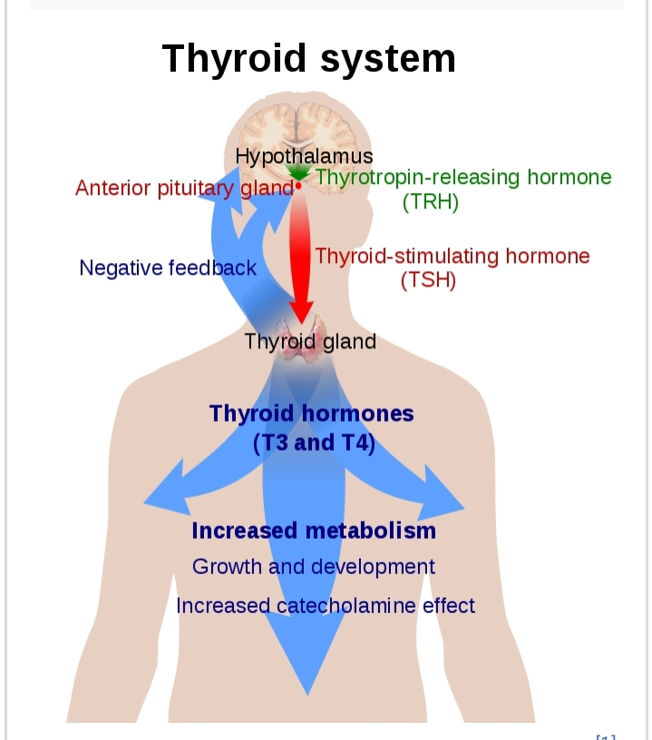

Slide 3
Definition
A chemical substance made by the thyroid gland for export into the bloodstream.
The thyroid gland needs iodine to make thyroid hormones.
Two hormones produced and released by thyroid gland , namely triiodothyronine and thyroxine.

Slide 4
They are tyrosine – based hormones that are primarily responsible for regulation of metabolism.
T3 and T4 are partially composed of iodine.

Slide 5
Classification
Thyroid gland produces two hormones:
1. Triiodothyronine (T3)
2. Tetraiodothyronine (T4 ) also called thyroxine.

Slide 6
T3
It affects almost every physiological process in the body, including growth and development , metabolism, body temperature and heart rate.

Slide 7
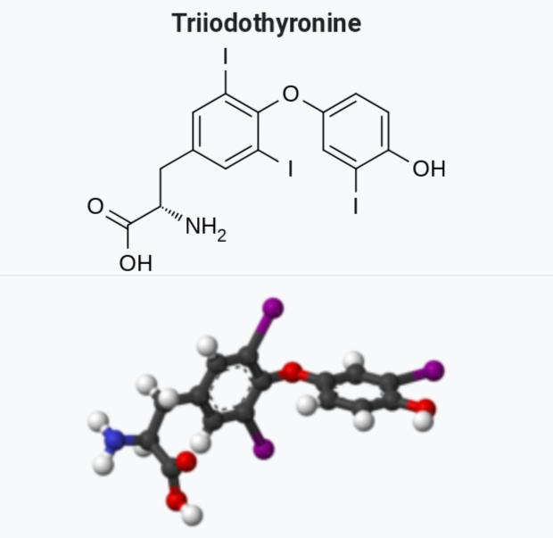

Slide 8
Thyroxin
Hormone produced by the thyroid glands to regulate metabolism by controlling the rate of oxidation in cells.
L – 3,5,5’- tetraiodothyronine increases the rate of chemical reactions in cells and helps control growth and development.
It can also be made in the laboratory and is used to treat thyroid disorders.

Slide 9
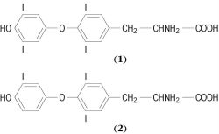

Slide 10
Biosynthesis of Thyroid hormone
Thyroid hormones are amine hormones and so their synthesis is based on the amino acid tyrosine.
The primary synthesis organ of Thyroid hormones is the thyroid gland which produces about twenty times more than T4 compared to T3 .

Slide 11
The thyroid gland is full of thyroid follicles which are the basic units of thyroid hormone synthesis.
Synthesis of thyroid hormones is a complex multi – step process .

Slide 12
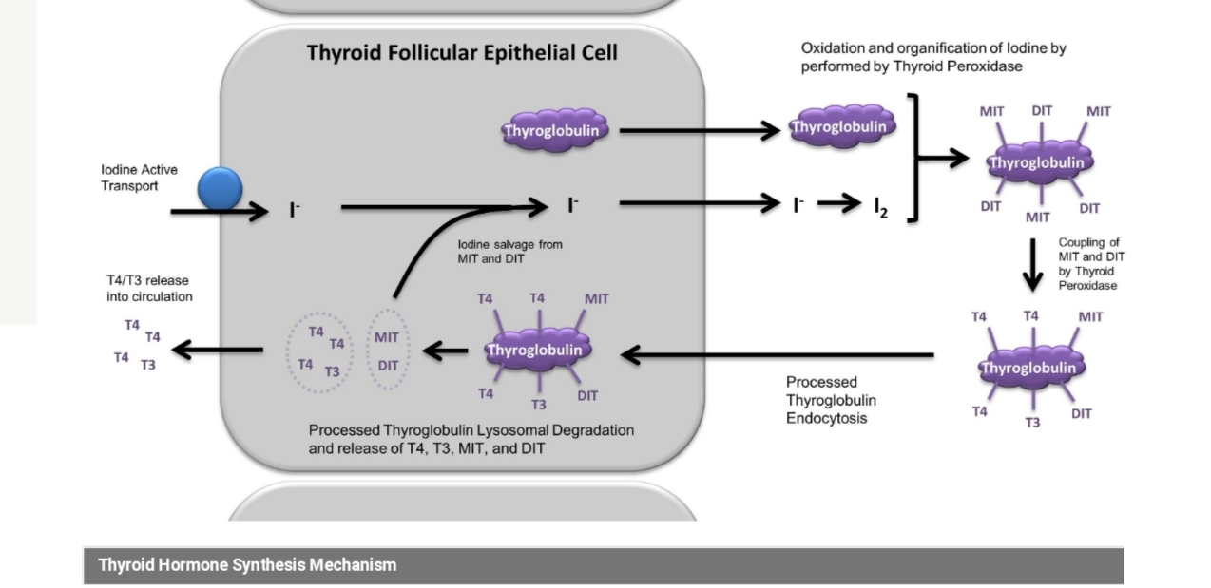

Slide 13
It involves five steps :
1) Iodide transport.
2) Thyroglobulin Synthesis .
3) Thyroid Peroxidase
4)Endocytosis of Peroxidase-processed Thyroglobulin.
5) Release of T4 and T3 from Thyroglobulin.

Slide 14
Mechanism of action of Thyroid hormone :
Thyroid hormone enters cell through membrane transportor protein .
The hormone binds its receptor to form hormone receptor complex in sequences of DNA.
The effect of the hormone – receptor complex binding to DNA is to modulate gene expression.

Slide 15
Physiological effects of Thyroid Hormones
Thyroid hormones have profound effects on many “big time” physiologic processes,such as
1)Development
2)Growth
3)Metabolism
a. Lipid metabolism
b. Carbohydrate metabolism

Slide 16
Deficiency of Thyroid hormone.
a) Hypo thyrodism – Cretinism, Myxedema and goiter.
b) Hyper thyrodism – Graves disease.

Slide 17
Thank you

