Slide 1
Fermentation Production of Penicillin and Vitamin B₁₂
III B.Sc. Biochemistry - Major Based Elective III –
Basic Biotechnology –
VI Semester - 16SMBEBC3 - Unit – 1
Presented by
Dr.S.Maneemegalai
Department of Biochemistry
Government Arts and Science College (Women)
[Formerly Bharathidasan University Constituent College for Women], Orathanadu – 614 625.

Slide 2
Penicillin
It is an antibiotic.
Produced from high yielding strains of Penicillium chrysogenum.
The high yielding strains are unstable.
They are maintained as spore suspension in sterile inert support or lyophilised in appropriate media or stored under liquid nitrogen.

Slide 3
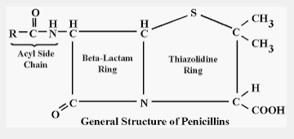
Structure of Penicillin

Slide 4
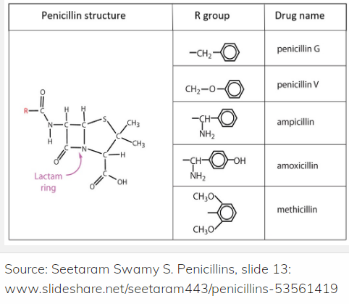

Slide 5
Requirements for production
Inoculum
Raw materials for Medium
Production
Extraction and Purification

Slide 6
Inoculum
Composition of inoculum (sporulation) medium
Glycerol – 7.5 g/l
Cane molasses – 7.5 g/l
Corn steep liquor – 2.5 g/l
Magnesium sulphate – 0.050 g/l
Potassium dihydrogen phosphate – 0.060 g/l
Peptone – 5 g/l
Sodium chloride – 4 g/l
Fe – tartrate – 0.005 g/l
Copper sulphate – 0.004 g/l
Agar – 2.5 g/l
Distilled water – 1 litre
Temperature – 24°C
Sterilized and adequate sterilized air must be supplied

Slide 7
Inoculation Method
Sodium lauryl sulphonate is used prepare a uniform of suspension of spores of high yielding Penicillium strains.
After adding the suspension to production medium, the medium is agitated and aerated.

Slide 8
Production medium
The raw materials in production medium must favour abundant growth of mycelium
Produce maximum penicillin
Easy to extract and purify penicillin.
Raw materials:
Carbon source: 6% lactose or glucose and sucrose
Nitrogen source: Ammonium salts, ammonia gas or corn steep liquor
Mineral source: Potassium, phosphorous, magnesium, sulphur, zinc and copper.
Corn steep liquor provides some minerals. They are supplied as sulphates and phospates.

Slide 9
Precursors for penicillin production:
The required penicillin is produced by the addition of phenyl acetic acid derivatives.
Eg., Penicillin G (Benzyl Penicillin)
Penicillin V (phenoxy methyl penicillin)

Slide 10
Medium for Penicillin production
Corn steep liquor solids– 3.5 %
Lactose – 3.5 %
Glucose – 1.0 %
Calcium carbonate – 1.0 %
Potassium dihydrogen phosphate – 0.4 %
Edible oil – 0.25 %
Slower addition of penicillin precursor

Slide 11
Requirements
Temperature – 25 – 26 ° C
pH - 5.5 to 6.0 ( Initially the pH remains constant and later rises to 7 to 7.5.
Time duration: 3 to 5 days
Aeration and agitation is required

Slide 12
Extraction and Purification
1. Removal of mycelium : Rotary vacuum filter is used.
2. Counter current solvent extraction : In acidified condition (pH 2 to 2.5) extraction is carried out qucikly, because penicillin is unstable at low pH.
Again extracted at pH 7 to 7.5 in aqueous solution.
3. Treatment of crude extract: Converted to penicillin salts by using sodium hydroxide.

Slide 13
Vitamin B₁₂
It is cyanocobalamin.
Cobinamide molecule linked to a nucleotide
Cobinamide having central cobalt linked to a cyanide surrounded by four reduced pyrrole ring.

Slide 14
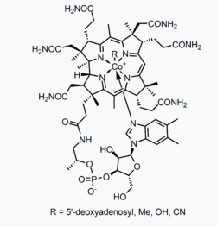
Structure of Vitamin B₁₂

Slide 15
Fermentation Production
It requires
1. Microorganisms
2. Inoculum preparation
3. Medium (sterilized)
4. Required production condition
5. Recovery
Mostly conducted by submerged culture method

Slide 16
Microorganisms
Streptomyces olivaceus NRRL B-1125 commonly used.
Other microorganisms: Streptomyces griseus, Bacillus megaterium, Bacillus coagulans, Pseudomonas denitrificans, Propionibacterium freudenreichii, Pseudomonas denitrificans

Slide 17
Inoculum Preparation
Inoculum medium (composition)
1. Yeast extract – 1.0 g/l
2. Beef extract – 1.0 g/l
3. Enzymatic hydrolysate of casein – 2.0 g/l
4. Glucose – 10 g/l
5. Agar – 15 g/l
6. Distilled water (pH 7.3) – 1 litre

Slide 18
Inoculum preparation
Pure agar slant culture of S. olivaceus NRRL B – 1125 is inoculated in 250 ml of inoculation medium in a Erlenmeyer flask.
It is placed on a mechanical shaker for aeration during incubation.
Inoculum is produced to a 5% volume of production medium.

Slide 19
Production medium
It contains carbohydrate, proteins, cobalt and other salts.
Medium composition
Distillers soluble – 4 g/100ml
Dextrose – 0.5 – 1.0 g/100ml
CaCO3 – 0.5 g/100ml
Cobalt chloride – 1.5 – 10 ppm
pH – 7.0
The medium is sterilized by heating at 250°F for 1 hour or by live steam at 330°F for 13 minutes

Slide 20
Optimum conditions
Temperature : 80°F
pH: It reduces in the first 24h and after 2 to 4 days rises.
Aeration and agitation: Optimum aeration and correct agitation is required.
Sterilized air : 0.5volume air/minute/volume medium
Antifoam agent: Sterilized soya bean oil or corn oil or lard oil are added to prevent foam formation.
Sterile condition to be maintained to get an optimum yield.
Yield: 1-2 mg/litre

Slide 21
Recovery of Vitamin B₁₂
Most of the cobalamin is associated with mycelium, it is boiled at pH 5 to liberate from mycelium.
Filtered to remove mycelium
Treated with cyanide to convert to cyanocobalamin
Cyanocobalamin is adsorbed to adsorbent columns packed with adsorbent such as activated charcoal.
Eluted and extracted.
Evaporated and dried
Yield: 10 – 30mg/lb

Slide 22
References
Text books
Industrial Microbiology – L.E.Casida, Jr,
Industrial Microbiology – A.H. Patel
Internet sources

