Slide 1
CAPITAL MARKETS
IN
INVESTMENT MANAGEMENT
Presented by
Mrs. M. Julie
Asst. Prof of Commerce
Auxilium college of arts and science
Regunathapuram.

Slide 2
CAPITAL MARKET refer to the places where savings and investments are moved between suppliers of capital and those who are in need of capital. Capital markets consist of the primary market, where new securities are issued and sold, and the secondary market, where already-issued securities are traded between investors.
DEFINITION
Capital market is a market where buyers and sellers engage in trade of financial securities like bonds, stocks, etc. The buying/selling is undertaken by participants such as individuals and institutions.

Slide 3
CAPITAL MARKETS
PRIMARY MARKET
SECONDARY MARKET

Slide 4
PRIMARY MARKET
may also be called the New Issue Market (NIM). In the primary market, securities are directly issued by companies to investors. Securities are issued either by an Initial Public Offer (IPO) ... Similarly, an FPO is a process by which already listed companies offer fresh equity in the company.
What is the Primary Market?
The Primary Market is the financial market where new securities are issued and become available for trading by individuals and institutions. The trading activities of the capital markets are separated into the primary market and secondary market.

Slide 5
RAISING FUNDS FROM THE PRIMARY MARKET
PUBLIC ISSUE
The most common way to issue securities to the general public. Through an IPO, the company is able to raise funds. The securities are listed on a stock exchange for trading purposes.
2. RIGHTS ISSUE
A company wants to raise more capital from existing shareholders, it may offer the shareholders more shares at a price discounted from the prevailing market price. The number of shares offered is on a pro-rata basis. This process is known as a Rights Issue.
3. PREFERENTIAL ALLOTMENT
When a listed company issues shares to a few individuals at a price that may or may not be related to the market price, it is termed a preferential allotment. The company decides the basis of allotment and it is not dependent on any mechanism such as pro-rata or anything else.

Slide 6
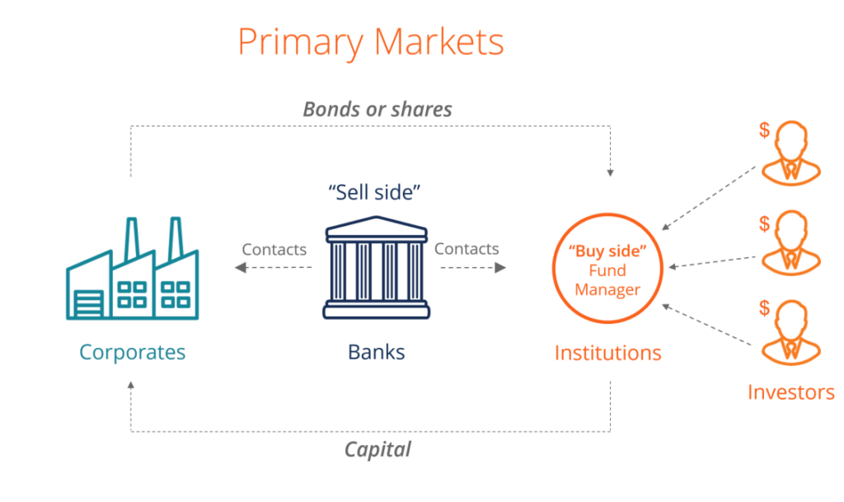

Slide 7
SECONDARY MARKET
The secondary market is where existing shares, debentures, bonds, etc. are traded among investors. Securities that are offered first in the primary market are thereafter traded on the secondary market. The trade is carried out between a buyer and a seller, with the stock exchange facilitating the transaction. In this process, the issuing company is not involved in the sale of their securities.

Slide 9
Primary Market vs. Secondary Market
PRIMARY MARKET | SECONDARY MARKET
It is a way of issuing fresh shares in the market. It is also called New Issue Market. A major component of the primary market is the IPO. | It is a place where already issued or existing shares are traded. It is called After Issue Market.
The amount received from the issue of shares goes to the company for their business expansion purposes. | The amount invested by the buyer of shares goes to the seller, and hence the company doesn’t receive anything.
Securities are issued by the companies to the investors. | Securities are exchanged between buyers and sellers, and stock exchanges facilitates the trade.
The securities are all issued at one price for all investors participating in the offering. | Securities are exchanged at the market price.
The primary market doesn’t provide liquidity for the stock. | The secondary market provides liquidity to the stock.
Underwriters act as intermediaries. | Brokers act as intermediaries.
On the primary market, security can be sold just once. | On the secondary market, securities can be sold innumerable times.

Slide 10
THANK YOU

