Slide 1
Programming in C++
By
M.Juno Isabel Susinthra,
Asst.Professor of B.C.A,
Annai Vailankanni College of Arts and Science ,Thanjavur

Slide 2
Unit-IV
CONTENTS:
Managing I/O Operations
Working with Files
Templates
Exception Handling

Slide 3
1.Managing I/O Operations
C++ Streams
The C++ I/O system operates through streams. A stream is logical device that either produces the same or consumes the different information. A stream is linked to a physical device by the C++ I/O system. All streams behave in the same manner, even if the actual physical devices are linked to several devices. As all streams act the same, the I/O system links the programmer with a uniform interface.

Slide 4
Types of streams
Output stream: If a stream takes data from the program and sends (writes) to the destination.
Input stream: If a stream that gets (reads) data from the source and sends to the program.

Slide 5
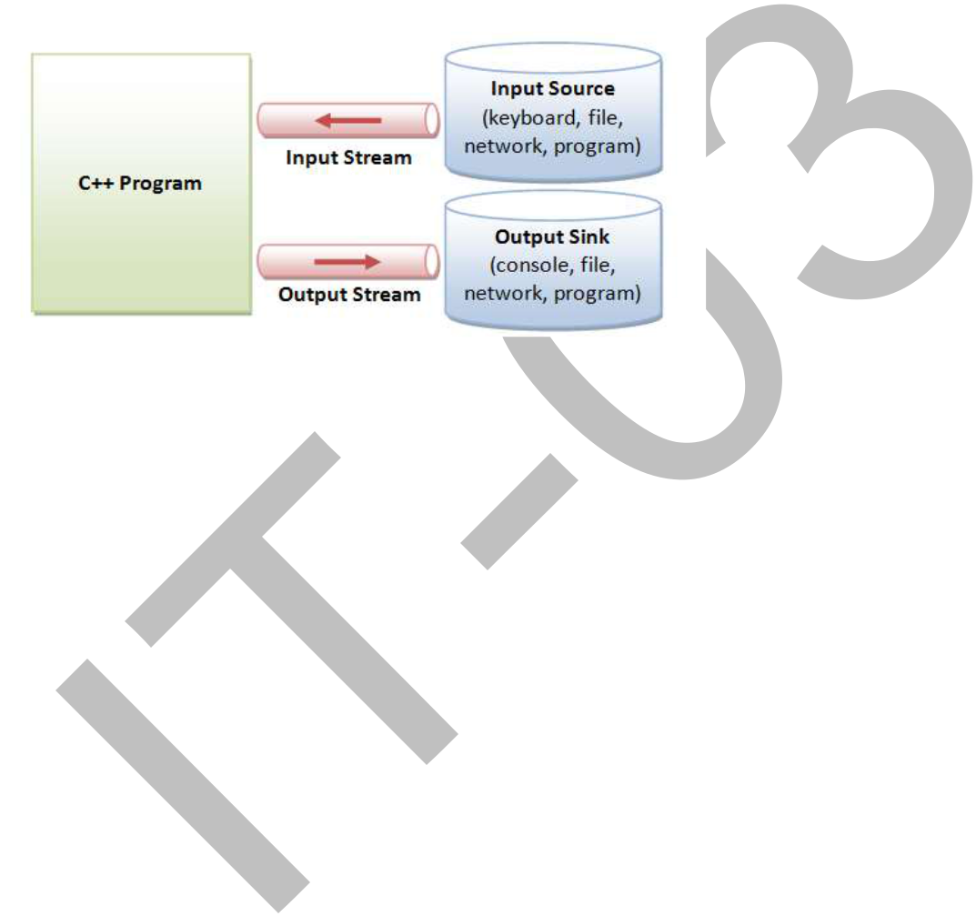

Slide 6
Class istream :- Defines input streams that can be used to carry out formatted and unformatted input operations. It contains the overloaded extraction (>>) operator functions. Declares input functions such get(), getline() and read().
Class ostream :- Defines output streams that can be used to write data. Declares output functions put and write().The ostream class contains the overloaded insertion (<<) operator function

Slide 7
Cin and Cout objects
Cin -is a predefined object that corresponds to the standard input stream. The standard input stream represents keyboard.
EX:
cin >> name;
char name;
Cout is a predefined object that represents the standard output stream in C. The << operator is referred to as the insertion operator.
Ex:
cout << “Programming in C++”;

Slide 8
Functions get and put:
There are two prototypes available in C++ for get as given below:
get (char *)
get ()
EX:
char ch ; AND cin.get (ch);
PUT has two forms as given below:
cout.put (var);
Here the value of the variable var will be displayed in the console monitor.User can also display a specific character directly as given below:
cout.put (var); AND cout.put (‘a’);

Slide 9
2. Working with Files
A file is a bunch of bytes stored on some storage devices like hard disk, floppy disk etc. File I/O and console I/O are closely related.
To create an input stream, declare an object of type ifstream.
To create an output stream, declare an object of type ofstream.
To create an input/output stream, declare an object of type fstream.

Slide 10
ifstream in; // input;
fstream out; // output;
fstream io; // input and output
EX:
void ifstream::open(const char*filename,openmode mode=ios::in);
void ofstream::open(const char*filename,openmode mode=ios::out | ios::trunc);
void fstream::open(const char*filename,openmode mode=ios::in | ios::out);

Slide 11
Opening File and Closing File:
Opening a File:
myfile.open ("example.bin", ios::out | ios::app | ios::binary);
Each of the open member functions of classes ofstream, ifstream and fstream has a default mode that is used if the file is opened without a second argument.
Closing a File:
myfile.close();

Slide 12
//To demonstrate writing and reading- using open
#include<fstream.>
#include<iostream>
int main(){ //Writing
ofstream outf;
outf.open(“Temp2.txt”);
outf<<“Working with files is fun\n”;
outf<<“Writing to files is also fun\n”;
outf.close();
char buff[80];
ifstream inf;
inf.open(“Temp2.txt”); //Reading
while(inf){
inf.getline(buff, 80);
cout<<buff<<“\n”;
}
inf.close();
return 0;}

Slide 13
3.Templates
Templates are very useful when implementing generic constructs like vectors, stacks, lists, queues which can be used with any arbitrary type.
C++ provides two kinds of templates: class templates and function templates.
Syntax:
template <class T>
T someFunction(T arg)
{
... .. ...
}
A class template is a class definition, except it is prefixed by the keyword template.

Slide 14
#include <iostream> using namespace std;
template <class T>
class Calculator
{
private: T num1, num2;
public: Calculator(T n1, T n2) { num1 = n1; num2 = n2;
}
void displayResult()
{
cout << "Numbers are: " << num1 << " and " << num2 << "." << endl;
cout << "Addition is: " << add() << endl; cout << "Subtraction is: " << subtract() << endl;
cout << "Product is: " << multiply() << endl; cout << "Division is: " << divide() << endl;
}
T add()
{ return num1 + num2; }
T subtract() { return num1 - num2; }
T multiply() { return num1 * num2; }
T divide() { return num1 / num2; } };

Slide 15
int main()
{ Calculator<int> intCalc(2, 1);
Calculator<float> floatCalc(2.4, 1.2);
cout << "Int results:" << endl;
intCalc.displayResult();
cout << endl << "Float results:" << endl; floatCalc.displayResult();
return 0;
}
O/P
int results: Numbers are: 2 and 1.
Addition is: 3
Subtraction is: 1
Product is: 2
Division is: 2

Slide 16
Function templates
#include <iostream> using namespace std ; //max returns the maximum of the two elements
template <class T>
T max(T a, T b)
{ return a > b ? a : b ; }
void main()
{ cout << "max(10, 15) = " << max(10, 15) << endl ;
cout << "max('k', 's') = " << max('k', 's') << endl ;
cout << "max(10.1, 15.2) = " << max(10.1, 15.2) << endl ;
}
Program Output
max(10, 15) = 15
max('k', 's') = s
max(10.1, 15.2) = 15.2

Slide 17
4. Exception Handling
Exceptions provide a way to react to exceptional circumstances (like runtime errors) in programs by transferring control to special functions called handlers.
EX:
// exceptions
#include <iostream>
using namespace std;
int main ()
{ try { throw 20; }
catch (int e)
{
cout << "An exception occurred. Exception Nr. " << e << '\n';
}
return 0;
}
A throw expression accepts one parameter (in this case the integer value 20), which is passed as an argument to the exception handler.

