Slide 1
Hydrogen bond

Slide 2
Hydrogen bond
When hydrogen atom lies between two atoms strong electronegatives, it shows an unique property of forming a bond between the two electronegative atoms.
One is held by a covalent bond and the other by an electrostatic force.
This electrostatic force is called the hydrogen bond.
Hydrogen bond is usually indicated by dotted lines.
hydrogen bond may be reperesented by the general formuls A-H…….B.

Slide 3
Conditions for hydrogen bond
Both atoms A & B which are bridged by hydrogen must be highly electronegative elements.
Small in size.
Must have a lone pair of electrons
Hydrogen bond is seen only compounds of fluorine, oxygen and nitrogen.

Slide 4
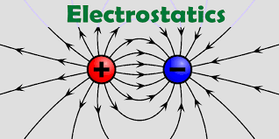
Nature of hydrogen bonding
Hydrogen bond is
electrostatic in nature.
Hydrogen fluroide.
H-F …………H-F
Hydrogen bond is much weaker than a normal covalent bond. The strength of hydrogen bond has been found to vary between 2-10k.cal.per mole. Covalent bond 100k.cals.per mole.

Slide 5
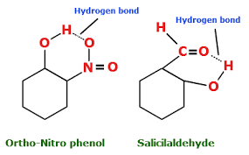
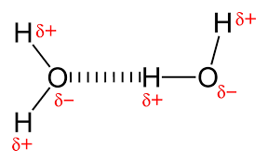
Types of hydrogen bond
Inter molecular hydrogen bond
Intra molecular hydrogen bond
Formed between atoms with different molecule
Leads to molecular association
This results in increase in the boiling point or melting point.
Formed between atoms within the same molecule
Does not lead to molecular association
Have low boiling point and melting point.

Slide 6
Effect of properties
Abnormal boiling points
Density of ice is less than that of water
(the orientation of hydrogen bonds causes molecules to push farther apart, which lowers the density.)
3. P-nitrophenols higher boiling point than o-nitrophenol.
4. The second dissociation constant is lesser than the first dissociation constant in maleic acid while both are same for fumaric acid.
5. Solubility of organic compounds
6. Biological process

Slide 7
Solubility of organic compounds
Organic compounds are generally insoluble in water
Lower alcohols acids and sugars etc are soluble in water. Due to hydrogen bonding.
As a rule, if a compound is capable of forming hydrogen bond with water, it dissolves in water.

Slide 8
Biological process
One stage to other
Enzyme action
Muscle action which is rapid and reversible
Contraction is due to the formation of hydrogen bond and relaxation is breaking of hydrogen bond.
Memory – regular hydrogen bonds in the brain

