Slide 1
DATABASE SYTEMS
UNIT II
Dr.S.Chitra,
Assistant Professor,
Department of Computer Science,
Annai Vailankanni Arts and Science College,Thanjavur

Slide 2
Outline
Structure of Relational Databases
Database Schema
Keys
Schema Diagrams
Relational Query Languages
The Relational Algebra
Notes:
1

Slide 3
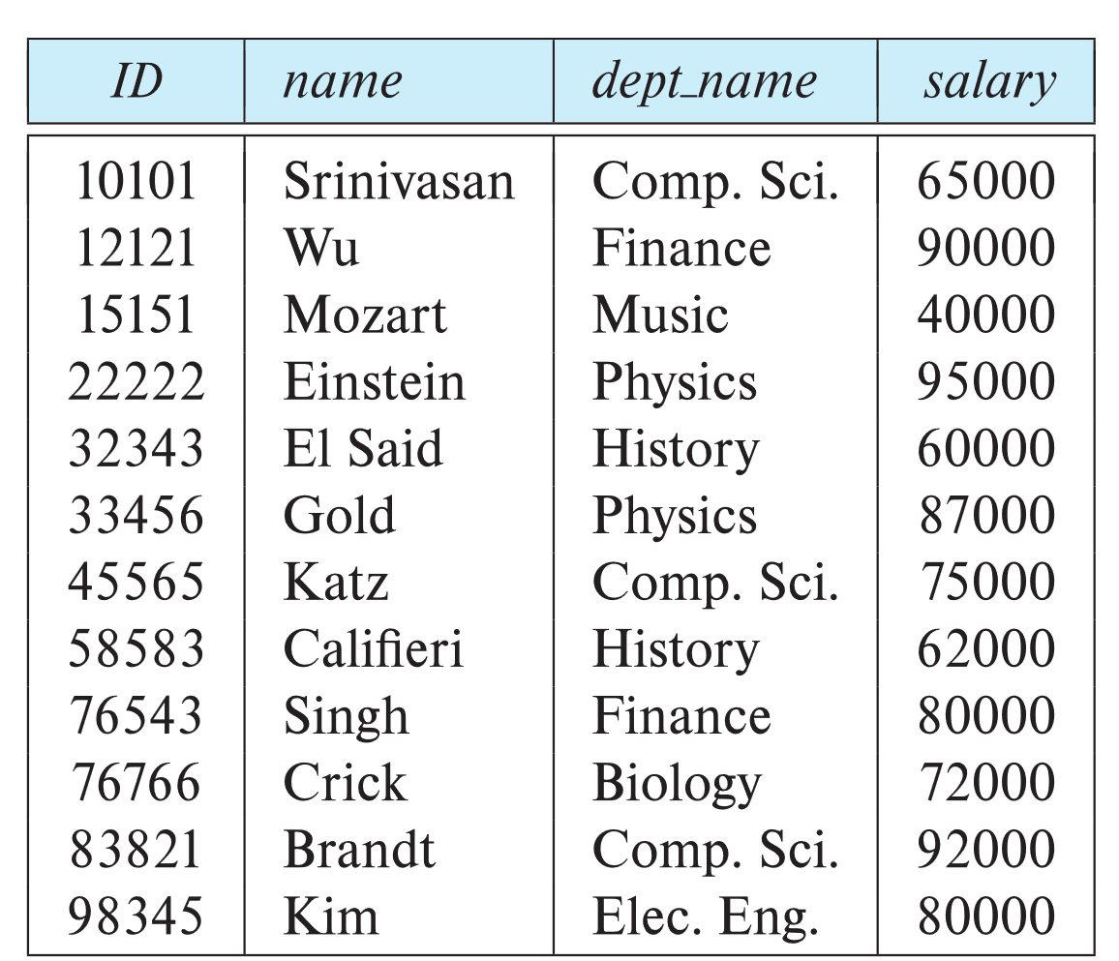
Example of a Instructor Relation
attributes
(or columns)
tuples
(or rows)

Slide 4
Relation Schema and Instance
A₁, A₂, …, A_{n} are attributes
R = (A₁, A₂, …, A_{n} ) is a relation schema
Example:
instructor = (ID, name, dept_name, salary)
A relation instance r defined over schema R is denoted by r (R).
The current values a relation are specified by a table
An element t of relation r is called a tuple and is represented by a row in a table
Notes:
1

Slide 5
Attributes
The set of allowed values for each attribute is called the domain of the attribute
Attribute values are (normally) required to be atomic; that is, indivisible
The special value null is a member of every domain. Indicated that the value is “unknown”
The null value causes complications in the definition of many operations

Slide 6
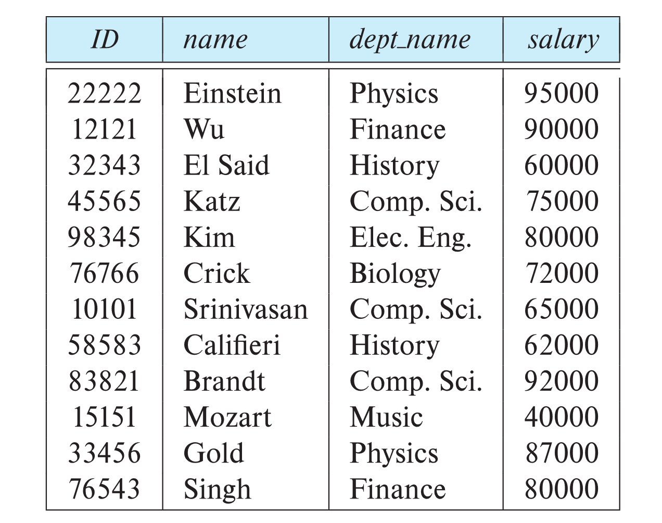
Relations are Unordered
Order of tuples is irrelevant (tuples may be stored in an arbitrary order)
Example: instructor relation with unordered tuples

Slide 7
Database Schema
Database schema -- is the logical structure of the database.
Database instance -- is a snapshot of the data in the database at a given instant in time.
Example:
  schema: instructor (ID, name, dept_name, salary)
  Instance:

Slide 8
Keys
Let K ⊆ R
K is a superkey of R if values for K are sufficient to identify a unique tuple of each possible relation r(R)
  Example: {ID} and {ID,name} are both superkeys of instructor.
Superkey K is a candidate key if K is minimal
Example: {ID} is a candidate key for Instructor
One of the candidate keys is selected to be the primary key.
  Which one?
Foreign key constraint: Value in one relation must appear in another
  Referencing relation
  Referenced relation
  Example: dept_name in instructor is a foreign key from instructor referencing department

Slide 9
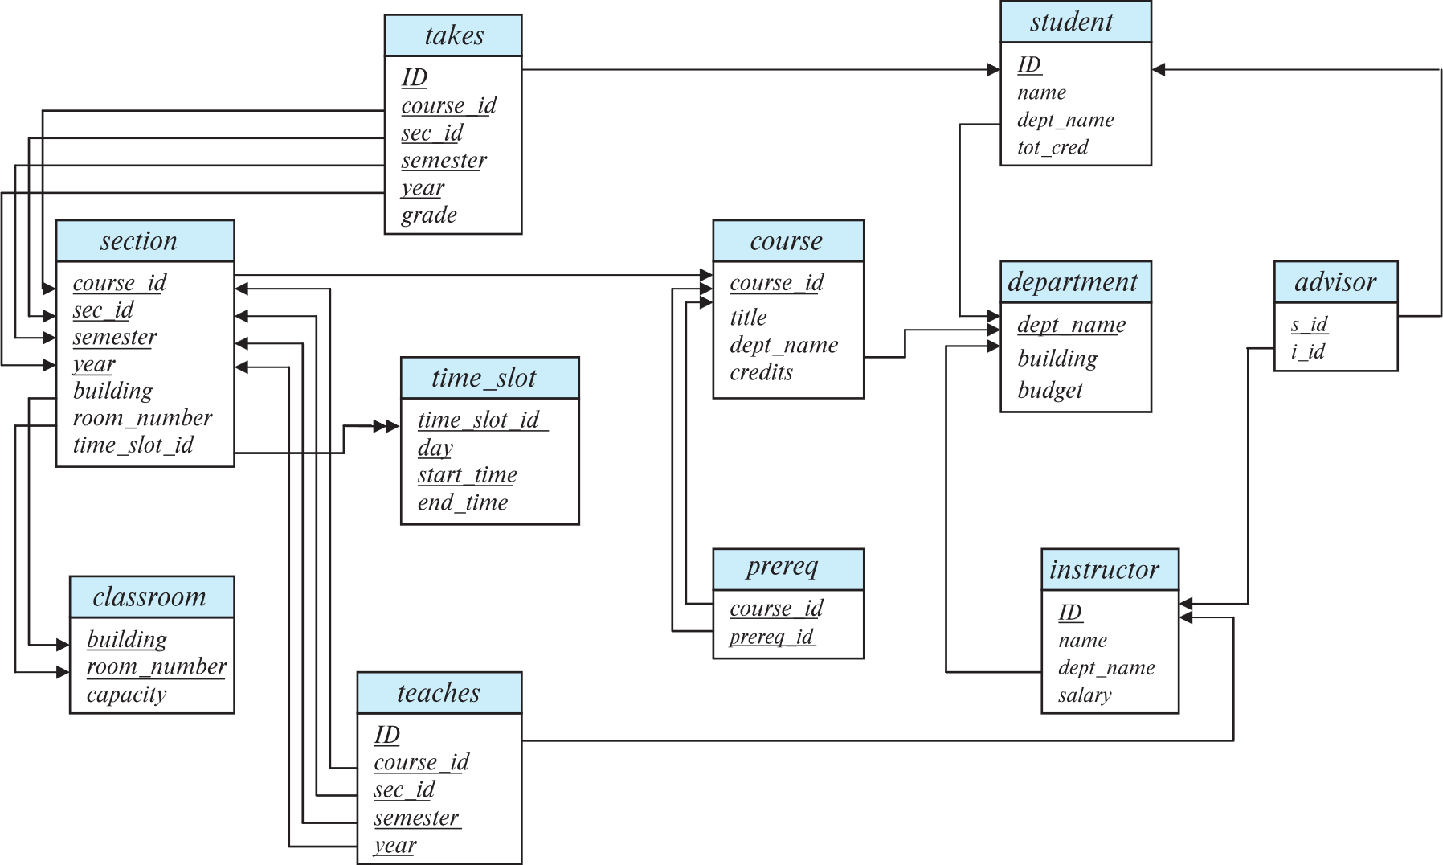
Schema Diagram for University Database

Slide 10
Relational Query Languages
Procedural versus non-procedural, or declarative
“Pure” languages:
  Relational algebra
  Tuple relational calculus
  Domain relational calculus
The above 3 pure languages are equivalent in computing power
Consists of 6 basic operations

Slide 11
Relational Algebra
A procedural language consisting of a set of operations that take one or two relations as input and produce a new relation as their result.
Six basic operators
  select: σ
  project: ∏
  union: ∪
  set difference: –
  Cartesian product: x
  rename: ρ

Slide 12
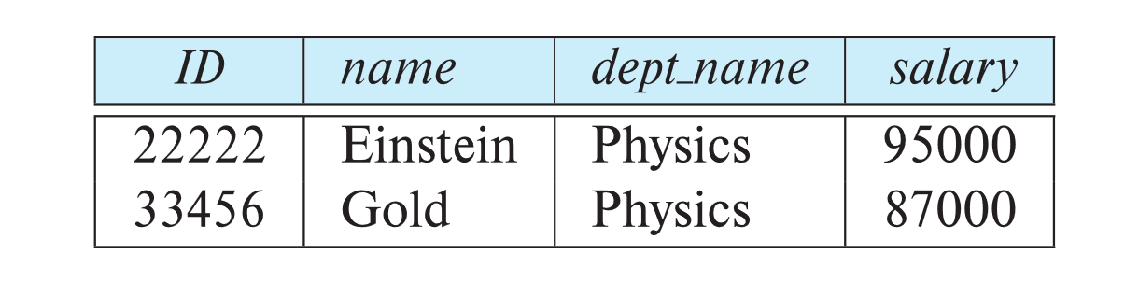
Select Operation
The select operation selects tuples that satisfy a given predicate.
Notation: σ _{p} (r)
p is called the selection predicate
Example: select those tuples of the instructor relation where the instructor is in the “Physics” department.
  Query
  σ _{dept_name=“Physics”} (instructor)
  Result

Slide 13
Select Operation (Cont.)
It allow comparisons using
=, ≠, >, ≥. <. ≤
in the selection predicate.
It can combine several predicates into a larger predicate by using the connectives:
∧ (and), ∨ (or), ¬ (not)
Example: Find the instructors in Physics with a salary greater $90,000, we write:
σ _{dept_name=“Physics”} ∧ _{salary >} _{90,000} (instructor)
The select predicate may include comparisons between two attributes.
  Example, find all departments whose name is the same as their building name:
  σ _{dept_name=building} (department)

Slide 14
Project Operation
A unary operation that returns its argument relation, with certain attributes left out.
Notation:
∏ _{A1,A2,A3 ….Ak} (r)
where A₁, A₂, …, A_{k} are attribute names and r is a relation name.
The result is defined as the relation of k columns obtained by erasing the columns that are not listed
Duplicate rows removed from result, since relations are sets

Slide 15
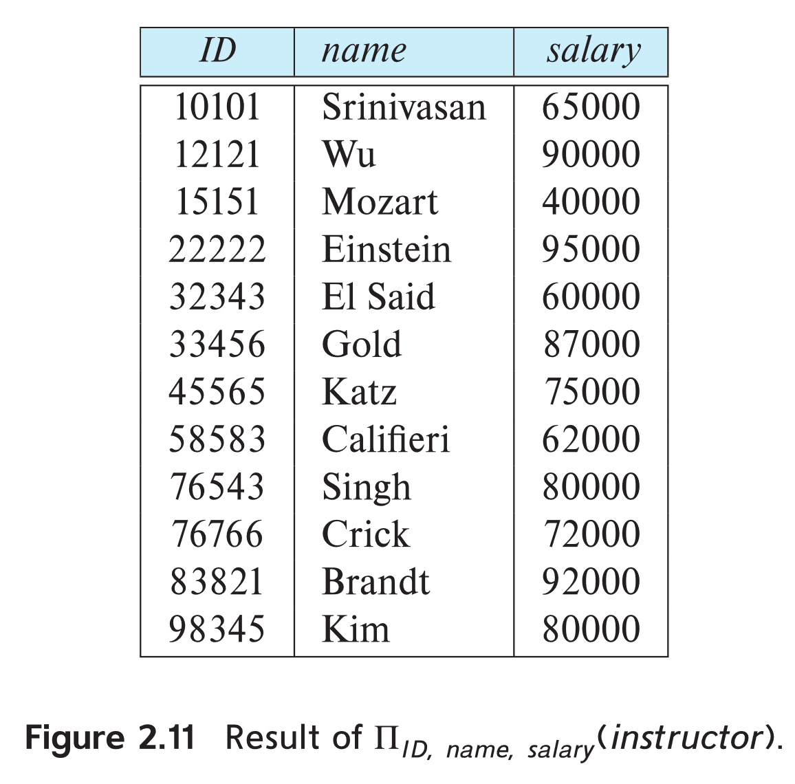
Project Operation Example
Example: eliminate the dept_name attribute of instructor
Query:
∏_{ID, name, salary} (instructor)
Result:

Slide 16
Composition of Relational Operations
The result of a relational-algebra operation is relation and therefore of relational-algebra operations can be composed together into a relational-algebra expression.
Consider the query -- Find the names of all instructors in the Physics department.
∏_{name}(σ _{dept_name} _{=“Physics”} (instructor))
Instead of giving the name of a relation as the argument of the projection operation, we give an expression that evaluates to a relation.

Slide 17
Cartesian-Product Operation
The Cartesian-product operation (denoted by X) allows us to combine information from any two relations.
Example: the Cartesian product of the relations instructor and teaches is written as:
instructor X teaches
We construct a tuple of the result out of each possible pair of tuples: one from the instructor relation and one from the teaches relation (see next slide)
Since the instructor ID appears in both relations we distinguish between these attribute by attaching to the attribute the name of the relation from which the attribute originally came.
  instructor.ID
  teaches.ID

Slide 18
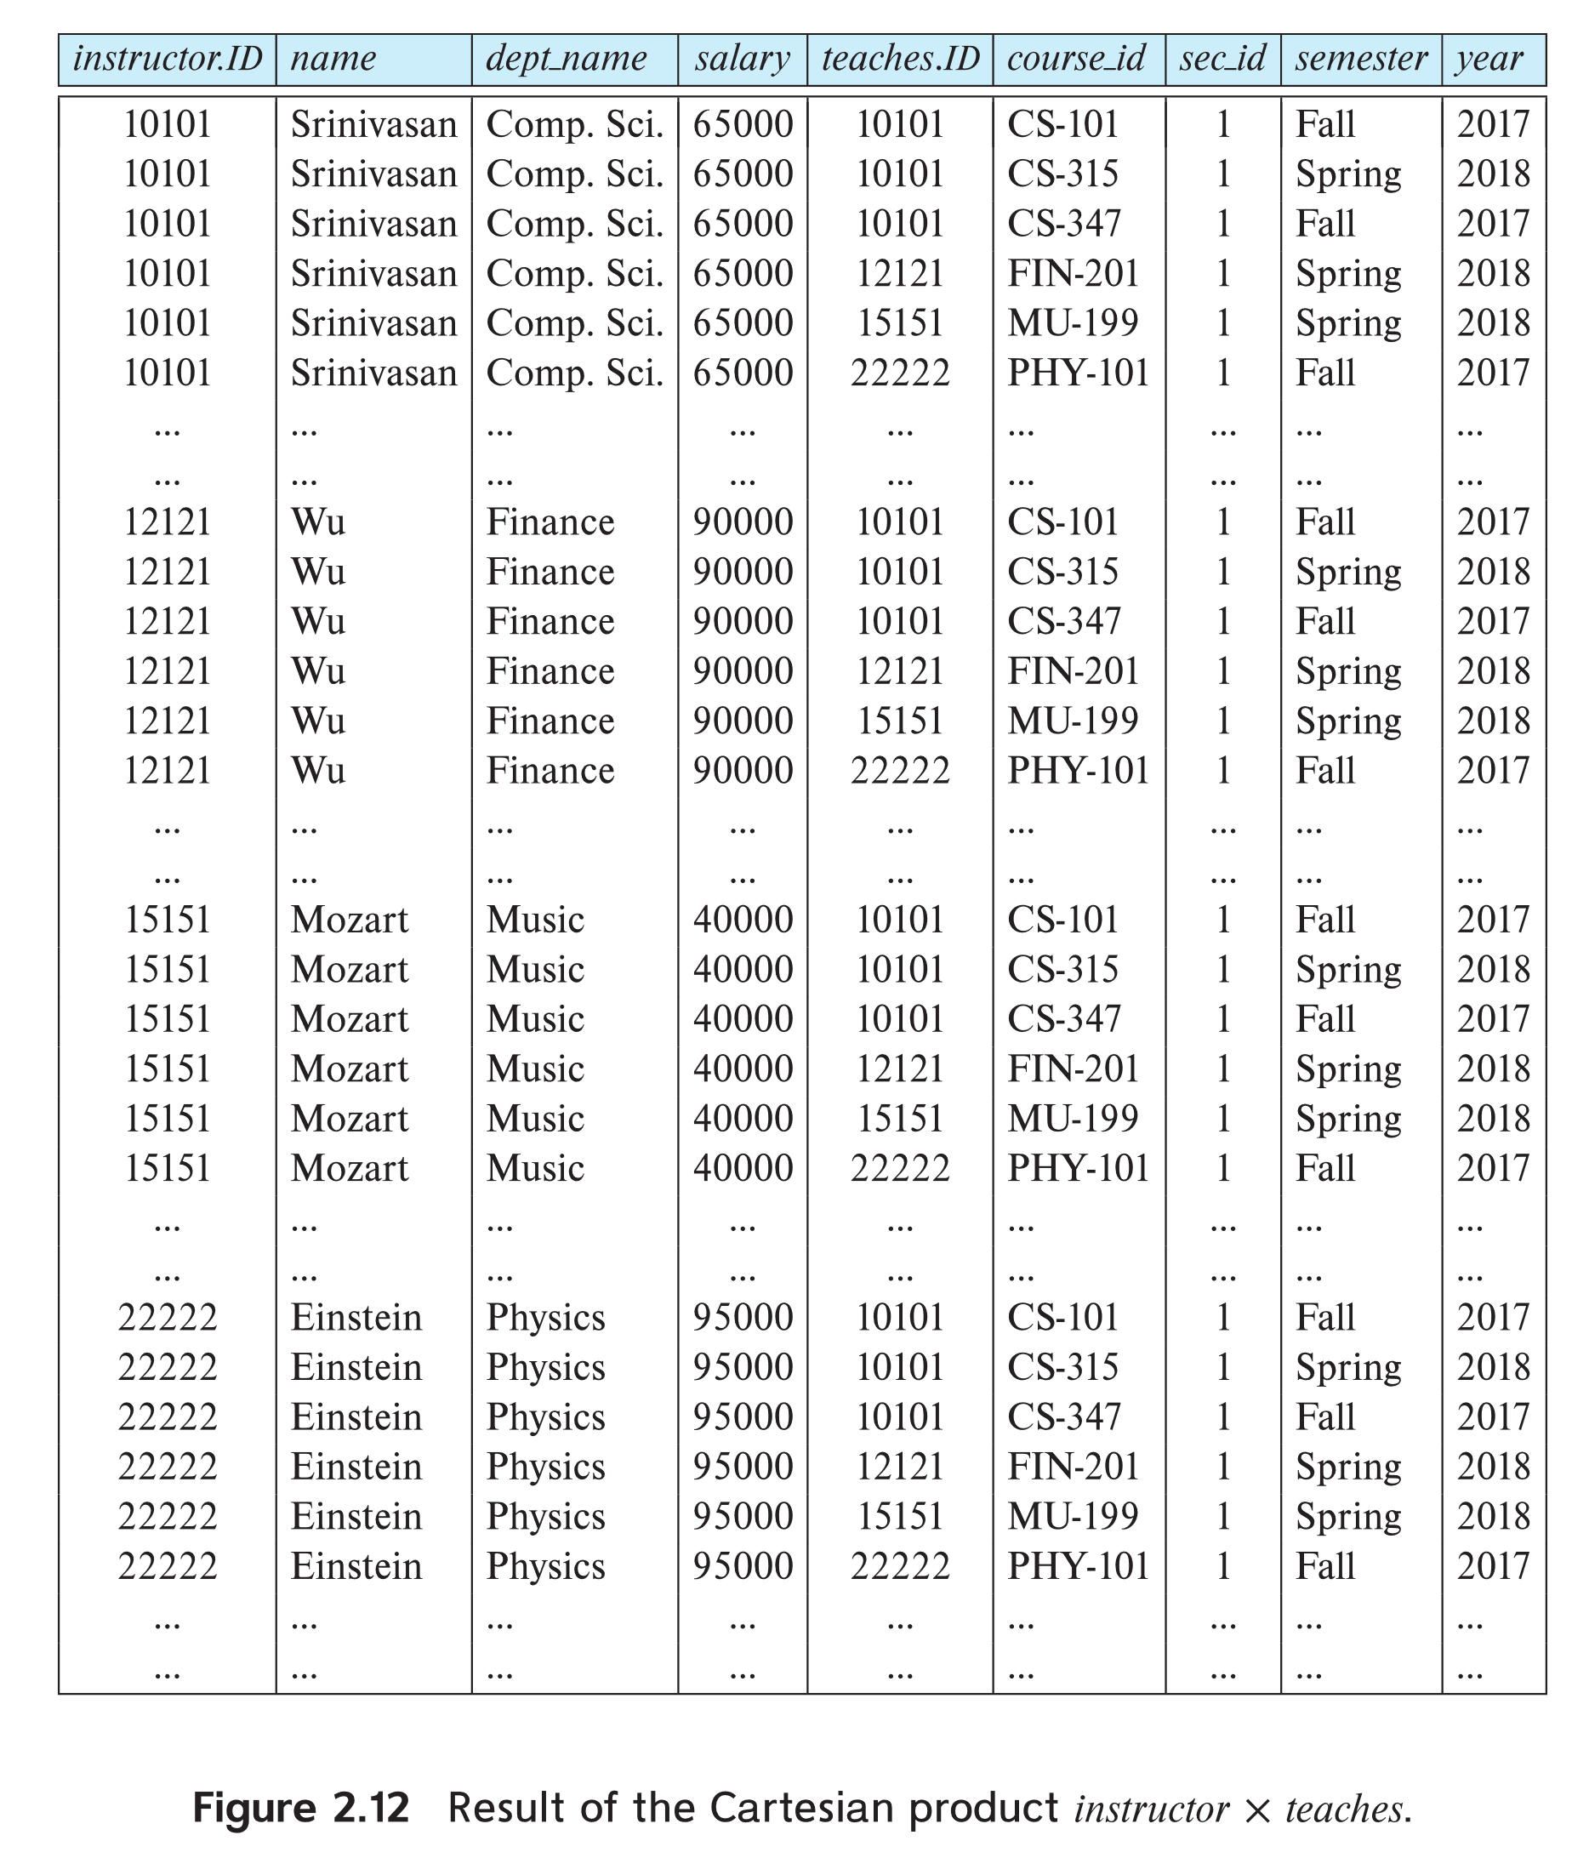
The instructor X teaches table

Slide 19
Join Operation
The Cartesian-Product
instructor X teaches
associates every tuple of instructor with every tuple of teaches.
  Most of the resulting rows have information about instructors who did NOT teach a particular course.
To get only those tuples of “instructor X teaches “ that pertain to instructors and the courses that they taught, we write:
σ _{instructor.id = teaches.id} (instructor x teaches ))
  It get only those tuples of “instructor X teaches” that pertain to instructors and the courses that they taught.
The result of this expression, shown in the next slide

Slide 20
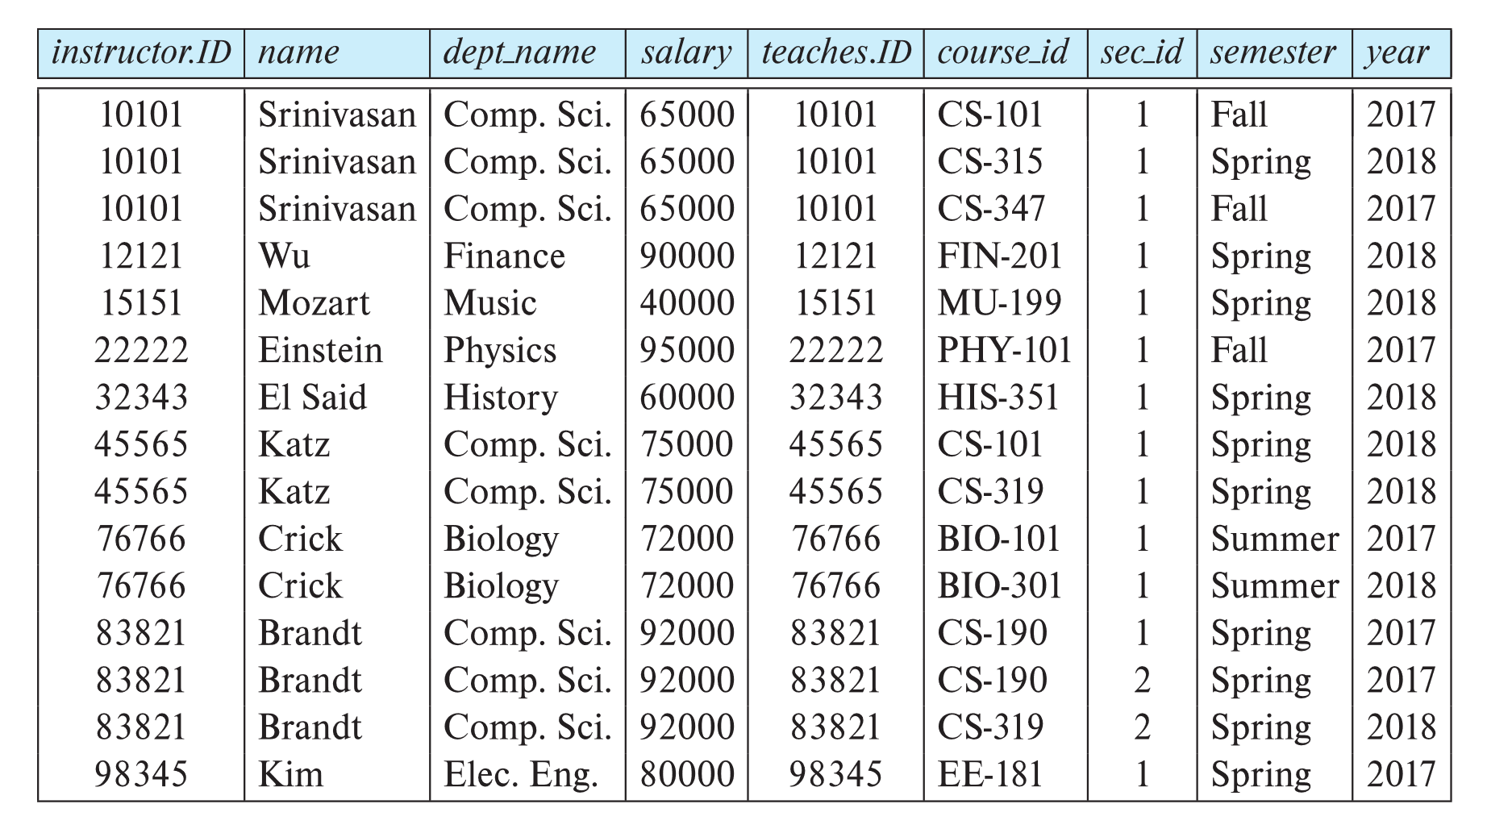
Join Operation (Cont.)
The table corresponding to:
σ _{instructor.id = teaches.id} (instructor x teaches))

Slide 21
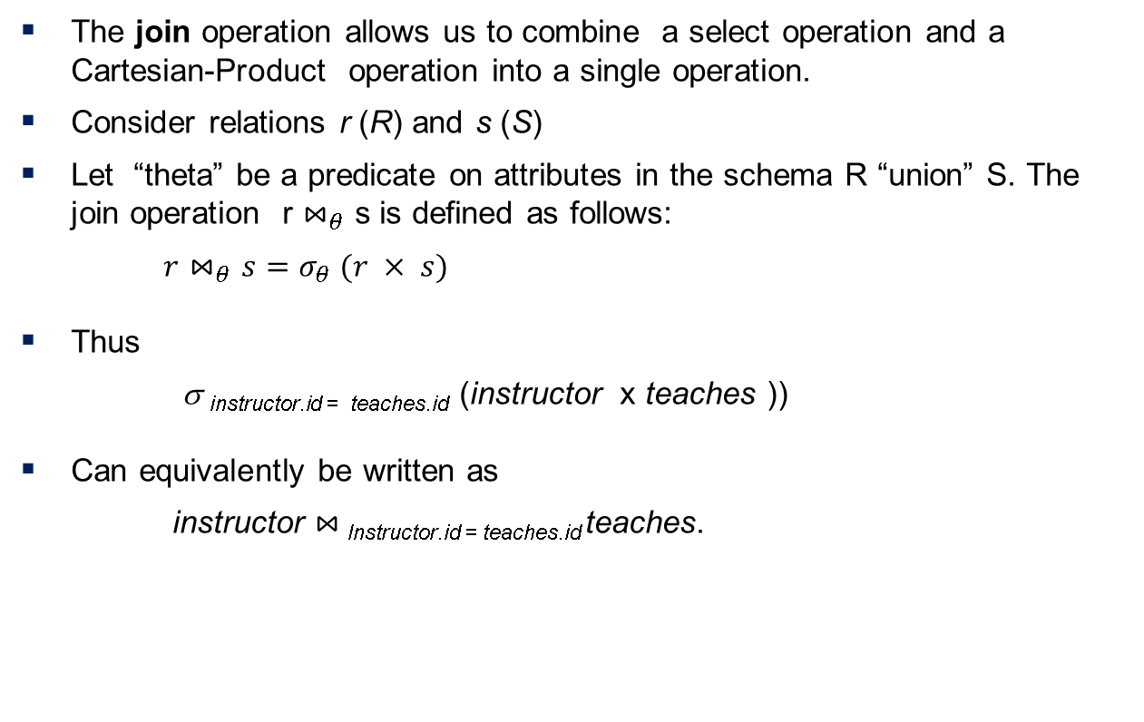
Join Operation (Cont.)

Slide 22
Union Operation
The union operation allows us to combine two relations
Notation: r ∪ s
For r ∪ s to be valid.
1. r, s must have the same arity (same number of attributes)
2. The attribute domains must be compatible (example: 2nd
  column of r deals with the same type of values as does the
  2nd column of s)
Example: to find all courses taught in the Fall 2017 semester, or in the Spring 2018 semester, or in both
∏_{course_id} (σ _{semester=“Fall” Λ year=2017} (section)) ∪
∏_{course_id} (σ _{semester=“Spring” Λ year=2018} (section))

Slide 23
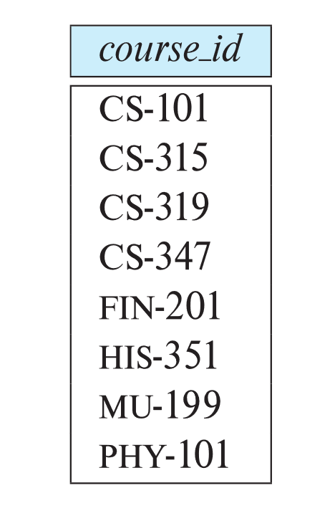
Union Operation (Cont.)
Result of:
∏_{course_id} (σ _{semester=“Fall” Λ year=2017} (section)) ∪
∏_{course_id} (σ _{semester=“Spring” Λ year=2018} (section))

Slide 24

Set-Intersection Operation
The set-intersection operation allows us to find tuples that are in both the input relations.
Notation: r ∩ s
Assume:
  r, s have the same arity
  attributes of r and s are compatible
Example: Find the set of all courses taught in both the Fall 2017 and the Spring 2018 semesters.
∏_{course_id} (σ _{semester=“Fall” Λ year=2017} (section)) ∩
∏_{course_id} (σ _{semester=“Spring” Λ year=2018} (section))
  Result

Slide 25

Set Difference Operation
The set-difference operation allows us to find tuples that are in one relation but are not in another.
Notation r – s
Set differences must be taken between compatible relations.
  r and s must have the same arity
  attribute domains of r and s must be compatible
Example: to find all courses taught in the Fall 2017 semester, but not in the Spring 2018 semester
∏_{course_id} (σ _{semester=“Fall” Λ year=2017} (section)) −
∏_{course_id} (σ _{semester=“Spring” Λ year=2018} (section))

Slide 26
The Assignment Operation
It is convenient at times to write a relational-algebra expression by assigning parts of it to temporary relation variables.
The assignment operation is denoted by ← and works like assignment in a programming language.
Example: Find all instructor in the “Physics” and Music department.
Physics ← σ _{dept_name=“Physics”} (instructor)
  Music ← σ _{dept_name=“Music”} (instructor)
  Physics ∪ Music
With the assignment operation, a query can be written as a sequential program consisting of a series of assignments followed by an expression whose value is displayed as the result of the query.

Slide 27
The Rename Operation
The results of relational-algebra expressions do not have a name that we can use to refer to them. The rename operator, ρ , is provided for that purpose
The expression:
ρ_{x} (E)
returns the result of expression E under the name x
Another form of the rename operation:
ρ_{x(A1,A2, .. An)} (E)

Slide 28
Equivalent Queries
There is more than one way to write a query in relational algebra.
Example: Find information about courses taught by instructors in the Physics department with salary greater than 90,000
Query 1
σ _{dept_name=“Physics”} ∧ _{salary > 90,000} (instructor)
Query 2
σ _{dept_name=“Physics”} (σ _{salary > 90.000} (instructor))
The two queries are not identical; they are, however, equivalent -- they give the same result on any database.

Slide 29
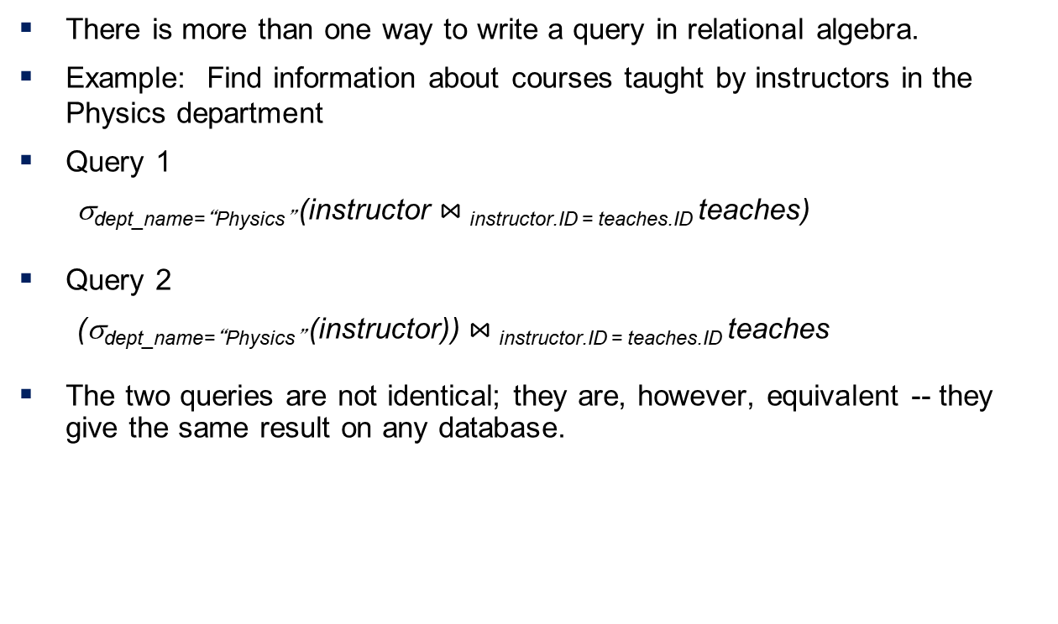
Equivalent Queries
There is more than one way to write a query in relational algebra.
Example: Find information about courses taught by instructors in the Physics department
Query 1
σ_{dept_name=“Physics”} (instructor$⋈_{ }$_{instructor.ID = teaches.ID}teaches)
Query 2
(σ_{dept_name=“Physics”} (instructor))$⋈_{ }$_{instructor.ID = teaches.ID}teaches
The two queries are not identical; they are, however, equivalent -- they give the same result on any database.

Slide 30
PART – I Two Mark Question Bank
1. Define attributes.
The term attribute refer to a column of a table. For example, the relation instructor has four attributes: ID, Name, Depart, and Salary.
2. Define relation instance.
The term relation instance to refer to a specific instance of a relation, i.e., containing a specific set of rows.
3. What is the difference between database schema and database instance?
The database schema, which is the logical design of the database and the database instance, which is a snapshot of the data in the database at a given instant in time.
4. Define super key and primary key
A super key of a relation is a set of one or more attributes whose values are guaranteed to identify tuples in the relation uniquely. A candidate key is a minimal super key, that is, a set of attributes that forms a super key, but none of whose subsets is a super key. One of the candidate key of a relation chosen as its primary key.

Slide 31
5. What is foreign key?
A foreign key is a set of attributes in a referencing relation, such that for each tuple in the referencing relation, the values of the foreign key attributes are guaranteed to occur as the primary key value of a tuple in the referenced relation.
6. Define schema diagram.
A schema diagram is a pictorial depiction of the schema of a database that shows the relation in the database, their attributes and primary keys and foreign keys.
7. Define mapping constraints.
The E-R model represents certain constraints to which the contents of a database must conform. Two of the most important types of constraints are mapping cardinalities: express the number of entities to which another entity can be associated via relationship set.
8. Define Relational algebra.
The relational algebra provides a set of operations that take one or more relations as input and return a relation as an output. It is a procedure query language. Practical query languages such as SQL are based on the relational algebra, but add a number of useful syntactic features.

Slide 32
9. Define Relational calculus.
A tuple relational calculus expression is of the form {t/P (t)} where P is a formula. Several tuple variables may appear in a formula.
10. List possible operations in Relation algebra
Select, project, theta join, equijoin, union, intersection, difference, Cartesian product, division.

Slide 33
PART – 2 Big Question Bank (Answer: Ref content from ppt)
Describe the structure of relational database.
Explain about database schema.
Describe about select operation with eg.
Describe about projection operation with eg.
Explain about union operation with eg.
Describe about set difference operation with eg.
Describe about Cartesian product operation with eg.
Explain about NULL Values with eg.
Describe the Modification of the Database.
Describe about Algebra Operations with eg.
Describe about key Constraints.

Slide 34
Thank You

