Slide 1
DATABASE SYTEMS
UNIT IV
Dr.S.Chitra,
Assistant Professor,
Department of Computer Science,
Annai Vailankanni Arts and Science College,Thanjavur

Slide 2
Tuple Relational Calculus

Slide 3
Tuple Relational Calculus
A nonprocedural query language, where each query is of the form
{t | P (t ) }
It is the set of all tuples t such that predicate P is true for t
t is a tuple variable
t [A ] denotes the value of tuple t on attribute A
t ∈ r denotes that tuple t is in relation r
P is a formula similar to that of the predicate calculus

Slide 4
Predicate Calculus Formula
Set of attributes and constants
Set of comparison operators: (e.g., <, ≤, =, ≠, >, ≥)
Set of connectives: and (∧), or (v)‚ not (¬)
Implication (⇒): x ⇒ y, if x if true, then y is true
x ⇒ y ≡ ¬x v y
Set of quantifiers:
  ∃ t ∈ r (Q (t )) ≡ ”there exists” a tuple in t in relation r
  such that predicate Q (t ) is true
  ∀t ∈ r (Q (t )) ≡ Q is true “for all” tuples t in relation r

Slide 5
Example Queries
Find the ID, name, dept_name, salary for instructors whose salary is greater than $80,000
{t | t ∈ instructor ∧ t [salary ] > 80000}
Notice that a relation on schema (ID, name, dept_name, salary) is implicitly defined by the query
As in the previous query, but output only the ID attribute value
{t | ∃ s ∈ instructor (t [ID ] = s [ID ] ∧ s [salary ] > 80000)}
Notice that a relation on schema (ID) is implicitly defined by the query

Slide 6
Example Queries
Find the names of all instructors whose department is in the Watson building
Find the set of all courses taught in the Fall 2009 semester, or in the Spring 2010 semester, or both
{t | ∃s ∈ instructor (t [name ] = s [name ]
∧ ∃u ∈ department (u [dept_name ] = s[dept_name] “
∧ u [building] = “Watson” ))}
{t | ∃s ∈ section (t [course_id ] = s [course_id ] ∧
s [semester] = “Fall” ∧ s [year] = 2009
v ∃u ∈ section (t [course_id ] = u [course_id ] ∧
u [semester] = “Spring” ∧ u [year] = 2010 )}

Slide 7
Example Queries
Find the set of all courses taught in the Fall 2009 semester, and in
the Spring 2010 semester
Find the set of all courses taught in the Fall 2009 semester, but not in the Spring 2010 semester
{t | ∃s ∈ section (t [course_id ] = s [course_id ] ∧
s [semester] = “Fall” ∧ s [year] = 2009
∧ ∃u ∈ section (t [course_id ] = u [course_id ] ∧
u [semester] = “Spring” ∧ u [year] = 2010 )}
{t | ∃s ∈ section (t [course_id ] = s [course_id ] ∧
s [semester] = “Fall” ∧ s [year] = 2009
∧ ¬ ∃u ∈ section (t [course_id ] = u [course_id ] ∧
u [semester] = “Spring” ∧ u [year] = 2010 )}

Slide 8
Universal Quantification
Find all students who have taken all courses offered in the Biology department
  {t | ∃ r ∈ student (t [ID] = r [ID]) ∧
  (∀ u ∈ course (u [dept_name]=“Biology” ⇒
  ∃ s ∈ takes (t [ID] = s [ID ] ∧
  s [course_id] = u [course_id]))}

Slide 9
Safety of Expressions
It is possible to write tuple calculus expressions that generate infinite relations.
For example, { t | ¬ t ∈ r } results in an infinite relation if the domain of any attribute of relation r is infinite
To guard against the problem, we restrict the set of allowable expressions to safe expressions.
An expression {t | P (t )} in the tuple relational calculus is safe if every component of t appears in one of the relations, tuples, or constants that appear in P
  NOTE: this is more than just a syntax condition.
    E.g., { t | t [A] = 5 ∨ true } is not safe --- it defines an infinite set with attribute values that do not appear in any relation or tuples or constants in P.

Slide 10
Safety of Expressions (Cont.)
Consider again that query to find all students who have taken all courses offered in the Biology department
  {t | ∃ r ∈ student (t [ID] = r [ID]) ∧
  (∀ u ∈ course (u [dept_name]=“Biology” ⇒
  ∃ s ∈ takes (t [ID] = s [ID ] ∧
  s [course_id] = u [course_id]))}
Without the existential quantification on student, the above query would be unsafe if the Biology department has not offered any courses.

Slide 11
Domain Relational Calculus

Slide 12
Domain Relational Calculus
A nonprocedural query language equivalent in power to the tuple relational calculus
Each query is an expression of the form:
{ < x₁, x₂, …, x_{n} > | P (x₁, x₂, …, x_{n})}
  x₁, x₂, …, x_{n} represent domain variables
  P represents a formula similar to that of the predicate calculus

Slide 13
Example Queries
Find the ID, name, dept_name, salary for instructors whose salary is greater than $80,000
  {< i, n, d, s> | < i, n, d, s> ∈ instructor ∧ s > 80000}
As in the previous query, but output only the ID attribute value
  {< i> | < i, n, d, s> ∈ instructor ∧ s > 80000}
Find the names of all instructors whose department is in the Watson building
{< n > | ∃ i, d, s (< i, n, d, s > ∈ instructor
∧ ∃ b, a (< d, b, a> ∈ department ∧ b = “Watson” ))}

Slide 14
Example Queries
Find the set of all courses taught in the Fall 2009 semester, or in
the Spring 2010 semester, or both
{<c> | ∃ a, s, y, b, r, t ( <c, a, s, y, b, r, t > ∈ section ∧
s = “Fall” ∧ y = 2009 )
v ∃ a, s, y, b, r, t ( <c, a, s, y, b, r, t > ∈ section ] ∧
s = “Spring” ∧ y = 2010)}
This case can also be written as
{<c> | ∃ a, s, y, b, r, t ( <c, a, s, y, b, r, t > ∈ section ∧
( (s = “Fall” ∧ y = 2009 ) v (s = “Spring” ∧ y = 2010))}
Find the set of all courses taught in the Fall 2009 semester, and in
the Spring 2010 semester
{<c> | ∃ a, s, y, b, r, t ( <c, a, s, y, b, r, t > ∈ section ∧
s = “Fall” ∧ y = 2009 )
∧ ∃ a, s, y, b, r, t ( <c, a, s, y, b, r, t > ∈ section ] ∧
s = “Spring” ∧ y = 2010)}

Slide 15
Safety of Expressions
The expression:
{ < x₁, x₂, …, x_{n} > | P (x₁, x₂, …, x_{n} )}
is safe if all of the following hold:
1. All values that appear in tuples of the expression are values from dom
(P ) (that is, the values appear either in P or in a tuple of a relation
mentioned in P ).
2. For every “there exists” subformula of the form ∃ x (P₁(x )), the subformula is true if and only if there is a value of x in dom (P₁) such that P₁(x ) is true.
3. For every “for all” subformula of the form ∀_{x} (P₁ (x )), the subformula is
true if and only if P₁(x ) is true for all values x from dom (P₁).

Slide 16
Universal Quantification
Find all students who have taken all courses offered in the Biology department
  {< i > | ∃ n, d, tc ( < i, n, d, tc > ∈ student ∧
  (∀ ci, ti, dn, cr ( < ci, ti, dn, cr > ∈ course ∧ dn =“Biology”
  ⇒ ∃ si, se, y, g ( <i, ci, si, se, y, g> ∈ takes ))}
  Note that without the existential quantification on student, the above query would be unsafe if the Biology department has not offered any courses.

Slide 17
Design Phases
Initial phase -- characterize fully the data needs of the prospective database users.
Second phase -- choosing a data model
  Applying the concepts of the chosen data model
  Translating these requirements into a conceptual schema of the database.
  A fully developed conceptual schema indicates the functional requirements of the enterprise.
    Describe the kinds of operations (or transactions) that will be performed on the data.

Slide 18
Design Phases (Cont.)
Final Phase -- Moving from an abstract data model to the implementation of the database
  Logical Design – Deciding on the database schema.
    Database design requires that we find a “good” collection of relation schemas.
    Business decision – What attributes should we record in the database?
    Computer Science decision – What relation schemas should we have and how should the attributes be distributed among the various relation schemas?
  Physical Design – Deciding on the physical layout of the database
Notes:
18

Slide 19
Design Alternatives
In designing a database schema, we must ensure that we avoid two major pitfalls:
  Redundancy: a bad design may result in repeat information.
    Redundant representation of information may lead to data inconsistency among the various copies of information
  Incompleteness: a bad design may make certain aspects of the enterprise difficult or impossible to model.
Avoiding bad designs is not enough. There may be a large number of good designs from which we must choose.
Notes:
19

Slide 20
Design Approaches
Entity Relationship Model (covered in this chapter)
  Models an enterprise as a collection of entities and relationships
    Entity: a “thing” or “object” in the enterprise that is distinguishable from other objects
      Described by a set of attributes
    Relationship: an association among several entities
  Represented diagrammatically by an entity-relationship diagram:
Normalization Theory (Chapter 7)
  Formalize what designs are bad, and test for them
Notes:
20

Slide 21
Outline of the ER Model

Slide 22
ER model -- Database Modeling
The ER data mode was developed to facilitate database design by allowing specification of an enterprise schema that represents the overall logical structure of a database.
The ER data model employs three basic concepts:
  entity sets,
  relationship sets,
  attributes.
The ER model also has an associated diagrammatic representation, the ER diagram, which can express the overall logical structure of a database graphically.

Slide 23
Entity Sets
An entity is an object that exists and is distinguishable from other objects.
  Example: specific person, company, event, plant
An entity set is a set of entities of the same type that share the same properties.
  Example: set of all persons, companies, trees, holidays
An entity is represented by a set of attributes; i.e., descriptive properties possessed by all members of an entity set.
  Example:
  instructor = (ID, name, salary )
  course= (course_id, title, credits)
A subset of the attributes form a primary key of the entity set; i.e., uniquely identifying each member of the set.

Slide 24
Entity Sets -- instructor and student

Slide 25
Representing Entity sets in ER Diagram
Entity sets can be represented graphically as follows:
  Rectangles represent entity sets.
  Attributes listed inside entity rectangle
  Underline indicates primary key attributes

Slide 26
Relationship Sets
A relationship is an association among several entities
Example:
44553 (Peltier) advisor 22222 (Einstein)
student entity relationship set instructor entity
A relationship set is a mathematical relation among n ≥ 2 entities, each taken from entity sets
{(e₁, e₂, … e_{n}) | e₁ ∈ E₁, e₂ ∈ E₂, …, e_{n} ∈ E_{n}}
where (e₁, e₂, …, e_{n}) is a relationship
  Example:
  (44553,22222) ∈ advisor

Slide 27
Relationship Sets (Cont.)
Example: we define the relationship set advisor to denote the associations between students and the instructors who act as their advisors.
Pictorially, we draw a line between related entities.

Slide 28
Representing Relationship Sets via ER Diagrams
Diamonds represent relationship sets.

Slide 29
Relationship Sets (Cont.)
An attribute can also be associated with a relationship set.
For instance, the advisor relationship set between entity sets instructor and student may have the attribute date which tracks when the student started being associated with the advisor

Slide 30
Relationship Sets with Attributes

Slide 31
Roles
Entity sets of a relationship need not be distinct
  Each occurrence of an entity set plays a “role” in the relationship
The labels “course_id” and “prereq_id” are called roles.

Slide 32
Degree of a Relationship Set
Binary relationship
  involve two entity sets (or degree two).
  most relationship sets in a database system are binary.
Relationships between more than two entity sets are rare. Most relationships are binary. (More on this later.)
  Example: students work on research projects under the guidance of an instructor.
  relationship proj_guide is a ternary relationship between instructor, student, and project

Slide 33
Non-binary Relationship Sets
Most relationship sets are binary
There are occasions when it is more convenient to represent relationships as non-binary.
E-R Diagram with a Ternary Relationship

Slide 34
Complex Attributes
Attribute types:
  Simple and composite attributes.
  Single-valued and multivalued attributes
    Example: multivalued attribute: phone_numbers
  Derived attributes
    Can be computed from other attributes
    Example: age, given date_of_birth
Domain – the set of permitted values for each attribute

Slide 35
Composite Attributes
Composite attributes allow us to divided attributes into subparts (other attributes).

Slide 36
Representing Complex Attributes in ER Diagram

Slide 37
Mapping Cardinality Constraints
Express the number of entities to which another entity can be associated via a relationship set.
Most useful in describing binary relationship sets.
For a binary relationship set the mapping cardinality must be one of the following types:
  One to one
  One to many
  Many to one
  Many to many

Slide 38
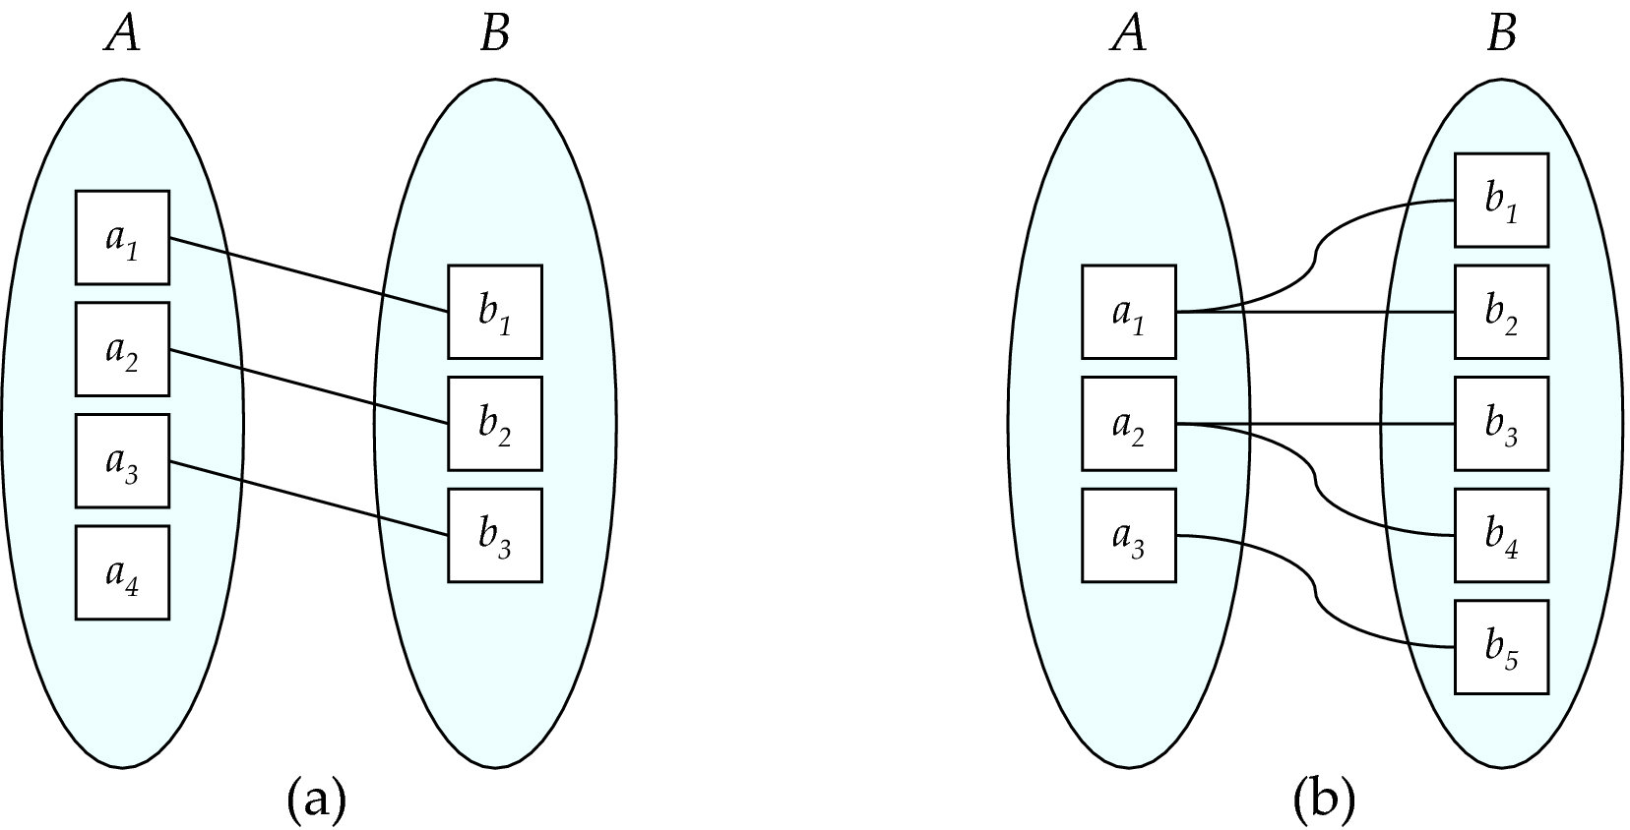
Mapping Cardinalities
One to one
One to many
Note: Some elements in A and B may not be mapped to any
elements in the other set

Slide 39
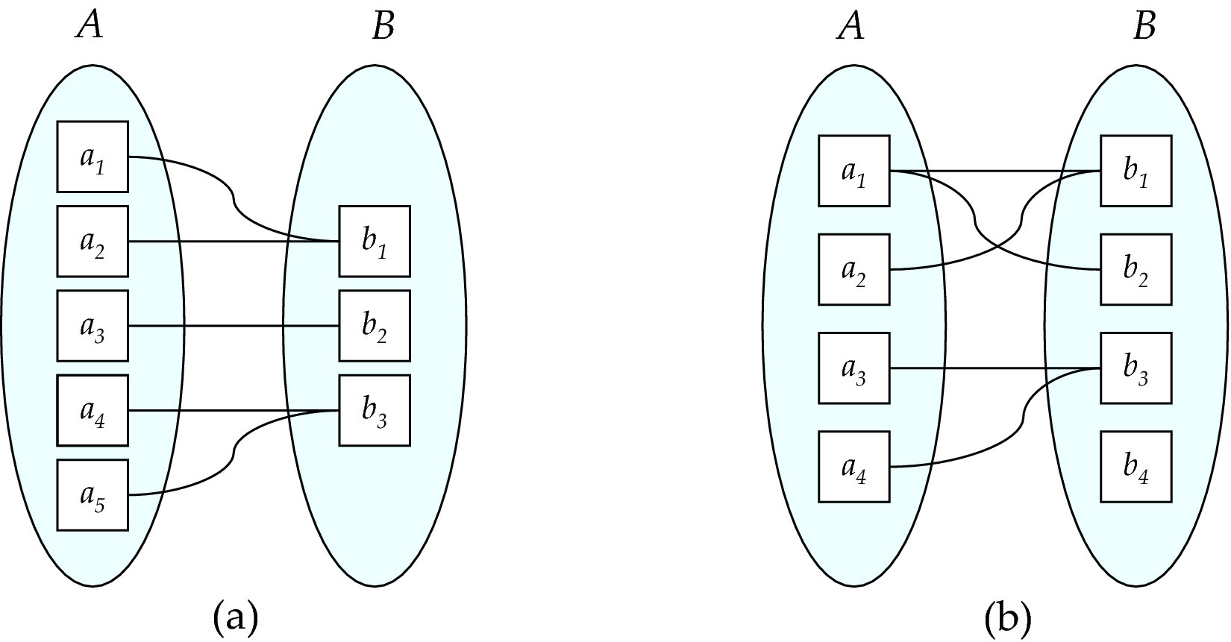
Mapping Cardinalities
Many to one
Many to many
Note: Some elements in A and B may not be mapped to any
elements in the other set

Slide 40
Representing Cardinality Constraints in ER Diagram
We express cardinality constraints by drawing either a directed line (→), signifying “one,” or an undirected line (—), signifying “many,” between the relationship set and the entity set.
One-to-one relationship between an instructor and a student :
  A student is associated with at most one instructor via the relationship advisor
  A student is associated with at most one department via stud_dept

Slide 41
One-to-Many Relationship
one-to-many relationship between an instructor and a student
  an instructor is associated with several (including 0) students via advisor
  a student is associated with at most one instructor via advisor,

Slide 42
Many-to-One Relationships
In a many-to-one relationship between an instructor and a student,
  an instructor is associated with at most one student via advisor,
  and a student is associated with several (including 0) instructors via advisor

Slide 43
Many-to-Many Relationship
An instructor is associated with several (possibly 0) students via advisor
A student is associated with several (possibly 0) instructors via advisor

Slide 44
Total and Partial Participation
Total participation (indicated by double line): every entity in the entity set participates in at least one relationship in the relationship set
  participation of student in advisor relation is total
    every student must have an associated instructor
Partial participation: some entities may not participate in any relationship in the relationship set
  Example: participation of instructor in advisor is partial

Slide 45
Notation for Expressing More Complex Constraints
A line may have an associated minimum and maximum cardinality, shown in the form l..h, where l is the minimum and h the maximum cardinality
  A minimum value of 1 indicates total participation.
  A maximum value of 1 indicates that the entity participates in at most one relationship
  A maximum value of * indicates no limit.
Example
  Instructor can advise 0 or more students. A student must have 1 advisor; cannot have multiple advisors

Slide 46
Cardinality Constraints on Ternary Relationship
We allow at most one arrow out of a ternary (or greater degree) relationship to indicate a cardinality constraint
For example, an arrow from proj_guide to instructor indicates each student has at most one guide for a project
If there is more than one arrow, there are two ways of defining the meaning.
  For example, a ternary relationship R between A, B and C with arrows to B and C could mean
    1. Each A entity is associated with a unique entity from B
    and C or
    2. Each pair of entities from (A, B) is associated with a unique C entity, and each pair (A, C) is associated with a unique B
  Each alternative has been used in different formalisms
  To avoid confusion we outlaw more than one arrow

Slide 47
Primary Key
Primary keys provide a way to specify how entities and relations are distinguished. We will consider:
  Entity sets
  Relationship sets.
  Weak entity sets

Slide 48
Primary key for Entity Sets
By definition, individual entities are distinct.
From database perspective, the differences among them must be expressed in terms of their attributes.
The values of the attribute values of an entity must be such that they can uniquely identify the entity.
  No two entities in an entity set are allowed to have exactly the same value for all attributes.
A key for an entity is a set of attributes that suffice to distinguish entities from each other

Slide 49
Primary Key for Relationship Sets
To distinguish among the various relationships of a relationship set we use the individual primary keys of the entities in the relationship set.
  Let R be a relationship set involving entity sets E1, E2, .. En
  The primary key for R is consists of the union of the primary keys of entity sets E1, E2, ..En
  If the relationship set R has attributes a1, a2, .., am associated with it, then the primary key of R also includes the attributes a1, a2, .., am
Example: relationship set “advisor”.
  The primary key consists of instructor.ID and student.ID
The choice of the primary key for a relationship set depends on the mapping cardinality of the relationship set.

Slide 50
Choice of Primary key for Binary Relationship
Many-to-Many relationships. The preceding union of the primary keys is a minimal superkey and is chosen as the primary key.
One-to-Many relationships . The primary key of the “Many” side is a minimal superkey and is used as the primary key.
Many-to-one relationships. The primary key of the “Many” side is a minimal superkey and is used as the primary key.
One-to-one relationships. The primary key of either one of the participating entity sets forms a minimal superkey, and either one can be chosen as the primary key.

Slide 51
Weak Entity Sets
Consider a section entity, which is uniquely identified by a course_id, semester, year, and sec_id.
Clearly, section entities are related to course entities. Suppose we create a relationship set sec_course between entity sets section and course.
Note that the information in sec_course is redundant, since section already has an attribute course_id, which identifies the course with which the section is related.
One option to deal with this redundancy is to get rid of the relationship sec_course; however, by doing so the relationship between section and course becomes implicit in an attribute, which is not desirable.

Slide 52
Weak Entity Sets (Cont.)
An alternative way to deal with this redundancy is to not store the attribute course_id in the section entity and to only store the remaining attributes section_id, year, and semester.
  However, the entity set section then does not have enough attributes to identify a particular section entity uniquely
To deal with this problem, we treat the relationship sec_course as a special relationship that provides extra information, in this case, the course_id, required to identify section entities uniquely.
A weak entity set is one whose existence is dependent on another entity, called its identifying entity
Instead of associating a primary key with a weak entity, we use the identifying entity, along with extra attributes called discriminator to uniquely identify a weak entity.

Slide 53
Weak Entity Sets (Cont.)
An entity set that is not a weak entity set is termed a strong entity set.
Every weak entity must be associated with an identifying entity; that is, the weak entity set is said to be existence dependent on the identifying entity set.
The identifying entity set is said to own the weak entity set that it identifies.
The relationship associating the weak entity set with the identifying entity set is called the identifying relationship.
Note that the relational schema we eventually create from the entity set section does have the attribute course_id, for reasons that will become clear later, even though we have dropped the attribute course_id from the entity set section.

Slide 54
Expressing Weak Entity Sets
In E-R diagrams, a weak entity set is depicted via a double rectangle.
We underline the discriminator of a weak entity set with a dashed line.
The relationship set connecting the weak entity set to the identifying strong entity set is depicted by a double diamond.
Primary key for section – (course_id, sec_id, semester, year)

Slide 55
Redundant Attributes
Suppose we have entity sets:
  student, with attributes: ID, name, tot_cred, dept_name
  department, with attributes: dept_name, building, budget
We model the fact that each student has an associated department using a relationship set stud_dept
The attribute dept_name in student below replicates information present in the relationship and is therefore redundant
  and needs to be removed.
BUT: when converting back to tables, in some cases the attribute gets reintroduced, as we will see later.

Slide 56
E-R Diagram for a University Enterprise

Slide 57
Reduction to Relation Schemas

Slide 58
Reduction to Relation Schemas
Entity sets and relationship sets can be expressed uniformly as relation schemas that represent the contents of the database.
A database which conforms to an E-R diagram can be represented by a collection of schemas.
For each entity set and relationship set there is a unique schema that is assigned the name of the corresponding entity set or relationship set.
Each schema has a number of columns (generally corresponding to attributes), which have unique names.

Slide 59
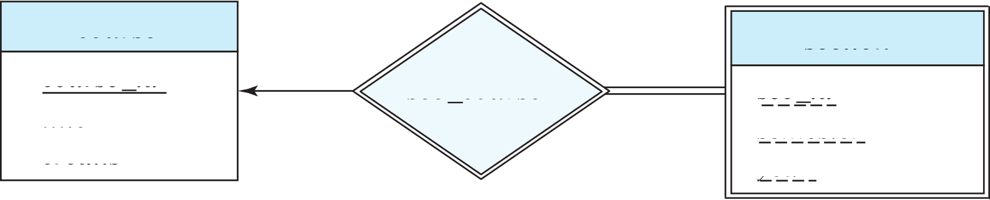
Representing Entity Sets
A strong entity set reduces to a schema with the same attributes
student(ID, name, tot_cred)
A weak entity set becomes a table that includes a column for the primary key of the identifying strong entity set
section ( course_id, sec_id, sem, year )
Example

Slide 60
Representation of Entity Sets with Composite Attributes
Composite attributes are flattened out by creating a separate attribute for each component attribute
  Example: given entity set instructor with composite attribute name with component attributes first_name and last_name the schema corresponding to the entity set has two attributes name_first_name and name_last_name
    Prefix omitted if there is no ambiguity (name_first_name could be first_name)
Ignoring multivalued attributes, extended instructor schema is
  instructor(ID,
  first_name, middle_initial, last_name,
  street_number, street_name,
  apt_number, city, state, zip_code,
  date_of_birth)
Notes:
60

Slide 61
Representation of Entity Sets with Multivalued Attributes
A multivalued attribute M of an entity E is represented by a separate schema EM
Schema EM has attributes corresponding to the primary key of E and an attribute corresponding to multivalued attribute M
Example: Multivalued attribute phone_number of instructor is represented by a schema:
inst_phone= ( ID, phone_number)
Each value of the multivalued attribute maps to a separate tuple of the relation on schema EM
  For example, an instructor entity with primary key 22222 and phone numbers 456-7890 and 123-4567 maps to two tuples:
  (22222, 456-7890) and (22222, 123-4567)
Notes:
61

Slide 62
Representing Relationship Sets
A many-to-many relationship set is represented as a schema with attributes for the primary keys of the two participating entity sets, and any descriptive attributes of the relationship set.
Example: schema for relationship set advisor
advisor = (s_id, i_id)

Slide 63
Redundancy of Schemas
Many-to-one and one-to-many relationship sets that are total on the many-side can be represented by adding an extra attribute to the “many” side, containing the primary key of the “one” side
Example: Instead of creating a schema for relationship set inst_dept, add an attribute dept_name to the schema arising from entity set instructor
Example

Slide 64
Redundancy of Schemas (Cont.)
For one-to-one relationship sets, either side can be chosen to act as the “many” side
  That is, an extra attribute can be added to either of the tables corresponding to the two entity sets
If participation is partial on the “many” side, replacing a schema by an extra attribute in the schema corresponding to the “many” side could result in null values
Notes:
64

Slide 65
Redundancy of Schemas (Cont.)
The schema corresponding to a relationship set linking a weak entity set to its identifying strong entity set is redundant.
Example: The section schema already contains the attributes that would appear in the sec_course schema
Notes:
65

Slide 66
Extended E-R Features

Slide 67
Specialization
Top-down design process; we designate sub-groupings within an entity set that are distinctive from other entities in the set.
These sub-groupings become lower-level entity sets that have attributes or participate in relationships that do not apply to the higher-level entity set.
Depicted by a triangle component labeled ISA (e.g., instructor “is a” person).
Attribute inheritance – a lower-level entity set inherits all the attributes and relationship participation of the higher-level entity set to which it is linked.

Slide 68
Specialization Example
Overlapping – employee and student
Disjoint – instructor and secretary
Total and partial

Slide 69
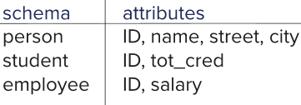
Representing Specialization via Schemas
Method 1:
  Form a schema for the higher-level entity
  Form a schema for each lower-level entity set, include primary key of higher-level entity set and local attributes
  Drawback: getting information about, an employee requires accessing two relations, the one corresponding to the low-level schema and the one corresponding to the high-level schema
Notes:
69

Slide 70
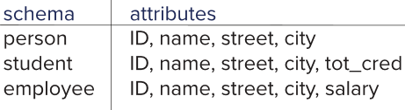
Representing Specialization as Schemas (Cont.)
Method 2:
  Form a schema for each entity set with all local and inherited attributes
  Drawback: name, street and city may be stored redundantly for people who are both students and employees
Notes:
70

Slide 71
Generalization
A bottom-up design process – combine a number of entity sets that share the same features into a higher-level entity set.
Specialization and generalization are simple inversions of each other; they are represented in an E-R diagram in the same way.
The terms specialization and generalization are used interchangeably.

Slide 72
Completeness constraint
Completeness constraint -- specifies whether or not an entity in the higher-level entity set must belong to at least one of the lower-level entity sets within a generalization.
  total: an entity must belong to one of the lower-level entity sets
  partial: an entity need not belong to one of the lower-level entity sets

Slide 73
Completeness constraint (Cont.)
Partial generalization is the default.
We can specify total generalization in an ER diagram by adding the keyword total in the diagram and drawing a dashed line from the keyword to the corresponding hollow arrow-head to which it applies (for a total generalization), or to the set of hollow arrow-heads to which it applies (for an overlapping generalization).
The student generalization is total: All student entities must be either graduate or undergraduate. Because the higher-level entity set arrived at through generalization is generally composed of only those entities in the lower-level entity sets, the completeness constraint for a generalized higher-level entity set is usually total

Slide 74
Aggregation
Consider the ternary relationship proj_guide, which we saw earlier
Suppose we want to record evaluations of a student by a guide on a project

Slide 75
Aggregation (Cont.)
Relationship sets eval_for and proj_guide represent overlapping information
  Every eval_for relationship corresponds to a proj_guide relationship
  However, some proj_guide relationships may not correspond to any eval_for relationships
    So we can’t discard the proj_guide relationship
Eliminate this redundancy via aggregation
  Treat relationship as an abstract entity
  Allows relationships between relationships
  Abstraction of relationship into new entity

Slide 76
Aggregation (Cont.)
Eliminate this redundancy via aggregation without introducing redundancy, the following diagram represents:
  A student is guided by a particular instructor on a particular project
  A student, instructor, project combination may have an associated evaluation
Notes:
76

Slide 77
Reduction to Relational Schemas
To represent aggregation, create a schema containing
  Primary key of the aggregated relationship,
  The primary key of the associated entity set
  Any descriptive attributes
In our example:
  The schema eval_for is:
  eval_for (s_ID, project_id, i_ID, evaluation_id)
  The schema proj_guide is redundant.

Slide 78
Design Issues

Slide 79
Common Mistakes in E-R Diagrams
Example of erroneous E-R diagrams
Notes:
79

Slide 80
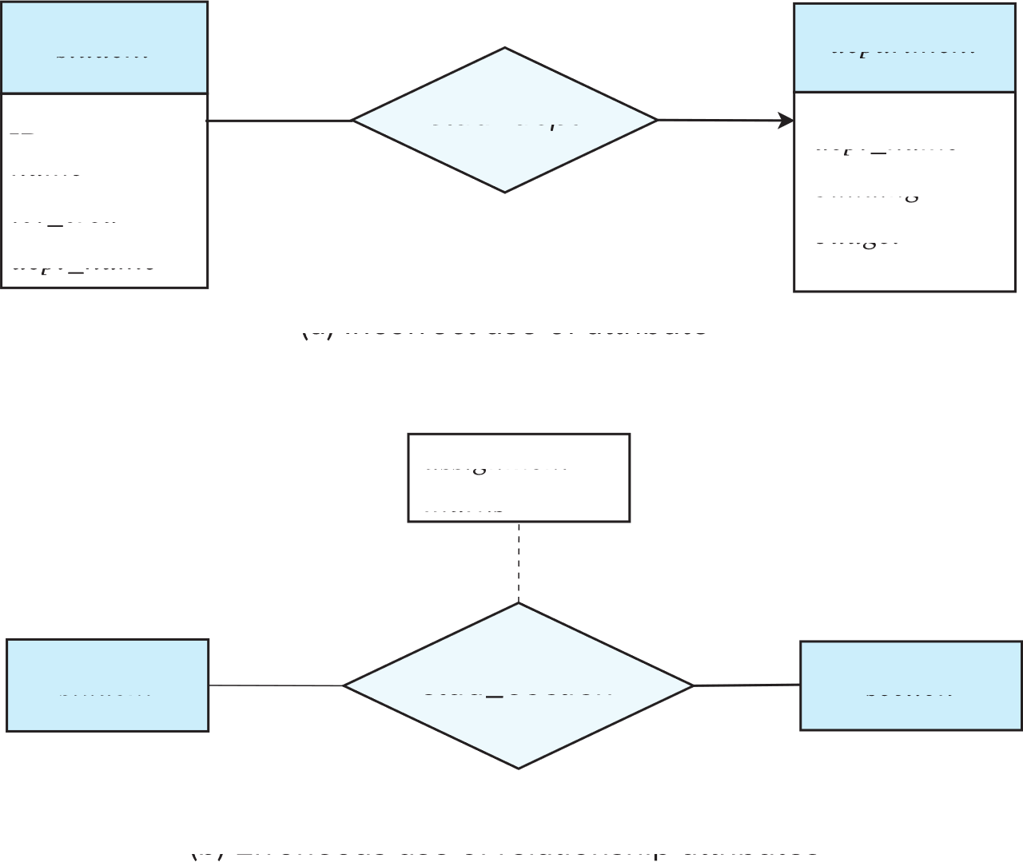
Common Mistakes in E-R Diagrams (Cont.)
Notes:
80

Slide 81
Entities vs. Attributes
Use of entity sets vs. attributes
Use of phone as an entity allows extra information about phone numbers (plus multiple phone numbers)
Notes:
81

Slide 82
Entities vs. Relationship sets
Use of entity sets vs. relationship sets
Possible guideline is to designate a relationship set to describe
  an action that occurs between entities
Placement of relationship attributes
For example, attribute date as attribute of advisor or as attribute of student
Notes:
82

Slide 83
Binary Vs. Non-Binary Relationships
Although it is possible to replace any non-binary (n-ary, for n > 2) relationship set by a number of distinct binary relationship sets, a n-ary relationship set shows more clearly that several entities participate in a single relationship.
Some relationships that appear to be non-binary may be better represented using binary relationships
  For example, a ternary relationship parents, relating a child to his/her father and mother, is best replaced by two binary relationships, father and mother
    Using two binary relationships allows partial information (e.g., only mother being known)
  But there are some relationships that are naturally non-binary
    Example: proj_guide
Notes:
83

Slide 84
Converting Non-Binary Relationships to Binary Form
In general, any non-binary relationship can be represented using binary relationships by creating an artificial entity set.
  Replace R between entity sets A, B and C by an entity set E, and three relationship sets:
1. R_{A}, relating E and A 2. R_{B}, relating E and B
3. R_{C}, relating E and C
  Create an identifying attribute for E and add any attributes of R to E
  For each relationship (a_{i} , b_{i} , c_{i}) in R, create
1. a new entity e_{i} in the entity set E 2. add (e_{i} , a_{i} ) to R_{A}
3. add (e_{i} , b_{i} ) to R_{B} 4. add (e_{i} , c_{i} ) to R_{C}
Notes:
84

Slide 85
Converting Non-Binary Relationships (Cont.)
Also need to translate constraints
  Translating all constraints may not be possible
  There may be instances in the translated schema that
  cannot correspond to any instance of R
    Exercise: add constraints to the relationships R_{A}, R_{B} and R_{C} to ensure that a newly created entity corresponds to exactly one entity in each of entity sets A, B and C
  We can avoid creating an identifying attribute by making E a weak entity set (described shortly) identified by the three relationship sets
Notes:
85

Slide 86
E-R Design Decisions
The use of an attribute or entity set to represent an object.
Whether a real-world concept is best expressed by an entity set or a relationship set.
The use of a ternary relationship versus a pair of binary relationships.
The use of a strong or weak entity set.
The use of specialization/generalization – contributes to modularity in the design.
The use of aggregation – can treat the aggregate entity set as a single unit without concern for the details of its internal structure.

Slide 87
Summary of Symbols Used in E-R Notation

Slide 88
Symbols Used in E-R Notation (Cont.)

Slide 89
Alternative ER Notations
Chen, IDE1FX, …

Slide 90
Alternative ER Notations
Chen IDE1FX (Crows feet notation)

Slide 91
UML
UML: Unified Modeling Language
UML has many components to graphically model different aspects of an entire software system
UML Class Diagrams correspond to E-R Diagram, but several differences.

Slide 92
ER vs. UML Class Diagrams
* Note reversal of position in cardinality constraint depiction

Slide 93
ER vs. UML Class Diagrams
ER Diagram Notation
Equivalent in UML
* Generalization can use merged or separate arrows independent
of disjoint/overlapping

Slide 94
UML Class Diagrams (Cont.)
Binary relationship sets are represented in UML by just drawing a line connecting the entity sets. The relationship set name is written adjacent to the line.
The role played by an entity set in a relationship set may also be specified by writing the role name on the line, adjacent to the entity set.
The relationship set name may alternatively be written in a box, along with attributes of the relationship set, and the box is connected, using a dotted line, to the line depicting the relationship set.

Slide 95
ER vs. UML Class Diagrams

Slide 96
Other Aspects of Database Design
Functional Requirements
Data Flow, Workflow
Schema Evolution

Slide 97
PART – I Two Mark Question Bank
What is meant by nonprocedural query language?
The tuple relational calculus, by contrast, is a nonprocedural query language. It describes the desired information without giving a specific procedure for obtaining that information. A query in the tuple relational calculus is expressed as: {t | P(t)}
2.Write a query to find the ID, name, dept name, salary for instructors whose salary is greater than $80,000.
{t | t ∈ instructor ∧ t[salary] > 80000} {t | ∃ s ∈ instructor (t[ID] = s[ID] ∧ s[salary] > 80000)}
3. Formal Definition for tuple relation calculus.
A tuple-relational-calculus expression is of the form: {t|P(t)} where P is a formula. Several tuple variables may appear in a formula. A tuple variable is said to be a free variable unless it is quantified by a ∃ or ∀. Thus, in: t ∈ instructor ∧ ∃ s ∈ department(t[dept name] = s[dept name]) t is a free variable. Tuple variable s is said to be a bound variable.

Slide 98
What is meant by Safety of Expressions?
A tuple-relational-calculus expression may generate an infinite relation. The expression: {t |¬ (t ∈ instructor )} There are infinitely many tuples that are not in instructor. Most of these tuples contain values that do not even appear in the database.
What is meant by Expressive Power of Languages?
The tuple relational calculus restricted to safe expressions is equivalent in expressive power to the basic relational algebra (with the operators ∪, −, ×, , and , but without the extended relational operations such as generalized projection and aggregation (G)).
Define Domain Relational Calculus.
A second form of relational calculus, called domain relational calculus, uses domain variables that take on values from an attributes domain, rather than values for an entire tuple.
Formal Definition for domain relational calculus.
An expression in the domain relational calculus is of the form {< x1, x2,..., xn > | P(x1, x2,..., xn)} where x1, x2,..., xn represent domain variables. P represents a formula composed of atoms, as was the case in the tuple relational calculus.

Slide 99
Write a Rules to build up a domain relational calculus.
An atom is a formula.• If P1 is a formula, then so are ¬P1 and (P1).• If P1 and P2 are formulae, then so are P1 ∨ P2, P1 ∧ P2, and P1 ⇒ P2.• If P1(x) is a formula in x, where x is a free domain variable, then ∃ x (P1(x)) and• ∀ x (P1(x))
Find the instructorID, name, dept name, and salary for instructors whose salary is greater than $80,000.
{< i, n, d,s > | < i, n, d,s > ∈ instructor ∧ s > 80000}
Expressive Power of Languages for domain relational calculus.
When the domain relational calculus is restricted to safe expressions, it is equivalent in expressive power to the tuple relational calculus restricted to safe expressions. The restricted tuple relational calculus is equivalent to the relational algebra; all three of the following are equivalent: o The basic relational algebra (without the extended relational-algebra operations) o The tuple relational calculus restricted to safe expressions o The domain relational calculus restricted to safe expressions

Slide 100
Define entity relationship model.
The entity-relationship (E-R) data model was developed to facilitate database design by allowing specification of an enterprise schema that represents the overall logical structure of a database.
Define Entity Sets.
An entity is a “thing” or “object” in the real world that is distinguishable from all other objects. For example, each person in a university is an entity. An entity has a set of properties, and the values for some set of properties may uniquely identify an entity.
Define Relationship Sets.
A relationship is an association among several entities. For example, we can define a relationship advisor that associates instructor Katz with student Shankar. This relationship specifies that Katz is an advisor to student Shankar. A relationship set is a set of relationships of the same type. Formally, it is a mathematical relation on n ≥ 2 (possibly nondistinct) entity sets. If E1, E2,..., En are entity sets, then a relationship set R is a subset of {(e1,e2,...,en) | e1 ∈ E1,e2 ∈ E2,...,en ∈ En} where (e1,e2,...,en) is a relationship.

Slide 101
What is an attribute?
It is a single-valued property of either an entity-type or a relationship-type. For example, a lecture might have attributes: time, date, duration, place, etc. An attribute is represented by an Ellipse.
What is meant by Composite attribute?
It is possible to break down composite attribute. For example, a student's full name may be further divided into first name, second name, and last name.
What is meant by Derived attribute?
This type of attribute does not include in the physical database. Their values are derived from other attributes present in the database. For example, age should not be stored directly. Instead, it should be derived from the DOB of that employee.
What is meant by Multivalued attribute?
Multivalued attributes can have more than one values. For example, a student can have more than one mobile number, email address, etc.

Slide 102
Define Cardinality.
Defines the numerical attributes of the relationship between two entities or entity sets. Different types of cardinal relationships are: One-to-One Relationships• One-to-Many Relationships• May to One Relationships• Many-to-Many Relationships•
List out the ER- Diagram Notations.
ER- Diagram is a visual representation of data that describe how data is related to each other. Rectangles: This symbol represent entity types• Ellipses : Symbol represent attributes• Diamonds: This symbol represents relationship types• Lines: It links attributes to entity types and entity types with other relationship types• Primary key: attributes are underlined• Double Ellipses: Represent multi-valued attributes•
Define Unified Modeling Language UML.
The Unified Modeling Language (UML) is a standard developed under the auspices of the Object Management Group (OMG) for creating specifications of various components of a software system.

Slide 103
List out the parts of UML.
Class diagram. A class diagram is similar to an E-R diagram. Later in this section we• illustrate a few features of class diagrams and how they relate to E-R diagrams. Use case diagram. Use case diagrams show the interaction between users and the system,• in particular the steps of tasks that users perform (such as withdrawing money or registering for a course). Activity diagram. Activity diagrams depict the flow of tasks between various components• of a system. Implementation diagram. Implementation diagrams show the system components and• their interconnections, both at the software component level and the hardware component level.
Define workflow.
The term workflow refers to the combination of data and tasks involved in processes like those of the preceding examples. Workflows interact with the database system as they move among users and users perform their tasks on the workflow.
Define Weak Entities.
A weak entity is a type of entity which doesn't have its key attribute. It can be identified uniquely by considering the primary key of another entity. For that, weak entity sets need to have participation.

Slide 104
List out the difference between strong entity and weak entity set.
Strong Entity Set :
Strong entity set always has a primary key, represented by a rectangle symbol.
It contains a Primary key represented by the underline symbol.
The member of a strong entity set is called as dominant entity set.
Primary Key is one of its attributes which helps to identify its member.
In the ER diagram the relationship between two strong entity set shown by using a diamond symbol.
Weak Entity Set
It does not have enough attributes to build a primary key,represented by a double rectangle symbol.
It contains a Partial Key which is represented by a dashed underline symbol.
The member of a weak entity set called as a subordinate entity set.
In a weak entity set, it is a combination of primary key and partial key of the strong entity set.
The relationship between one strong and a weak entity set shown by using the double diamond symbol.

Slide 105
PART – II Big Questions
1. Explain database design & ER model.
2. Discuss about the use of entity set in shape.
3. Explain about the extended ER features.
4. Explain about Formal Definition for tuple relational calculus.
5. Describe about Formal Definition for domain relational calculus.
6. Explain about Safety of Expressions for tuple relational calculus.
7. Describe about Safety of Expressions for domain relational calculus.
8. Discuss about Expressive Power of Languages in domain relational calculus.
9. Explain about types attributes with eg.
10. Discuss about mapping cardinalities with eg.
11. Explain about Entity-Relationship Model

Slide 106
Thank You

