Slide 1
Big Data Analytics
Unit IV : Hadoop Foundation For Analytics
Dr.S.Chitra,
Assistant Professor,
Department of Computer Science,
Annai Vailankanni Arts and Science College, Thanjavur

Slide 2
Hadoop
Hadoop is
An Open source project of the Apache foundation
Framework written in java
Uses Googles MapReduce and Google File System technologies as its foundation
Core part of the computing infrastructure for companies : yahoo,flipkart

Slide 3
History of Hadoop
Developed : Doug Cutting, 2005,Creator of Apache Lucene ( text search Library)
created to support distribution “Nutch”, text search engine
Doug Cutting and Mike Cafarella
Doug added DFS and MapReduce to Nutch
Cloudera founded
Started working on Nutch
2002
2003
2004
2005
2006
2007
2008
2009
Google published GFS and MapReduce
Yahoo hired Doug Hadoop spins out Nutch
Doug Cutting joined Cloudera

Slide 4
Needs of Hadoop
Needs of Hadoop
Inherent data protection
Low cost
Scalability
Storage Flexibility
Computing power

Slide 5
Features of Hadoop
Handle massive quantities of structures, Semi Structured and unstructured data
Shared nothing architecture
Replicates its data across multiple computers
High throughput rather than low latency
Complement of OLAP and OLTP
Not a replacement for RDBMS
Not good for dependencies within the data
Not good for processing small files
Best for huge data files and data sets

Slide 6
Key Advantages of Hadoop
Stores data in its native format
No loss of information as there is no translation / transformation to any specific schema
Scalability – proven to scale by companies like facebook & yahoo
Delivers new insights
Higher Availability – Fault tolerance through replication of data / fail over across computer nodes
Reduced cost – lower cost / terabyte of storage and processing
H/W can be added or swapped in or out of a cluster

Slide 7
Versions of Hadoop
Hadoop 1.0 :
Stores data files in any format
Schema less
HDFS[Hadoop Distributed File System]
Data Storage Framework:
Reducers: produce the output data
Mappers: key-value pairs and generate intermediate data
Map Reduce
Data Processing Framework:
Limitations of Hadoop1.0
Requirement of MapReduce Programming expertise along with java.
Supports only batch processing.
Tightly coupled with MapReduce.
Hadoop 2.0:
YARN [ Yet Another Resource Negotiator]
Parallel Tasks, flexibility, Scalability and efficiency
Advantages of Hadoop 2.0
MapReduce programming expertise no required
It supports both batch processing and real time processing

Slide 8
RDBMS vs Hadoop
Parameters
System
Data
RDBMS
Relational Database Systems
Structured Data
Hadoop
Node based flat structure
processing
10,000 to 14,000 per terabytes of storage
Analytical and big data processing
Structured and Unstructured
Data needs consistent relationship
Big data processing does not require consistent relationship
OLTP
Needs expensive hardware or high end processor to store huge amount of data
Requires only a processor, network card and few hard drives
Cost
4,000 per terabytes of storage
processor
Choice

Slide 9
Hadoop Overview
Open Source Software framework, distributed fashion on large clusters of hardware
Accomplishes two tasks
1. Massive Data Storage
2. Faster Data Processing

Slide 10
Ke y Aspects of Hadoop
Open Source Software: free to download,use and contribute to
Framework : to develop and execute applicatio
Distribued : parallel across multiple conneced nodes
Massive Storage
Faster Processig : Parallel,quick response

Slide 11
Hadoop Components
Hadoop Ecosystem
FLUME
OOZIE
MAHOUT
----
HIVE
PIG
SQOOP
HBASE
Core Components:
MapReduce Programming
Hadoop Distributed File System (HDFS)

Slide 12
Hadoop Core Components
HDFS:
Storage Component
Distributes data across several nodes
Natively redundant
Map Reduce:
Computational framework
Splits a task across multiple nodes
Processes data in parallel

Slide 13
Hadoop Ecosystem
HDFS : stores data files to original format
Hbase : Hadoop’s database, supports structured data storage for large files
Hive : analysis of large data set using language ANSI SQL
Pig : data flow language, data converted into Map Reduce jobs automatically
ZooKeeper: coordination service for distributed applications
Oozie: workflow scheduler system to manage jobs
Mahout: scalable machine learning and data mining library
Chukwa : data collection system for managing large distributed system
Sqoop : transfer bulk data between Hadoop and structured data stores
Ambari: web-based tool for provisioning, managing and monitoring Apache Hadoop clusters

Slide 14
Hadoop Conceptual layer
Conceptually divided into two layers
Data Storage Layer : stores huge volume of data
Data processing layer : process data in parallel to extract meaningful insights from data.

Slide 15
Hadoop Architecture
Hadoop has a master-slave topology.
One master node and multiple slave nodes.
Master node : assign a task to various slave nodes manage resources and metadata.
Slave nodes : actual computing and store the real data.
Hadoop Architecture comprises three major layers.
HDFS (Hadoop Distributed File System)
Yarn
MapReduce (Contd..)

Slide 16
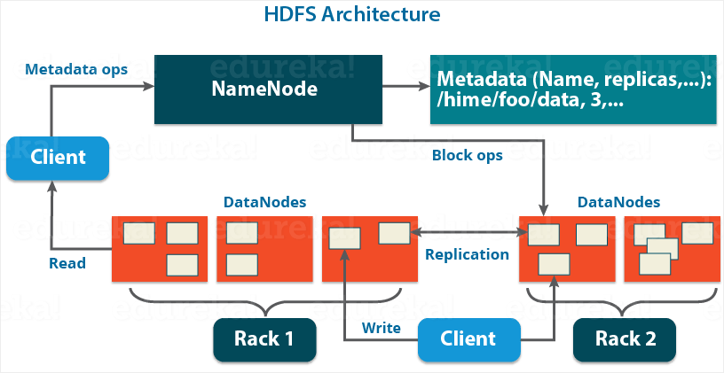

Slide 17
1. HDFS (Hadoop Distributed File System)
HDFS has a Master-slave architecture.
It provides for data storage of Hadoop.
HDFS splits the data unit into smaller units called blocks
It has got two daemons , master node – NameNode and slave nodes – DataNode. a. NameNode and DataNode :
NameNode : runs on the master server. Responsible : Namespace management and regulates file access by the client.
DataNode : runs on slave nodes. Responsible : storing actual business data.
NameNode also keeps track of mapping of blocks to DataNodes.
DataNodes serves read/write request from the file system’s client.
DataNode also creates, deletes and replicates blocks on demand from NameNode.

Slide 18
Secondary NameNode:
There is a third daemon or a process called Secondary NameNode.
The Secondary NameNode works concurrently with the primary NameNode as a helper daemon.
Functions of Secondary NameNode:
constantly reads all the file systems & writes it into the hard disk or the file system.
It is responsible for combining the EditLogs with FsImage from the NameNode.
It downloads the EditLogs from the NameNode at regular intervals and applies to FsImage.
The new FsImage is copied back to the NameNode.

Slide 19
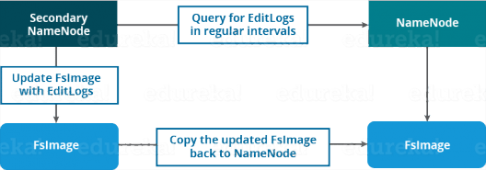
Secondary NameNode

Slide 20
b. Block in HDFS :
Block : smallest unit of storage on a computer system.
It is the smallest contiguous storage allocated to a file.
In Hadoop, we have a default block size of 128MB or 256 MB.

Slide 21
c. Replication Management
To provide fault tolerance, HDFS uses a replication technique.
It makes copies of the blocks and stores in on different DataNodes.
Replication factor decides how many copies of the blocks get stored.
It is 3 by default but we can configure to any value.

Slide 22
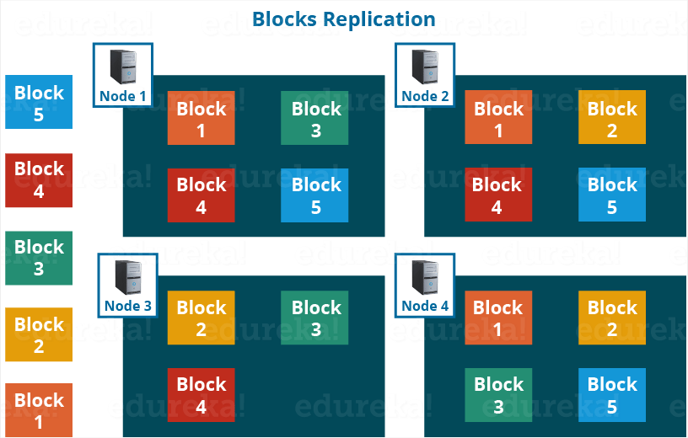

Slide 23
d. Rack Awareness : A rack contains many DataNode and there are several such racks in the production. HDFS follows a rack awareness algorithm : to place the replicas of the blocks in a distributed fashion. It provides for low latency and fault tolerance. Advantages of Rack Awareness: To improve the network performance To prevent loss of data:

Slide 25
HDFS Read/ Write Architecture:
HDFS follows Write Once – Read Many Philosophy.
can’t edit files already stored in HDFS. But, append new data by re-opening the file.
HDFS Write Architecture:
HDFS client write a file named “example.txt” of size 248 MB.
The client will be dividing the file “example.txt” into 2 blocks – one of 128 MB (Block A) and the other of 120 MB (block B).

Slide 26
The steps to write data into HDFS:
HDFS client Write Request against the two blocks, say, Block A & B.
NameNode grant permission for client and provide IP addresses of the DataNodes .
The selection of IP addresses of DataNodes is purely randomized based on availability, replication factor and rack awareness.
The NameNode provided following lists of IP addresses to the client:
For Block A, list A = {IP of DataNode 1, IP of DataNode 4, IP of DataNode 6}
For Block B, set B = {IP of DataNode 3, IP of DataNode 7, IP of DataNode 9}
Each block be copied in three different DataNodes to maintain the replication factor consistent throughout the cluster.

Slide 27
The whole data copy process will happen in three stages:
Set up of Pipeline
Data streaming and replication
Shutdown of Pipeline (Acknowledgement stage)
1. Set up of Pipeline:
Before writing , the client confirms whether the DataNodes, present in IP List, are ready to receive the data or not.
the client creates a pipeline for each of the blocks by connecting the individual DataNodes in the respective list for that block.
Let us consider Block A. The list of DataNodes provided by the NameNode is:

Slide 28
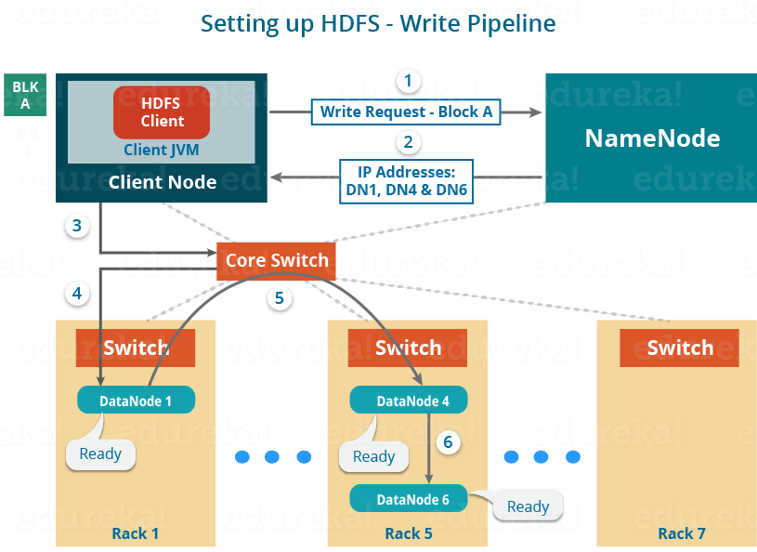
For Block A, list A = {IP of DataNode 1, IP of DataNode 4, IP of DataNode 6}.

Slide 29
For block A, the client will be performing the following steps to create a pipeline:
The client choose the first DataNode in the list, DataNode 1 and establish a TCP/IP connection.
The client inform DataNode 1 to be ready to receive the block.
It also provide the IPs of next two DataNodes (4 and 6) to the DataNode 1 where the block is supposed to be replicated.
The DataNode 1 connect to DataNode 4. The DataNode 1 inform DataNode 4 to be ready to receive the block and give IP of DataNode 6.
DataNode 4 tell DataNode 6 to be ready for receiving the data.
Next, the acknowledgement of readiness follow the reverse sequence, i.e. From the DataNode 6 to 4 and then to 1.
At last DataNode 1 inform the client that all the DataNodes are ready and a pipeline will be formed between the client, DataNode 1, 4 and
Now pipeline set up is complete and the client will finally begin the data copy or streaming process.

Slide 30
2. Data Streaming:
As the pipeline has been created, the client push the data into the pipeline.
Data is replicated based on replication factor. So, here Block A will be stored to three DataNodes as the assumed replication factor is 3.
Moving ahead, the client will copy the block (A) to DataNode 1 only. The replication is always done by DataNodes sequentially.

Slide 32
The following steps will take place during replication:
Once the block has been written to DataNode 1 by the client, DataNode 1 connect to DataNode 4.
Then, DataNode 1 push the block in the pipeline and data will be copied to DataNode 4.
Again, DataNode 4 connect to DataNode 6 and will copy the last replica of the block.

Slide 33
3. Shutdown of Pipeline or Acknowledgement stage:
Once the block has been copied into all the three DataNodes.
A series of acknowledgements will take place to ensure the client and NameNode that the data has been written successfully.
Then, the client finally close the pipeline to end the session.
In the figure below, the acknowledgement happens in the reverse sequence i.e. from DataNode 6 to 4 and then to 1.
Finally, the DataNode 1 push three acknowledgements into the pipeline and send to the client.
The client inform NameNode that data has been written successfully.
The NameNode will update its metadata and the client will shut down the pipeline.

Slide 35
Similarly, Block B also copied into the DataNodes in parallel with Block A. So, the following things are to be noticed here:
The client will copy Block A and Block B to the first DataNode simultaneously.
Two pipelines be formed for each of the block and all the process discussed above happen in parallel in these two pipelines.
The client writes the block into the first DataNode and then the DataNodes will be replicating the block sequentially.

Slide 37
As you can see in the above image, there are two pipelines formed for each block (A and B).
Following is the flow of operations that is taking place for each block in their respective pipelines:
For Block A: 1A -> 2A -> 3A -> 4A
For Block B: 1B -> 2B -> 3B -> 4B -> 5B -> 6B

Slide 38
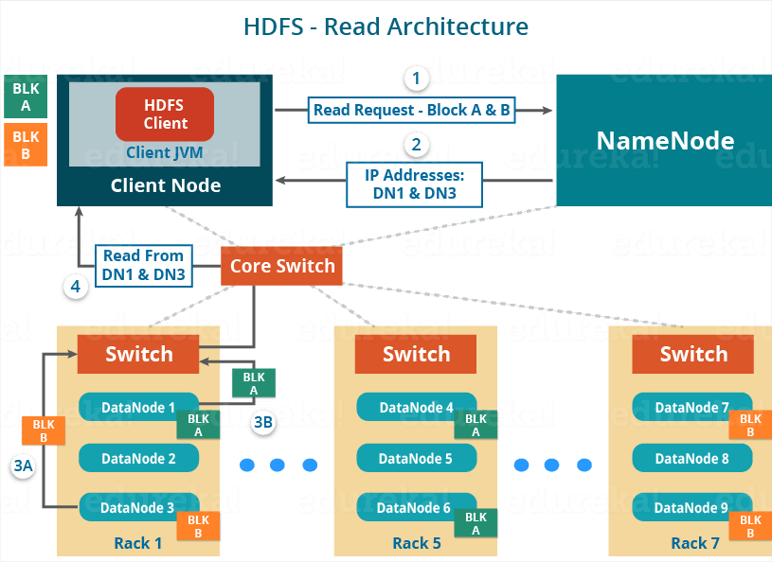
HDFS Read Architecture:
HDFS Read architecture is comparatively easy to understand.
Let’s take the above example again where the HDFS client wants to read the file “example.txt” now.

Slide 39
Now, following steps will be taking place while reading the file:
The client reach out to NameNode asking for the block metadata for the file “example.txt”.
The NameNode return the list of DataNodes where each block (Block A and B) are stored.
After that client connect to the DataNodes where the blocks are stored.
The client starts reading data parallel from the DataNodes (Block A from DataNode 1 and Block B from DataNode 3).
Once the client gets all the required file blocks, it combine these blocks to form a file.
HDFS selects the replica which is closest to the client. This reduces the read latency and the bandwidth consumption.

