Slide 1
Big Data Analytics
Unit V : Hadoop MapReduce and YARN framework
Dr.S.Chitra,
Assistant Professor,
Department of Computer Science,
Annai Vailankanni Arts and Science College, Thanjavur

Slide 2
Syllabus in Unit V
Hadoop MapReduce and YARN framework
Introduction to MapReduce
Processing data with Hadoop using MapReduce
Introduction to YARN
YARN Components
Needs of YARN
Challenges of YARN

Slide 3
Dissecting YARN
MapReduce application
Data serialization
Working with common serialization formats
Big data serialization formats

Slide 4
Introduction to Map Reduce

Slide 5
Introduction to MapReduce
Applications are split into a set of map tasks and reduce tasks.
These tasks are executed in a distributed fashion on Hadoop Cluster.
MapReduce job takes a set of files that is stored in HDFS as input.
Map task takes care of loading, parsing, transforming and filtering.
Reduce task is grouping and aggregating data produced by map task to generate final output.
(contd)

Slide 6
Introduction to MapReduce
Phases in Map task:
Record Reader
Mapper
Combiner
Partitioner
The output produced by map task is known as intermediate keys and values.
These values are sent to reducer.

Slide 7
Introduction to MapReduce
Phases in reduce task :
Shuffle
Sort
Reducer
Output format
Hadoop assigns map tasks to the Data Node where the actual data to be processed.
Data Locality : data is not moved over network; only computational code is moved to process data which saves network bandwidth.

Slide 8
MAPPER
Maps input key-value pairs into a set of intermediate key-value pairs.
Responsibility : transforming input records into intermediate key-value pairs.
Record Reader :
converts a byte-oriented view into record-oriented view and presents it to the mapper task.
It presents the task with keys and values.
Key : positional information
Values : chunk of data that constitutes the record.
(Contd..)

Slide 9
2. Map :
Works on the key-value pair produced by RecordReader.
Generates zero or more intermediate key-value pairs.
3. Combiner : (Local reducer)
Optional function
It provides high performance in terms of network bandwidth and disk space.
Local reducer : apply user specific aggregate function to only that mapper.
(Contd..)

Slide 10
4. Partitioner :
It splits the key-value pairs into shards and send the shards to the reducer as per the user-specific code.
The partitioned data of each map and is written to the local disk of that machine and pulled by the respective reducer.

Slide 11
REDUCER
Chore (responsibility) : reduce a set of intermediate values into a smaller set of values.
Shuffle and Sort :
It takes output of all partitioners and downloads them into the local machine where the reducer is running.
These individual data pipes are sorted by keys which produce large data list.
Purpose of sort : grouping similar words
(Contd..)

Slide 12
2. Reduce :
It takes the grouped data from the previous step
It applies reduce function and processes one group at a time
It iterates all the values associated with that key.
It provides various operations such as aggregation, filtering and combining data.
Once it is done , the output of reducer is sent to the output format.
3. Output Format :
It separates key-value pair with tab and write it out to a file using record writer.

Slide 13
COMBINER
(Optimization techniques)
It is an optimization technique for MapReduce job.
The ouput generated by combiner is intermediate data and it is passed to the reducer
Output of the reducer is passed to the output file on disk.

Slide 14
Partitioner
(Optimization Technique)
It happens after map phase and before reduce phase.
The number of partitions are equal to the number of reducers.
The default partitioner is hash partitioner.

Slide 15
COMPRESSION
It can compress MapReduce output file
It provides two benefits
Reduce the space to store files.
Speeds up data transfer across the network.
Codec : compression and decompression algorithm
GzipCodec : algorithm for gzip.

Slide 16
Processing data with Hadoop using MapReduce
MapReduce is a software framework

Slide 17
Introduction : YARN (Yet Another Resource Negotiator)
Apache Hadoop YARN : sub-project of Hadoop 2.x
Hadoop 2.x : YARN based Architecture, general processing platform.
It can run multiple applications parallel but it share a common resource management.

Slide 18
Hadoop 1.0
HDFS and MapReduce : Core Components
Hadoop version 1.0 : MRV1(MapReduce Version 1),
It performed both processing and resource management functions.
Job Tracker : single master, allocated the resources, performed scheduling and monitored the processing jobs.
It assigned map and reduce tasks on a number of subordinate processes called the Task Trackers.
It periodically reported their progress to the Job Tracker.

Slide 19
Hadoop 1.0 Architecture

Slide 20
Comparison of Hadoop 1.0 vs Hadoop 2.0

Slide 21
Limitations of Hadoop 1.0
Scalability : The cluster size will not be exceed more than 4000 nodes. it cannot run more than 40000 concurrent task.
Availability issues: if job tracker fails then it kills all queued and running jobs.
Resource utilization :due to prredefined number of map and reduce slots for each task tracker, resource utilization issues occur.
Limitations in running non-MapReduce applications : it supports only batch processing

Slide 22
Need for YARN
Scalability: it can have a cluster size of more than 10,000 nodes and can run more than 1,00,000 concurrent tasks.
Compatability: YARN supports the existing map-reduce applications without disruptions.
Cluster Utilization: allows dynamic allocation of cluster resources to improve resource utilization.
Multi-tenancy: It allows multiple engine access and perform real time analysis and running adhoc query.

Slide 23
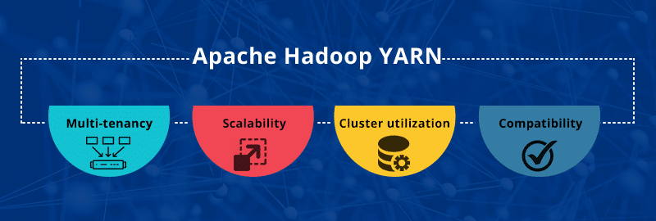
Need for YARN

Slide 24
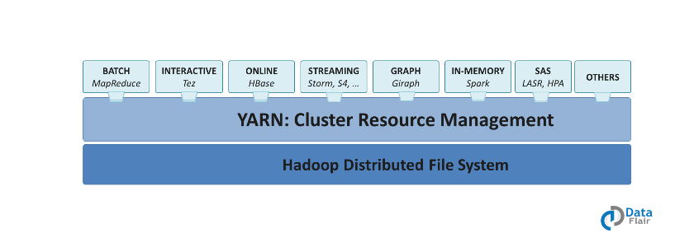
What is YARN?
Yet Another Resource Negotiator
It is the cluster resource management layer of the Apache Hadoop Ecosystem, which schedules jobs and assigns resources.

Slide 25
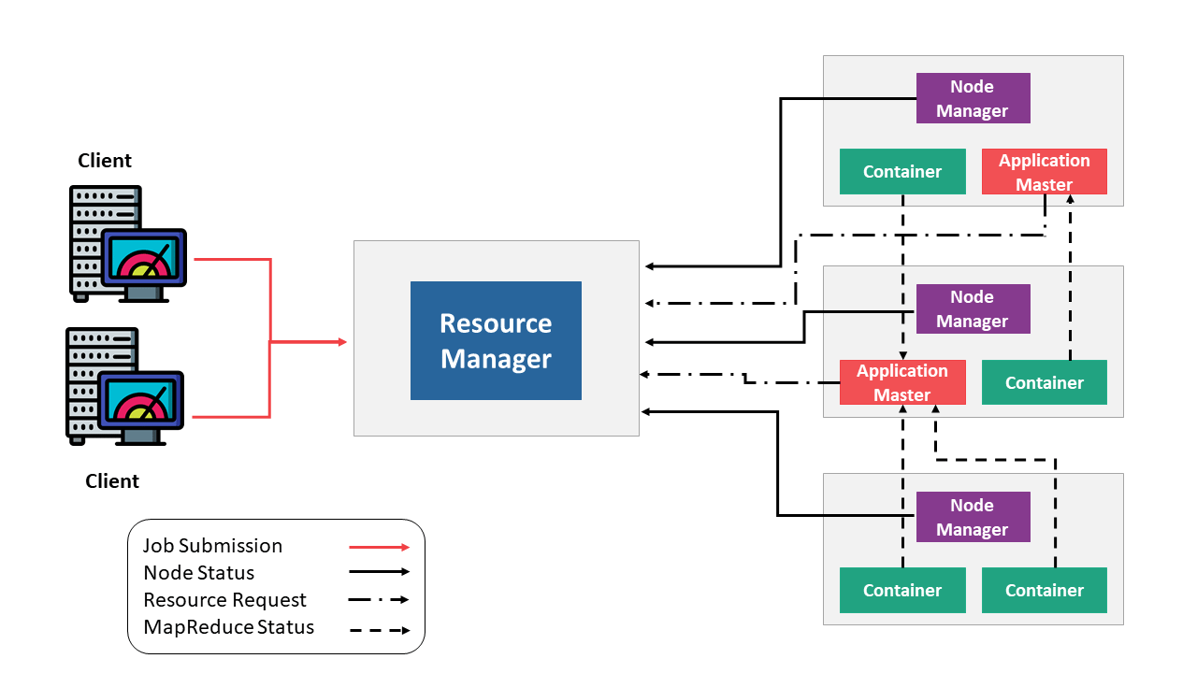
Components of YARN
General overview of YARN architecture

Slide 26
Components of YARN : 1. Resource Manager
Resource Manager
Scheduler
Applications Manager
Responsible for allocating resources to various running applications
Does not perform monitoring or tracking of status for the applications.
Offers no gurantee about restarting failed task due to hardware or application failures
responsible for accepting job submissions
Negotiates the first container for executing the application specific Application master
Provides the service for restarting the application master container on failure.

Slide 27
Components of YARN : 2. Node Manager
Node Manager
Container
Application Master
Has a collection of resources like CPU, Memory, Disk, Network etc.,
Authenticates and provides rights to an application to use specific amount of resources.
it manages resource needs of individual applications.
Interact with scheduler to acquire required resources and node manager to execute and manage tasks

Slide 28
Components of YARN : 2. Node Manager
Node Manager
Container
Application Master
Node Manager
Resource Manager
Monitors
Application Master
Resource Usage, CPU,Memory,etc
Node Manager

Slide 29
Running an Application in YARN :
Clients
Clients submits an application to the Resource Manager
Resource Manager
launches the Application Master by assigning some container
App. Master
It launches the container by providing the container launch specification to the node manager
Node Manager
it executes the application code and provides necessary information such as progress,status to the Application Master.
Container
it executes the Application master

Slide 30
MapReduce
MapReduce :
programming model for processing large data sets with a parallel , distributed algorithm on a cluster.
Map Reduce when coupled with HDFS can be used to handle big data.
The fundamentals of this HDFS-MapReduce system, which is commonly referred to as Hadoop

Slide 31
The basic unit of information, used in MapReduce is a (Key,value) pair.
All types of structured and unstructured data need to be translated to this basic unit, before feeding the data to MapReduce model.
As the name suggests, MapReduce model consist of two separate routines, namely Map-function and Reduce-function.
The computation on an input (i.e. on a set of pairs) in MapReduce model occurs in three stages:
Step 1 : The map stage
Step 2 : The shuffle stage
Step 3 : The reduce stage.

Slide 32
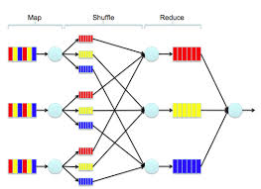
Semantically, the map and shuffle phases distribute the data, and the reduce phase performs the computation.

Slide 33
In the map stage, the mapper takes a single (key, value) pair as input and produces any number of (key, value) pairs as output .
It is important to think of the map operation as stateless, that is, its logic operates on a single pair at a time (even if in practice several input pairs are delivered to the same mapper).
The user simply designs a map function that maps an input (key, value) pair to any number (even none) of output pairs.
Most of the time, the map phase is simply used to specify the desired location of the input value by changing its key.

Slide 34
The shuffle stage is automatically handled by the MapReduce framework, i.e. the engineer has nothing to do for this stage.
The underlying system implementing MapReduce routes all of the values that are associated with an individual key to the same reducer.
In the reduce stage, the reducer takes all of the values associated with a single key k and outputs any number of (key, value) pairs.
all of the maps need to finish before the reduce stage can begin.
Since the reducer has access to all the values with the same key, it can perform sequential computations on these values. In the reduce step, the parallelism is exploited by observing that reducers operating on different keys can be executed simultaneously.

Slide 35
Map Reduce Applications
Let’s consider an example to understand Map-Reduce in depth. We have the following 3 sentences :
1. The quick brown fox
2. The fox ate the mouse
3. How now brown cow
Our objective is to count the frequency of each word in all the sentences.
Imagine that each of these sentences acquire huge memory and hence are allotted to different data nodes.

Slide 36
Mapper takes over this unstructured data and creates key value pairs. In this case key is the word and value is the count of this word in the text available at this data node. For instance, the 1st Map node generates 4 key-value pairs : (the,1), (brown,1),(fox,1), (quick,1). The first 3 key-value pairs go to the first Reducer and the last key-value go to the second Reducer.

Slide 38
Similarly, the 2nd and 3rd map functions do the mapping for the other two sentences. Through shuffling, all the similar words come to the same end. Once, the key value pairs are sorted, the reducer function operates on this structured data to come up with a summary.
Let’s take some example of Map-Reduce function usage in the industry :
• At Google:
– Index building for Google Search – Article clustering for Google News – Statistical machine translation
• At Yahoo!:
– Index building for Yahoo! Search – Spam detection for Yahoo! Mail
• At Facebook:
– Data mining – Ad optimization, – Spam detection Example

Slide 39
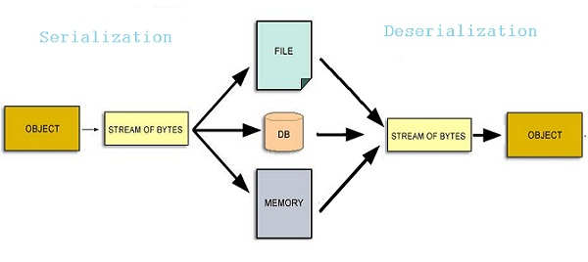
DATA SERIALIZATION
It is the process of converting data objects present in complex data structures into a byte stream for storage,transfer and distribution purposes on physical devices.
Once the serialized data is transmitted the reverse process of creating objects from the byte sequence called deserialization.

Slide 40
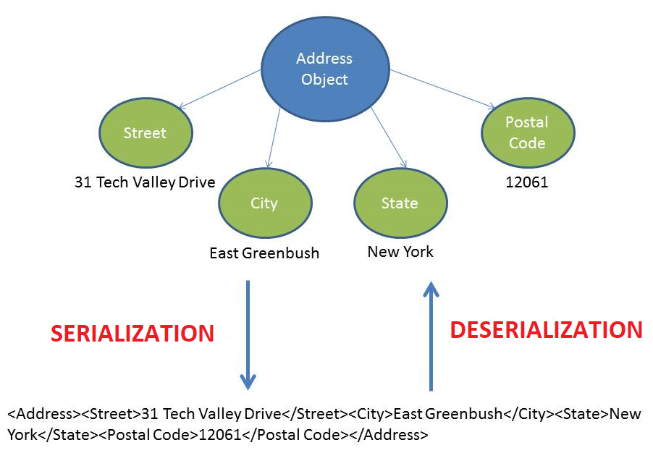
HOW IT WORKS?
Computer data is generally organized in data structures such as arrays, tables, trees, classes. When data structures need to be stored or transmitted to another location, such as across a network, they are serialized.
Serialization becomes complex for nested data structures and object references.

Slide 41
APPLICATIONS OF DATA SERIALIZATION
Serialization allows a program to save the state of an object and recreate it when needed.
Persisting data onto files – happens mostly in language-neutral formats such as CSV or XML.
Storing data into Databases – when program objects are converted into byte streams and then stored into DBs, such as in Java JDBC.
Transferring data through the network – such as web applications and mobile apps passing on objects from client to server and vice versa.
Sharing data in a Distributed Object Model – When programs written in different languages need to share object data over a distributed network .

Slide 42
Disadvantages Of SERIALIZATION
It may allow a malicious party with access to the serialization byte stream to read private data, create objects with illegal or dangerous state, or obtain references to the private fields of deserialized objects.
Workarounds are tedious, not guaranteed.
Open formats too have their security issues.
XML might be tampered using external entities like macros or unverified schema files.
JSON data is vulnerable to attack when directly passed to a JavaScript engine due to features like JSONP requests.

Slide 43
Data Serialization Formats in Hadoop
XML • CSV • YAML • JSON • BSON • MessagePack • Thrift • Protocol buffers • Avro

Slide 44
TEXT-BASED DATA SERIALIZATION FORMATS
• XML(Extensible Markup Language):
Nested textual format. Human-readable and editable.
• Schema based validation.
• Used in metadata applications, web services data transfer, web publishing.
CSV (Comma-Separated Values) :
• Table structure with delimiters.
• Human-readable textual data.
• Opens as spreadsheet or plaintext.
• CSV file is the most commonly used datafile format.
• Easy to read, Easy to parse, Easy to export data from an RDBMS table.

Slide 45
JSON (JavaScript Object Notation) :
Short syntax textual format with limited data types.
Human-readable. Derived from JavaScript data formats.
No need of a separate parser (like XML) since they map to JavaScript objects. No direct support for DATE data type. All data is dynamically processed
It is in text format that stores meta data with the data, so it fully supports schema evolution and also spiltable.
It can easily add or remove attributes for each datum.

Slide 46
YAML Ain't Markup Language :
It is a data serialization language which is designed to be human -friendly and works well with other programming languages for everyday tasks.
Superset of JSON • Supports complex data types. Maps easily to native data structures.
Binary JSON:
It is a binary-encoded serialization of JSON-like documents.
MongoDB uses BSON ,when storing documents in collections
It deals with attribute-value pairs like JSON. Includes datetime, bytearray and other data types not present in JSON.

Slide 47
Protopuf :
It is designed for data to be transparently converted from/to JSON.
Support rich set of data structures
It create schema based annotation
Primary use is network communication
Message Pack:
•It is Created by Google
•It is Google's language-neutral, platform-neutral, extensible mechanism for serializing structured data
•Protocol buffers currently support generated code in Java, Python, Objective-C, and C++.

Slide 48
AVRO :
Apache Avro is a language-neutral data
serialization system, developed by Doug Cutting. the father of Hadoop.
It also called a schema-based serialization technique.

Slide 49
PERFORMANCE CHARACTERISTICS
Speed – Binary formats are faster than textual formats. A late entrant, protobuf reports the best times. JSON is preferable due to readability and being schema-less.
Data size – This refers to the physical space in bytes post serialization. For small data, compressed JSON data occupies more space compared to binary formats like protobuf. Generally, binary formats always occupy lessspace.
Usability – Human readable formats like JSON are naturally preferred over binary formats. For editing data, YAML is good. Schema definition is easy in protobuf, with in-built tools.
Compatibility-Extensibility – JSON is a closed format. XML is average with schema versioning. Backward compatibility (extending schemas) is best handled by protobuf.

Slide 50
Thank You

