Slide 1
Effector Responses
Dr. P. Murugan, M.Sc., M.Phil., Ph.D.,
Assistant Professor and Principal i/c
Department of Biochemistry,
Bharathidasan University Model College,
Vedharanyam - 614 810.

Slide 2
Antibody Mediated Effector Functions
Neutralization
Agglutination
Opsonization
Complement fixation
Antibody-dependent cell-mediated cytotoxicity
Degranulation

Slide 3
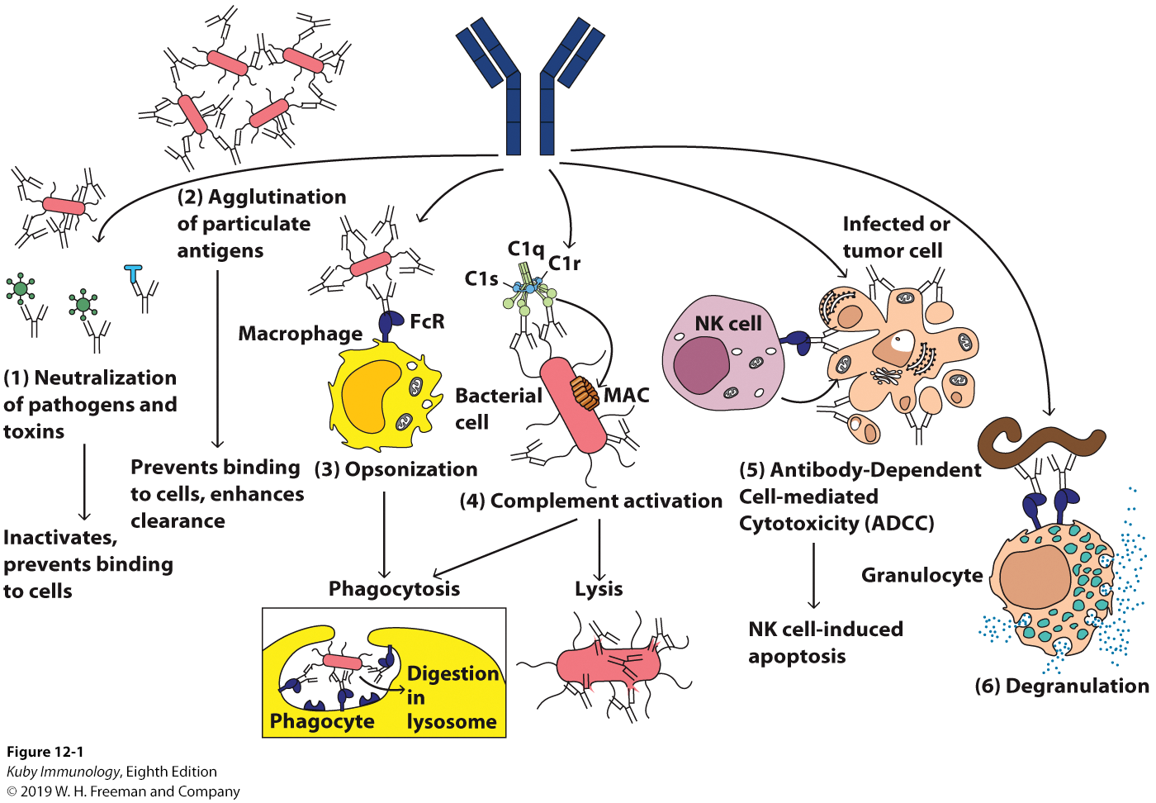

Slide 4
Neutralization
Antibodies can coat a virus or other antigen, preventing it from binding other cells or tissue

Slide 5
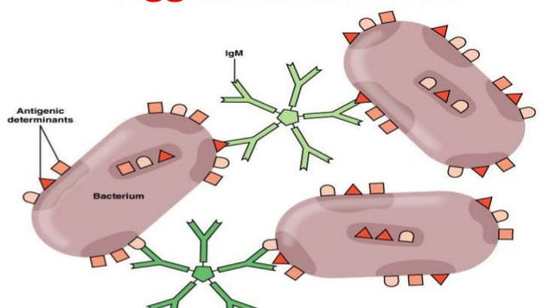
Agglutination

Slide 6
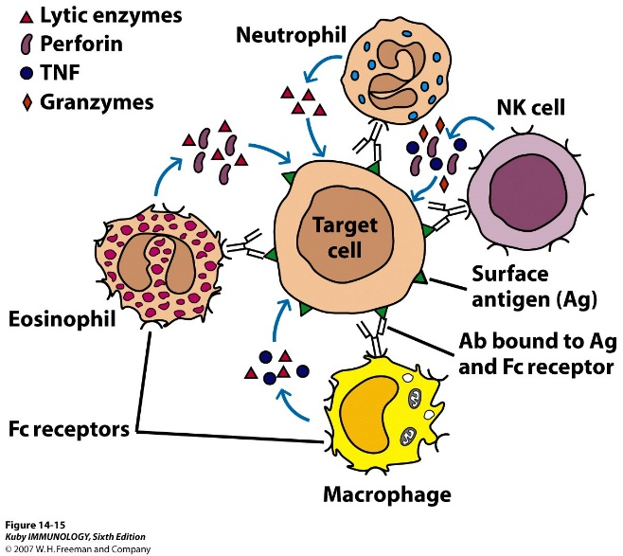
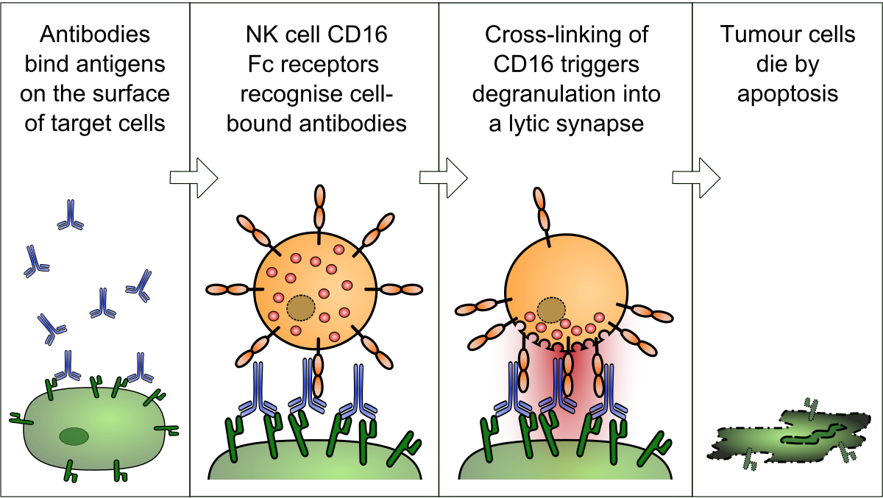
Antibody-dependent cell-mediated cytotoxicity (ADCC)
Cells that have cytotoxic potential (NK cells, macrophages, etc) express receptors for Fc portion of antibody
Fc receptors
Antibody binds antigen with Fab portion, Fc portion is free to bind with Fc receptors on immune cells for phagocytosis, etc.

Slide 7
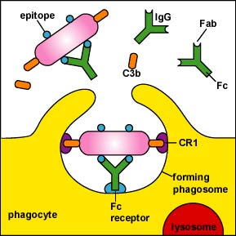
Opsonization
Fc receptors
Antibody binds antigen with Fab portion, Fc portion is free to bind with Fc receptors on immune cells for phagocytosis, etc.

Slide 8
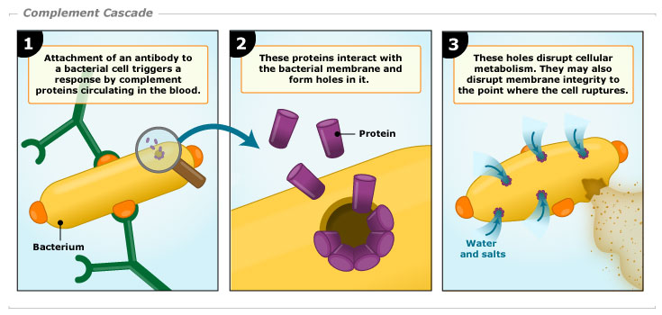
Complement Fixation

Slide 9
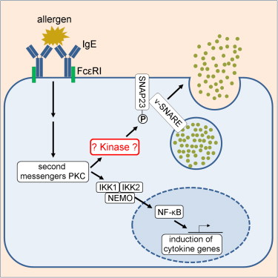
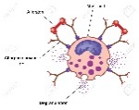
Degranulation

Slide 10
Antibody Isotypes Mediate Different Effector Functions
IgM
Fixing complement
Very good at grabbing pathogens
IgG
Fix complement
Mediate ADCC
IgA
Neutralize toxins and pathogens
In secretions
IgE
Inflammation, parasite

Slide 11
Cell Mediated Immunity
Important in detecting and eliminating cells that harbor intracellular pathogens
Antigen specific
CD8+ and CD4+ T cells
Nonspecific cells
NK cells, non-lymphoid types such as macrophages, neutrophils, and eosinophils

Slide 12
Effector Responses
Importance of these become evident when system is defective
DiGeorge Syndrome
Born without thymus, lack T cell component
Can fight extracellular pathogens but have issues with intracellular pathogens (viruses, intracellular bacteria)
Effector T cells express variety of effector molecules

Slide 13
Cytotoxic T cells
CTLs or T_{c} cells, CD8+
Class I MHC restricted

Slide 14
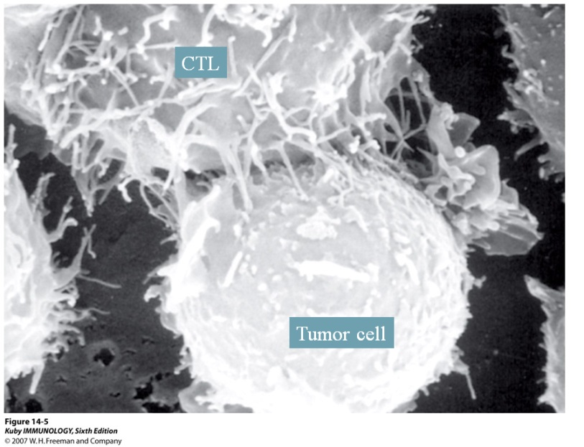
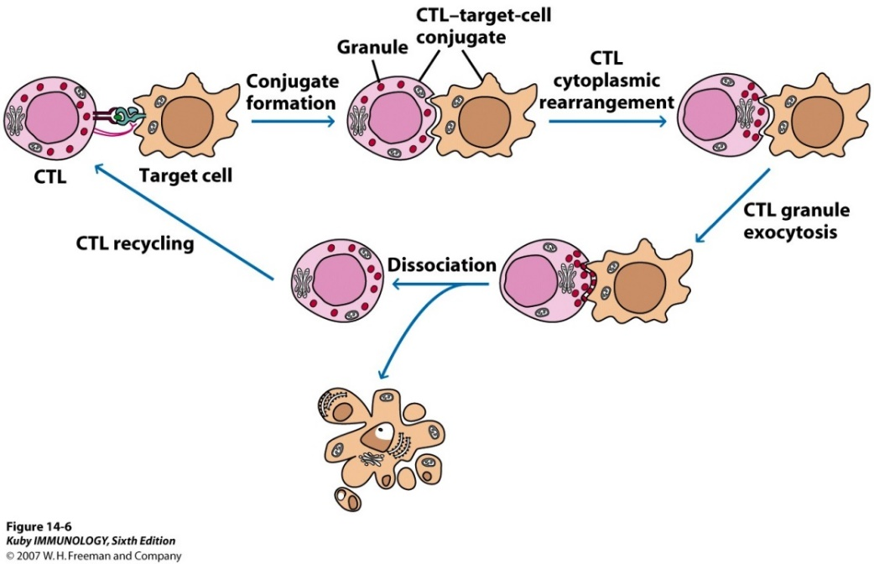
Effector phase of CTLs
CTL-Mediated Death
Conjugate formation of CTL with infected cell
Membrane attack, CTL dissociation
Target cell destruction either through perforin or Fas-FasL pathway
Apoptosis: https://www.youtube.com/watch?v=-vmtK-bAC5E
Granules contain perforin

Slide 15
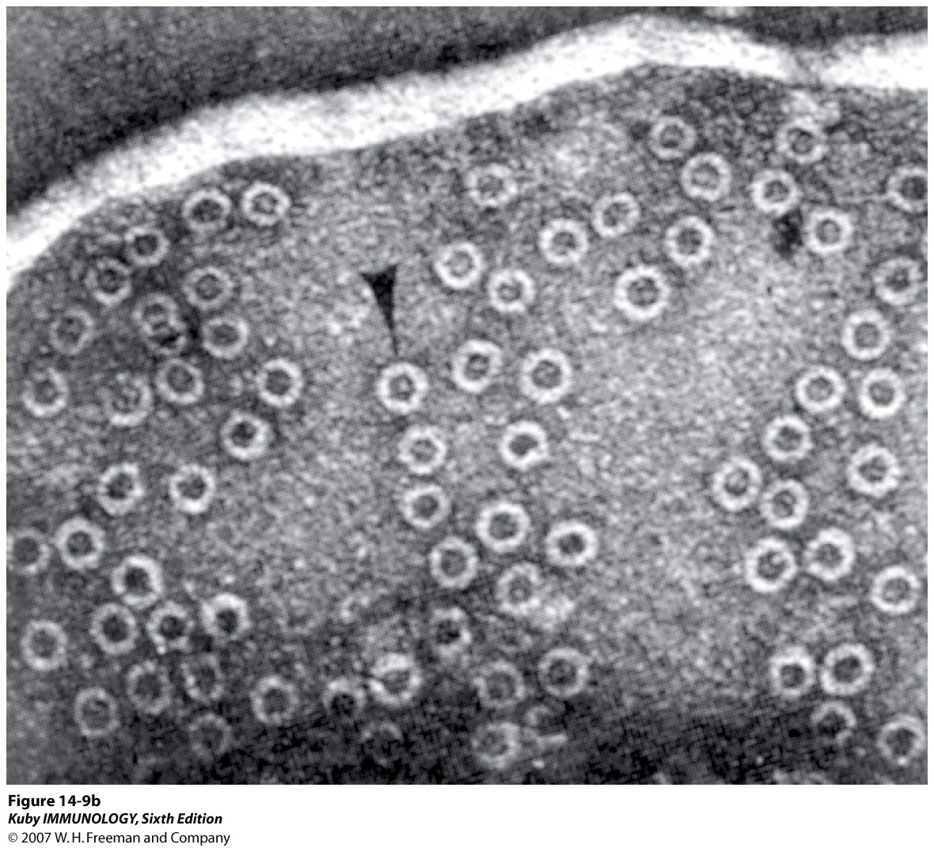
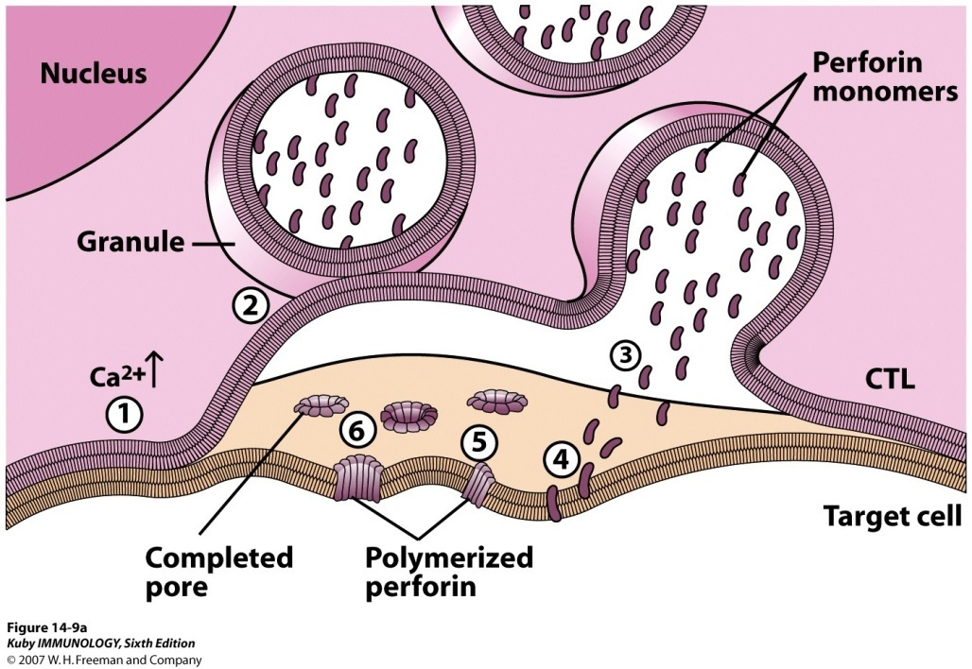

Slide 16
Natural Killer Cells (NK)
Defend against viruses, other intracellular pathogens, and tumors
Produce important cytokines
Lymphoid cells
Share early lineage to T cells
NK cells don’t develop exclusively in thymus
Killing of target cell is similar to that of CTL

Slide 17
NK Cells
Opposing signals model
Many different receptors for activation and different inhibitory ones
NK receptors
Lectin-like
Actually bind proteins instead of carbs
Immunoglobulin-like
Balance between activation and inhibitory signals allows NK to distinguish between self and nonself
Very complicated

Slide 18
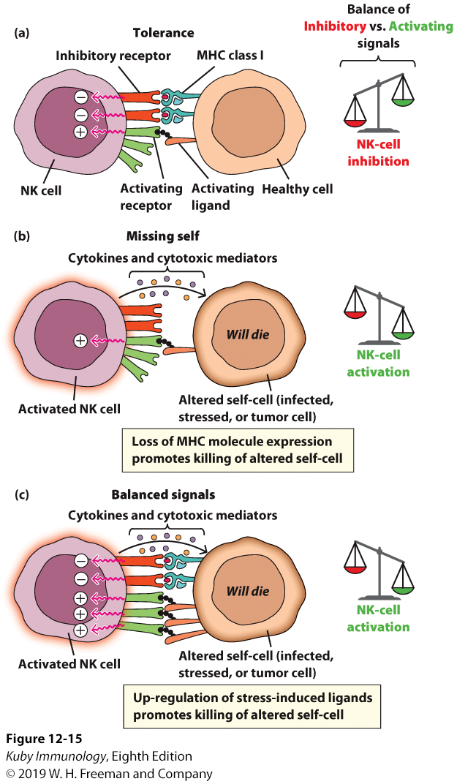

Slide 19
Natural Killer Cells
Watch this video:
https://www.youtube.com/watch?v=XLOcG8pZNZE
Some NK cells show that they may be able to become memory cells (?)

Slide 20
NKT cells
Cells that have characteristics common to CTLs and NK cells
Considered part of the innate immune system
Role remains to be completely defined

Slide 21
Experimental Assessment of CML
Mixed Lymphocyte Reaction (MLR)
T lymphocytes from 2 donors undergo extensive proliferation when mixed
Each donors’ MHC is the antigen
If MHC is same on both donors’ cells then there is no reaction
If MHC is different, each donors’ T cells will react to each other and will proliferate
Degree can be measured by adding [³H]-Thymidine to culture and monitoring uptake into DNA

Slide 22
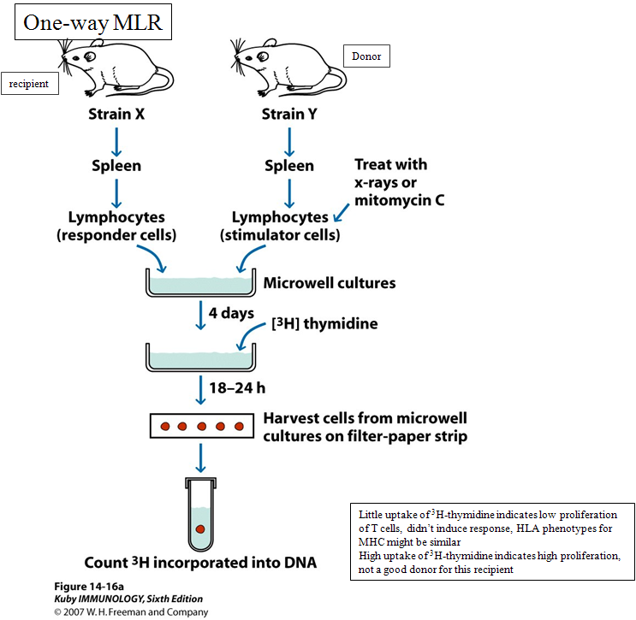

Slide 23
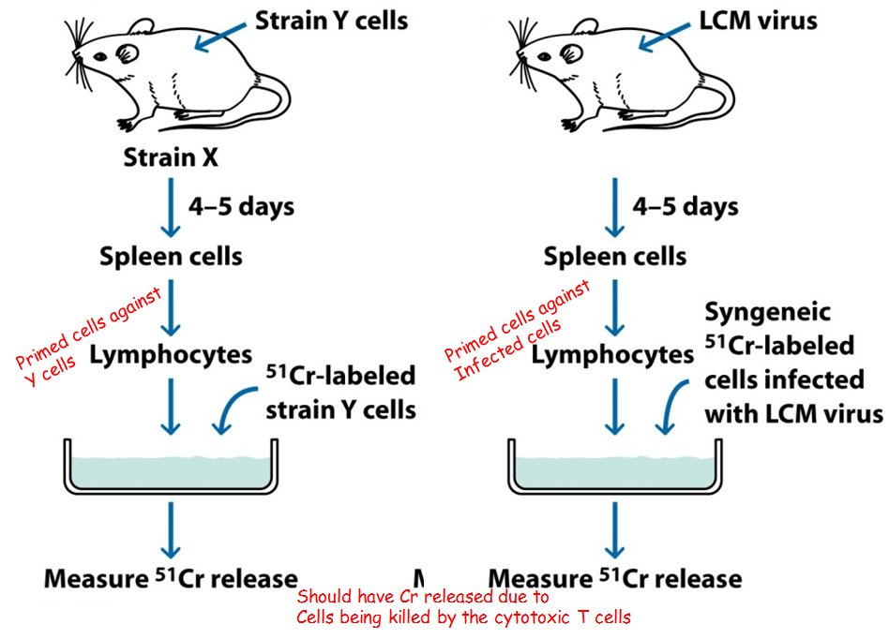
Experimental Assessment of CML
Cell-mediated lympholysis
Target cells are labeled intracellularly with ⁵¹Cr (will not pass out of the cell unless cell is lysed)
If there is cell-mediated cytotoxicity, then ⁵¹Cr will be detected

Slide 24
Thank you

