Slide 1
T- Cell Dependent B- Cell Dependent
Dr. P. Murugan, M.Sc., M.Phil., Ph.D.,
Assistant Professor and Principal i/c
Department of Biochemistry,
Bharathidasan University Model College,
Vedharanyam - 614 810.

Slide 2
Each of the several million T and B cells circulating in the body expresses a novel and unique antigen receptor
Cells entering the thymus are not yet committed to becoming a lymphocyte and express no antigen-specific receptors
Cells leaving the thymus are functional and unique TCRs

Slide 3
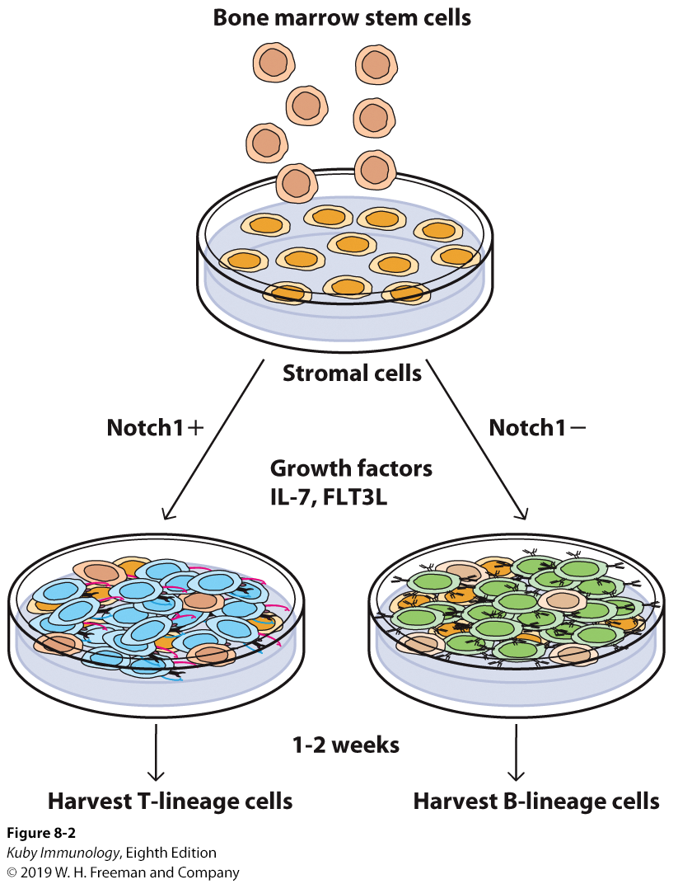
Progenitor T cells migrate from bone marrow to thymus
T cells can be grown in vitro in absence of thymic fragments
Grown on bone marrow stem cells with Notch protein (transcription factor)
Notch protein is key in determining T-lineage specification

Slide 4
Vertebrates generate 2 broad categories of T cells:
TCR-αβ – dominant participant in adaptive immune response
TCR-γδ – protect barrier tissues from outside infection
First cells to arise during fetal development, drop off after birth

Slide 5
Progenitor T cells migrate to thymus
Start very early in gestational development
T cell maturation involves rearrangements of the germ-line TCR genes
In thymus, thymocytes proliferate and differentiate

Slide 6
T-cell Development
Begins with arrival of small numbers of lymphoid precursors migrating from blood to thymus
When they do arrive in thymus, T-cell precursors don’t express signature surface markers (CD3, CD4, and CD8)
Do not yet express RAG-1 or RAG-2 that are necessary for gene rearrangement

Slide 7
T-cell Development
During development, differentiating T cells pass through stages of development based on surface phenotypes

Slide 8
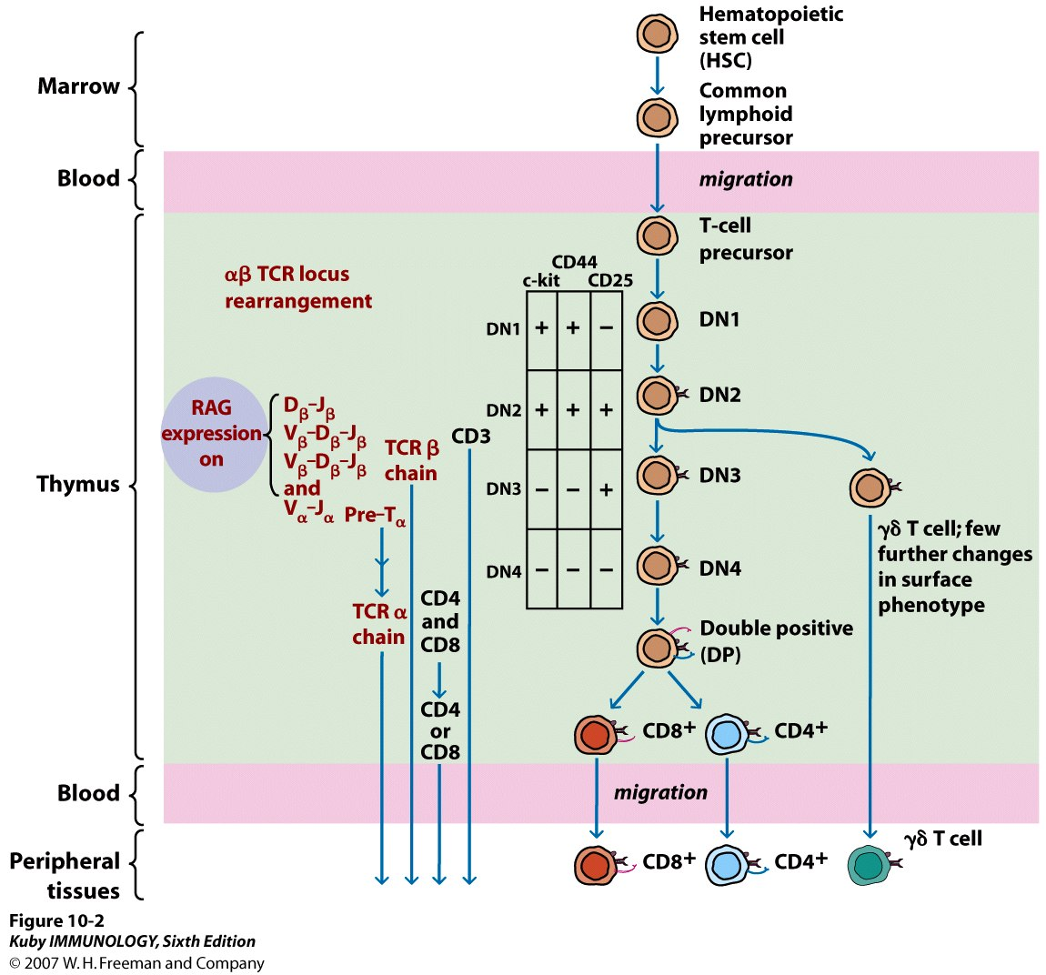
DN = Double negative
CD4- and CD8-
DP = Double positive
CD4+ and CD8+
C-kit – receptor for stem cell growth factor
CD44 – an adhesion molecule
CD25 - alpha chain of IL-2 receptor

Slide 9
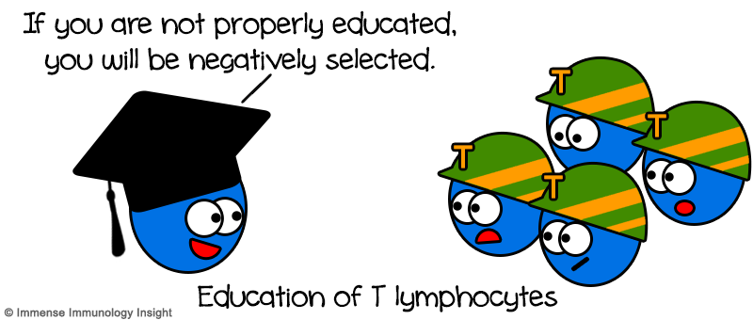
Selection process in thymus
Positive selection
Survival of only T cells whose TCRs recognize self-MHC molecules
Ensure MHC restriction
Negative selection
Eliminates T cells that react too strongly with self MHC or MHC with self-peptides

Slide 10
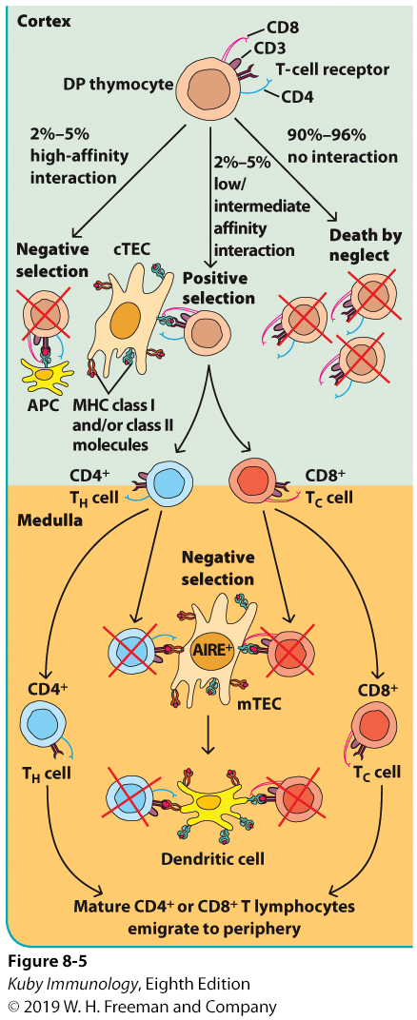

Slide 11
T cell development is expensive for host
98% of all thymocytes do not mature, die by apoptosis within thymus
However, the benefits of having functional T cells outweigh the costs

Slide 12
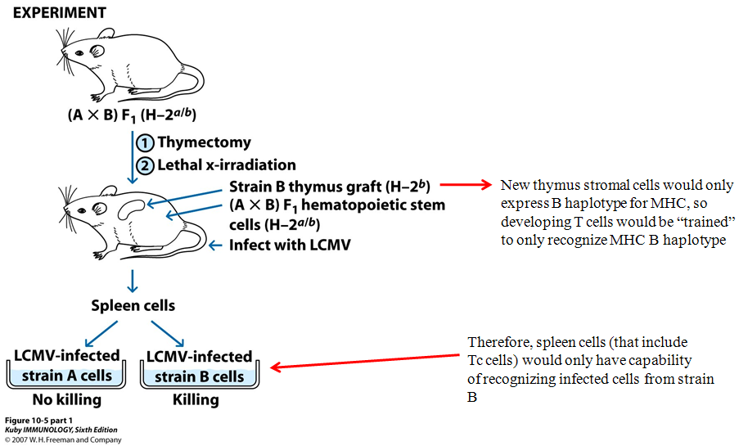
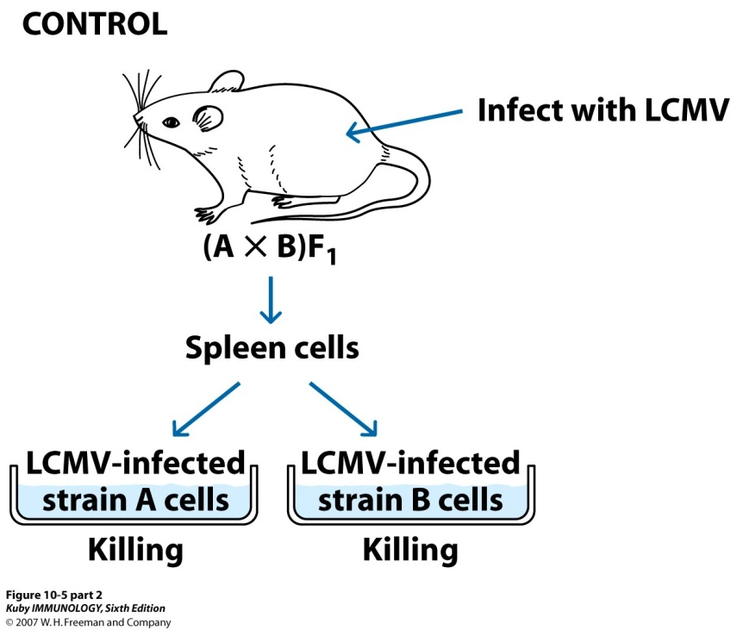
LCMV = Lymphocytic Choriomenigitis
virus

Slide 13
Exit from Thymus and final maturation
Mature T cells that survive the selection process leave the thymus
Recent thymic emigrants

Slide 14
T_{reg} Cells
Shown to inhibit proliferation of other T cells in vitro
CD4+CD25+
Shown to inhibit development of autoimmune diseases

Slide 15
Cell Death and T Cell Populations
Apoptosis plays critical role
Deletion of potentially autoreactive thymocytes
Deletion of T cell populations after activation
Fas and FasL pathway to induce self death

Slide 16
B- Cell Dependent

Slide 17
Development of B cells
In many vertebrates, including humans and mice, B cells generate in bone marrow
Antigen-independent phase
Ig-gene rearrangement to create antigen-specificity
In the fetus, this happens in the liver
Immature B cell bearing IgM on membrane leaves bone marrow
Matures to express both IgM and IgD with single antigen specificity
NAÏVE B cells – have not encountered antigen
Encounter antigen in secondary lymphoid tissue
Differentiate into plasma cells and memory cells
Class switching

Slide 18
In many vertebrates, B cells generate in the bone marrow
Antigen-independent phase
Gene rearrangement to create specificity
Central Tolerance – checked to see if they are self-reactive
Immature B cell (T1) bearing IgM leaves bone marrow
Travels to spleen
T1 B cell checked again for self-reactivity (peripheral tolerance) and allowed to develop into T2 (expressing now both IgM and IgD)
Naïve B cell (hasn’t encountered antigen) travels through the body
Encounters antigen – antigen-dependent phase
Class switching, differentiation into plasma and memory cells

Slide 19
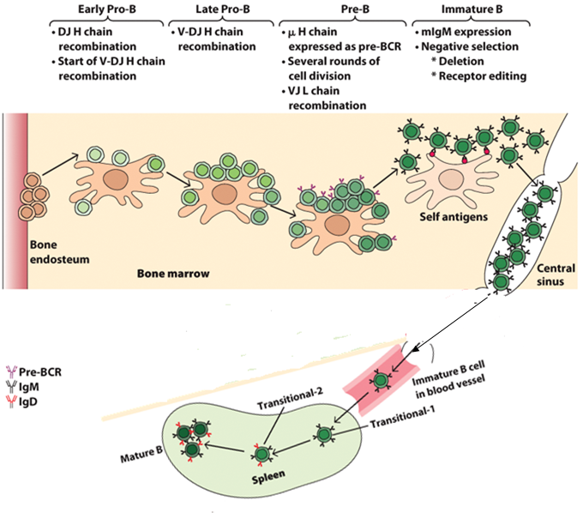

Slide 20
Pro-B Cell
Heavy chain rearrangement
Pre-B cell
Light chain rearrangement
Immature B cell
Is now committed to antigenic specificity and produces IgM
B cell not fully functional, must first express both IgM AND IgD on membrane

Slide 21
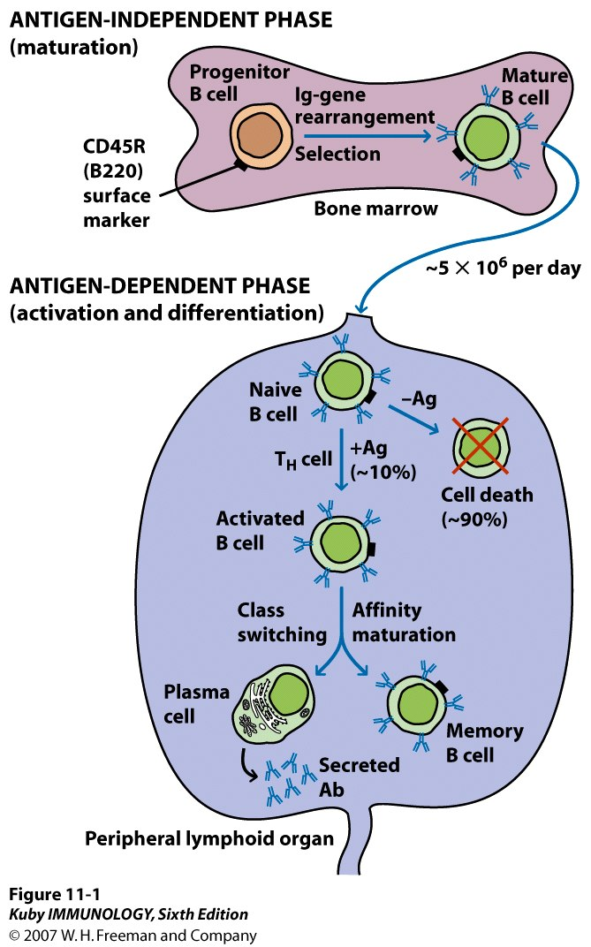
B cell development starts
in bone marrow and
completes in periphery

Slide 22
Remember that cells can be characterized as to stage of development based on cell surface markers
These markers can be adhesion molecules or receptors for certain cytokines

Slide 23
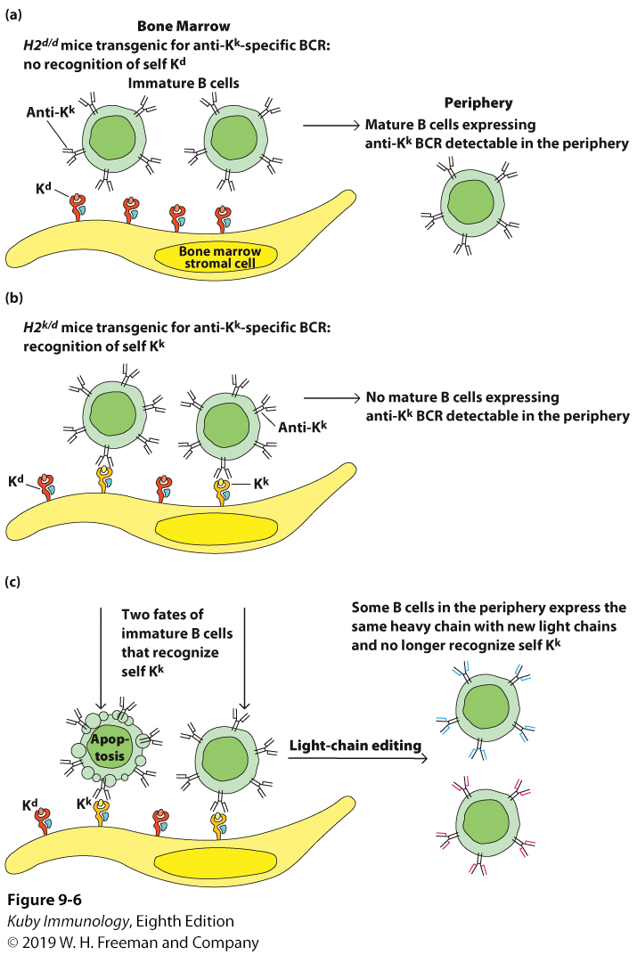
Central Tolerance
in the Bone Marrow

Slide 24
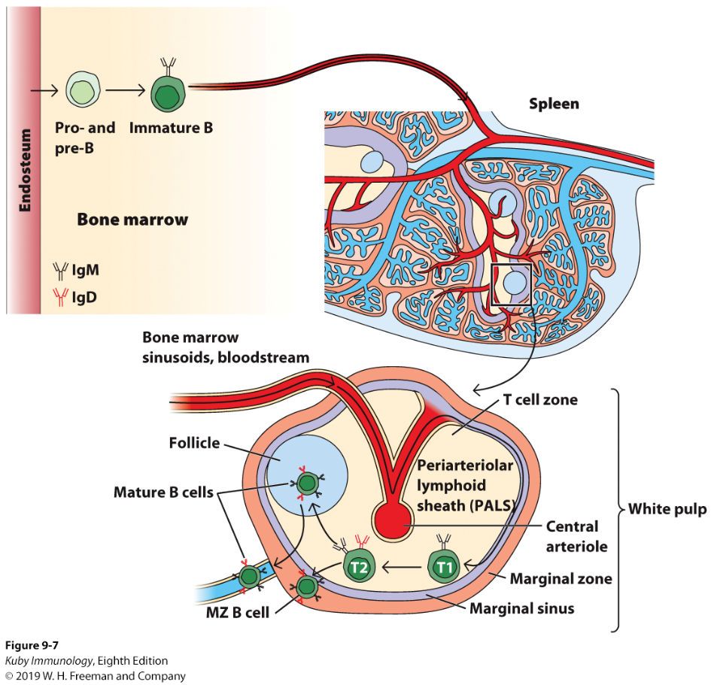
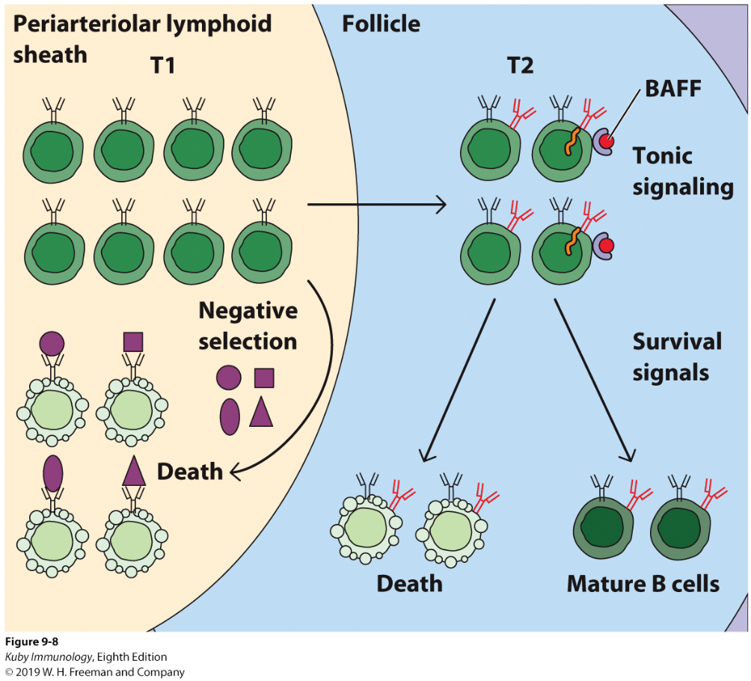
Immature B cells leave the bone marrow and go to the spleen
2 subpopulations of transitional B cells (B cells still going through development, transition)
T1 B cells → T2 B cells (higher levels of IgD on surface) → Mature B cell
If T1 cells are self-reactive, will not be able to progress to T2 B cells (Peripheral Tolerance)

Slide 25
T3 B cells are a population of self-reactive B cells that have left the spleen but anergic
Not activated by antigen and fail to divide and fail to secrete antibody

Slide 26
So far, this has focused on development of B2 cells – largest and best characterized population
Arise from hematopoietic stem cells in bone marrow
There is evidence that B1 cells are derived from early embryonic precursors that seed out in the pleural and peritoneal cavities and are capable of self-renewal

Slide 27
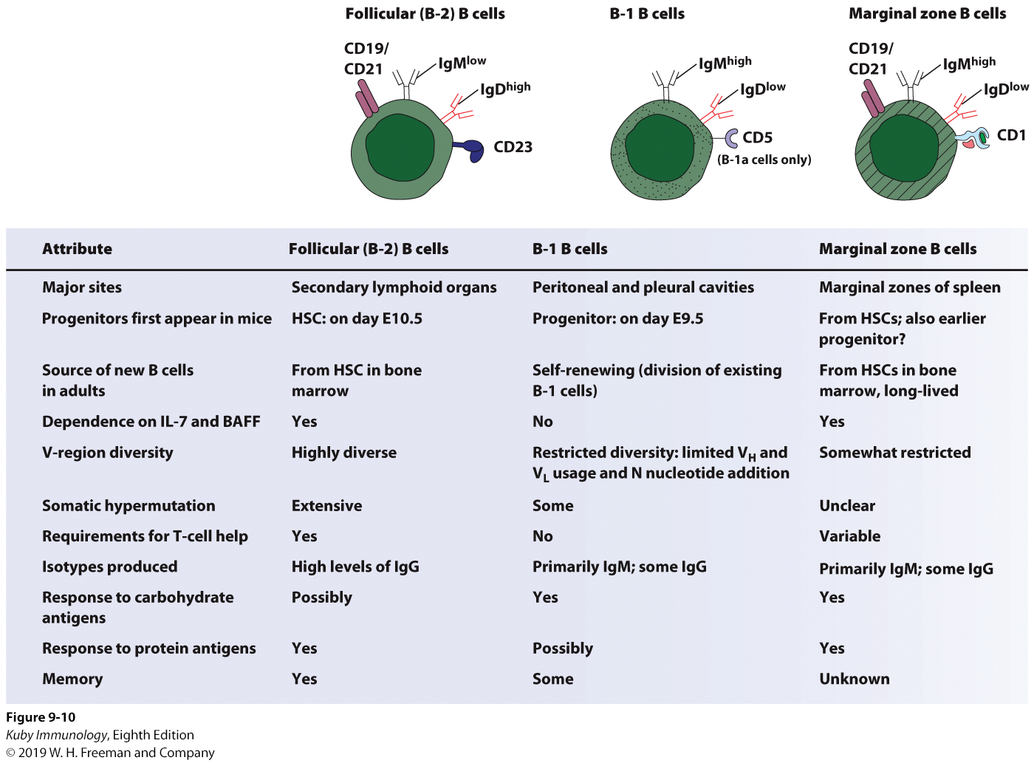

Slide 28
In mice, 90% of B cells produced everyday die without ever leaving bone marrow
Negative selection due to cells that express auto-antibodies against self antigen in the marrow

Slide 29
Thank You

