Slide 1
Facings Made Easy
BY
M.ROCH SOUMIA
ASSISTANT PROFESSOR
DEPT OF FASHION TECHNOLOGY & COSTUME DESIGNING
SHRIMATI INDIRA GANDHI COLLEGE, TRICHY.

Slide 2
Introduction
A facing is a piece of fabric used to finish raw edges of a garment at open areas, such as the neckline, armholes, and front and back plackets or openings. A facing may be a separate pattern piece to be added to the garment or an extension of the pattern piece itself. The facing is cut on the same grain as the garment section it will “face” so it will wear and hang in the same manner.
There are three basic types of facings:
Shaped facings
Extended facings
Bias facings.

Slide 3
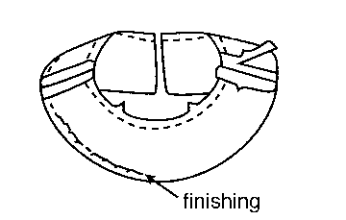
Shaped Facings
A shaped facing is a separate piece of fabric cut from a pattern to the same shape and on the same grain as the garment edge it will finish. Interfacing should be applied to the facing piece of fabric, prior to any stitching.
Once the interfacing is applied, stay-stitch the neckline on the front and back pieces (Figure 1). Stitch the facing together at the shoulder seams. Once the facing is stitched together, finish the outer edge prior to stitching it on the garment (Figure 2).
Figure 1
Figure 2

Slide 4
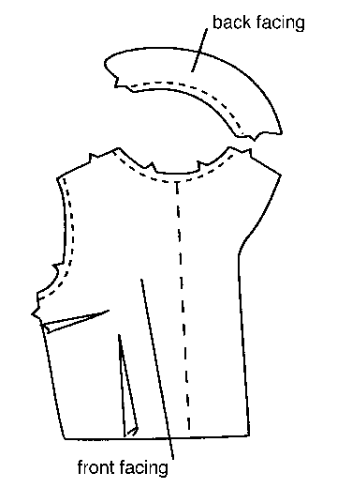
Extended Facings
An extended facing is cut as an extension of the garment and then folded back along the edge it finishes (Figure 3). Extended facings are often used on garments with front or back openings cut on a straight line.
The neckline of an extended facing is a shaped facing and should be applied using the same techniques as other facings (Figure 4).
Figure 3
Figure 4

Slide 5
Bias Facings
A bias facing is a narrow strip of lightweight fabric cut on the bias so that it can be shaped to conform to the curve it will finish. Bias facings are often used on sheer fabrics to eliminate a wide facing that may show through. Bias facings are also used on children's garments. A bias strip of lining fabric can eliminate heavy shaped facings on bulky fabrics. A bias facing should be about 1/2 in. wide when finished.

Slide 6
Tips For Applying Facings
Both shaped and bias facings can be cut from a fabric lighter in weight than the garment to reduce bulk.
If you have to alter the pattern, be sure to alter facings and interfacings to match.
Interface a facing that will have buttonholes in it.
Make facings smooth and flat by clipping inward curves and notching outward curves.
Under stitch shaped and extended facings to keep them from rolling to the outside of the garment.
Finish outer edges of facings. Generally, the same finish that is applied to seams can be used to finish facing edges. Use the least bulky seam finish that will prevent raveling.
Tack facings only at seams, such as the underarm seam or side seam. Do not hand stitch the outer facing edge to the garment all the way around; this gives garments a puckered and unprofessional look.
Finish neckline facings over zippers as illustrated in Figure 20. Then sew a hook and eye or flying snap to hold edges closed.

Slide 7
THANK YOU

