Slide 1

Cauvery College for Women (Autonomous)
Nationally Accredited (III Cycle) with ‘A’ Grade by NAAC
Annamalai Nagar, Tiruchirappalli-18.

Slide 2
Name of the Faculty : Ms.S.Agalya
Mobile Number : 8428141101
Designation : Asst Professor
Department : Food Service Management and Dietetics
Programme : B.Sc., Nutrition and Dietetics
Batch : 2016-2017 Onwards
Semester : VI
Course : Food Service Management II
Course Code : 16SCCND9
Unit : IV
Topic Covered : Dining Room Furnishings

Slide 3
DINING ROOM FURNISHINGS
Elegant and attractive service ware, colourful and clean dishes, quality plates and glass ware add to the decor of the food service facility.
Furniture
Furniture should be chosen according to the needs of the establishment. The kind of operation carried out determines the specific needs of equipments used. Word remains to be the most commonly used material in dining room furniture. But other metals like aluminium, aluminum plated steel or brass are also gradually being used because of their several advantageous factors such as being light weight, hard wearing, easily cleanable and reasonable cost. Plastics, fiberglass, and formica are also used extensively especially in bars, lounges and canteens etc.

Slide 4
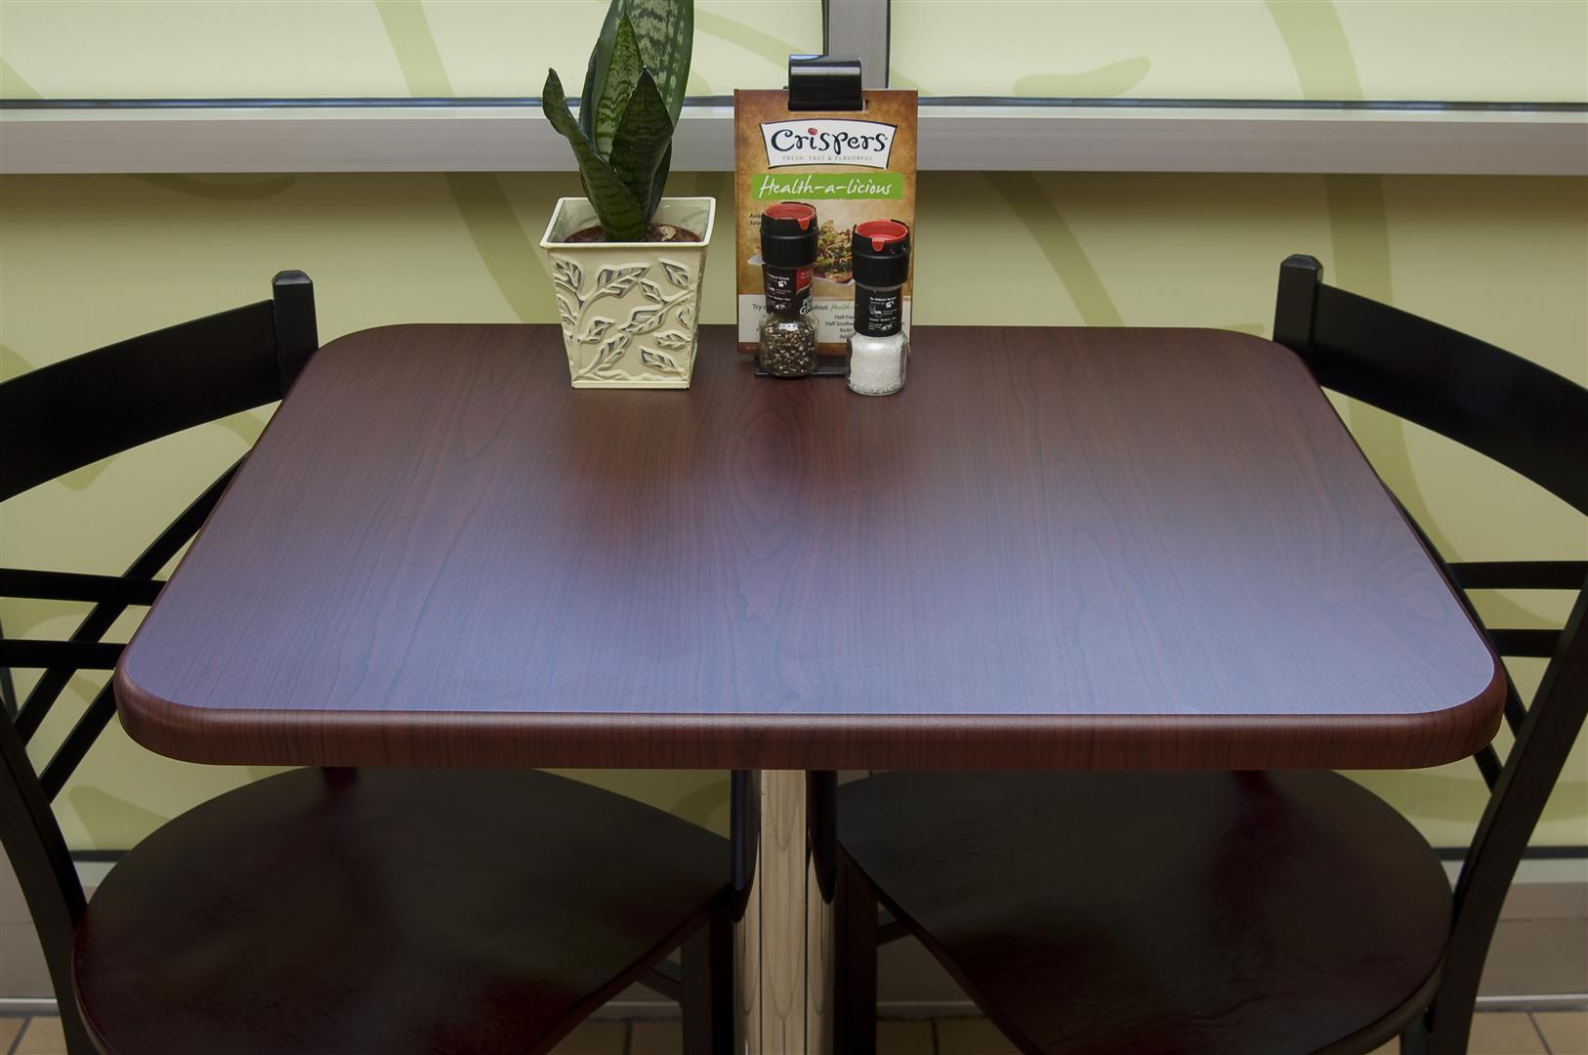
TABLE
The size and shape of tables depends entirely on the availability of space and the skin of service envisaged.
Normally three types of tables are used. They are round, rectangular and square. The height of the table irrespective of the shape should be 75cm from the floor level. The diameter of a round table to seat four people should be approximately 92cm. The size of a square table to seat two people should 76 cm sq and 92 cm squares to seat four people. The size of rectangular table to seat four people should be 137 cm x 76cm.
Commercial table top come in a variety of materials: wood, metal, stone, tile and melamine. Many restaurants table tops are available with edged finishes to prevent scuffs and dents.
In some expensive tables, another table top is placed with the revolving facility, on top of which is placed where the guests can rotate revolving top and serve himself, if he chooses to.

Slide 5
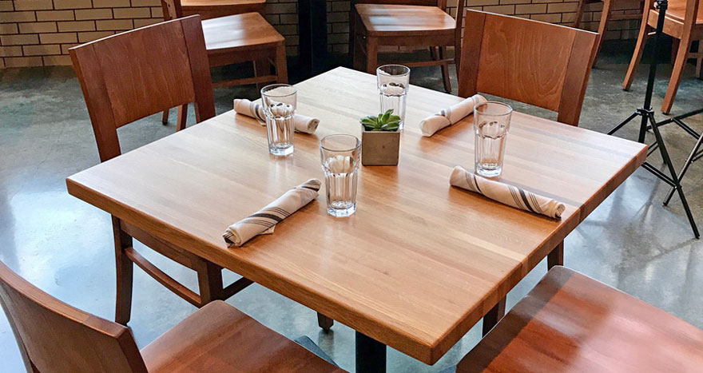
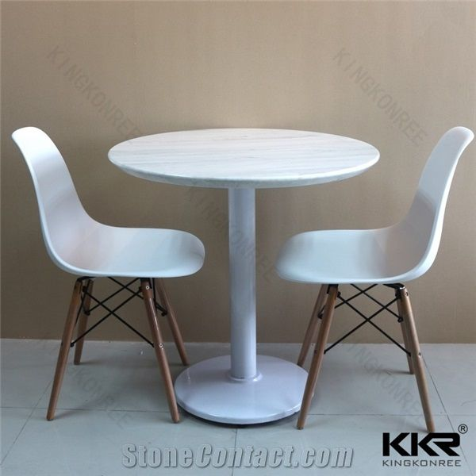
TABLE
Restaurant tables: Usually come in various sizes and shapes particularly round. Tables are covered with baize also called as moulton to deaden the sound of the service implements being placed on the table. Large tables can be provided with a carousel or rotating table at the centre of the round table, referred to as the - Lazy Suzan.
Coffee shop tables: Usually square or rectangular in shape. They are more suitable for American style of service. Coffee shop tables do not have baize covering but have tabletops of wood, covered with glass or plastic.

Slide 6
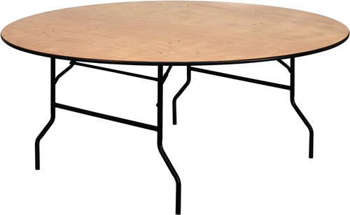
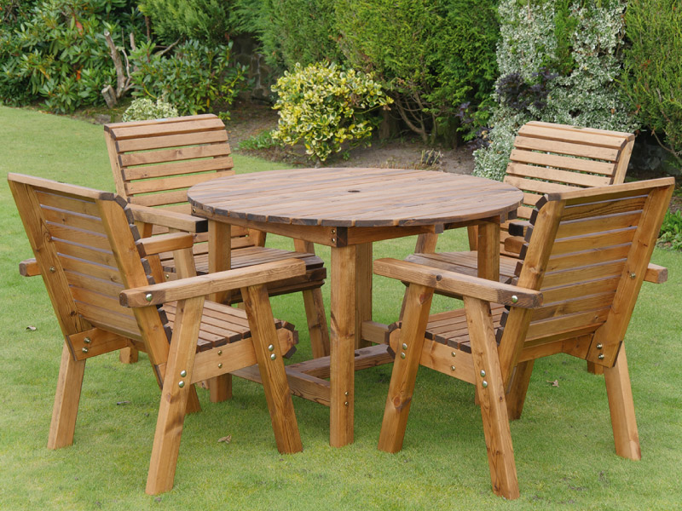
FURNITURE - TABLE
Banquet tables: These tables are collapsible and can be stacked that they can be easily shifted and stored when not in use.
Garden or pool side tables: These are generally left out in the open during the day by the garden or the swimming pool. And therefore are made of strong all weather impervious materials.

Slide 7
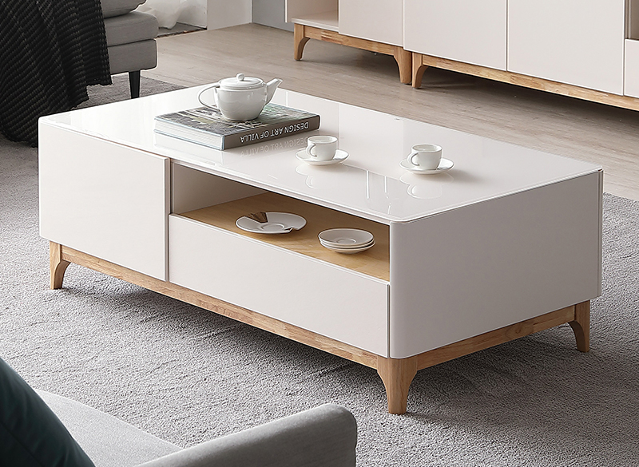
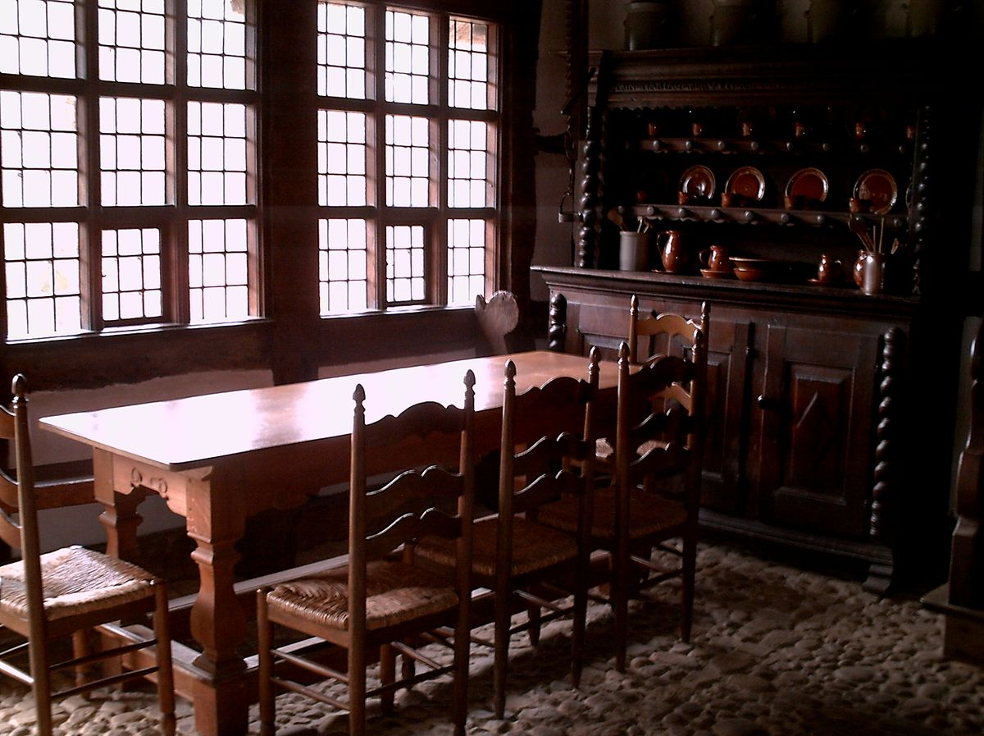
TABLE
Lounge tables: These tables are low, usually 1 foot 7 inches. They, come in various shapes and may have table tops of wood, glass or patent plastic.
Counter table: Most fast food restaurants use counter tables to serve food across the table top. They are generally 105 cms high and guests may be seated across on stools around 75 cms high.

Slide 8
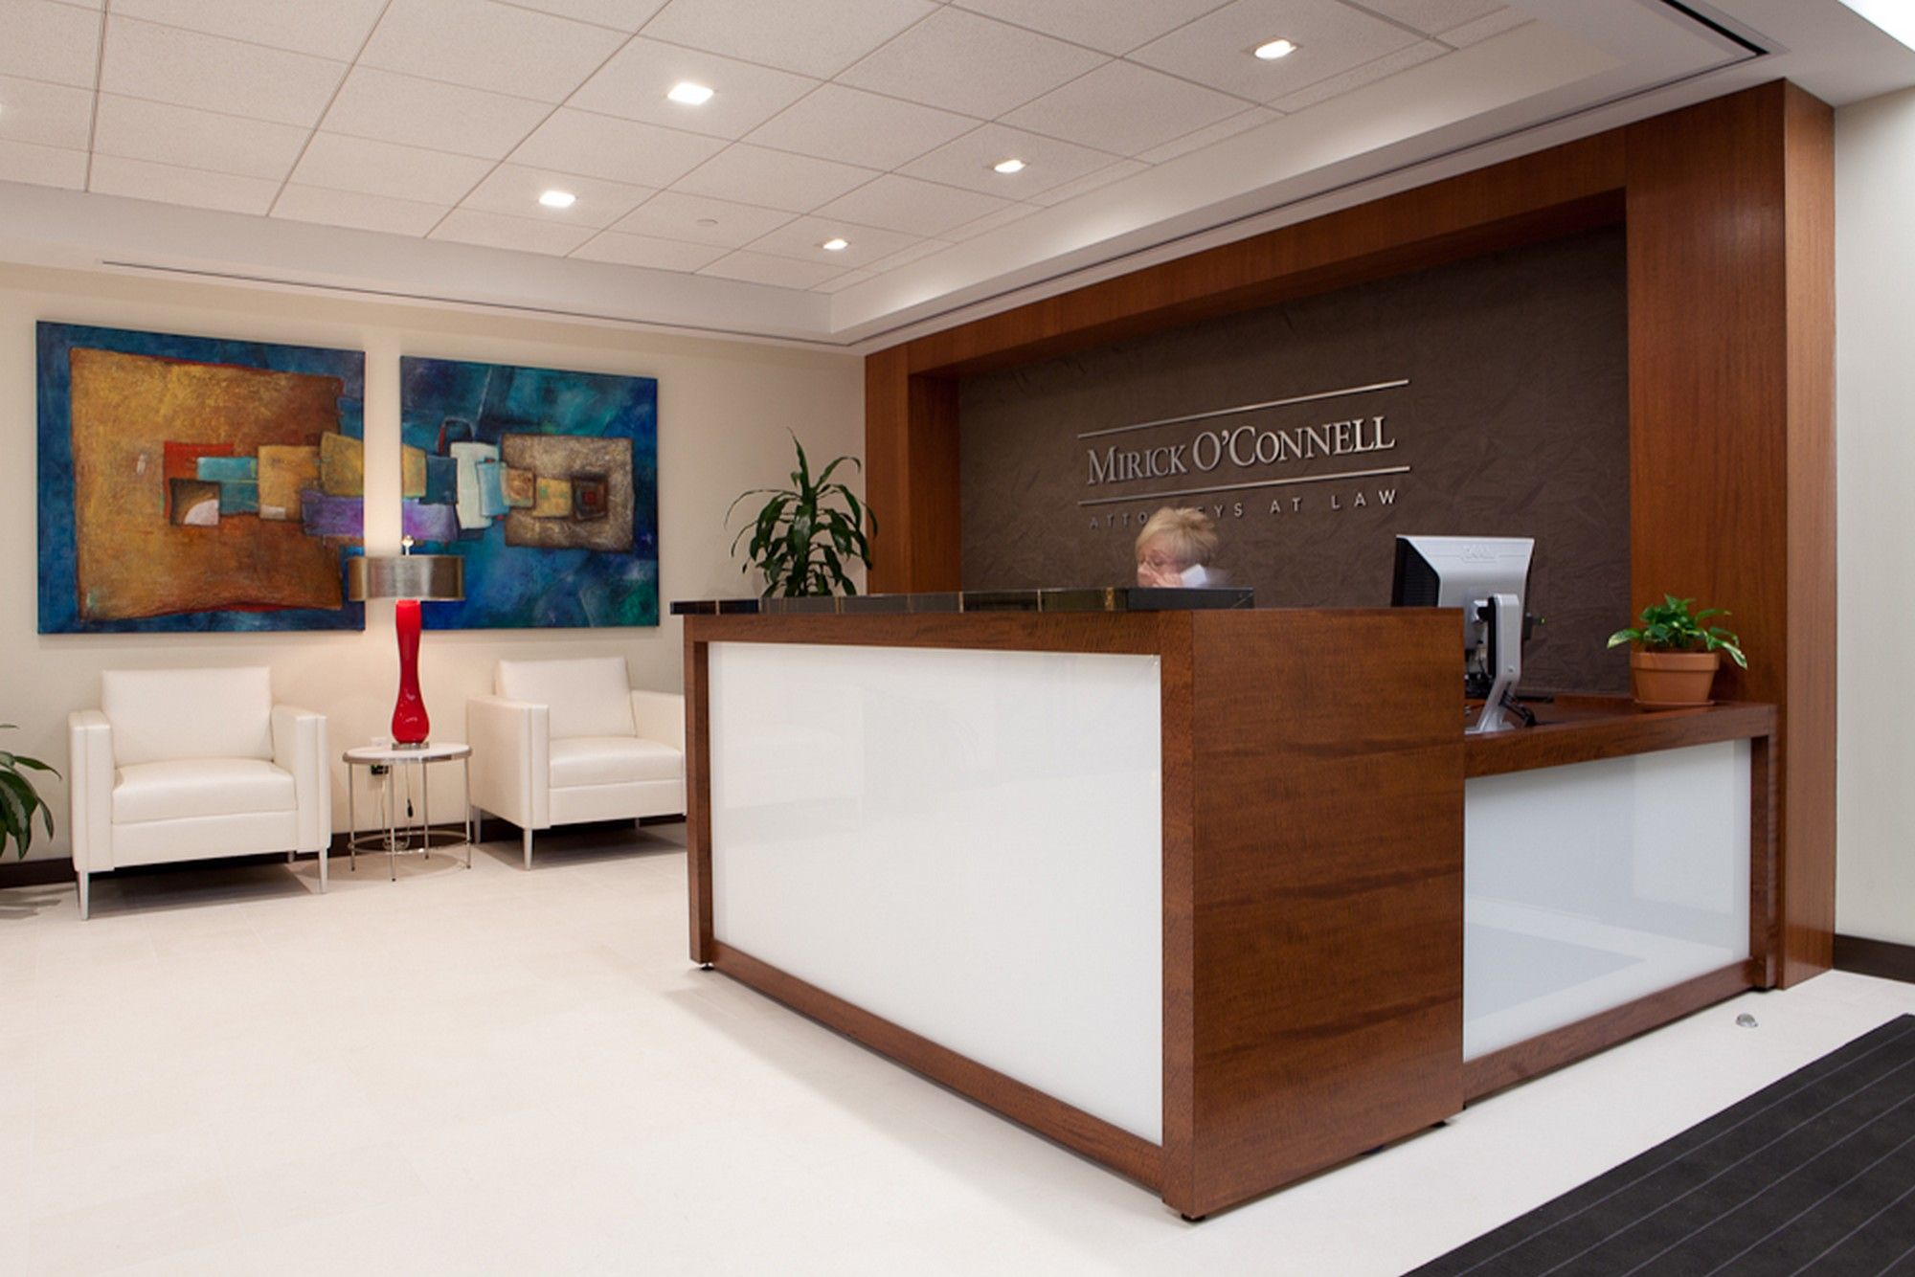
FURNITURE - TABLE
Hostess desk: It is a high desk usually made of fine wood at the entrance of the restaurant for the hostess to stand and receive the guests.

Slide 9
CHAIRS
Chairs: Chairs are available in various shapes, colour and sizes to suit all occasions. Because of the wide range of style, chairs come in varied height and width. However the dimension of chairs should be relative to help dimensions. The average height of the chair should be 92cm.
The seat should be 46cm from the floor and 23cm from the top of the table. This would enable guests to sit and eat comfortably, without their legs touching the underside of the table. Some designs of chairs used are:

Slide 10
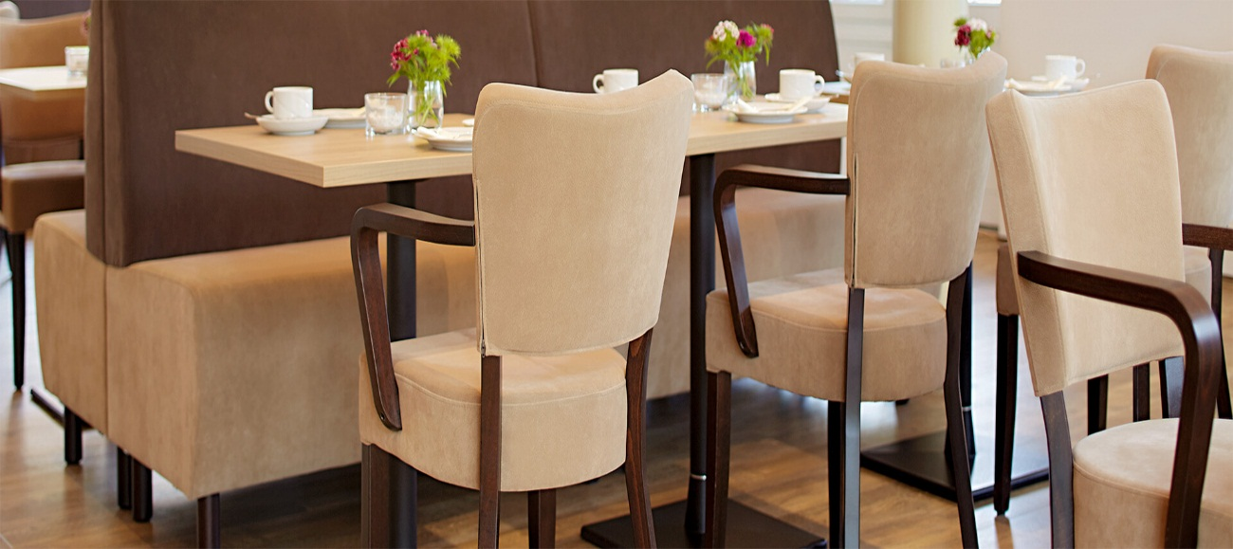
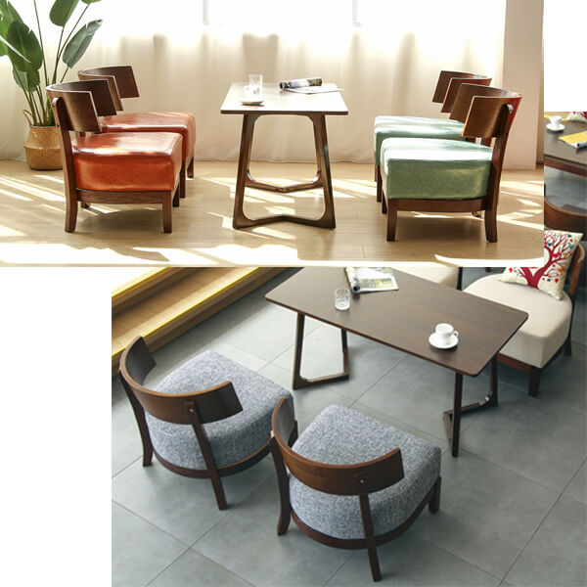
CHAIRS
Restaurant chairs: They are provided with expensive upholstery and armrests with intricate designs.
Coffee shop chairs: used particularly in fast food services w quick seat turnover is expected. Coffee shop chairs are usually made of fiberglass, cane, plastic and other less expensive materials with straight short backs and no armrests.

Slide 11
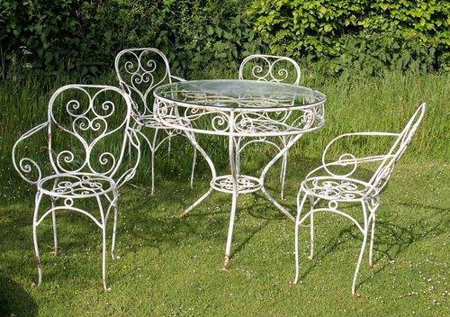
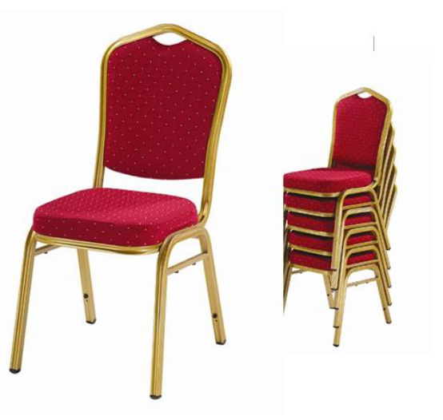
CHAIRS
Banquet chairs: Banquet chairs are usually upholstered and have a gently reclining back and armrests. Some banquet chairs may not have armrests in order to be stacked when not in use.
Garden chairs: fiberglass and other plastic moulded chairs with legs are popular for garden or open air food and beverage so with service.

Slide 12
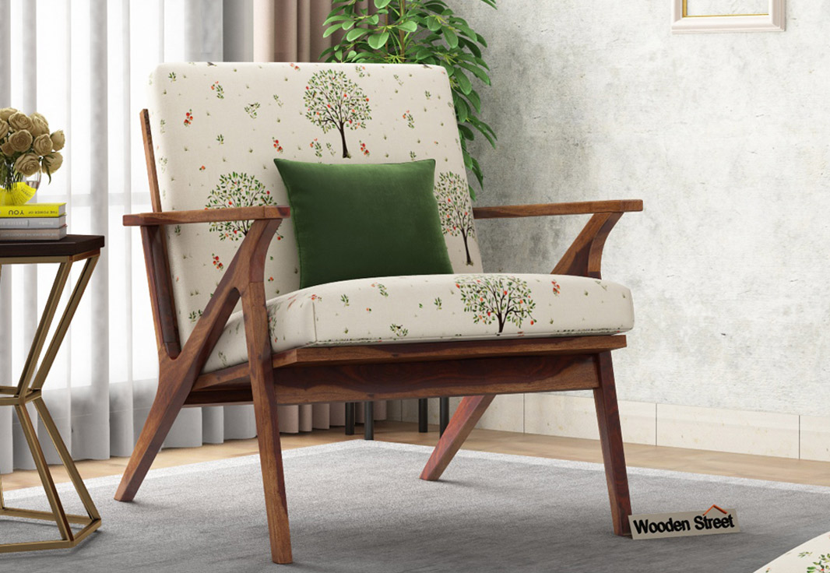
CHAIRS
Lounge chairs: Lounge chairs or sofas are heavily upholstered and should be luxurious and comfortable to the guests who are made to wait until the service is available.

Slide 13
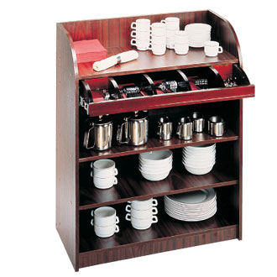
SIDE STATION / DUMMY WAITER
The side station is also called the dummy waiter or service console. This is a very important piece of furniture in a restaurant. It is used by the service staff for keeping all the service equipment at one place. It also used as a landing table for the dishes picked up from the kitchen en route to the table and the dirty dishes from the guest's table to the wash - up area. For the convenience of the service staff, the side station should be strategically located in restaurant. The side station should be kept clean and presentable as it can be seen by guests.
The style and design of the side board varies from establishment to establishment. It depends upon:
The style of service and menu offered.
The number of waiters working from one sideboard.
The number of tables to be served from one sideboard.
The amount of equipment it is expected to hold.

Slide 14
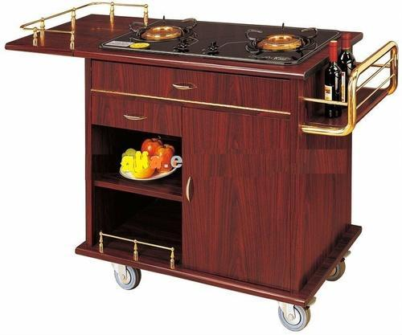
TROLLEYS
Gueridon trolley
A gueridon or flambé trolley is a small mobile trolley that can be placed long side the guests's table. It consists of one or two burners, a gas cylinder and a work and storage space for plates and cooking equipments. Using this trolley, the food is flamed at the guest's table. Only skilled and well trained waiters are allowed to handle this service as there is the risk of spoiling food by over cooking it, and of the fame causing a fire in the premises.

Slide 15
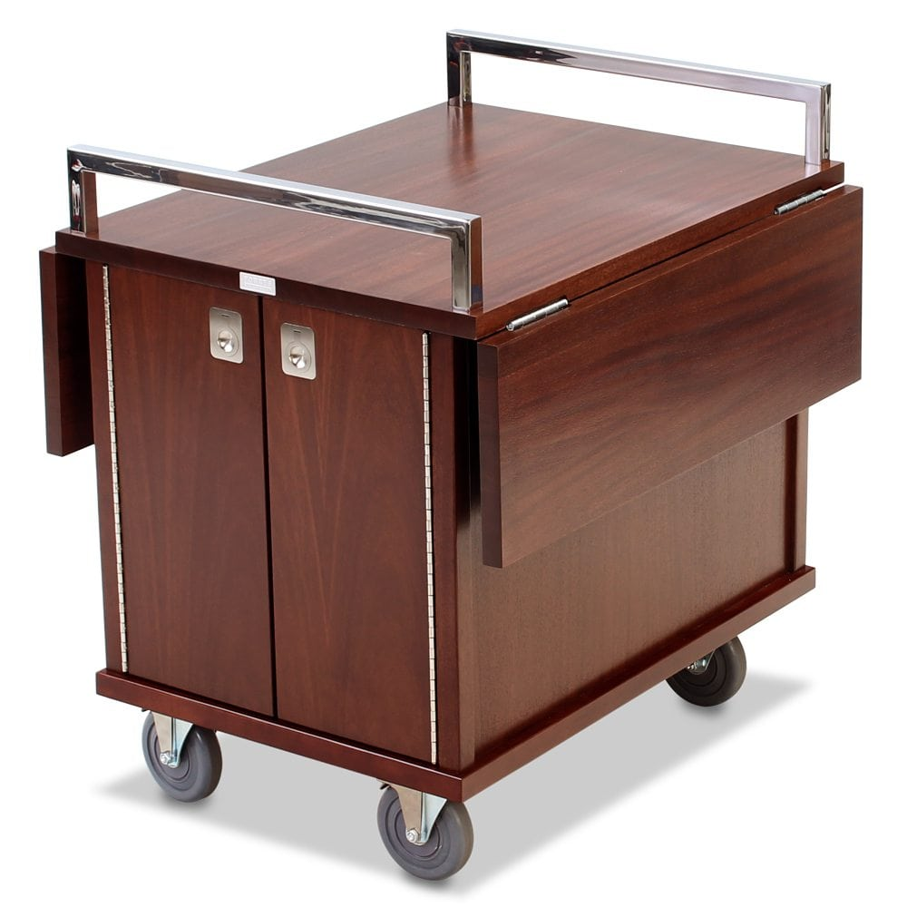
TROLLEYS
Room service trolley
This trolley is known for its versatility. It is used for the service to guests in their rooms. The waiter sets up the metal and covers on the trolley and wheels it into the guest's room. This trolley may also be used as a dining table in the privacy of the guest's room. Beneath the trolley top, provision is made for mounting a hot case to keep the food warm.

Slide 16
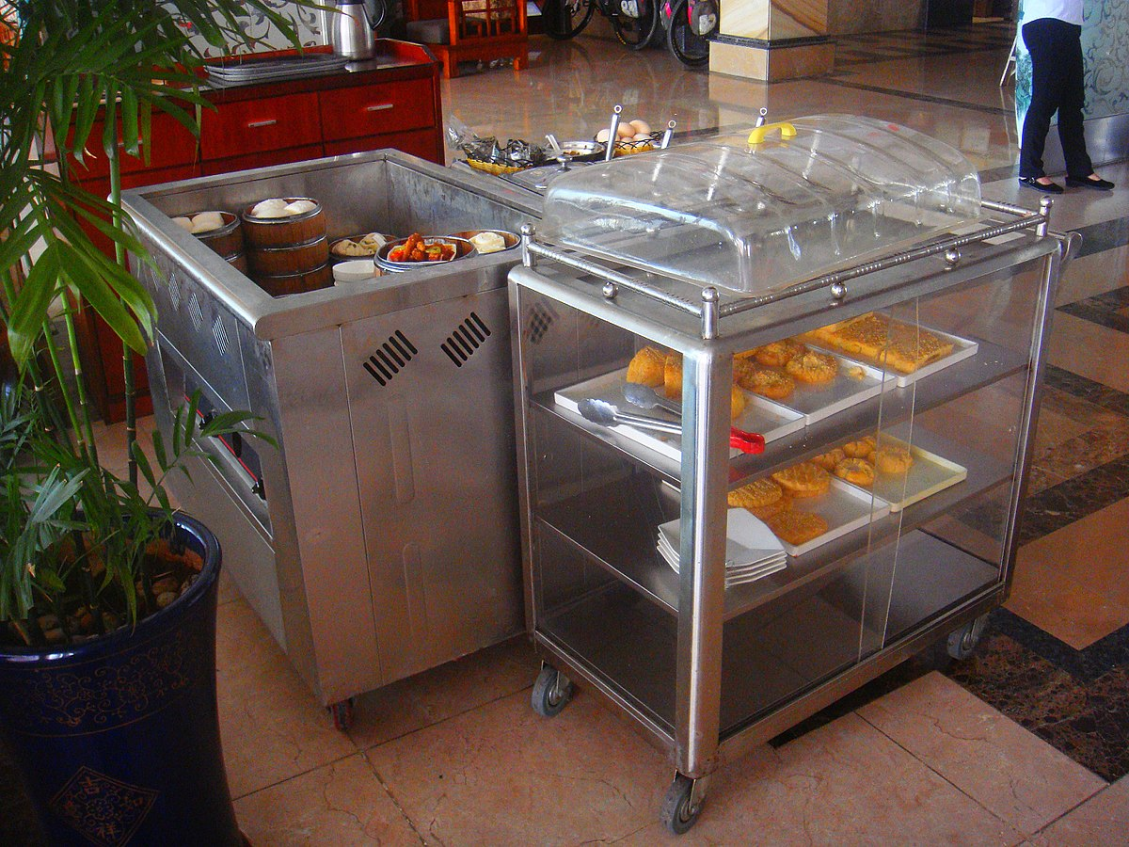
TROLLEYS
Dessert trolley
This trolley serves as a visual aid to selling desserts. Guests a more likely to order a dessert if they can see what is available, particularly if it is well presented. Some dessert trolley is refrigerated. Gateaux, jellies, tarts, pies, flans and souffls can be served from the dessert trolley, This trolley has several shelv5 and the bottom shell is reserved for plates, Cutlery, linen and other service equipments, A glass or transparent trolley top makes it easy 1or guests to select a des8ert of their choice.

Slide 17
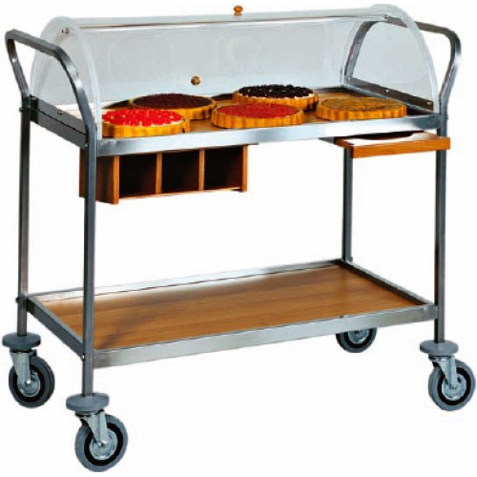
TROLLEYS
Hors d'oeuvre trolley
A hors d'oeuvre is the first course of a menu usually consisting o a selection of small items of egg, fish, meal, fruit, and vegetables in pungent dressings, This hors d'oeuvre trolley is used to carry variety of appetizers, This trolley is probably the least popular in India, as a majority of guests are not too keen on hors d'oeuvre as a starter They prefer soups instead, However, this trolley can be used to popularize the special dishes that are introduced in the restaurant from time to time.

Slide 18
LINEN
Linens are fabric goods, such as tablecloth, napkins and slip cloth, Linen is a material made from the fibers of the flax plant, Originally, many, such as bed sheets and tablecloth, were made up of linen, Today, the term "linen" has come to be applied to all related products even though most are made of cotton, various synthetic materials, or blends. The main items of linen normally found in a restaurant are: tablecloths; slip cloths; buffet cloths; trolley and sideboard; and waiter's cloth or service cloths.

Slide 19
LINEN - TABLE CLOTHS
Table linens made from cotton or linen are not only more absorbent but also last longer, Egyptian cotton and Irish linen are considered the finest materials for table linens because of their long, durable fibers. White is the most popular color for table linens because it is considered formal. Table linens in off white or ivory are also acceptable, A damask (woven) or embroidered pattern is a perfectly acceptable cloth.
Types of Tables | Size of Tables | Size of Cloth
Square table | 76 cm (2 ft 6 in) | 137 cm 137 cm
 | 1 m (3ft) square | 183 cm x 183 cm
Rectangular table | 136x 76cm | 183 x 224cm
Round table | 72 cm in diameter | 184 cm diameter

Slide 20
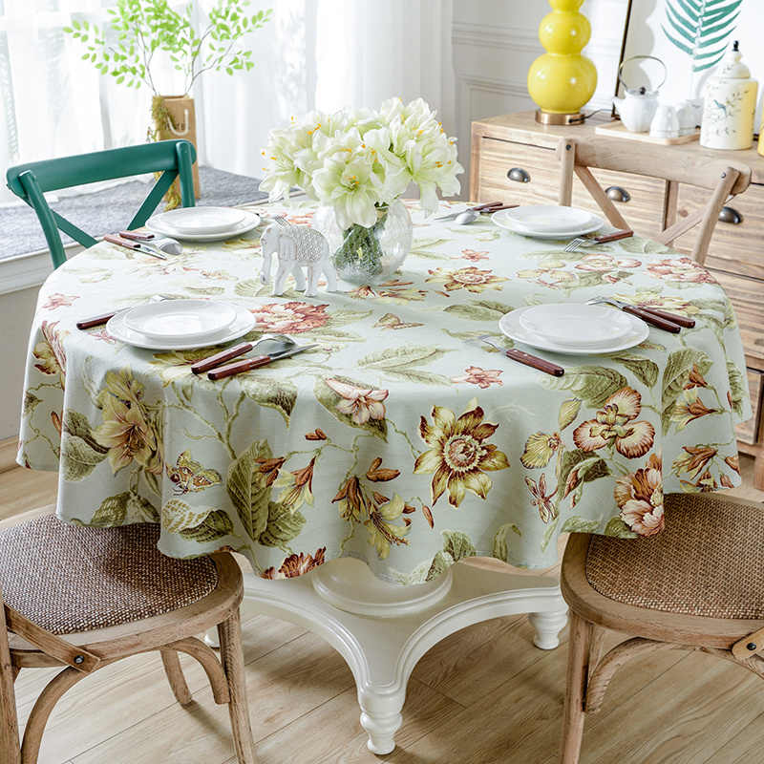
LINEN - SLIP CLOTHS OR NAPERONES
These are designed to be laid over the tablecloth to protect it from spillage and give it a longer life. Using a slip cloth reduce the number of table cloths used and thus reduce the cost of inventory and laundry. Slip cloths may measure 1 meter square approximately.

Slide 21
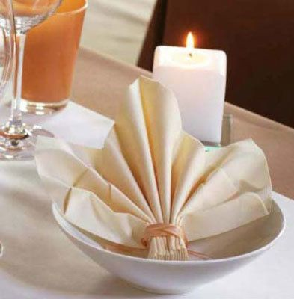
LINEN - NAPKINS OR SERVIETTES
A napkin or serviette is a rectangular cloth or paper used at the table for wiping the mouth while eating. It is usually small and folded. Conventionally, outside the outermost fork. In a ambitious restaurant setting, it may be folded into elaborate shapes and displayed on the empty plate. A napkin may also be held together in a bundle (with cutlery) by a nap A napkin or serviette is a rectangular cloth or paper used at the table for kin ring. Alternatively, paper napkins may be contained with a napkin holder.
Napkins may be of the same colour as table cloths, or in a colour that blends with the decor off the restaurant. Napkins should be spotlessly clean and well - pressed. The ideal size for a napkin is between 46 to Su cm sq

Slide 22
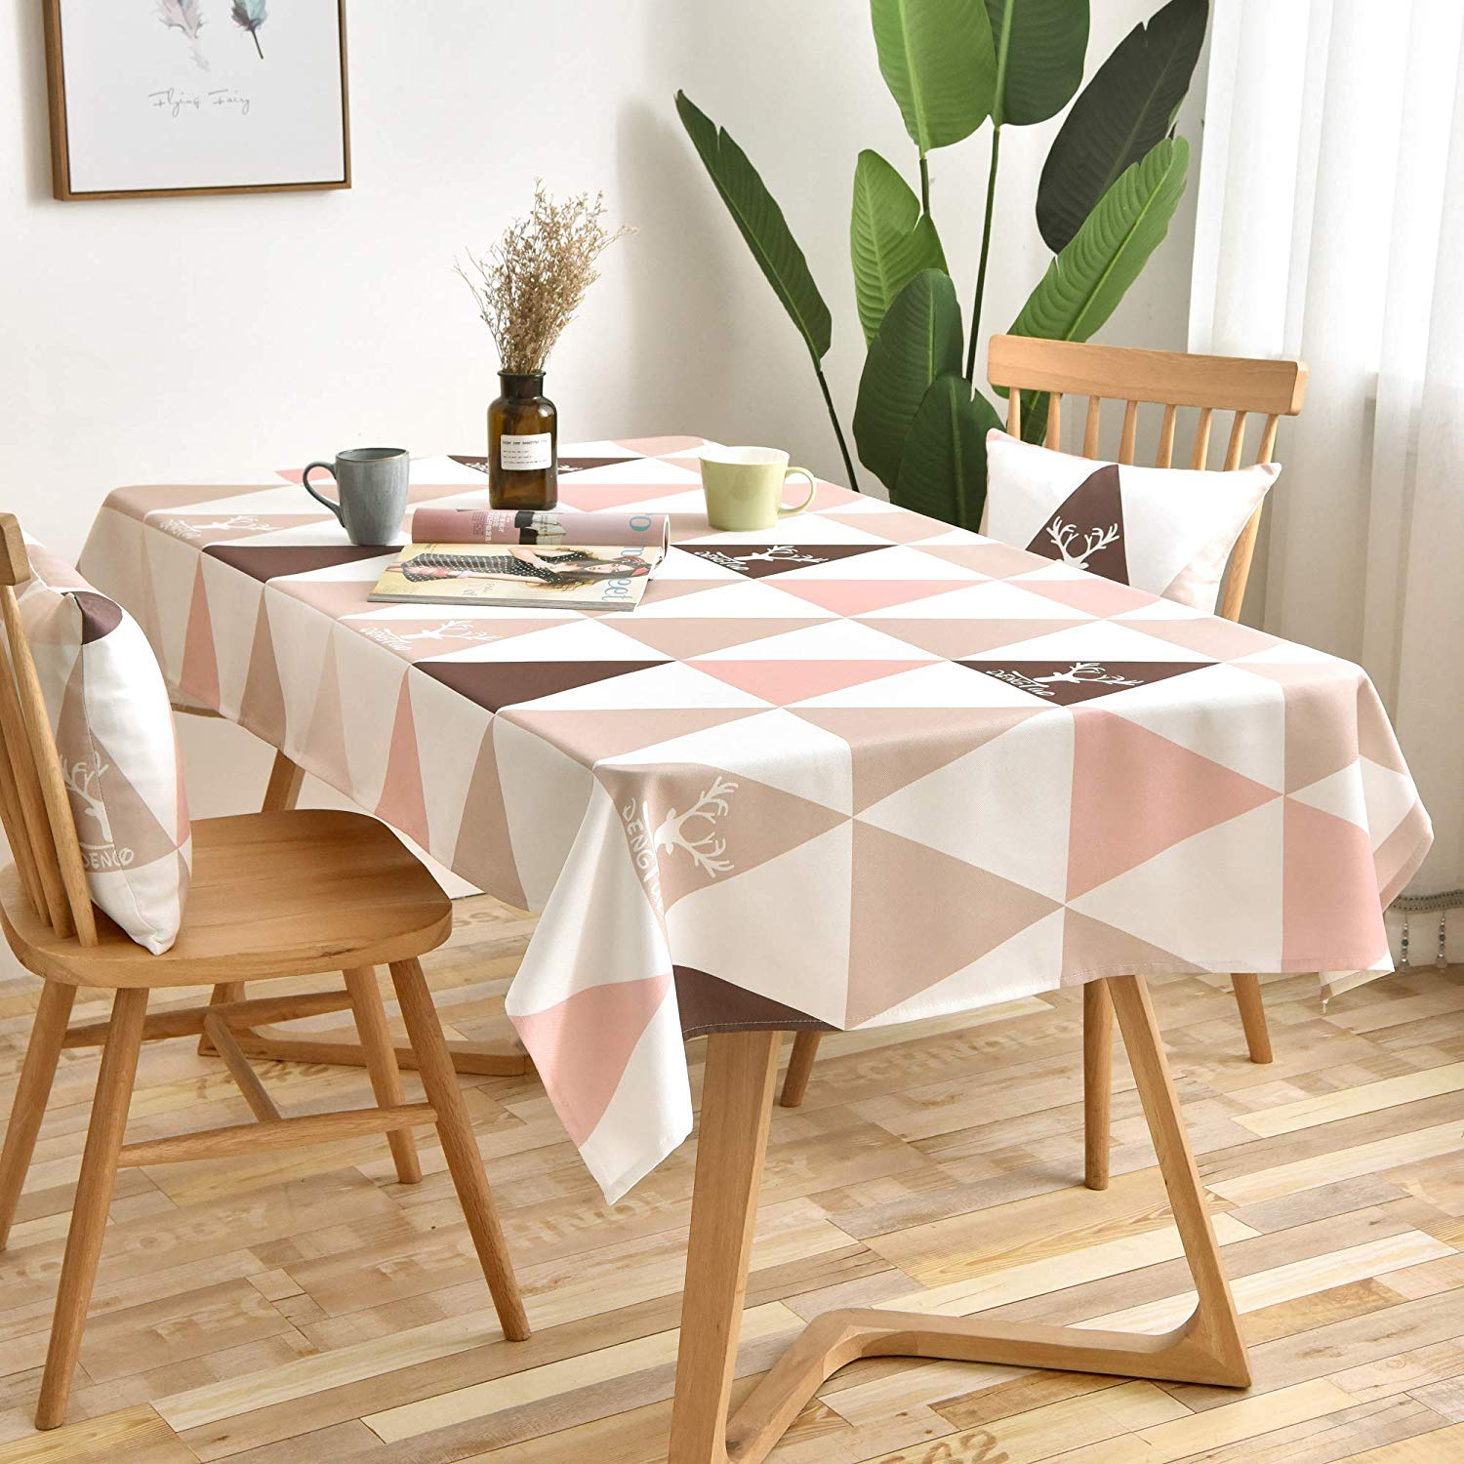
LINEN - BUFFET CLOTHS
For buffet table, the minimum size of the tablecloth required is 2m x 4m.

Slide 23
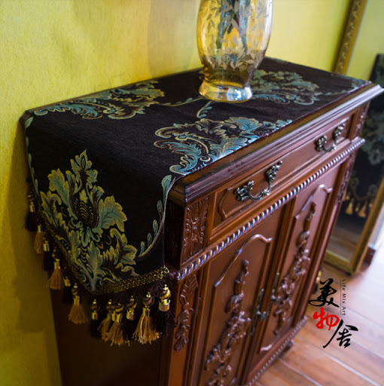
LINEN -TROLLEY CLOTHS AND SIDEBOARD CLOTHS
These are usually made from tablecloths well-worn and not suitable use on tables, mended by the house keeping department and folded a sideboard or trolley.

Slide 24
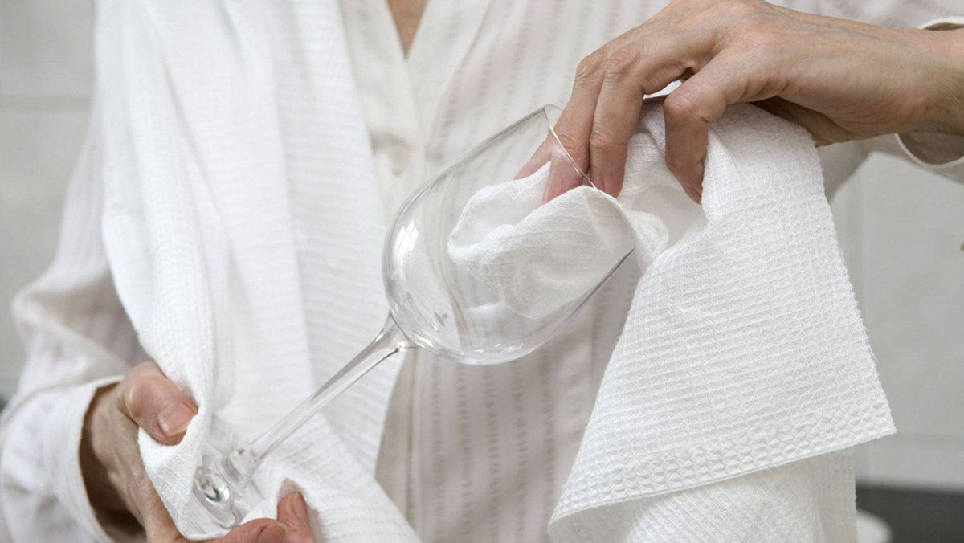
LINEN - TEA AND GLASS CLOTHS
These are used for drying items after washing. Tea cloths are u crockery and glass cloths for glassware.

Slide 25
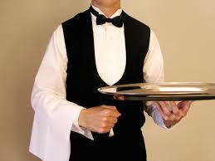
LINEN - WAITER'S CLOTHS OR SERVICE CLOTHS
A service cloth is very important part of equipment as well as being part of the food server's uniform. Service cloths are also u well as A service cloth is a very important part of service equipment a by every waiter as protection against heat and to keep uniform clean.

