Slide 1
Cauvery College for Women (Autonomous)
Nationally Accredited (III Cycle) with ‘A’ Grade by NAAC
Annamalai Nagar, Tiruchirappalli-18.

Slide 2
Name of the Faculty : Ms.S.Agalya Mobile Number : 8428141101 Designation : Asst Professor Department : Food Service Management and Dietetics Programme : M.Sc., Food Service Management and Dietetics Batch : 2016-2017 Onwards Semester : IV Course : Food Service Facilities Course Code : P16FS41 Unit : III Topic Covered : Equipments used in Commercial and Non Commercial Establishments

Slide 3
Equipments used in Commercial and Non Commercial Establishments

Slide 4
Equipments used in Receiving area
Receiving is the area where the ownership of the goods purchased transfers from the purveyor to the food service operation
This department requires certain equipment, including scales in good working order.
Both platform and counter scales should be available and portion scales also useful for checking portion cuts of meat.
In larger operations – the scales used print the weight of the merchandise on the reverse side of the invoice
An unloading platform of a convenient height for delivery truck is needed.
Ramp – to facilitate unloading of other delivery trucks.
Proper dollies and hand trucks are important to expedite the movement of merchandise to storage with the least amount of effort.
Other equipments should include a table for inspection of deliveries ad tools such as – can opener, crow bar, claw hammer, and short bladed knife for opening containers and packages.

Slide 5
Equipments used in Receiving area
A thermometer to check whether chilled or frozen products are delivered at the at the appropriate temperature according to specification,
Clip boards, pencils, and marking and tagging equipment are also necessary.
Finally in addition to the desk, a file cabinet should be available for storing records and reports, as well as calculator for verifying the computations on the invoice

Slide 6
Equipments used in Receiving area
Weighing machine

Slide 7
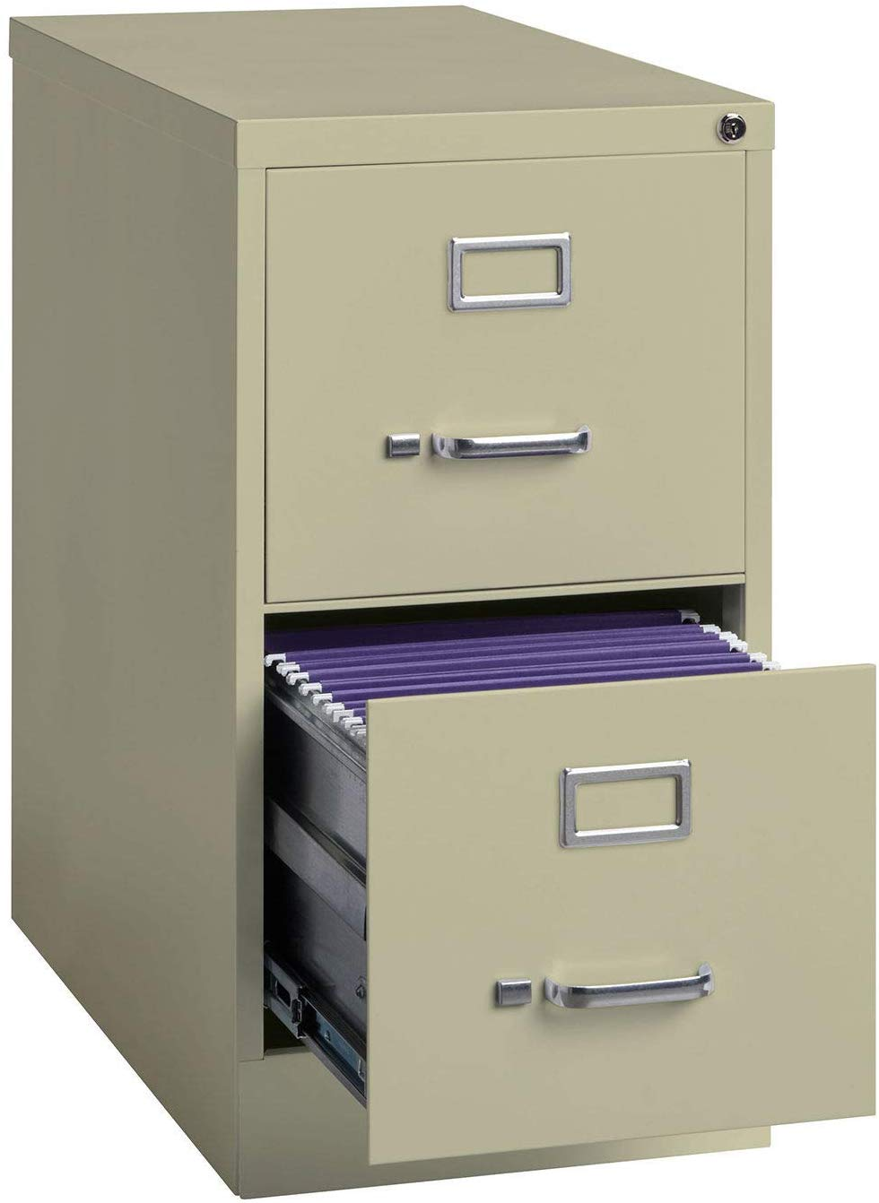
Equipments used in Receiving area
File Cabinet

Slide 8
Dolly

Slide 9
Storage Equipment - Equipment for dry storage
The predominant equipment in the dry storage are the racks used to store food.
The racks must be strong enough to support cases of food while providing ventilation.
These racks are available in number of sizes and configurations, allowing operations to customize to their needs.

Slide 10
Storage Equipment
STORAGE RACKS

Slide 11
Storage Equipment - Equipment for chilled storage
Refrigeration is considered indispensible for modern food service operations, which rely on it for both short term and long term storage.
Refrigerators and freezers are basically insulated boxes with a unit that lowers and maintains the interior temperature. For efficient use, food that is still hot should not be placed in a refrigerator. If warm food must be put into a refrigerator, it should be placed toward the top so that the rising heat does not heat the food on the shelves above.
Walk in refrigerators and freezers
Walk in units are the mainstays of most large volume food service establishments. A Walk in refrigerators and freezers can be located either inside the kitchen or in an adjacent area with access form the kitchen.
A walk in is big enough to walk into and its perimeter is lined with storage shelves and places for roll – in carts.

Slide 12
Storage Equipment - Equipment for chilled storage
Reach in refrigerators and freezers
These are smaller unit that are usually placed closer to production lines and areas that are used for storing food for the meal period.
Reach in refrigerators and freezer can be a half – height unit, located beneath a workstation or table, or a full height unit.
The insides of the units are lined with either shelves or racks for sheet pans, or are completely open so that rolling racks for food can be rolled in and out as needed.
In – counter refrigerators
In – counter un its are refrigerated counter wells, generally installed in the pantry or other areas where food must be kept cold prior to service. Food is kept in pans that are submerged into cold area.
Coolers
Medium temperature range storage units designed to hold the temperature between a minimum of 32^{O}F and maximum of 48^{O}F, used for thawing frozen food, storing meat at 32-38^{O}F, storing dairy products at 36-40^{O}F, and storing vegetables and fruits at 44-48^{O}F.

Slide 13
Storage Equipment - Equipment for chilled storage
Thawers or tempering boxes
Units for thawing frozen foods specially designed to maintain a steady temperature of 40^{O}F regardless of room temperature or product load.

Slide 14
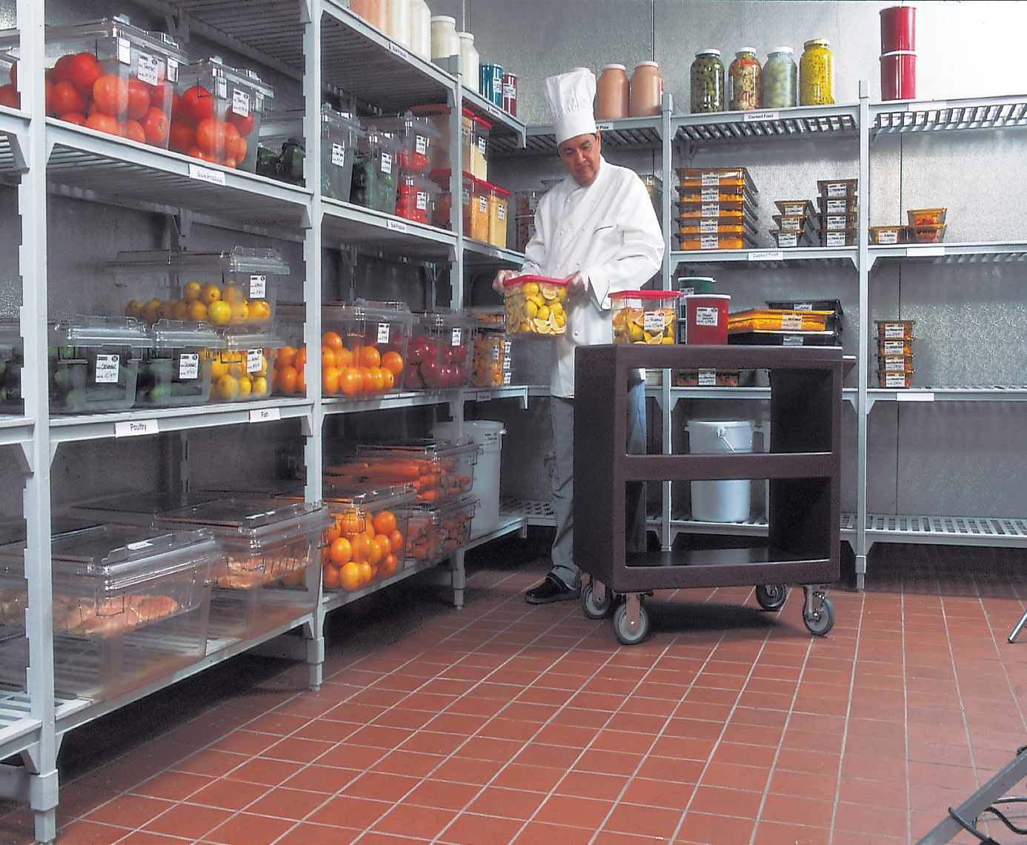
Equipment for chilled storage
Location - Either inside the kitchen or in an adjacent area with access from the kitchen
Walk in Refrigerator & Walk in freezer

Slide 15
Reach in Refrigerator - Placed closer to production lines
Which is used for meal period
Located beneath a workstation or table
In counter Refrigerator – installed in pantry (where the food stored)
where the food must be kept cold prior to service

Slide 16
PRE PREPARATION EQUIPMENT
Graters
Although large quantities of food will be mechanically grated, the hand grater is indispensible for small amounts. They can be cylindrical or square in shape and usually have four different types of surface.
Beaters
The flat paddle/beater is used for a variety of medium to heavy duty mixing tasks.
It is used for making batters, mashing potatoes and creaming butter.
Wire Whip
This composed of a series of heavy – duty mixing tasks. The whip is used to incorporate air into egg whites and whipped cream and is reserved for light consistency items
Butcher’s Saw
The one used for small bones is called ‘tenon’ type and the one used for splitting carcasses is called bow’ type.
Butcher’s Cleaver
This is used for breaking bones and splitting carcasses. It finds in dividing loins and best ends into cutlets and chops, since it will follow the line of the bones.
In skilled hands, a cleaver does the job more quickly and efficiently than a saw.
Mincing Knife
It can have one or more blades and is used to chop food finely like a mechanical mincer.

Slide 17
PRE PREPARATION EQUIPMENT
The dough hook
Is a larger bar that is bent in an offset S shape. The hook is used for mixing doughs, to help develop the gluten and for mixing other heavy-consistency items.
Bowl choppers
These are usually table top models and are used for cutting meat, fish, colesaw, breadcrumbs etc. the blade action also includes a mixing function as well.
The texture of the chopped product will be finer, the longer the chopping operation.
Food Slicer
Is a motor – driven metal disk that is ground sharp on its edge.
Large volume operations use slicers with mechanically powered food trays to bring the food to the blade, thus allowing greater productivity.
Food mixers
These may be bench –top or floor standing. Apart from whisking, mixing and kneading, machines also have attachments for adding a mincer, vegetable slicer, cheese –grater, and in some cases liquidiser.

Slide 18
PRE PREPARATION EQUIPMENT
Food Processors
These vary from small domestic 2-4 liter size to 30-45 liter floor – standing cutters/mixers. These machines use for cutting, kneading, slicing, blending and liquidising.
Potato peeler
These are electrically powered to stir the potatoes against the abrasive drum interior with water input for continual washing.
Pedestal, mounted or bench models are available.
Soup machine
The hand operated soup machine also called ‘Triturator’ is an old fashioned but effective version of the modern powered mincing machine.
Vegetable preparation machine
There are a variety of types ranging from attachments to food mixers to dedicated stand alone models.
All machines perform variety of operations such as grating, slicing, shredding, dicing and chipping with the use of interchangeable cutting blades.
Can openers, metal spoons, laddles, scoops, bowls are the other equipments used in preparation area

Slide 19
Equipments used in Pre preparation Area
Butchers Cleaver – breaking bones and splitting carcasses
Butchers Saw

Slide 20
Graters
Mincing knife – chop food finely

Slide 21
Beaters/wire whips – making batters, mashing potatoes and creaming butter
Dough hook – used for mixing doughs

Slide 22
Bowl choppers – used for cutting meat, fish, breadcrumbs etc. Fine Chopping
Food Slicer

Slide 23
Food Processors – upto 30-45 litre floor standing cutters/mixers used for cutting, kneading, slicing, blending and liquidising
Food mixers – mincer, vegetable slicer, cheese grater and even liquidizer

Slide 24
Vegetable Preparation machine – grating, slicing, shredding, dicing and chopping
Potato Peeler

Slide 25
PREPARATION OR COOKING EQUIPMENT
Ranges
A range is a multifaceted piece of equipment. The unit can be heated by either gas or electricity, and is designed to cook food in pots and pans as well as on a flat – topped grill.

Slide 26
PREPARATION OR COOKING EQUIPMENT
Ovens
There are various oven used in production area.
Convection oven, convection and steaming oven, cook and hold oven, smoking ovens and microwave ovens.
Cookers
Combination convection and microwave cooker, induction cooker
Steam equipment
Steam may be supplied from a central heating plant, directly connected to the equipment or steam may be generated at point of use which requires water connection and means of heating it from the steam.
Atmospheric – pressure steamer, convection steamer, low-pressure steamer, steam jacketed kettles are commonly used.

Slide 27
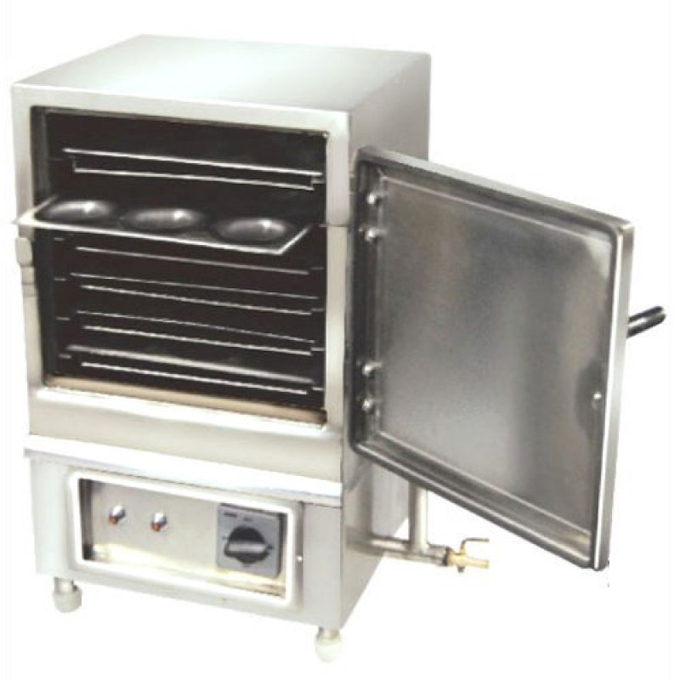
Steamer

Slide 28
PREPARATION OR COOKING EQUIPMENT
Large pans, broilers and fryers
Bratt pan - is one of the most versatile pieces of cooking equipment in the kitchen because it is possible to use it for shallow frying, deep frying, stewing, braising and boiling.
Boiling pans – many types are available in different metals – aluminium, stainless steel, etc.
Fryers like pressure fryers, hot air rotary fryers, computerized fryers (programmed and controlled automatically cooking temperature)
Bratt pan

Slide 29
PREPARATION OR COOKING EQUIPMENT
Grills and Salamanders – the salamander or grill heated from above by gas or electricity.
Under fired grill – most commonly fuelled by gas, which heats a bed of firebricks. Food is cooked on grill bars, which slant above the firebricks.
Contact grill – these are sometimes referred to as double –sided or infra grills and have two heating surfaces arranged facing each other.
Salamander

Slide 30
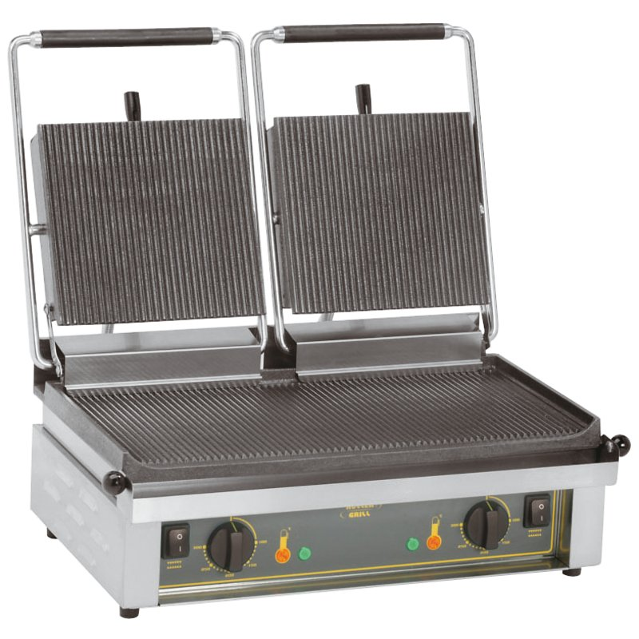
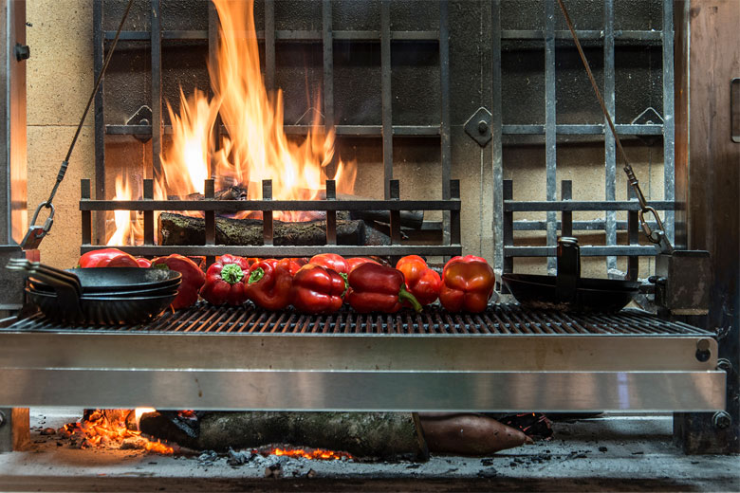
Contact grill
Under fire grill

Slide 31
HOLDING EQUIPMENT
Bain Marie
This is basically a well containing hot water into which pots are placed to keep their contents hot for service.
These may be free-standing or incorporated into a cooking range.
Hot cupboards (Hot plate)
These are used for heating plates and serving dishes and for keeping food hot.
They may heated by steam, gas or electricity. The top of most hot cupboards are used as serving counters
Plate Warmers/ dispensers
These are units for heating and storing plates for service.
These may stand-alone, be mobile, or be a part of a service arrangements.

Slide 32
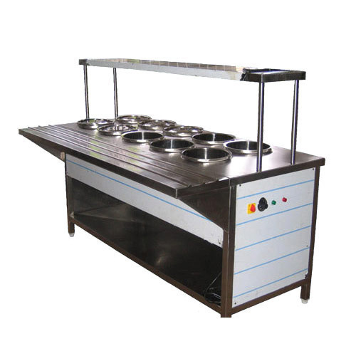
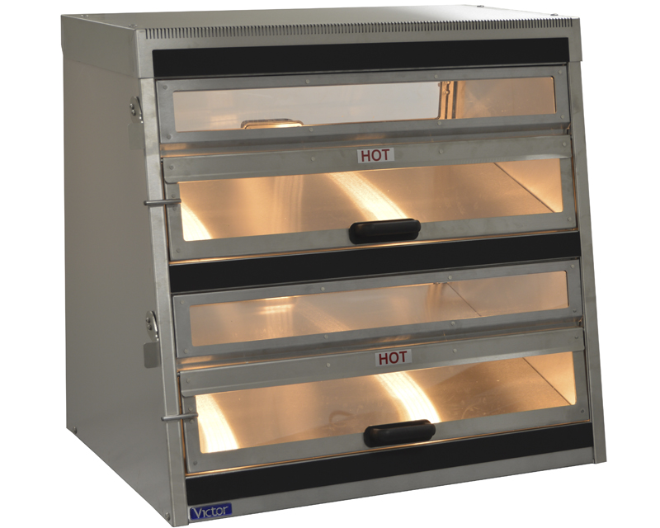
Bain marie
Hot cupboards

Slide 33
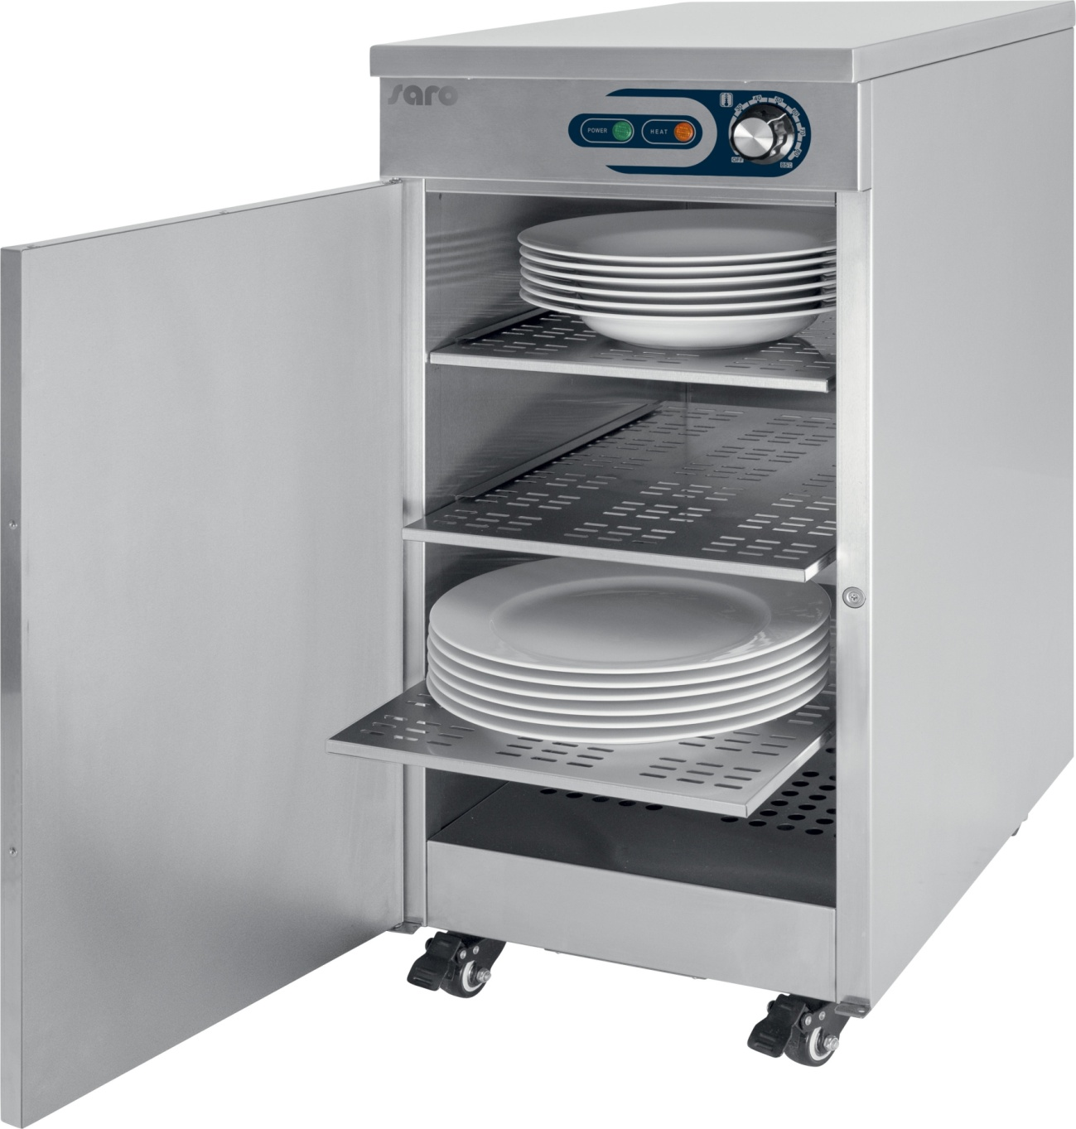
Plate warmers

Slide 34
HOLDING EQUIPMENT
Cold Rooms
Maintained at a temperature of 10^{O}C, these walk-in rooms are designed for the storage of perishable foods which do not require temperatures as low as a refrigerator.
Blast chillers
These are large units which are designed to cool hot food to chilling temperatures in minimum amount of time.
Frozen food storage cabinet
A container for the storage of frozen foods at a temperature of below - 18^{O}C, sizes vary small, single-door cupboards to walk in freezer rooms.

Slide 35
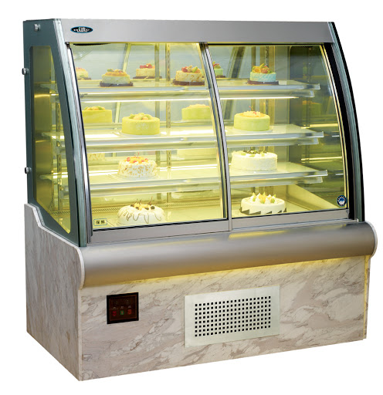
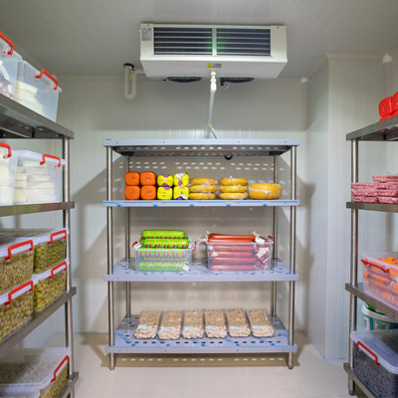
Cold rooms
Frozen Food Cabinet

Slide 36
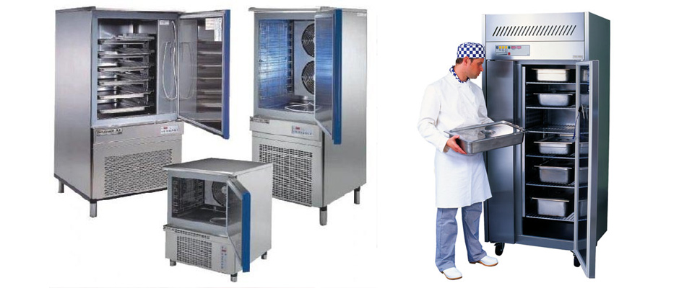
Blast Chillers

Slide 37
DINING ROOM EQUIPMENT
A restaurant / hotel dining room that is attractive and appealing does much to make patrons feel comfortable and also adds to the enjoyment of the food.
The following are the equipment to be used in first class restaurants/hotels,
Top of the table items
Dinnerware/crockery
Table ware
Glass ware
Linen ware
Table cloths
Table mats and napkins
Centre table accompaniments
Furniture
Serving equipment
Dinnerware/crockery
These are various plates of different sizes and bowls that are used in eating of food by customers at the table.
These are available in glass, stainless steel, silver, plastic, electroplated, nickel, silver materials etc.

Slide 38
DINING ROOM EQUIPMENT
Plates
Souvier (used as underliner for tea, coffee or soup cups), side plate (used for accompaniments), half plate (fish plate or dessert plate), full plate (main plate or meat plate), soup plate (hollow in shape).
Bowls
Nappy bowl (used for cornflakes or oatmeal), soup cup (used to serve soup), egg cup (used to serve boiled egg with shell), salad bowl (used to serve salad)

Slide 39
DINING ROOM EQUIPMENT
Types of flatware (Spoons and forks)
Spoons
Coffee spoons (used along with coffee cup), teaspoons (used along with teacup), soup spoons (round and hollow and used for drinking soup) and dessert spoon (oval in shape and it goes with dessert).
Fork
Fruit fork (smallest fork used for eating for fruit), pastry fork (used to eat pastry) and fish fork (its like a dessert fork but has a smaller cut at the side)
Cutlery (includes knives used for eating and other cutting tools)
Fish Knife (this has a small wedge and it goes with fish fork), large knife (goes with large fork and main dishes) and side knife (used to be kept on the side plate and commonly used to apply butter)
Hollowware
Items such as coffeepot, teapot, sugar bowl and milk jugs are collectively called as hollowware.
These are made up of porcelain, china and stainless steel. Silver and gold coatings can be used.

Slide 40
DINING ROOM EQUIPMENT
Glassware
Glasses of catering field are made in many sizes and shapes and one needs to b familiarized with all these so as to be able to select the correct one for a particular drink. The various glasses of hotel industry are
Juice glass (used to serve small juice during breakfast), hiball (this is used only for serving whisky, rum and gin and it is not to be used for water), water goblet (used only to serve water) and tom collins (used for lassi, milk shake and parfait etc)
Linen ware
Tablecloth - table cloth or table covering is one of the important dining room furnishing to be used on the dining table. Table covering is made up of cotton, rayon, cotton blends, thin plastics and so on.

Slide 41
CLEANING EQUIPMENT
Pot and Pan Cleaners
Manually controlled power scrubbing brush, cleans and polishes; multiple use with accessories, extension cords, scouring brushes, buffers; requires no extra space.
Water agitator attachment for pot soaking sink.
Dishwashers, pot and pan washers and glass washers.
Dishwashing equipment
Conveyor dishwashers:
These operate on the conveyor-belt principle as the name implies. The soiled items are loaded at one end and passed through the pre-wash, wash, rinse and if included, drying tunnels, emerging at the other end ready for use.
These are usually stainless steel, heated by electricity or steam and have variable belt-speed controls.

Slide 42
CLEANING EQUIPMENT
Front Loading batch dishwashers
The usual design is a single compartment with one or two sliding trays on to which soiled items are placed.
All models have a selection of automatic programs for lightly – to – heavily- soiled items.
Glass washing machine
Similar in operation to the front loading batch washers although counter models are available as well which may fit under a bar counter.
Some machines are incorporated in units with counter, sink and storage racks.
Pass through batch dishwashers
These operate with push-in trays on one side and pull-out at the other. The push – in and pull - out operation can be at an angle or corner models.
Outputs may be up to 1100 plates per hour.

Slide 43
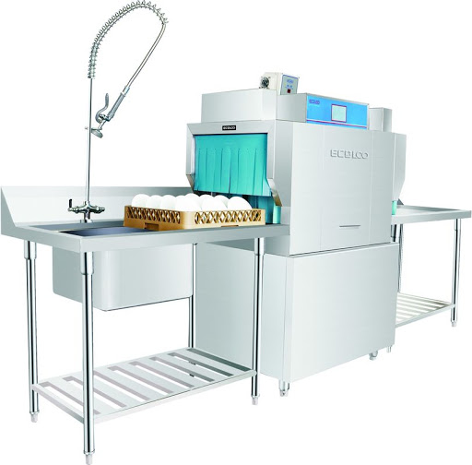
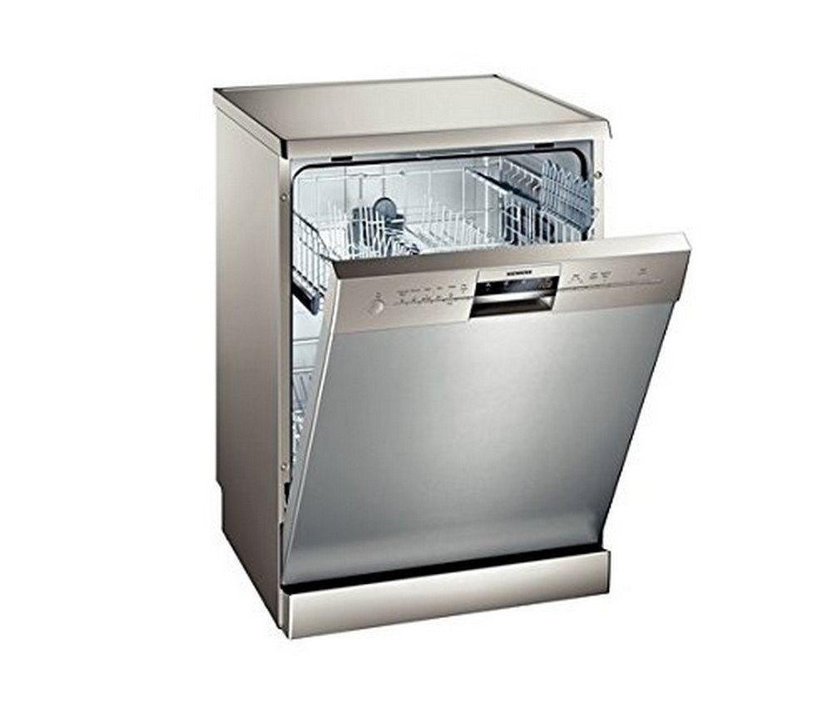
Front Loading Batch Dishwashers
Conveyor dishwasher

Slide 44
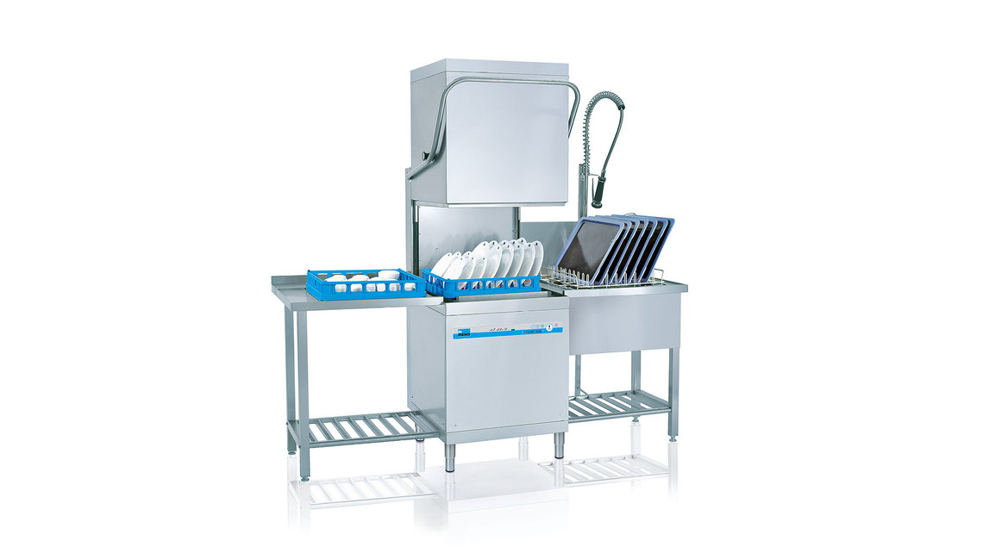
Pass through batch dishwasher

Slide 45
CLEANING EQUIPMENT
Chemical sanitizing machine
This machine was developed to reduce the need for the expensive hot water that other types of machines used.
This machine operate using lower temperatures, higher water pressure and increased amount of chemicals.

Slide 46
DISPOSAL EQUIPMENT
Food waste disposers
All types of food production generate waste, which must be removed as soon as possible. Waste disposable units reduce the volume of waste by
Producing a slurry of soft food waste and disposing of it down the drain or producing a semi-dry pulp
Crushing both hard and soft waste and compacting it into a dense, solid material to be disposed off in the normal way.
Waste bins
Waste bins may be wheeled or static with a hinged or free lid and are often used with strong polythene liner bags.
Compactors
These come in various capacities.
This will crush bottles, flatten cans and cardboard and crush food and vegetable matter.
Once compacted, the refuse is removed in a plastic bag, sealed and placed in a waste in ready for collection by the local authority.

Slide 47
DISPOSAL EQUIPMENT
Shredders
Shredders are used to cut up such items as paper, card, metal and other waste in order to reduce large volumes of waste to a more manageable size.
However unless there is likely to be large quantity of waste to be shredded, such a method may not be economical to employ.
Paper balers
Cope with larger volumes of paper and cardboard, compressing and baling up these products into neat 30-50 kg bales. Unless there is a larger volume of paper and card, it is not an economical method to use.

Slide 48
Waste Compactors

Slide 49
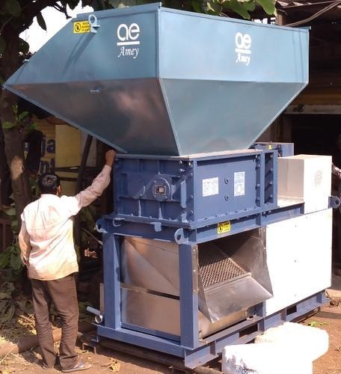
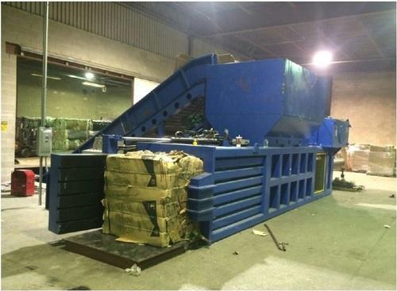
Shredders
Paper Balers

