Slide 1

Cauvery College for Women (Autonomous)
Nationally Accredited (III Cycle) with ‘A’ Grade by NAAC
Annamalai Nagar, Tiruchirappalli-18.

Slide 2
Name of the Faculty : Ms.S.Agalya
Mobile Number : 8428141101
Designation : Asst Professor
Department : Food Service Management and Dietetics
Programme : M.Sc., Food Service Management and Dietetics
Batch : 2016-2017 Onwards
Semester : IV
Course : Food Service Facilities
Course Code : P16FS41
Unit : III
Topic Covered : Materials used for Bases and Finishes

Slide 3
Materials used for Bases and Finishes

Slide 4
Type of materials
Stainless steel
Copper and copper alloys
Zinc coated materials
Organic (Non-Metallic) Coatings
Glass and Glass Like Materials
Wood
Aluminium
Iron
Earthenware and Enamelware
Clay

Slide 5
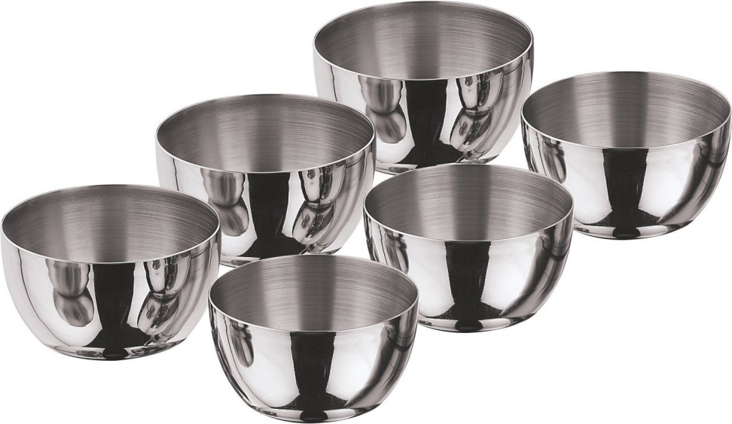
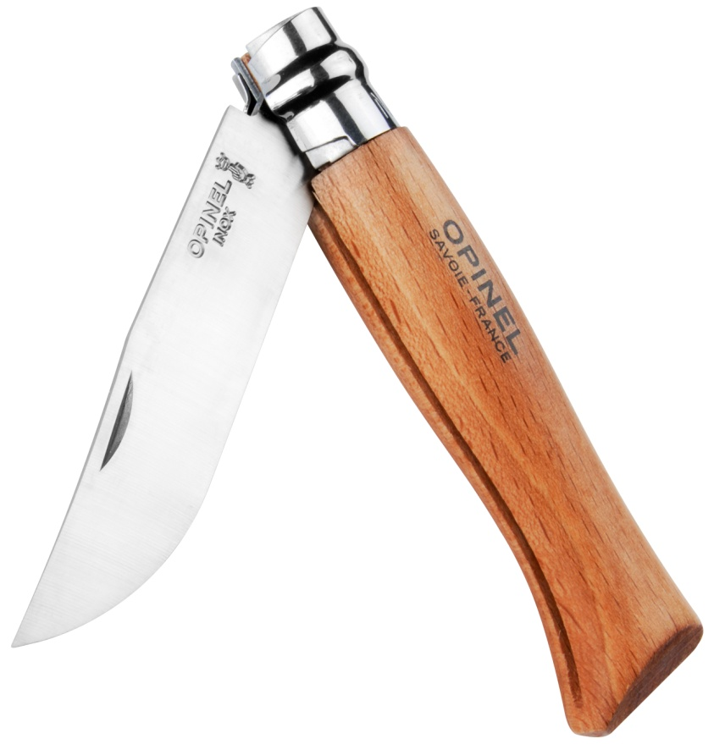
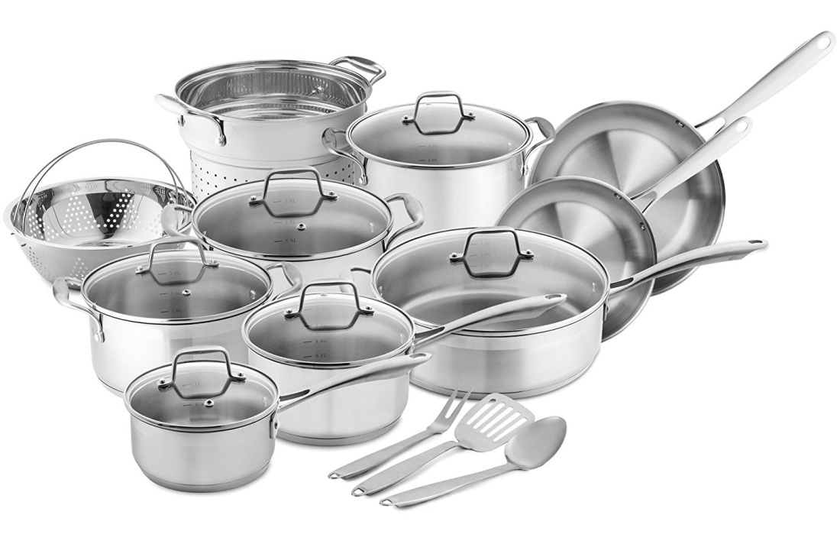
Stainless steel
Min chromium content – 16% - Can be used for cutlery, blades and similar Applications requiring sharp edge

Slide 6
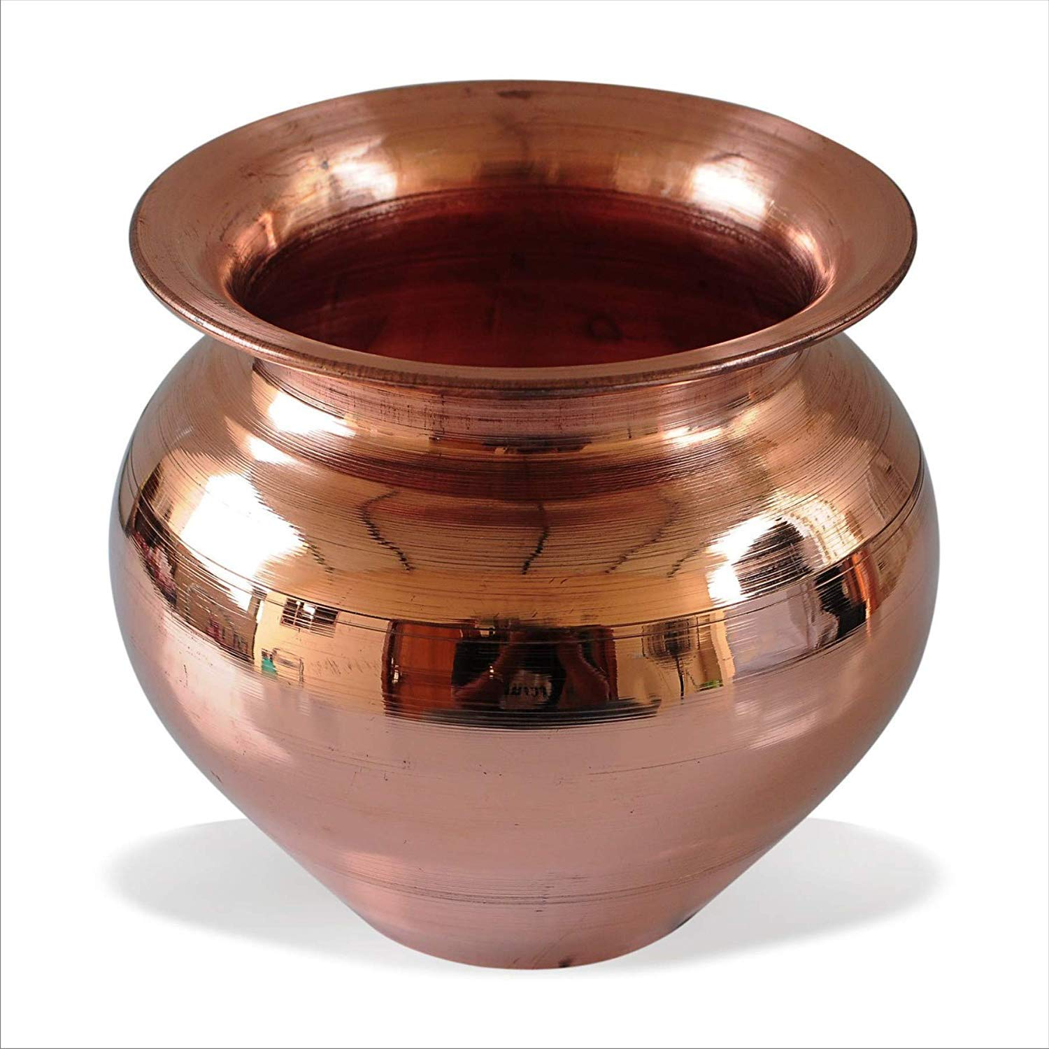
Copper and Copper Alloys
Commonly not used in food zone
Used – when food exposed in limited – potable, non-carbonated water under constant pressure

Slide 7
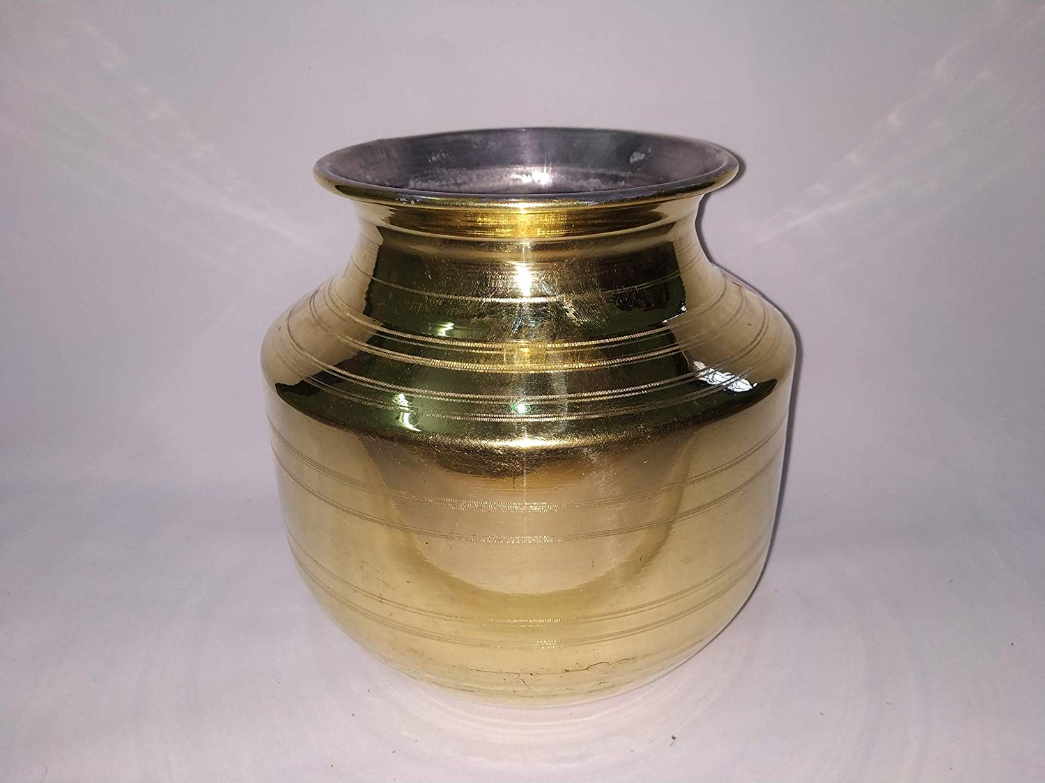
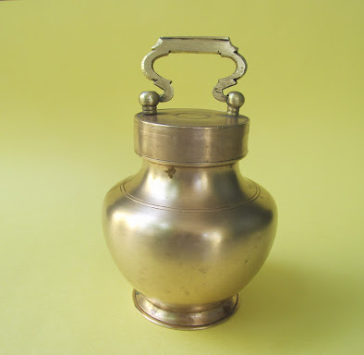
Brass and bronze – used in food zone where only tea, coffee and water
When used the led content – should not exceed 80%

Slide 8
Copper nickel alloys – used when non acid foods and beverages ( food and beverage with pH 0f 0.6 or greater

Slide 9
Zinc coated materials
Shall not be used for direct food contact

Slide 10
Organic (Non metallic) coatings
Not used for direct contact with food – except flourous resin coatings are permitted
The organic coating used should resist – cracking, chipping, peeling when subject to impact
Also heat resistant

Slide 11
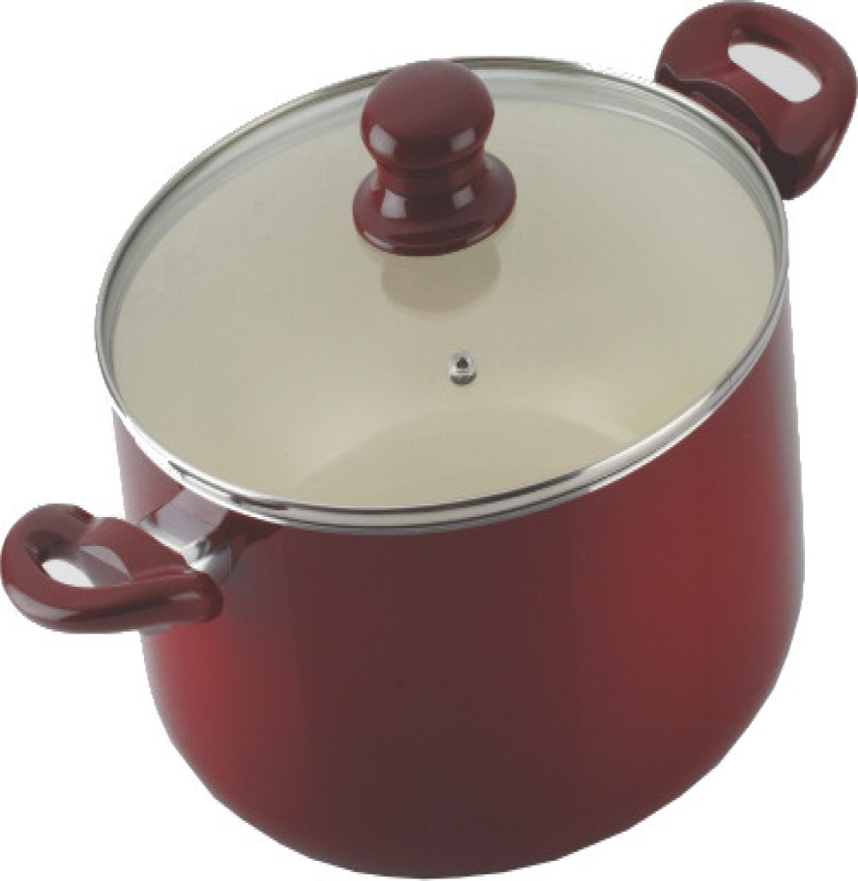
Glass and Glass like materials
Porcelain and porcelain enamels – should not used in direct contact
Impact by counter tops, table tops, cutting boards, cooking surfaces and food preparation utensils
Should not impact any fractures

Slide 12
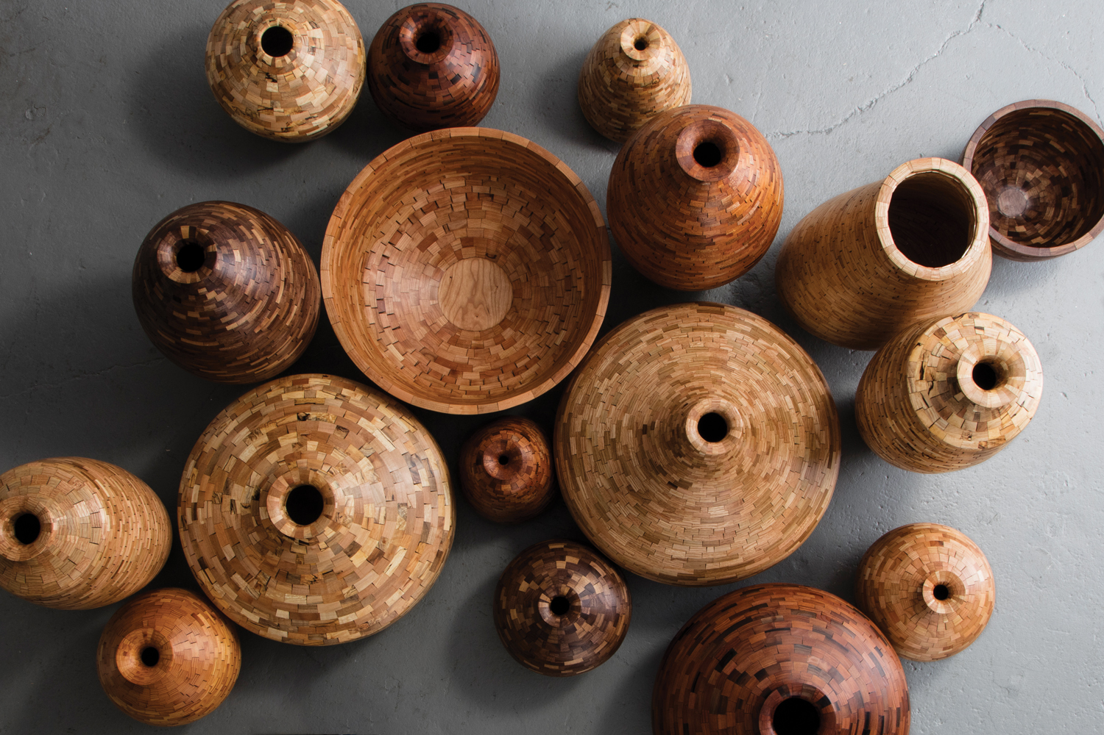
Wood
Not direct contact
Used for wood top tables and cutting boards
When for decoration – should be sanded smooth and sealed with appropriate sealant
Should not exposure to excessive moisture and cocas

Slide 13
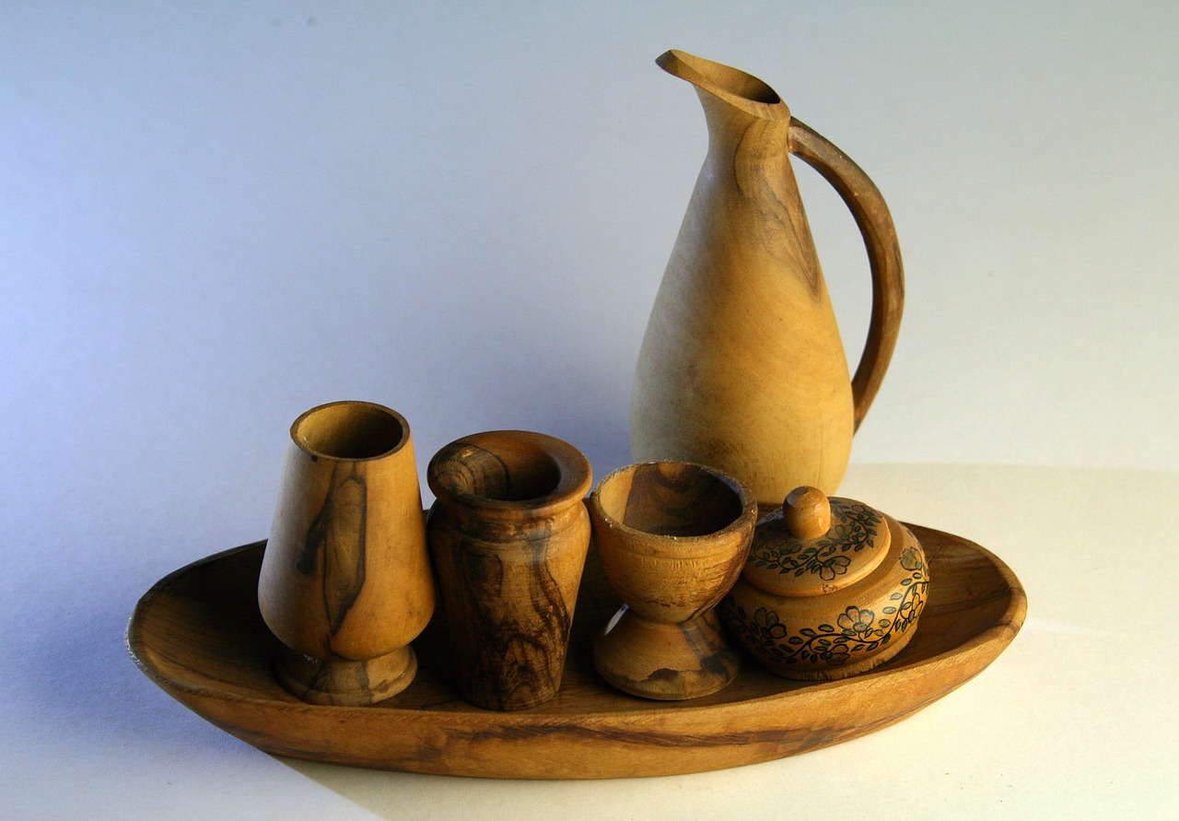
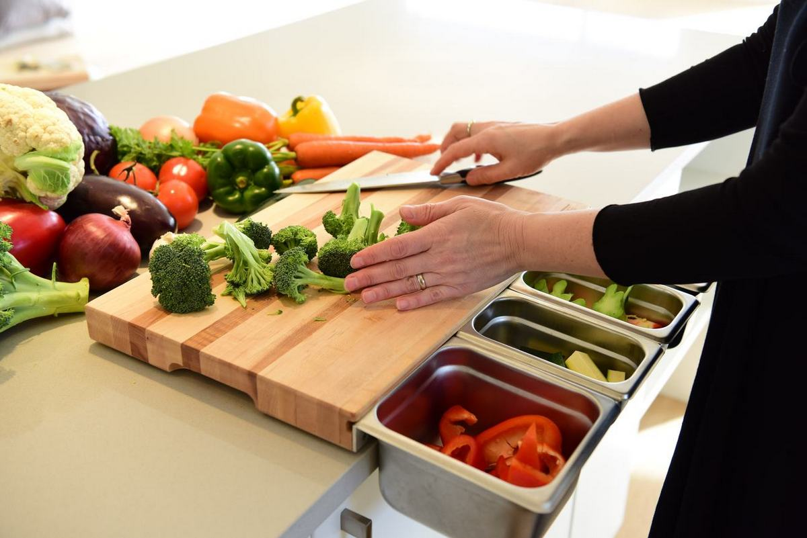

Slide 14
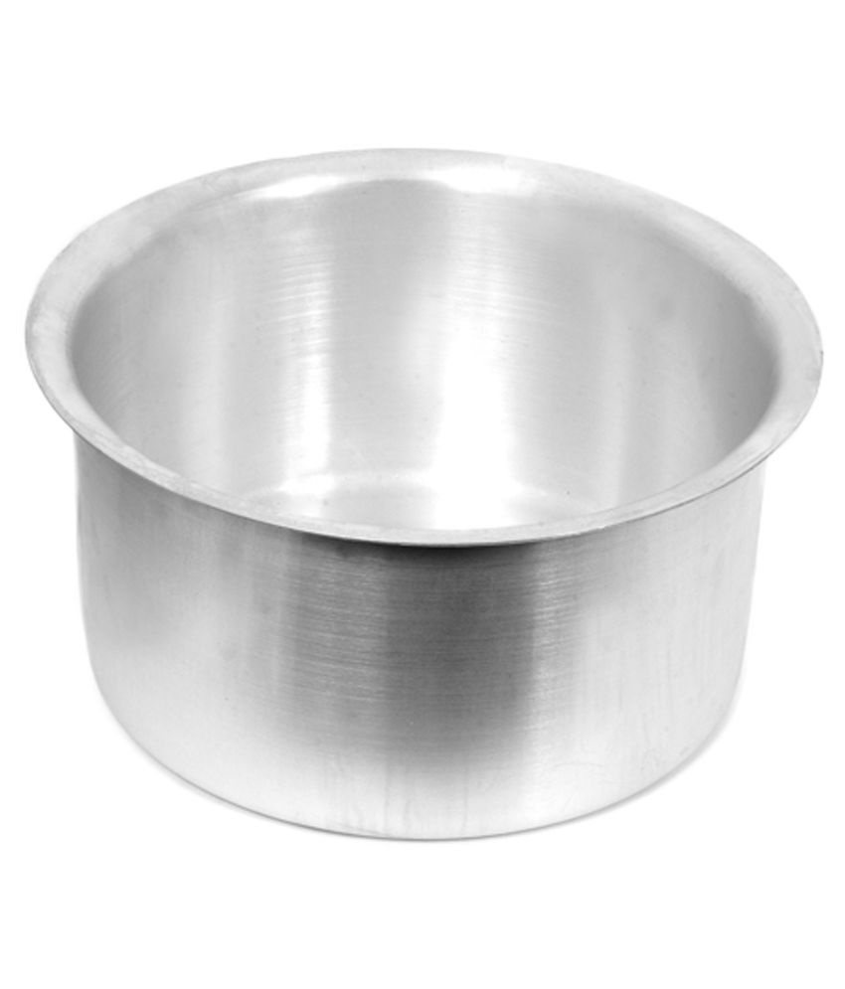
Aluminium
Best material for kitchen utensils
Adv – good thermal conductivity,
- non reactive with food stuffs at low & high temperature
- Low toxicity
- no discoloration of food

Slide 15
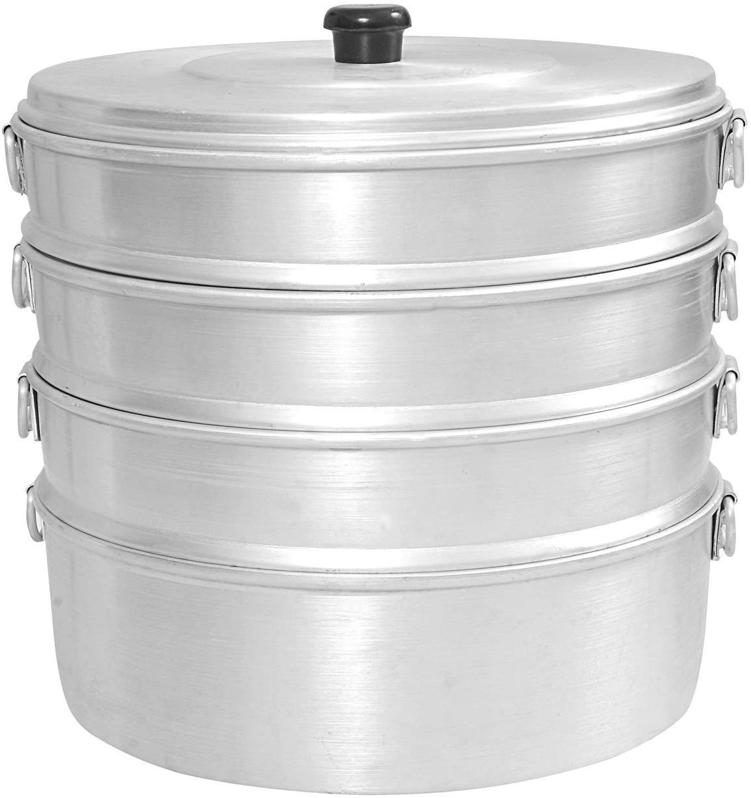
Disadvantage
Dissolved by acidic foods
Reacts to alkaline soaps
Easily discolured

Slide 16
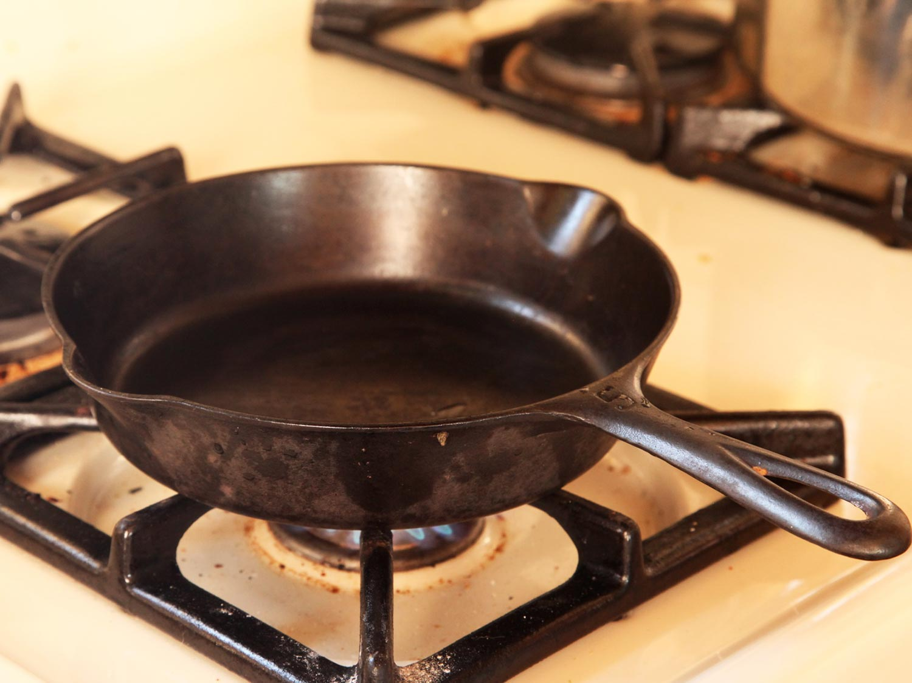
Iron
More prone to rusting than copper
Cast iron kitchen utensils – less prone to rust if simply washed and wiped clean
Little problem with high temperature, simple to clean, durable and strong

Slide 17
Iron
Solely used for frying a cooking with fat or oil
Corrosion can be reduced by never heating water with it and never icing it to cook with water

Slide 18
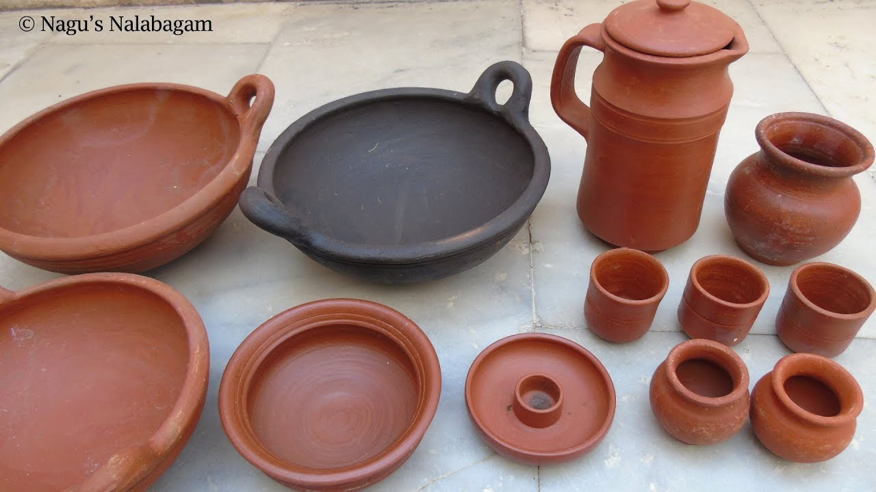
Earthenware and Enamelware
Suffer from brittleness when subjected to rapid changes in temperature
Require careful handling – prone to chipping
But enamel utensils are not affected by acidic foods, durable and easily cleaned

Slide 19
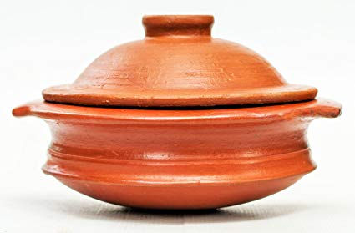
They cannot be used with strong alkalies
Earthenware and potter utensils can be used both cooking and serving food
Durable and excellent for slow and even cooking in even heat such as slow baking
But unsuitable for cooking using direct heat

Slide 20
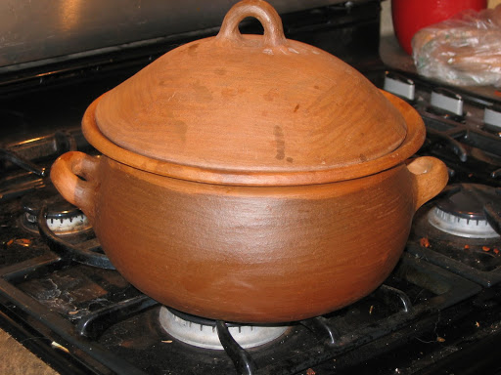
Clay
Non enameled clay -Natural
Specific aroma and refined taste
Used for preparation, storing – regulates temperature and humidity
Non enameled ceramics – does not come into a reaction with food, toxic substances and safe to prepare food
Many types – terracotta utensils – made of red clay and black ceramics

Slide 21
