Slide 1

Queens College of Arts and Science for Women,
Punalkulam. Near Thanjavur, Pudukkottai (Dt)
DEPARTMENT OF BUSINESS ADMINISTRATION
TOPIC: MARKETING CHANNELS
SUBJECT: MARKETING MANAGEMENT
SUB CODE: 16CCBB3
Staff Name:Dr.A.Akilandeswari
Assistant Professor of BBA

Slide 2
MARKETING CHANNELS

Slide 3
What’s Marketing Channels ?
Project Shakti: Among the new channels is A Marketing channel is the series of interdependent marketing institutions that facilitate transfer of title to a product as it moves from producer to ultimate consumer or industrial user. The title may be transferred directly, as and when the commodity is bought or sold outright, or indirectly, as and when the transaction is negotiated through a functional middleman such as an agent or broker who does not take credit to it.

Slide 4
DEFINE MARKETING CHANNELS
Different people perceive marketing channels in different ways, some see it as a route
taken by a product as it moves from the producer to the consumer, and others describe it
as a loose coalition of business firms that have come together for purpose of business.
Customers may view marketing channels as simply ‘a lot of middlemen’ standing
between the producer and the product. Given all these different perspectives it is not
possible to have one single definition for marketing channels.

Slide 5
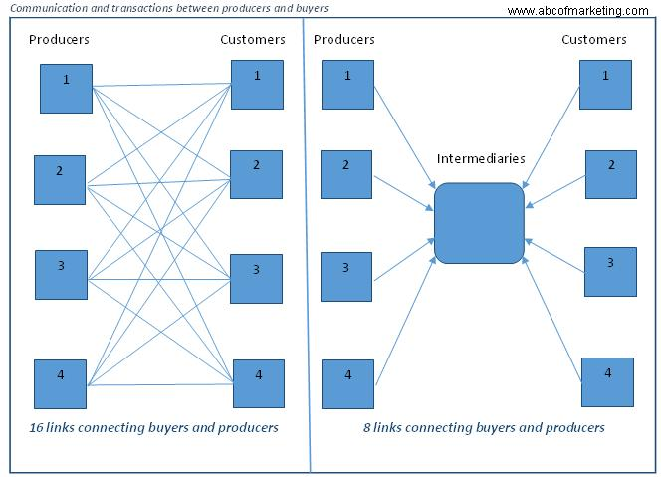
Bulk-Breaking Function
Conti…

Slide 6
The intermediaries reduce the transaction costs because of the lower number of links between manufacturers and buyers.
They are the source of information for manufacturers. The intermediaries provide information about the market like demand, competitors, consumer behaviour, consumer buyer behaviour, etc. (marketing environment) which helps manufacturers in altering marketing strategies or identifying new needs and wants in the market (information on opportunities and threats).
Intermediaries take the risk of new product launches. Irrespective of the acceptance of a new product in the market, the intermediaries take the risk of managing the new product that requires investment in time, effort and money.
The intermediaries perform the function of product storage as well as transportation. In their absence, the manufacturer will have to perform these functions. They take the risk of transportation and storage.
The intermediaries help promote products via different in-store promotion activities like distribution of pamphlets, display, assigning shelf space, store salesman, etc. For example, customers do ask the store representatives about the value of the product, any complaints from other customers, etc.
Knowledge of the region – a manufacturer will need help of local people in the target market on the expertise on the local language, culture, etc. The retailers, etc. perform this function, and help the manufacturer in implementing its marketing strategies.
Conti…

Slide 7
When the product information is available (promotion), the customer is bound to make enquires with different retailers, ecommerce sites, wholesalers, etc. It becomes important for the manufacturers to ensure the product is easily available to the customers. Else a competitor will take advantage of this opportunity and introduce the product with different intermediaries for the customer.
Presence of intermediaries reduces the number of links between the manufacturers and the buyers. As shown in the figure, for example, if the producer 1 manufactures shirts and producer 2 manufacturers shoes. So a customer looking for both these items will have to contact these 2 manufacturers separately.
The presence of the marketing channels ensure market coverage and a successful marketing strategy for the organisation. The intermediaries provide a variety of products from different manufacturers at one place. The customer doesn’t needs to make extra efforts to reach the manufacturers.
The intermediaries provide a variety of products at one place. The buyers get a great opportunity of comparing the products and their substitutes from different manufacturers.

Slide 8
Types of Intermediaries
Brokers and Agents: Both the intermediaries sell products and services on a commission or percentage basis. They are legally appointed to impart information about a product to the customers on behalf of the manufacturer or producer, but never take ownership of the product sold. The key function of these intermediaries is to bring buyers and sellers together to make a deal. For example, an insurance or real estate agent gets a commission for their service or a sale, but do not take ownership.
Conti…

Slide 9
Wholesalers and Reseller- They typically buy goods from the manufacturer in bulk and resell them to the retailer or other businesses. They are an independent businessman and take ownership of the products purchased from the manufacturers or producers. Some wholesalers also provide services such as order processing, storage, delivery, and participate in promotion as well.
Distributors- The distributors are selected by the manufacturer to distribute their products to the wholesaler or resellers in different locations. The distributors are involved in many businesses and cover many geographical areas. Few services distributors offer to the wholesalers are delivery, maintain inventory, extend credit, etc.
Retailers- The retailers are the mediator between wholesaler and customers. They purchase different goods from the wholesaler and sell them to the ultimate customers in small quantities from one place.

Slide 10
What is a wholesaler?
A wholesaler is a company or individual that purchases great quantities of products from manufacturers, farmers, other producers, and vendors. Wholesalers store them in warehouses and sell them on to retailers (shops and stores) and businesses.
Wholesalers are the merchant middlemen who sell mainly to retailers, other merchants, commercial, industrial, or institutional users. They buy principally for resale or business use.

Slide 11
Define wholesaler
According to Collins.Dictionary.com, a wholesaler is:
“A wholesaler is a person whose business is buying large quantities of goods and selling them in smaller amounts, for example to shops.”

Slide 12
who is a Retailer?
A retailer is a person or a couple of persons or a business entity which purchases products directly from distributors or wholesaler and sells these products directly to their customers who come to their business premises to buy products from them.

Slide 13
Define Retailer
A retailer is a company that buys products from a manufacturer or wholesaler and sells them to end users or customers. In a sense, a retailer is an intermediary or middleman that customers use to get products from the manufacturers.

Slide 14
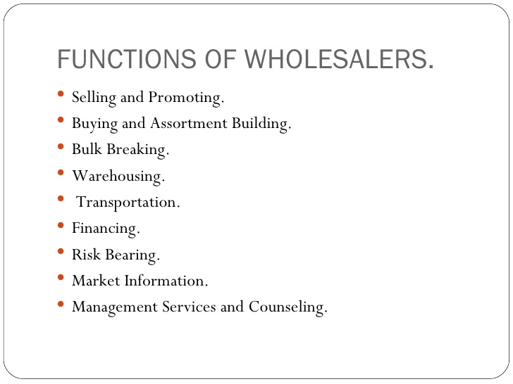

Slide 15
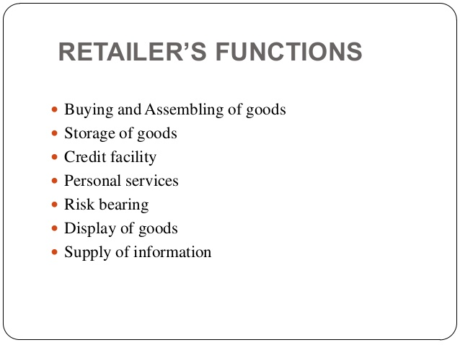

Slide 16
Differences between Wholesalers and Retailers:
Wholesalers | Retailers
Wholesalers buy from the manufactures and sell goods to the retailers. | Retailers buy from the wholesalers and sell goods to the consumers.
Wholesalers usually sell on credit to the retailers. | Retailers usually sell for cash.
They specialise in a particular product. | They deal in different kinds of goods.
They buy in bulk quantities from the manufacturers and sell in small quantities to the retailers. | They buy in small quantities from the wholesalers and sell in smaller quantities to the ultimate consumers.
Wholesalers always deliver goods at the doorstep of the retailers. | Retailers usually sell at their shops. They provide door delivery only at the request of the consumers.
A wholesaler needs mainly a godown to stock the goods he handles. | A retailer needs a shop or a showroom to sell.
Conti…

Slide 17
Wholesalers | Retailers
A wholesaler goes to different places to supply. | A retailer usually sells at a particular place. Sometime he may have branches in other places.
A wholesaler need not provide shopping comforts like luxurious, interiors, provision of air-condition, trolleys, etc. | A retailer usually provides shopping comforts mainly to attract customers.
As the wholesaler specializes in a particular product, he has to necessarily convince the retailers about the product quality. Only then the latter will place an order. | As the retailer deals in a variety of goods, he need not influence buyers. He can let the buyer choose any brand of product the he likes.
As per the custom of their trade, wholesalers allow the retailers trade discount each time the retailers buy. | The retailers normally do not allow any discount to their customers. Some of them may offer cash discount to bulk buyers. Sometimes, they may offer seasonal discounts.

Slide 18
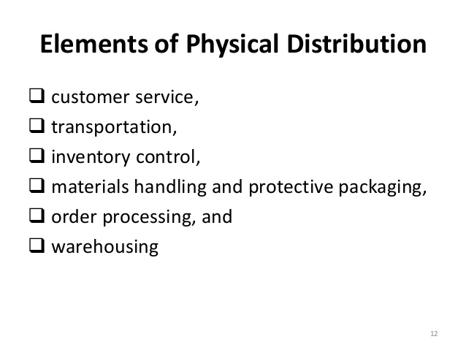

Slide 19
THANK YOU

