Slide 1
QUEENS COLLEGE OF ARTS AND SCIENCE FOR WOMEN, Punalkulam, NEAR THANJAVUR, Pudukkottai (Dt)
DEPARTMENT : MATHEMATICS
COURSE : BCA & COMPUTER SCIENCE
SUBJECT : OPRATION RESEARCH
TOPIC : LINEAR PROGRAMMING- GRAPHICAL METHOD
UNIT : I
SUBJECT CODE : 16SACMA3
PREPARED STAFF : Dr. S. SRIDEVI
DESGINATION : ASSISTNAT PROFESSOR

Slide 2
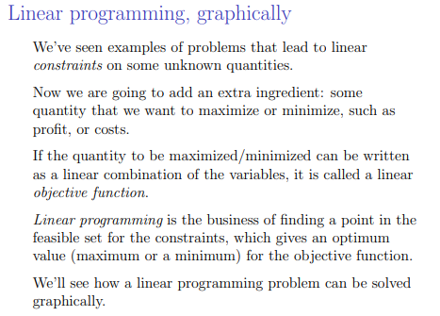

Slide 4
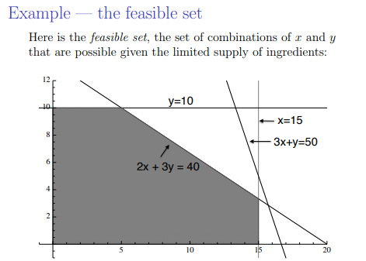

Slide 9
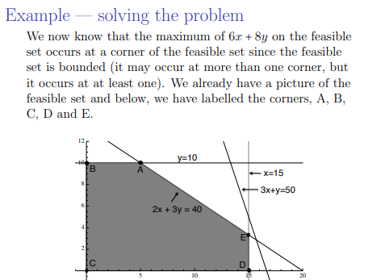

Slide 10
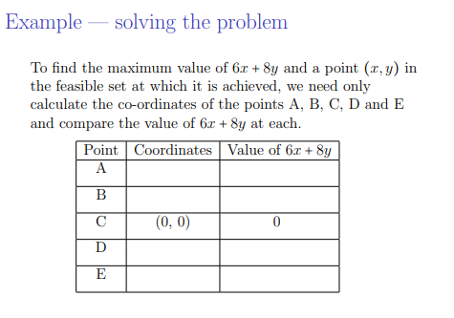

Slide 12
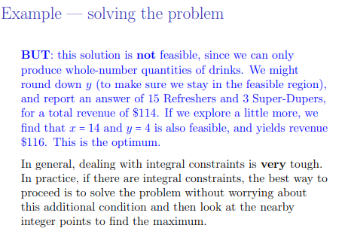

Slide 24
ALL THE BEST

