Slide 1


Slide 2
Author: Charles Dickens
First published: 1849
Number of pages: 624
Characters: Uriah Heep · Betsey Trotwood · Peggotty · David Copperfield · James Steerforth · Dora Spenlow · Wilkins Micawber· Mr. Edward Murdstone
New content will be added above the current area of focus upon selection
Genres: Novel · Fiction · Künstlerroman

Slide 3
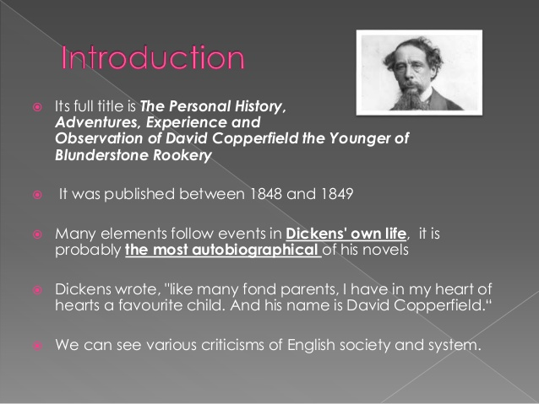

Slide 4


Slide 5
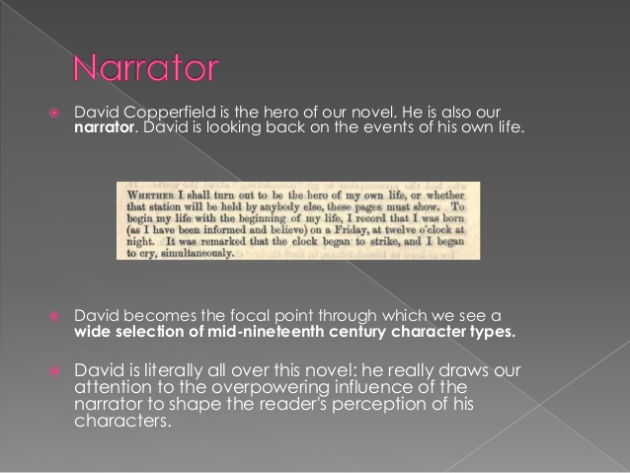

Slide 6
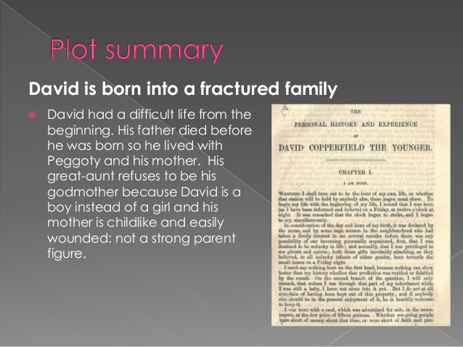

Slide 7
The story starts with an account of the birth and childhood of David Copperfield at his home, Blunderstone Rookery.
He was born six months after the death of his father and under circumstances which one of the nurses claimed would cause him to lead an unlucky life.

Slide 8
He is raised by his mother Clara and his nurse Peggotty, who give him a happy childhood.
He remembers his mother as carefree and recalls the relaxed atmosphere that the three of them had together.
He frequently says that this is one of the happiest times in his life.

Slide 9
Everything changes once his mother meets the dark but handsome Mr. Murdstone. Peggotty immediately takes a disliking to him and often fights with Clara about him, but Clara refuses to heed her advice.
Peggotty and David visit Yarmouth, Peggotty's hometown, for a week, which is when David first meets Mr. Barkis, the carrier driver, Mr. Peggotty, Peggotty's brother, Ham, and Little Em'ly

Slide 10
When David and Peggotty return, however, his mother and Mr. Murdstone have been married, and their former life disappears forever.
Mr. Murdstone is a very controlling man who forces the principle of firmness on Clara with the help of his sister, Miss Murdstone.

Slide 11
After David bites Mr. Murdstone while being beaten by him, David is sent away to Salem House, a boarding school for boys.
There he meets Steerforth, a handsome, cultured boy whom he admires dearly, and Traddles, an overweight but jovial and kind-hearted boy.
He learns a lot at the school and has one more good day with his mother, but he soon receives the bad news that his mother has passed away.

Slide 12
He returns home for the funeral and never goes back to Salem House.
Peggotty is fired by Mr. Murdstone and marries Mr. Barkis, and although she writes to David and sees him from time to time, she can no longer be there for him the way she was before.

Slide 13
David is constantly neglected before he is finally sent away to London to work in one of Mr. Murdstone's warehouses, which he does not like at all, despite the respect he earns. He does get to meet the Micawbers, a kind yet financially troubled family.

Slide 14
They are eventually forced to move away to evade all of their debts, and once they move, David decides to leave as well and to find his aunt, Miss Betsey, who abandoned him and his mother at his birth because he was not a girl.
After a difficult journey, he finds the home of his aunt in Dover, and after a rude encounter with the Murdstones, she decides to let him stay, along with her other houseguest, Mr. Dick.

Slide 15
David begins attending school in Canterbury and does well, He quickly rises to the top of his class. He lives with family friends Mr. Wickfield and his daughter, Agnes.
Agnes is around David's age and will continue to be a significant influence in David's life.
He also meets Uriah Heep, Mr. Wickfield's servant to whom David takes an immediate disliking, Dr. Strong, the master of his school, and Dr. Strong's wife Annie.

Slide 16
After conferring with his aunt, David decides to pursue the career of a proctor.
He moves into Doctors' Commons in London and works at the offices of Spenlow and Jorkins. He even gets his own apartment with a landlady named Mrs. Crupp

Slide 17
He encounters old friends of his, including Tommy Traddles from Salem House, who is studying to be a lawyer and is working to save money for his wedding to his fiancee, and Mr. Micawber.
Soon, however, Mr. Micawber is forced to leave once again due to financial issues. David meets Mr. Spenlow's daughter, Dora, a very beautiful but childish girl with whom he falls completely in love.

Slide 18
Although David is poor, he is determined to work hard so that his marriage with Dora can work out.
However, Mr. Spenlow soon finds out about the affair and forbids it, only to die in a carriage accident later that day, leaving Dora distraught and unwilling to see David.
Eventually, though, the two marry and lead a happy life, although Dora is very bad at keeping house and is very childlike in many ways. Her premature death is a serious blow to David, and it is mainly Agnes' support that keeps him afloat.

Slide 19
Meanwhile, Mr. Peggotty and David hear from Littimer, Steerforth's servant, that Little Em'ly has run away from Steerforth.
They ask her friend Martha for help finding her, and Martha eventually finds Little Em'ly and leads Mr. Peggotty to her

Slide 20
He decides to move to Australia, where Little Em'ly can start a new life, as does the Micawber family. Steerforth dies in a storm just outside of Yarmouth, and Ham dies trying to rescue him.

Slide 21
David moves away to recover from all that he has been through. During this time, he discovers that he truly loves Agnes.
Not long after he returns to London, the two get married and live happily with three children as well as Miss Betsey, Peggotty, and Mr

Slide 22
THANK YOU

