Slide 1


Slide 2
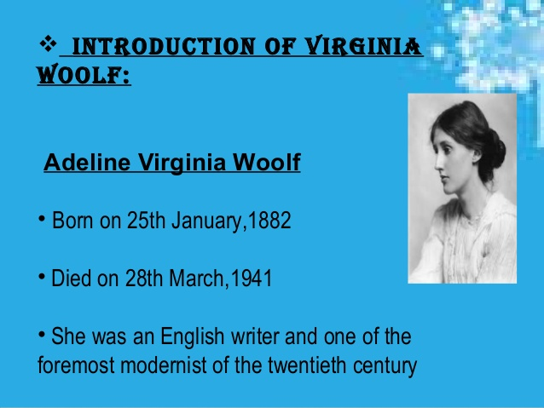

Slide 3
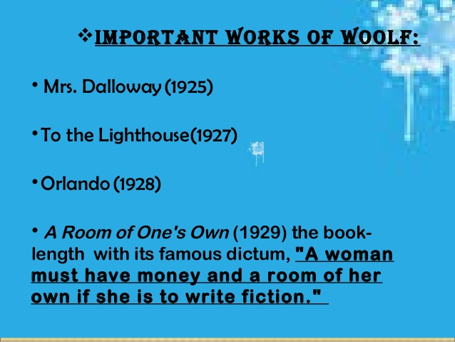

Slide 4
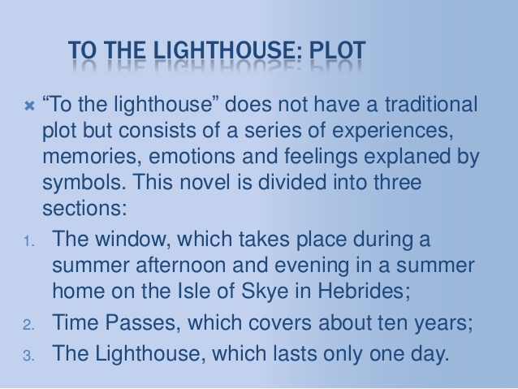

Slide 5
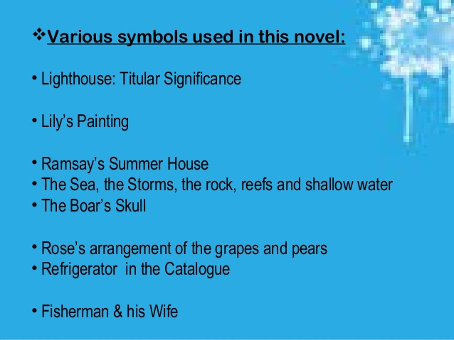

Slide 6
THE WINDOW

Slide 7
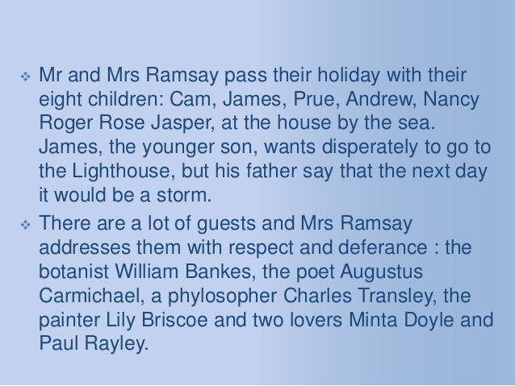

Slide 8
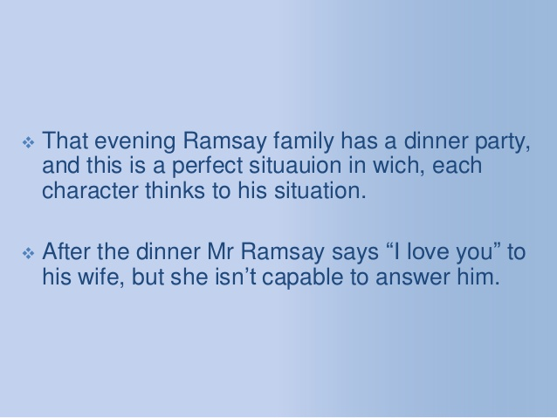

Slide 9
TIME PASSES

Slide 10
In the second section of the novel, "Time Passes," the house is abandoned for ten years, suffering the ravages of time, neglect, and decay.
Mrs. Ramsay unexpectedly dies one night, as does Prue in an illness related to childbirth

Slide 11
Andrew is the third Ramsay to die when he is killed instantaneously in battle.
Mrs. McNab goes to the house occasionally to tidy it up and restore it, but it is not until she hears word that the remaining Ramsays will be returning for the summer that she gets everything in order.

Slide 12
THE LIGHT HOUSE

Slide 13
In "The Lighthouse," all of the living Ramsays, as well as other guests (including Lily Briscoe), return to the summer home.
Mr. Ramsay decides that he, James, and Cam Ramsay will finally take the trip to the Lighthouse, but the children are resentful of his domineering manner

Slide 14
He is angry about delays on the morning of the trip, and he approaches Lily for sympathy, but she is unable to feel any sympathy for him until he has already set off on the journey, when it is too late.
Just as Mr. Ramsay decides to finally take this journey, Lily Briscoe decides to finally finish the painting that she started ten years ago.

Slide 15
On the boat, the children continue to resent their father's self-pity, yet as the ship approaches the Lighthouse, they find a new tenderness for and connection to him.
As the boat reaches its destination, Lily paints the final stroke on her canvas and finally achieves her vision.

Slide 16
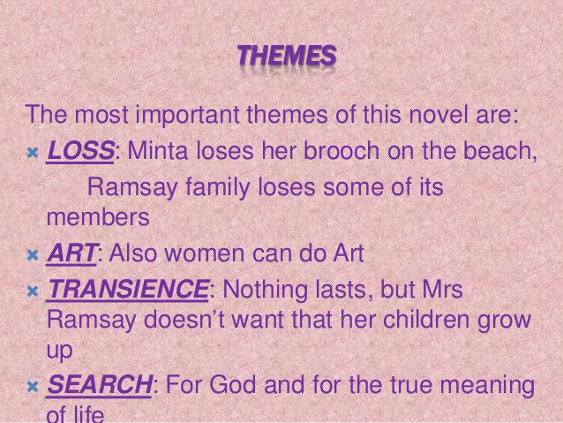

Slide 17
THANK YOU

