Slide 1




Law of Demand & Elasticity of Demand
General Economics
1

Slide 2
Demand
Willing to Purchase at Various Prices during Period of Time
Able to Purchase at Various Prices during Period of Time
General Economics: Law of Demand and
2
Elasticity of Demand

Slide 3
Definitions of Demand
Demand refers to the Quantities of Commodity that the Consumers are Able to Buy at each possible Price during a given Period of Time, other things being equal.
Demand is the Ability and Willingness to buy Specific Quantity of a Good at Alternative Prices in a given Time Period, Ceteris Paribus.
General Economics: Law of Demand
Elasticity of Demand

Slide 4
Determinants of Demand
Price of the Commodity
Price of Related Commodities
Level of Income of the Household
Taste & Preferences of Consumers
Other Factors

Slide 5
Determinants of Demand
Price of the Commodity
Ceteris paribus i.e. Other Things Being Equal,
1
D ∝
P
This Happens Because of Income & Substitution Effect.

Slide 6




Determinants of Demand
Price of Related Commodities
Complementary Goods e.g. Pen & Ink
Price of one Good Demand of Other Good
Substituting Goods e.g. Tea & Coffee
Price of one Good
Demand of Other Good

Slide 7








Determinants of Demand
Level of Income of the Household
Average Money Income Quantity Demanded of a Good
Exception: Inferior Goods
Average Money Income
Quantity Demanded of a Good
Elasticity of Demand

Slide 8
Determinants of Demand
Taste & Preferences of Consumers
Other Factors
– Size of the Population
– Composition of Population

Slide 9
Law of Demand
Law of demand states that People will Buy more at Lower Prices and Buy less at Higher Prices, Ceteris paribus, or other things Remaining the Same.
The Law of Demand states that Quantity Demanded Increases with a Fall in Price and Diminishes when Price Increases, other things being equal.

Slide 10
Assumption to Law of Demand
Law of demand holds Good when “Other Things Remain the Same” meaning thereby, the factors affecting demand ,other then price, are assumed to be constant.
Demand Function: D_{x}= f(P_{X}, P_{r}, Y, T, E) where, D_{x} = Demand for Commodity
P_{x} = Price of Commodity X
P_{r} = Price of Other Goods
Y = Income of the Consumer T = Tastes
E = Expectation of the consumer
Elasticity of Demand

Slide 11
Explanation
According to Law of Demand, Ceteris Paribus
1
Quantity Demanded ∝
Price
However, this Relation is not Proportional, meaning thereby that it is not necessary that when Price Falls by ½, Demand for Goods will be Doubled.
This simply indicates the Direction of Change in Demand as a ^{Gene}r ^{ra}e^{l Ec}s^{ono}u^{mic}l^{s:}t^{Law}o^{of} f^{Dem}C^{and}h^{and}ange in Price.
Elasticity of Demand

Slide 12
Demand Schedule
Demand Schedule is a Series of Quantities which Consumer would like to Buy per unit of Time at Different Prices.
Two Aspects of Demand Schedule
–Individual Demand Schedule
–Market Demand Schedule
General Economics: Law of Demand and
Elasticity of Demand

Slide 13
Individual Demand Schedule
It is defined as a Table which shows Quantities of a Given Commodity which an Individual Consumer will buy at all Possible Prices at a given Time.
Price per unit (in Rs.) | Quantity Demanded (Units)
1 | 4
2 | 3
3 | 2
4 | 1
General Economics: Law of Demand and
Elasticity of Demand

Slide 14
Market Demand Schedule
It is defined as the Quantities of a Given Commodity which all Consumers will buy at all Possible Prices at a given Moment of Time. In Market there are many Consumers of a Single Commodity. The Schedule is based on the Assumption that there are in all, 2 Consumers ‘A’ & ‘B’ of Commodity ‘X’. By aggregating their Individual Demand, the Market Demand Schedule is constructed.
General Economics: Law of Demand and Elasticity of Demand

Slide 15
Price of Commodity ‘X’ (in Rs.) | Demand of A | Demand of B | Market Demand (Units)
1 | 4 | 5 | 4+5=9
2 | 3 | 4 | 3+4=7
3 | 2 | 3 | 2+3=5
4 | 1 | 2 | 1+2=3
It indicates that when price of ‘X’ is Rs 1.00 per unit, Demand of ‘A’ is for 4 units and that of ‘B’ is for 5 units. Thus the Market Demand is 9 units. As the Price Increases, Demand Decreases.

Slide 16
Demand Curve
A Demand Curve is a Locus of Points showing various Alternative Price- Quantity Combinations.
It shows the Inverse Relationship between Price & Quantity Demanded.
It Slopes Downwards to the Right.

Slide 17

Individual Demand Curve
X
X Axis – Price (Rs.) Y Axis – Quantity DD – Demand Curve
D
4
Price
3
The Demand Curve
Slopes Downwards from Left to Right,
2
1
meaning thereby that
High and
D
when Price is
is Low
0
1 2 3 4
^{Y} Demand
Quantity
General Economics: Law of Demand and
vi
ce versa.
Elasticity of Demand

Slide 18
Market Demand Curve
Y
D
4
3
2
1
Price
D
X
0
General ³Econom⁵ics: Law of⁷Demand a⁹nd Elasticity oQf Deumaannd tity
18

Slide 19
Why does Demand Curve Slope Downward?
Income Effect : It is the Effect that a Change in a Person’s Real Income caused by Change in the Price of a Commodity has on the Quantity of that Commodity. In other words, the Increase in Demand on Account of Increase in Real Income is known as Income Effect.
Substitution Effect : It is the Effect that a Change in Relative Prices of Substitute Goods has on the Quantity Demanded. Substitutes are Goods that can be used in place of each other.

Slide 20
Why does Demand Curve Slope Downward?
Different Uses: Demand for Commodities with Alternative Uses tends to Extend Consequent upon the fall in their prices.
Size of Consumer Group: When the Price of a Commodity falls, then many Consumers, who are unable to buy that Commodity at its Previous Price, Come Forward to buy it.

Slide 21
Exceptions to Law of Demand
Article of Distinction or Veblen Goods: Goods like Jewellery, Diamonds & Gems are considered as Articles of Distinction. These Goods command More Demand when their Prices are High.
Ignorance: Many a time, Consumers out of sheer Ignorance or Poor Judgment consider a Commodity to be of Low Quality if its Price is Low and of High Quality if its Price is High.

Slide 22
Exceptions to Law of Demand
Giffen Goods : Giffen Goods are those Inferior Goods whose Demand falls even when their Prices Falls. For example, ‘Bajra’. Only those Inferior Goods are called Giffen Goods where Law of Demand Fails.
Expectation of Rise or Fall in Price in Future: If Prices are likely to Rise More in the Future then even at the Existing Higher Price people may Demand more Units of the Commodity in the Present and vice versa.

Slide 23
Expansion & Contraction in Demand
Price ↓, QD ↑
Downward Movement Along the Demand Curve
Expansion
Price ↑, QD ↓
Contraction Upward Movement Along the Demand Curve

Slide 24
Expansion & Contraction in Demand
Y
D
P``
Price
Contraction of Demand
P
Expansion of Demand
P`
D
O
X
L M
Quantity Demanded
N

Slide 25
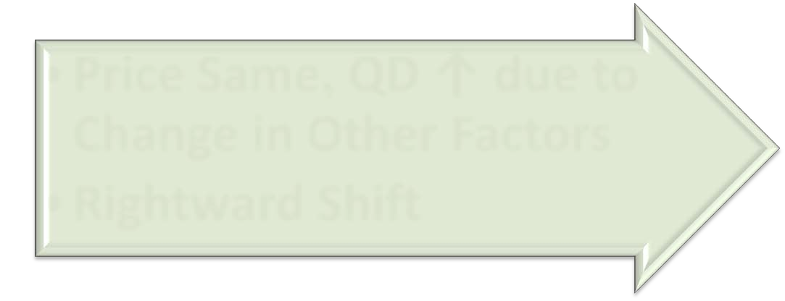

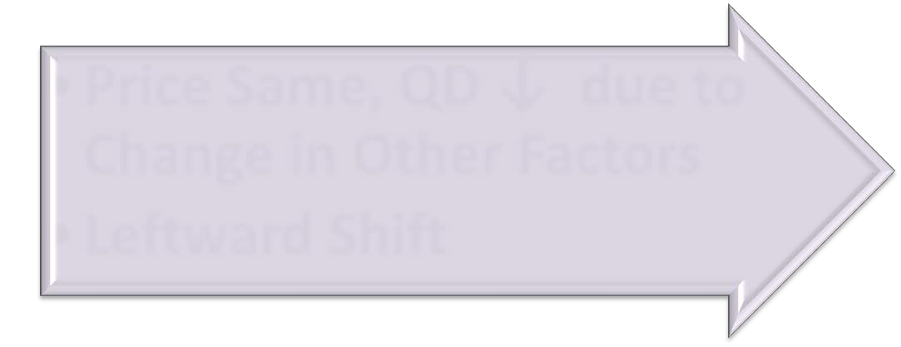

Increase & Decrease in Demand
Price Same, QD ↑ due to
Change in Other Factors
Rightward Shift
Increase
Price Same, QD ↓ due to
Change in Other Factors
Leftward Shift
Decrease

Slide 26
Increase & Decrease in Demand
Increase in Demand Decrease in Demand
D`
D
D D`
Price
D`
Price
D
D`
D
Quantity Demanded
Quantity Demanded

Slide 27
Distinction between Extension & Increase in Demand
Extension in Demand means Rise in Demand in Response to fall in the Price of a Commodity, Other things being equal.
It is expressed by the
Increase in demand refers to the rise in Demand in Response to the change in the Determinants of Demand other then price.
It is expressed by the Upward Shift of the Entire Demand Curve.
Movement from a Higher point to a Lower Point along the same demand curve.
eEco.nomics: Law of Demand and
Elasticity of Demand

Slide 28
Distinction between Contraction & Decrease in Demand
Contraction in Demand means Fall in Demand in Response to a Rise in the Price of a Commodity, Other things being Equal.
Decrease in Demand means Fall in Demand in Response to Change
in Determinants of
then
Demand, Other the Price.
• | It is expressed by | the | • | It is expressed by a
 | Movement from | a |  | Downward Shift of the
 | Lower Point to | a |  | Entire Demand Curve.
 | Higher Point on | the
Same Demand CuGenrerval Eeco.nomics: Law of Demand and
Elasticity of Demand

Slide 29
Elasticity of Demand
It answers the Question “BY HOW MUCH?”
Elasticity of Demand is defined as the Responsiveness of the Quantity Demanded of a Good to Change on one of the Variables on which Demand Depends.
% Change in Q.D.
E =
% Change in one of the Variables on which Demand depends

Slide 30
THANK YOU….

