Slide 1
WORKING PRINCIPALS OF INTERNET-NME

Slide 2
WHAT IS INTERNET?
Internet is a global network of inter-connected computers, where one computer can be connected to any other computer (or computerized device) in any portion of the world.
Internet uses various internet protocol technologies. The recent introduction of mobile internet have been equally successful.
Internet surfing is very easy. Internet is available in all major villages, towns, cities of almost every country.
It is possible to surf through Internet with the help of internet browsers such as Windows explorer, Google chrome, etc.

Slide 3
USES OF INTERNET
The key to success of Internet is the information. The better the quality, the more usage of Internet operations.
Large volume of Information: Internet can be used to collect information from around the world.
This information could relate to education, medicine, literature, software, computers, business, entertainment, friendship, tourism, and leisure.
People can search for information by visiting the home page of various search engines such as Google, Yahoo, Bing, etc.

Slide 4
Cont…
News and Journals: All the newspapers, magazines and journals of the world are available on the Internet. With the introduction of broadband and advanced mobile telecommunication technologies such as 3G (third generation) and 4G (fourth generation), the speed of internet service has increased tremendously. A person can get the latest news about the world in a matter of few seconds.
Electronic Mode of Communication: Internet has given the most exciting mode of communication to all. We can send an E-mail (the short form of Electronic Mailing System) to all the corners of the world.
Chatting: There are many chatting software that can be used to send and receive real-time messages over the internet. We can chat with our friend and relatives using any one of the chatting software.

Slide 5
Cont…
Social Networking: People can connect with old friends on social networking sites. They can even chat with them when they are online. Social networking sites also allow us to share pictures with others. We can share pictures with our loved ones, while we are on a vacation. People are even concluding business deals over these social networking sites such as Facebook.
Online Banking (Net-Banking): The use of internet can also be seen in the field of banking transactions. Many banks such as HSBC, SBI, Axis Bank, Hdfc Bank, etc. offers online banking facilities to its customers. They can transfer funds from one account to another using the net-banking facility.
E-commerce: Internet is also used for carrying out business operations and that set of operations is known as Electronic Commerce (E-commerce). Flipkart is the largest e-commerce company in India. The rival, Amazon, is giving stiff competition to Flipkart.

Slide 6
Cont..
Mobile commerce: Mobile commerce (also M-Commerce) refers to the commercial transaction that takes place over the mobile internet. Using the mobile internet technology, many companies have introduced mobile version of websites and mobile apps, to promote and sell their products. Customers can simply browse several through the products and buy online through mobile internet.
Mobile wallet: Many companies offer the service of mobile wallet to its customers. Users must have a smart-phone and internet connection to use this service. Users can pay an amount into their mobile wallet, which they can use to make online payment such as bill payments, recharges, etc.
Entertainment: Apart from a major source of knowledge and information, the utility of Internet in the field of entertainment cannot be undermined. We can visit various video sites and watch movies and serials at our convenient time.

Slide 7
INTERNET UNDERLYING ARCHITECTURE:
An Internet consists of a set of connected networks.
The chief advantage of an Internet is that it provides universal interconnection while allowing individual groups to use whatever network hardware is best suited to their needs.
The technology TCP/IP provides the basis for the global Internet, which helps in connecting individuals, universities, corporation and government department in many countries around the globe.
The global Internet is expanding rapidly

Slide 8
Underlying Network Technologies:
i) Approaches to Network Communication:
The two approached to network communications are
Circuit switched (Connection Oriented)
Packet switched (Connectionless)
Circuit switched:
Circuit switched network operates by forming a dedicated connection between two points.
Packet switched:
In a Packet switched network, data to be transferred across a network is divided into small pieces called packets that are multiplexed onto high capacity intermachine connections.

Slide 9
Cont..
(ii) Wide Area and Local Area Networks
The Packed switch technology is divided into two broad categories
Wide Area Network
Local Area Network
Wide Area Network:
WAN technologies, sometimes called long haul networks, provide communication over large distances.
Most WAN technologies do not limit the distance spanned. A WAN can allow the endpoints of a communication to be arbitrarily far apart. For example, a WAN can span a continent or can join computers across an ocean.

Slide 10
Cont..
Local Area Networks:
LAN technologies provide the highest speed connections among computers, but sacrifice the ability to span large distances.
For example, a typical LAN spans a small area like a single building or a small campus and operates between 10 Mbps and 2 Gbps (Billion bits per second).
Because LAN technologies cover short distances, they offer lower delays than WANs. The delay across a LAN can be as short as a few tenths of a millisecond, or as long as 10 milliseconds.
iii) Ethernet Technology
Ethernet is the name given to a popular packet switched LAN technology; most medium or large corporations use Ethernet.
It is a bus because all stations share a single communication channel; it is a broadcast because all transceivers receive every transmission.

Slide 11
INTERNET ARCHITECTURE
An Internet is more than a collection of networks interconnected by computers. Internetworking implies that the interconnected systems agree to conventions that allow each computer to communicate with every other computer.
The networks interconnect to form an internetwork.
Then, how a packet flows from one network to another? Physically, a device that attaches to both of them can only connect two networks.
Devices that interconnect two networks and pass packets from one to the other are called Internet gateways or routers.
A router reads the destination address, and routs the packet to the destination.

Slide 12
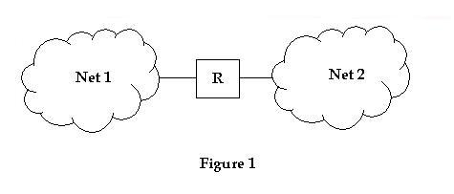
Cont..
In the figure, two physical networks interconnected by R, a router (IP gateway).
In a TCP/IP Internet, computers called routers or gateways provide all interconnections among physical networks.
Routers use the destination network, not the destination host, when routing a packet.

Slide 13
INTERNET ADDRESSES
Each host on a TCP/IP Internet is assigned a unique 32-bit Internet address that is used in all communication with that host.
Conceptually, each IP address consists of a network id that identifies a network, and host id identifies a host on that network.Given an IP address, its class can be determined from the three high-order bits, with two bits being sufficient to distinguish among the three primary classes.
i) ARP (Mapping Internet Addresses to Physical Addresses)
Address Resolution Protocol, ARP, allows a host to find the physical address of a target host on the same physical network, given only the target's IP address.
ARP is a low-level protocol that hides the underlying networks physical addressing, permitting one to assign an arbitrary IP address to every machine. ARP is a part of physical network system, and not as part of Internet protocols.

Slide 14
Cont…
(ii) RARP (Reverse Address Resolution Protocol)
At system startup, a computer that does not have a disk (diskless computers) must contact a server to find its IP address before it can communicate using TCP/IP.
It is found that the RARP protocol that uses physical network addressing to obtain that machine's Internet address.
The RARP mechanism supplies the target machine's physical hardware address to uniquely identify the processor and broadcasts the RARP request.
Servers on the network receive the message, look up the mapping in a table, and reply to the sender. Once a machine obtain its IP address in memory and does not use RARP again it reboots.

Slide 15
UNIT-II
Connecting to the internet
Communication to the internet

Slide 16
CONNECTING TO THE INTERNET
Internet connection options vary by Internet Service Provider and by region.
Customers should consider some of the following factors before selecting an Internet package: speed or bandwidth, cost, availability, reliability and convenience.
In order to determine what Internet plan is right for you, we recommend you review the different types of Internet connections available on the market today.
Understanding The Differences Between Internet Connections
In today's age, there are numerous ways to connect laptops, desktops, mobile phones, gaming consoles, e-readers and tablets to the Internet. Some of the most widely used Internet connections are described below.

Slide 17
WIRELESS
Radio frequency bands are used in place of telephone or cable networks.
One of the greatest advantages of wireless Internet connections is the "always-on" connection that can be accessed from any location that falls within network coverage.
Wireless connections are made possible through the use of a modem, which picks up Internet signals and sends them to other devices.

Slide 18
MOBILE & HOTSPOT
Many cell phone and smartphone providers offer voice plans with Internet access. Mobile Internet connections provide good speeds and allow you to access the Internet.
Hotspots are sites that offer Internet access over a wireless local area network (WLAN) by way of a router that then connects to an Internet service provider.
Hotspots utilize Wi-Fi technology, which allows electronic devices to connect to the Internet or exchange data wirelessly through radio waves.
Hotspots can be phone-based or free-standing, commercial or free to the public.

Slide 19
DIAL-UP
Dial-up connections require users to link their phone line to a computer in order to access the Internet.
This particular type of connection—also referred to as analog—does not permit users to make or receive phone calls through their home phone service while using the Internet.

Slide 20
BROADBAND
This high-speed Internet connection is provided through either cable or telephone companies.
One of the fastest options available, broadband Internet uses multiple data channels to send large quantities of information.
The term broadband is shorthand for broad bandwidth.
Broadband Internet connections such as DSL and cable are considered high-bandwidth connections.
Although many DSL connections can be considered broadband, not all broadband connections are DSL.

Slide 21
DSL(DIGITAL SUBSCRIBER LINE)
DSL, which stands for Digital Subscriber Line, uses existing 2-wire copper telephone line connected to one's home so service is delivered at the same time as landline telephone service.
Customers can still place calls while surfing the Internet.

Slide 22
CABLE
Cable Internet connection is a form of broadband access.
Through use of a cable modem, users can access the Internet over cable TV lines.
Cable modems can provide extremely fast access to the Internet.

Slide 23
SATELLITE
In certain areas where broadband connection is not yet offered, a satellite Internet option may be available.
Similar to wireless access, satellite connection utilizes a modem.

Slide 24
ISDN
ISDN (Integrated Services Digital Network) allows users to send data, voice and video content over digital telephone lines or standard telephone wires.
The installation of an ISDN adapter is required at both ends of the transmission—on the part of the user as well as the Internet access provider.

Slide 25
COMMUNICATION TO THE INTERNET
Internet-based communication refers to sharing information over the internet.
From instant messaging to placing calls, the internet offers multiple ways to communicate.
These tools help you save a considerable amount.
Some of them like email, social networking, and instant messaging are available free of cost, whereas some like internet telephony provide you with numerous advantages at cost-effective prices.

Slide 26
Instant Messaging
When it comes to internet-based communication tools, Instant Messaging (IM) is one of the most popular means.
With services as such, you can have a private conversation with another individual as well as create a chat room where you can communicate in real-time with more than two people.
The popularity of instant messaging is due to its real-time nature.
As opposed to email, that makes you wait until the recipient checks your email and sends a reply, IM enables you to view if a person in your contact list is online and send a message that pops immediately on his device’s screen.

Slide 27
Email
Most of the mainframes, microcomputers, and computer networks come with an email system.
Many email systems are confined to a single network or computer, whereas some boast gateways to other computer systems.
Hence, you can send email anywhere in the world.
Every Internet Service Provider and online service offers an email system and also supports gateways so that you can communicate without any hassles.
It also lets you broadcast data as well as share documents with a group.

Slide 28
Internet Relay Chat
Dating back to the 1980s, internet relay chat was one of the earliest chat tools on the internet.
It's still in use today for recreational purposes, coordinating work teams and handling tech support for some open-source software products.
Using networks of internet servers and specialized client software, IRC let anyone set up chat rooms, or "channels," devoted to topics of their choice.
It influenced subsequent chat systems such as AOL and Yahoo chat and even contributed the convention of using the "@" symbol before a username and the "#" symbol to denote a topic.

Slide 29
Instant Messaging Services
In the 1990s, computer-based instant messaging tools such as ICQ, AOL Instant Messenger, MSN Messenger and Yahoo Messenger became popular ways to stay in touch with people down the street or around the world for no cost beyond whatever users already paid to connect to the internet.
Some of these tools developed cult followings among particular types of users, such as Yahoo Messenger's rise among oil traders.
Most of these early tools have since been retired by the companies that operated them, though a few, such as ICQ, live on with loyal fan bases.

Slide 30
Smart Phone Messaging Apps
Most of the 1990s chat tools have since been supplanted by a new breed of messaging tools, including Facebook Messenger, Google Hangouts, Apple Messages and simple cellphone-based text messaging.
Many of these tools work on smart phones as well as desktop computers, or even on smart phones alone, and they contain more features than their earlier counterparts.
Workplace messaging tools, such as Slack and Microsoft Teams, have also become popular in many companies as a way to share information without picking up the phone or even drafting an email.

Slide 31
Social Networking Tools
Some of the most popular internet communication tools are social networking services, including Facebook, Twitter, Facebook-owned Instagram, Snapchat and work-oriented LinkedIn.
These services generally enable people to connect with and follow posts from a chosen group of associates, sharing updates about their lives, careers or musings throughout the day.
Social networking tools have run into some controversy over the spread of rumors, fake news stories, hate speech and other undesirable content, and some network operators have taken steps to reduce such behavior.

Slide 32
The Future of Internet Communication
Nobody knows for certain what the future internet will look like, but it's unlikely that we're done innovating.
Companies continue to experiment with new styles of internet-enabled tools, from virtual reality headsets to smart watches to smart speakers equipped with virtual assistants.
Technologies that used to be separate from the internet, such as televisions, cellphones and video game consoles, have all gotten networked by default in recent years.

Slide 33
UNIT-III
How the world wide web works
Common Internet Tools

Slide 34
WORLD WIDE WEB
WWW stands for World Wide Web.
A technical definition of the World Wide Web is : all the resources and users on the Internet that are using the Hypertext Transfer Protocol (HTTP).
A broader definition comes from the organization that Web inventor Tim Berners-Lee helped found, the World Wide Web Consortium (W3C).
The World Wide Web is the universe of network-accessible information, an embodiment of human knowledge.
In simple terms, The World Wide Web is a way of exchanging information between computers on the Internet, tying them together into a vast collection of interactive multimedia resources.

Slide 35
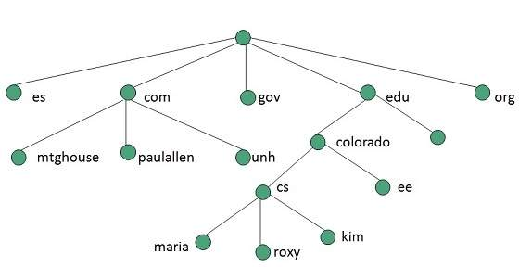
Internet and Web

Slide 36
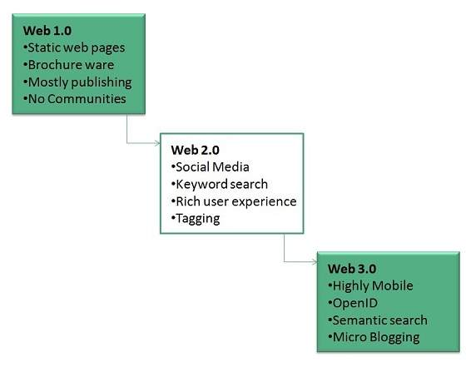
EVOLUTION
World Wide Web was created by Timothy Berners Lee in 1989 at CERN in Geneva. World Wide Web came into existence as a proposal by him, to allow researchers to work together effectively and efficiently at CERN. Eventually it became World Wide Web.
The following diagram briefly defines evolution of World Wide Web:

Slide 37
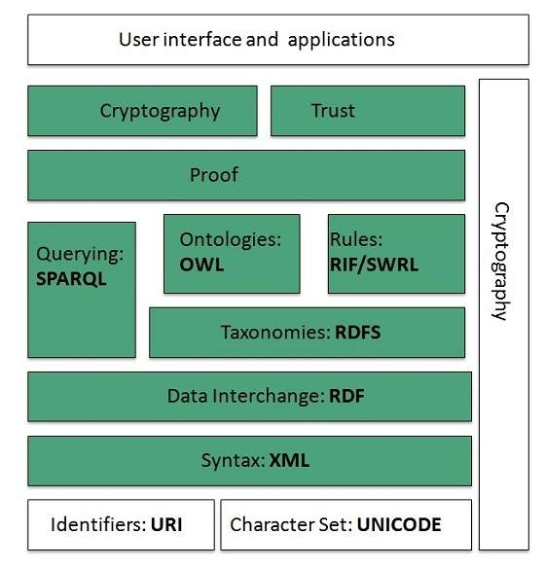
WWW ARCHITECTURE

Slide 38
FUNCTIONS OF LAYERS
Identifiers and Character Set
Uniform Resource Identifier (URI) is used to uniquely identify resources on the web and UNICODE makes it possible to built web pages that can be read and write in human languages.
Syntax
XML (Extensible Markup Language) helps to define common syntax in semantic web.
Data Interchange
Resource Description Framework (RDF) framework helps in defining core representation of data for web. RDF represents data about resource in graph form.

Slide 39
Cont...
Taxonomies
RDF Schema (RDFS) allows more standardized description of taxonomies and other ontological constructs.
Ontologies
Web Ontology Language (OWL) offers more constructs over RDFS. It comes in following three versions:
OWL Lite for taxonomies and simple constraints.
OWL DL for full description logic support.
OWL for more syntactic freedom of RD

Slide 40
Cont..
Rules
RIF and SWRL offers rules beyond the constructs that are available from RDFs and OWL. Simple Protocol and RDF Query Language (SPARQL) is SQL like language used for querying RDF data and OWL Ontologies.
Proof
All semantic and rules that are executed at layers below Proof and their result will be used to prove deductions.
Cryptography
Cryptography means such as digital signature for verification of the origin of sources is used.
User Interface and Applications
On the top of layer User interface and Applications layer is built for user interaction.

Slide 41
WWW Operation
WWW works on client- server approach. Following steps explains how the web works:
User enters the URL (say, http://www.tutorialspoint.com) of the web page in the address bar of web browser.
Then browser requests the Domain Name Server for the IP address corresponding to www.tutorialspoint.com.
After receiving IP address, browser sends the request for web page to the web server using HTTP protocol which specifies the way the browser and web server communicates.
Then web server receives request using HTTP protocol and checks its search for the requested web page. If found it returns it back to the web browser and close the HTTP connection.

Slide 42
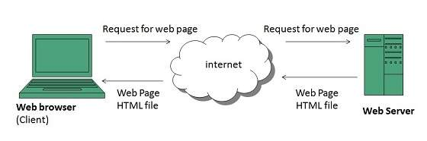
WWW ARCHITECTURE

Slide 43
FUNCTIONS
Future
There had been a rapid development in field of web. It has its impact in almost every area such as education, research, technology, commerce, marketing etc.
So the future of web is almost unpredictable.
Apart from huge development in field of WWW, there are also some technical issues that W3 consortium has to cope up with.
User Interface
Work on higher quality presentation of 3-D information is under deveopment. The W3 Consortium is also looking forward to enhance the web to full fill requirements of global communities which would include all regional languages and writing systems.

Slide 44
Technology:
Work on privacy and security is under way. This would include hiding information, accounting, access control, integrity and risk management.
Architecture:
There has been huge growth in field of web which may lead to overload the internet and degrade its performance. Hence more better protocol are required to be developed.

Slide 45
Cont….
Web Page
web page is a document available on world wide web. Web Pages are stored on web server and can be viewed using a web browser.
A web page can cotain huge information including text, graphics, audio, video and hyper links. These hyper links are the link to other web pages.
Static Web page
Static web pages are also known as flat or stationary web page. They are loaded on the client’s browser as exactly they are stored on the web server. Such web pages contain only static information. User can only read the information but can’t do any modification or interact with the information.

Slide 46
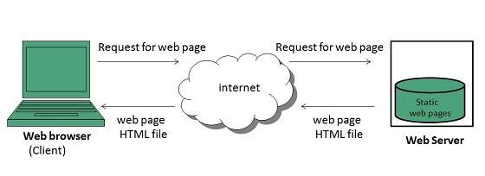
Cont..

Slide 47
Cont..
Dynamic Web page
Dynamic web page shows different information at different point of time. It is possible to change a portaion of a web page without loading the entire web page. It has been made possible using Ajax technology.
Server-side dynamic web page
It is created by using server-side scripting. There are server-side scripting parameters that determine how to assemble a new web page which also include setting up of more client-side processing.

Slide 48
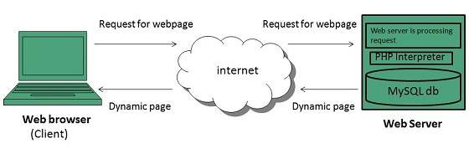
Cont..
Client-side dynamic web page
It is processed using client side scripting such as JavaScript. And then passed in to Document Object Model (DOM).

Slide 49
COMMON INTERNET TOOLS
FTP - FTP (File Transfer Protocol) and Telnet are two of the oldest Internet utilities, allowing two machines to communicate with each other.
Whereas Telnet lets you log into an account at a remote location and interact as if you were there, FTP allows you to move files between accounts on different computers, wherever they might be, at home and at the office or even in different cities, as long as both computers have Internet addresses.
It is rather like getting access to two disks between which you can copy files, only the disks are not on the same machine nor even necessarily in the same country.
The requirements are an FTP server running on a remote machine and an FTP client running on your local machine.
There are two major ways to use FTP. You can move files between computers on which you have accounts or you can get files from an anonymous FTP server.

Slide 50
MULTIMEDIA ON THE INTERNET
Multimedia technology has already been around for quite some time, but with the accelerated pace of development that it has enjoyed in the last few years it can be now safely said to be a part of our daily lives, both at work and in the home.
It finds application in fields ranging from encyclopedias to catalogues, from games to video clips, allowing computers to display to users information in a form that is not only textual, but can include sound, moving pictures, or both.
Up to now, the medium of choice for this technology has been the CD-ROM: due to its high capacity it is able - to a certain extent - to meet the needs of digital audio and video, it is stable and reliable and, last but not least, the cost of the device required to read it is low.
As a result, the CD-ROM has become the most widely used medium for the delivery of multimedia material.

Slide 51
MULTIMEDIA AND INTERNET
The type of data currently prevalent on the Web is text and still images, there is clearly a definite need to be able to use the same infrastructure/data networks to exchange multimedia data, including sound and moving pictures.
A non-negligible part of this perceived need finds its origin in the requirements of advertising: many "service providers" are financed (also) by commercials, and it is well-known to the advertisers that moving images have a much stronger impact on the viewer than any other form of communication.
It is already possible today using the Internet to listen to music and to radio news, to view short video sequences, and to talk to remote users by means of special applications that emulate the functions of a normal telephone. Nevertheless, it is also true to say that the use of multimedia information via a network is still restricted to more or less experimental applications.

Slide 52
REQUIREMENTS
To gain first-hand experience of the requirements in terms of infrastructure and the potential of multimedia technology, it was decided to carry out a small study and prototype development effort focussing on multimedia data distribution over local and geographical networks. The contract to perform the study was awarded to Cap Gemini (I), following the Agency's usual competitive call-for-tender procedure.
The requirements that were defined for the prototype system implementation include:
access to multimedia material through local and Wide-Area Networks good quality video, as users are accustomed to the high resolution of today's displays and are likely to be turned away by low quality
"streaming" (i.e. display of the video as it is received), to avoid delays between the user command and the start of the video experienced when the file has to be completely downloaded first.

Slide 53
Cont…
good interactivity, which is considered a key factor for the professional (as opposed to entertainment) use of multimedia data, and is in any case essential if the audio/video material lasts more than a few minutes.
A more general overall requirement for the implementation was to maintain openness to the integration of new products, avoiding ad hoc and proprietary solutions.
Prototype system
Approach
In the first phase of the activity, a fairly detailed state-of-the-art analysis was performed, supported by some early breadboard implementations, to define the best technical approach for the project.

Slide 54
Cont..
User interaction
The functionality supporting the interaction with the user is very high compared with that for the customary Web applications. In addition to the usual browsing and navigation functions, it is possible to:
synchronise the display of new HTML pages with the audio stream, by using a skip-to function to go to predefined positions in a video sequence using controls of the type found on a normal video recorder
display, at the user's request, information relating to the content at any specific moment of a video sequence; this further information may itself contain pointers to other items of information
skip from a predetermined position in a video sequence to other points or sequences
select the language of choice for the subtitles during the display of a video stream.

Slide 55
SHOPPING ON THE INTERNET
Due to rapid growth of technology, business organizations have switched over from the traditional method of selling goods to electronic method of selling goods.
Business organizations use internet as a main vehicle to conduct commercial transactions.
Online stores do not have space constraints and a wide variety of products can be displayed on websites.
It helps the analytical buyers to purchase a product after a good search.

Slide 56
Convenience of online shopping
Customers can purchase items from the comfort of their own homes or work place.
Shopping is made easier and convenient for the customer through internet.
It is also easy to cancel the transactions.

Slide 57
Top 6 reasons given by shoppers in buying through internet
Saves time and efforts.
Convenience of Shopping at home.
Wide variety / range of products are available.
Good discounts / lower prices.
Get detailed information of the product.
We can compare various models / brands.

Slide 58
Cont..
2.No pressure shopping
Generally, in physical stores, the sales representatives try to influence the buyers to buy the product.
There can be some kind of pressure, whereas the customers are not pressurized in any way in online stores.
3. Online shopping saves time
Customers do not have to stand in queues in cash counters to pay for the products that have been purchased by them.
They can shop from their home or work place and do not have to spend time traveling. The customers can also look for the products that are required by them by entering the key words or using search engines.

Slide 59
Cont..
4. Comparisons
Companies display the whole range of products offered by them to attract customers with different tastes and needs.
This enables the buyers to choose from a variety of models after comparing the finish, features and price of the products on display, Sometimes, price comparisons are also available online.
5. Availability of online shop
The mall is open on 365 x 24 x 7. So, time does not act as a barrier, wherever the vendor and buyers are.

Slide 60
Cont..
6. Online tracking
Online consumers can track the order status and delivery status tracking of shipping is also available.
7. Online shopping saves money
To attract customers to shop online, e-tailers and marketers offer discounts to the customers.
Due to elimination of maintenance, real-estate cost, the retailers are able to sell the products with attractive discounts through online.
Sometimes, large online shopping sites offer store comparison.

Slide 61
DISADVANTAGES IN ONLINE SHOPPING
1.Delay in delivery
Long duration and lack of proper inventory management result in delays in shipment.
Though the duration of selecting, buying and paying for an online product may not take more than 15 minutes; the delivery of the product to customer’ s doorstep takes about 1-3 weeks.
This frustrates the customer and prevents them from shopping online.
2. Lack of significant discounts in online shops
Physical stores offer discounts to customers and attract them so this makes it difficult for e-tailers to compete with the offline platforms.

Slide 62
Cont…
3. Lack of touch and feel of merchandise in online shopping
Lack of touch-feel-try creates concerns over the quality of the product on offer.
Online shopping is not quite suitable for clothes as the customers cannot try them on.
4. Lack of interactivity in online shopping
Physical stores allow price negotiations between buyers and the seller.
The show room sales attendant representatives provide personal attention to customers and help them in purchasing goods.
Certain online shopping mart offers service to talk to a sales representative,

Slide 63
Cont..
5.Lack of shopping experience
The traditional shopping exercise provides lot of fun in the form of show-room atmosphere, smart sales attendants, scent and sounds that cannot be experienced through a website.
Indians generally enjoy shopping. Consumers look forward to it as an opportunity to go out and shop.
6. Lack of close examination in online shopping
A customer has to buy a product without seeing actually how it looks like.
Customers may click and buy some product that is not really required by them. The electronic images of a product are sometimes misleading. The colour, appearance in real may not match with the electronic images.

Slide 64
SAFEGUARDING THE INTERNET
Turn On Private Browsing
Hide Your IP Address
Remember To Log Out
Google Yourself Periodically
Stay Updated On Privacy Policies
Use Start Page Instead of Google
Checking In
Revealing Location Info
Beware of Open Wi-Fi Hotspots

Slide 65
Turn On Private Browsing
Many internet websites use technologies such as cookies to capture the Internet Protocol (IP) address of a specific computer before collect information about online activities.
Other than using such data to help them provide optimized and personalized services to the users and better understand the behaviours of visitors to their sites, they may also sell such "digital profiles" to interested parties for their own marketing research, without our prior consent.
To address the growing concern over having our privacy compromised by such acts, major web browsers such as Internet Explorer, Google Chrome and Mozilla Firefox have incorporated a "private browsing" setting in their latest releases.

Slide 66
Hide Your IP Address
In a way, your IP address is kind of like your fingerprint in the online universe and what HideMyAss.com and Tor do is that they hide it well so you won’t leave any prints behind no matter which sites you visit.
Take note, however, that some of these web proxies have questionable security policies and may have access to the very data you wish to keep to yourself.
Do your own research before using them.
On sidetrack a little, a bonus for using web proxies or Tor is that you can bypass sites which your ISP has blocked

Slide 67
Remember To Log Out
According to Business Insider, Facebook can track the online activity of users who stay logged on to their Facebook account.
This means, if you happen to leave a Facebook tab opened on your browser as you surf elsewhere, webpages that contain the ‘Like’ button can track and collate data about your activities (even if you didn’t click it).
What’s even more chilling to know is they are no longer doing this through the conventional cookie tracking system where your identity is at best an anonymous IP address; rather, they are now basing it on your unique Facebook user ID.

Slide 68
Stay Updated On Privacy Policies
Most websites you encounter have privacy policies available for visitors, indicating what information they collect from your computer and who they will share this to.
Because these policies are usually lengthy and full of jargon, people do not actually read them at all.
Truth is, the reason why a website even has a privacy policy is usually because they want to spell out (as clearly as possible) how far they will only go to protect the users’ privacy, so as to excuse themselves for violating the very policy they set.

Slide 69
Use StartPage Instead of Google
If you’re still pretty concerned about Google tracking your search queries and building a profile for all your online activities even as you use web proxies, try Netherlands-based
If you own an iPhone, iPod Touch or iPad with iOS 4.3 or later, you can also download the Startpage Search app for your browsing needs.
The Android version is currently in development.StartPage, "the world’s most private search engine".

Slide 70
Checking In
Frequent check-ins puts your online and offline privacy in jeopardy and make you an easy target for actual stalkers.
Location-based services provided by Facebook, Foursquare, RunKeeper and more let you reveal where you are and what you are doing at a particular time of the day.
Another way of looking at this is someone else can have a rough sense of what your general schedule is like based on the data they have collected from your habitual check-ins.

