Slide 1
WELCOME

Slide 2
THE AUSPICIOUS VISION
-RABINDRANATH TAGORE

Slide 3
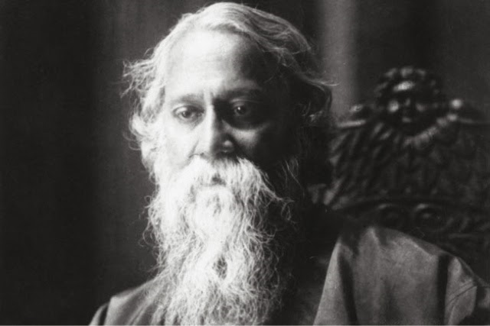

Slide 4
Rabindranath Tagore (born May 7, 1861, Calcutta , India—died August 7, 1941, Calcutta) is a Bengali poet, short-story writer, song composer, playwright, essayist, and painter. He
introduced new prose and verse forms and the use of colloquial language into Bengali literature, thereby freeing it from traditional models based on classical Sanskrit.
He was highly influential in introducing Indian culture to the West and vice versa, and he is generally regarded as the outstanding creative artist of early 20th-century India.
In 1913 he became the first non-European to receive the Nobel Prize for Literature.

Slide 5
SUMMARY
The Auspicious Vision" begins on the bank of a river. A wealthy man is on a duck hunting expedition accompanied by servants.
He spots a beautiful young woman, just adolescent on the banks of the river. She is holding some ducklings in her arm.
He tells her don't worry I won't shot them (In reading stories such as this, recall marriages were mostly arranged and girls once 13 or so were considered of marriageable age.). The girl runs off without speaking to him.

Slide 6
He tells his men to find what family she is from as he wants to marry her. He goes to visit her father and the father, happy to have a rich son in law, readily agrees to give his daughter in marriage.
As is the custom, the groom will not see her until what is called in Bengali wedding tradition, "The Auspucious Moment". At that moment the groom gets a surprise that at first angers him.

Slide 7
The bride is not the girl he saw. Then he realizes the father in law was never told who the girl was.
so he simply married him to another daughter. There is a further surprise to come. The girl he saw is not real Sudha, but a deaf and dumb.
Finally he realises everything and happily acceptsthe marriage life with the real Sudha.

Slide 8
THEME
In The Auspicious Vision by Rabindranath Tagore we have the theme of commitment, beauty, honour and paralysis.
Narrated in the third person by an unnamed narrator it becomes clear to the reader after reading the story that Tagore may be exploring the theme of commitment.

Slide 9
CRITICAL ANALYSIS
Kanti is fully aware of the mistake he has made in marrying Sudha. Having mistaken her for another girl.
However there is a sense that Kanti will still be happy and blessed with good fortune

Slide 10
If anything he remains committed to his new wife. This may be important as Kanti could have reacted very differently to the fact that he married the wrong girl.
Though he may not have been able to abandon his wife with ease the fact that Kanti stays at the wedding on discovery of his mistake suggests that he is an honourable man.
He may have originally being drawn by the beauty of the girl he thought was Sudha but he can also see the beauty in the real Sudha.

Slide 11
It is also interesting that the female characters in the story (Sudha) are treated more like products than they are as human beings.
Sudha’s father is desperate to marry off Sudha and is prepared to give any man willing to marry her a large dowry. T
his may be important as Tagore may be placing the spotlight on the position of women within Indian society at the time the story was written.
How for many young girls their parents longed for them to marry and as an incentive to a prospective husband a dowry was provided.

Slide 12
It is also interesting that while at the party the other women laugh at the servant girl when Kanti tries to speak to her.
He is unaware that she is deaf and dumb but this still does not change his opinion of her. It might also be important that Kanti does not do anything that would hinder his marriage to Sudha as this would again show just how honourable Kanti really is.
He may feel as though he has been tricked into marrying the wrong woman but nonetheless he will stay by Sudha’s side.

Slide 13
Though the servant girl is highly desirable by Kanti and one is to assume by other men too. The fact that she is deaf and dumb may suggest that she is to live her life alone with her only companions being the animals she brings back to health.
It is difficult to see any man marrying the servant girl due to her disability despite the fact that she has a good heart.
If possible suitors are swayed as Kanti was swayed by the fact that the servant girl is deaf and dumb there is a sense that the girl will live her life paralysed or going nowhere.

Slide 14
There will be no change or marriage for her. Which may be the point that Tagore is attempting to make.
He may be suggesting that many men are swayed by a woman’s appearance first and then by their personality.
The fact that the servant girl cannot communicate with a possible suitor suggests there will be few if any suitors who will attempt to marry the servant girl.

Slide 15
The end of the story is also interesting as Tagore affords Kanti the opportunity to be happy.
Though he had mistakenly picked the wrong bride when the veil is lifted he is a happy man.
The one downside of the marriage between Kanti and Sudha is the fact that they do not know each other.
They had not previously met and it may be a case that due to the position or role of woman in Indian society.

Slide 16
Sudha will have to play the role of the dutiful wife. It is not as though love can’t blossom. It can and most likely will such is the happiness that Kanti feels.
However he has taken a risk without knowing it and some critics might suggest that he is fortunate that the risk paid off.
Kanti has found himself a second wife. One in which he was not originally seeking and faith has been good to him.

Slide 17
Unfortunately the servant girl may never get to enjoy the experiences of getting married not only because of her disability but because of her low rank.
Whereas Sudha has come with a large dowry the servant girl’s father who is not mentioned in the story may not have a dowry to give a prospective suitor of his daughter.

Slide 18
THE END

