Slide 1
Unit - I (Morphology)
Inflorescence types – racemose, cymose, and mixed – special types, cyathium, hypanthodium, verticillaster and thyrsus.
Technical description of flower and floral diagram.
Notes:
Syllabus

Slide 2
INFLORESCENCE
Inflorescence is the arrangement of flowers on the floral axis. The flowers are arranged with respect to a fixed floral axis.
Type of inflorescence
RACEMOSE
In this type of inflorescence, the main axis continues to grow. It does not terminate in a flower and gives off flowers laterally in an acropetal manner.
Raceme: Eg. Radish, Mustard
Spike: Eg.Achyranthes.
Catkin/Amentum: Eg. Mulberry, Betula, Oak.
Corymb: Eg. Candytuft
Umbel: Eg. Centella

Slide 3
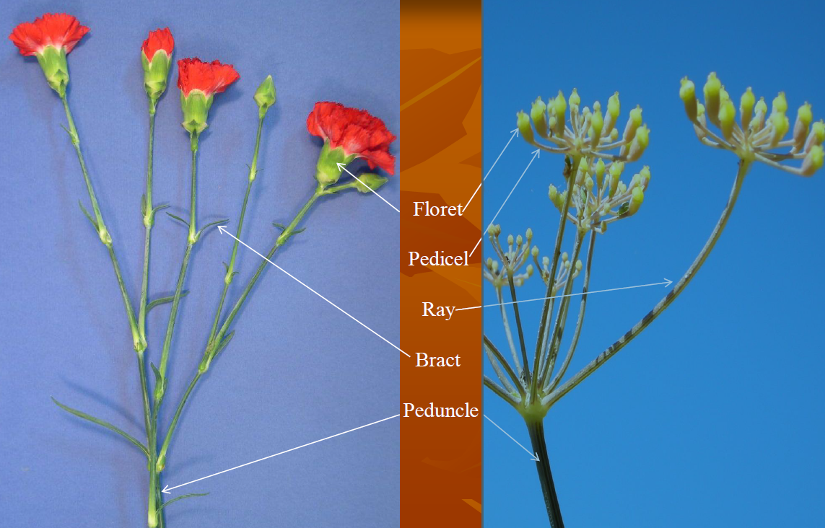
Inflorescence parts

Slide 4
CYMOSE
In this type of inflorescence, the peduncle terminates in a flower. Here, the older flowers are present at the upper portion and young buds are arranged towards the base. This arrangement is called as the basipetal succession. It is of the following types:
Uniparous cyme/Monochasial cyme
Dichasial or biparous cyme
Multiparous cyme/Polychasial

Slide 5
CYMOSE
Uniparous cyme/Monochasial cyme: The peduncle ends in a flower producing lateral branch at a time It is of two types again: Helicoid cyme and Scorpioid cyme.
Dichasial or biparous cyme: In this type, peduncle ends in a flower and from the basal part of peduncle, two lateral branches arise. These also end in a flower and this same arrangement occurs on these lateral branches. Eg. Bougainvillaea, Jasmine, Teak, Mirabilis.
Multiparous cyme/Polychasial: Here, the peduncle ends in a flower and from the base of it many lateral branches arise, which also terminate in flowers.

Slide 6
Special Inflorescence Types
1) Cyathium
The bracts or the involucre fuse and form a cup-shaped structure on the margin. This houses the glands. In the central part of the cup-shaped structure, you can find the female flowers.
These mature earlier. Due to the growth of pedicel, this comes out from the cup-shaped structure. Small male flowers surround these female flowers.
These are also found on Pedicel. The male flowers, which lie towards the centre, mature earlier than the flowers which are towards the periphery.
This inflorescence is found in Euphorbiaceae family like Euphorbia, Poinsettia, Pedilanthus.

Slide 7
Cyathium: consists of a simple female floret (one pistil) in the center surrounded by many simple male florets (one stamen each) on bracts. Found only in the Euphorbiaceae.

Slide 8
2) Verticillaster
We can find this type of inflorescence in Labiatae/Lamiaceae family, where the leaves are arranged in opposite manner on the stem.
From the axil of each leaf, inflorescence develops.
From the main axil, lateral axil arises, on which flowers you can find the flowers.
Examples include Salvia, Ocimum, Coleus etc.

Slide 9
3) Hypanthium
In this type of inflorescence, you can see the peduncle modified in narrow cup-like structure.
At the base of the cup, the female flowers develop while towards mouth the male flower develops.
All three types of flowers are present in this inflorescence. Eg. Banyan, Peepal etc.

Slide 10
Cyme: the growing tip becomes a floret before more arise from axillary buds. May appear corymb-like. Sometimes head inflorescences are arranged in cymes.
Raceme: elongated inflorescence with floret pedicels of about equal length that develop along a rachis.

Slide 11
Spike: inflorescence elongate and raceme-like but with very short or no pedicels. Occasionally head-like due to very short internodes, but these are not in the Asteraceae
Umbel: pedicels (and rays if a compound umbel) of about equal length all arising from the apex of the peduncle. A family feature of the Apiaceae but also occurs in other families.

Slide 12
Corymb: florets are formed on lateral stalks of different length, the longest being at the base creating a flat-topped inflorescence.
Panicle: a main axis supports several racemes so that the inflorescence appears branched. Term often applied to any highly branched, elongate, inflorescence whose flowering sequence is unclear, even if the branching is cymose

Slide 13
Catkin: florets unisexual, lack petals, and tightly packed together on a rachis that usually droops downward
Spadix: racemose inflorescence consisting of many tiny florets on an enlarged fleshy axis which is usually partially enclosed by a large bract (the spathe). In the Araceae only.

Slide 14
Spikelet: inflorescence consisting of an axis (rachilla), above two bracts (glumes) and one or more very small florets with perianths reduced to paired bracts (the palea and lemma). Spikelets may be arranged in spikes, racemes, or panicles. Found in grasses and sedges.
Head (Asteraceae): florets small, closely packed, lack pedicels, and arise from a flattened axis that is surrounded or subtended by bracts to appear as a large flower. Head inflorescences may be arranged in cymes, and may be small with only a few disk florets.

Slide 15
FLOWER
A flower contains four sets of parts arrange in whorls on the receptacle the swollen tip of the peduncle.
Accessory parts
Sepals(calyx): Protect the inner part of the flower.
Petals (corolla): most noticeable portion, different colours.
Perianth: calyx and corolla.
Essential parts
Stamen (androecium) : Pollen containing chamber, anther, flaments.
Carpel (gynoecium) : female reproductive leaf bearing structure of a flower. Ovary, stigma, style.
Notes:
FLOWER

Slide 16
Bract: floral leaf formed at the base of the flower or lower stalk, small, protect flower bud, involucre.
Modified stem: Receptacle end of peduncle, pedicel.
FLORAL VARIATONS:
Complete: flowers with four modified leaves (sepal, petal, stamen and carpel)
Incomplete: lacks any of the modified leaves.
SEXUALITY:
Perfect: bisexual or hermaphrodites, carpel and stamen, animal pollinated
Imperfect: unisexual, carpel and stamen, wind pollinated/
Imperfect types: Pistillate (female), staminate (male).

Slide 17
As to distribution of imperfect flowers plants can be
Monoecious
Dioecious
Polygamous
Monoecious: Plant with both imperfect flowers e.g. corn.
Dioecious: Imperfect flowers are borne in separate plants.

