Slide 1
UNIT-II (Plant Taxonomy)
General outline of Bentham and Hooker’s system of classification.
Study of the range of characters and economic importance of Annonaceae, Rutaceae, Rubiaceae, Solanaceae, Euphorbiaceae, and Poaceae.

Slide 2
BENTHAM AND HOOKER’S CLASSIFICATION
Genera Plantarum (1862-1883)
George Bentham (England) was an amateur botanist until almost middle age, after which time he gave the subject of systematic botany all his attention.
He is the most critical, and analytical systematist, besides an accomplished linguist and Latinist.
Prior to his joint publication ‘Genera Plantarum’ with J.D. Hooker Bentham published world monographs of the families Labiatae, Ericaceae, Polemoniaceae, Scrophulariaceae and Polygonaceae.
He was the author of the 7-volume Flora of Australia.

Slide 3
Sir Hooker, a plant explorer and a plant geographer.
He collected plants from Himalayas, Lebanon, Antarctic and Atlas mountains.
He succeeded his father as Director of Royal Botanical Gardens, Kew.
Joseph Dalton Hooker published Flora of British India (1872-1897), Student’s Flora of British Isles (1870) and also revised later editions of Handbook of British Flora.
He also supervised the publication of Index Kewensis.

Slide 4
Bentham and Hooker published their 3 volume work Genera Plantarum in Latin, at intervals between 1862 and 1883.
This work comprised the names and descriptions of all genera of seed plants then known and follow the classification principles of de Candolle.
Every genus was studied a new from the plant material of British and continental herbaria.
Full and complete descriptions were prepared from studies and dissections of the plants and not a mere compilation from literature.

Slide 5
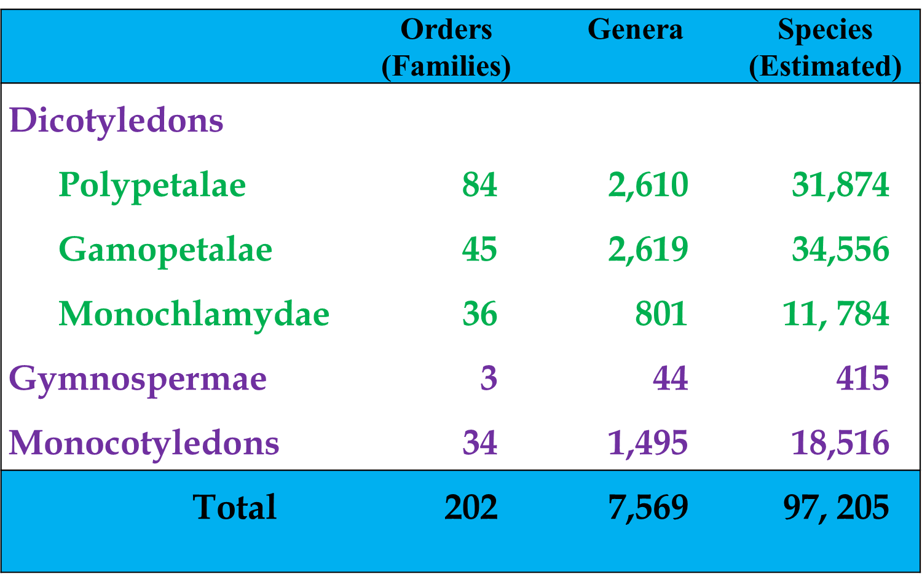

Slide 6
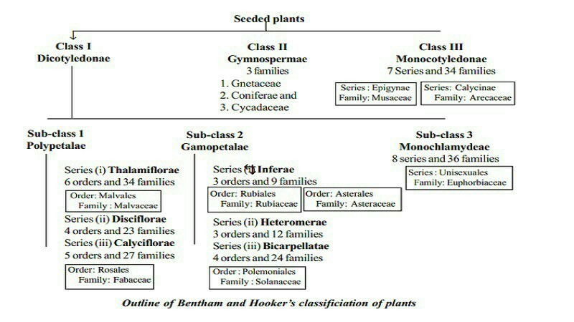

Slide 7
Merits
Full and complete descriptions of families and genera were made original dissections of plants and did not represent just a compilation from literature.
The system has great practical value for identification of plants. Keys to identify taxa are very useful for routine identification
Larger genera have been divided into subgenera to facilitate identification.
Treatment of certain families are correct. E.g. Leguminosae (=Fabaceae) is treated as single family - the latest APGC, 2016 also supported the same).

Slide 8
Demerits
1. Placement of Gymnosperms between Dicotyledons and Monocotyledons.
2. The Monochlamydeae is an unnatural assemblage of families
3. Placing the families with single whorl of perianth and without perianth at in monochlamydae is an anomaly.
4. Some polypetalous families are gamopetalous (e.g. Cucurbitaceae).
5. Liliaceae and Amaryllidaceae kept in different series on the basis of ovary nature (superior /inferior) although they show similarities.
5. No orders in Monochlamydeae and Monocots.
6. Although the system was proposed after Darwin’s theory of Evolution, the system has not followed any phylogenetic principles.

Slide 9
Annonaceae
Characters of Annonaceae:
Wood aromatic, leaves exstipulate, floral parts usually numerous, free spirally arranged; stamens with distinctive enlarged and flat connective; gynoecium multipistilate, apocarpous.
Distribution of Annonaceae:
The family Annonaceae is commonly called Custard-apple family. Rendle included 62 genera and 820 species in this family. Lawrence recognised 80 genera and 850 species. Takhtajan (1966) included 120 genera and 2,100 species in this family. The family is widely distributed in the tropical regions of the world. Some genera are also found in the temperate climates. In India it is represented by 129 species.
Notes:
Annonaceae

Slide 10
Vegetative characters:
Habit and habitat: Trees, shrubs or lianas. Artabotrys climbs by means of hooks. Oil ducts present in the bark, leaves and perianth leaves. Terrestrial and perennial. Evergreen, deciduous, cultivated as well as wild.
Root: Tap, deep and extensively branched.
Stem:Erect, branched, solid, woody, sometimes woody climbers. Leaves – Simple, entire, alternate, exstipulate, distichous, gland dotted.

Slide 11
B. Floral characters:
Inflorescence: Often solitary, axillary, sometimes cauliflourous in groups.
Flower: Actinomorphic but zygomorphic in Monodora due to difference in size of petals, hermaphrodite, unisexual in Stelechocarpus, complete, trimerous, hypogynous, perigynous (Eupomatia) spirocyclic, often aromatic.
Calyx: Sepals 3, sepaloid, polysepalous, connate at the base, valvate.
Corolla: Petals 6 in two whorls of 3 each, valvate or slightly imbricate. Sometimes no distinction into sepals and petals so perianth in 3 or more whorls of 3 each.
Androecium: Stamens numerous spirally arranged on the axis which forms a large convex receptacle, filament short and thick, anthers long, extrorse, truncate connective, bithecous.

Slide 12
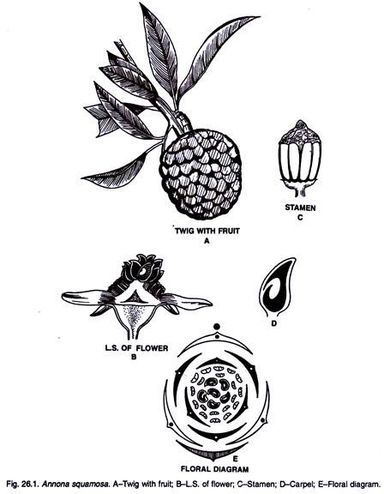
Annona squamosa

Slide 13
Gynoecium: Carpels numerous or a few, usually free, spirally arranged on the raised receptacle, apocarpous, superior, unicarpellary, unilocular; ovules one to many, anatropous; style short or none, stigma small, Monodora (Africa) with syncarpous ovary and parietal placentation.
Fruit: An aggregate of berries, united to form a single compound fruit (Annona squamosa).
Seed: Large, numerous, often embedded in a copious, white fleshy pulp, endospermic.
Pollination: Entomophilous, due to gaudy and scented flowers.

Slide 14
Economic Importance of Annonaceae:
1. Food:
The fleshy fruits of various Annona specifics are juicy and edible, and also used in preparation of soft drinks and jellies. Recent analysis shows that they contain about 18 per cent sugar.
Edible fruits are also obtained from various species of Annona and Asimina.
2. Timber:
Bocagea virgata, B. laurifolia, Cyathocalyx zeylanicus, Duguetia quitarensis, Oxandra lanceolata and Eupomatia laurina yield useful timber.
3. Oil:
The flowers of Desmos chinensis furnish ‘Macassar oil’ a perfume. The perfume is also obtained from Mkilua fragrans and specially liked by Arab women.
4. Fibre:
The bark of Goniothalamus wightii produces strong fibres.
5. Ornamental:
Artabotrys odoratissimus and Annona discolor are grown in garden for their scented flowers. Desmes chinensis is an ornamental tree.

Slide 15
Rutaceae
Distribution of Rutaceae: The family is commonly is called orange family. The family comprises 150 genera and 1300 species out of which India contributes 71 species. The members of the family are distributed in tropical and temperate regions and they are predominant in South Africa and Australia.
Characters of Rutaceae: Leaves gland dotted, simple or compound; flower hermaphrodite, hypogynous, actinomorphic with a disc below the ovary; corolla polypetalous; stamens ten, obdiplostemonous; carpels 5 or many, ovary superior, multilocular; fruit capsule or berry; aromatic odour is present.
Habit: The plant are generally shrubs (Murray a, Limonia, Zanthoxylum), trees (Aegle, Citrus, Feronia), rarely herbs (Ruta graveolens) with strong fragrance Paramignya is a shrub but climbs by means of axillary thorns.

Slide 16
Root: Tap root, branched often infected with fungus.
Stem: Woody (Citrus, Feronia), erect, cylindrical, branched, solid often thorny (Citrus), gland dotted.
Leaves: Alternate (Citrus, Murraya) or opposite (Evodia), petiolate, petiole may be winged (Citrus aurantium), simple or compound-pinnate (Murraya), palmate (Aegle and Citrus) smooth gland dotted, glands with essential oils, exstipulate, margin entire or serrate, unicostate reticulate venation. In Citrus petiole is winged.
Inflorescence: Usually cyme or axillary or terminal corymb (Murraya paniculata) some times racemose or solitary.
Flower: Pedicellate, ebracteate, hermaphrodite, or unisexual (Zanthoxylum, Evodia, Feronia), actinomorphic rarely zygomorphic (Dictamnus and Correa), hypogynous, complete, pentamerous or tetramerous (Acronychia and lateral flowers of Ruta).

Slide 17
Calyx: Sepals 5 or 4, free or fused; in zygomorphic flower it becomes gamosepalous and tubular; imbricate; sometimes deciduous.
Corolla: Petals 5 or 4, polypetalous rarely gamopetalous (Correa speciosa) or absent (Zanthoxylum), variously coloured, imbricate.
Androecium: In majority of cases the stamens are obdiplostemonous and 10 in number; in Citrus numerous stamens with polyadelphous condition; in Zanthoxylum 3 stamens and in Skimmia 5 stamens; anthers introrse, dithecous, basifixed or versatile.
Gynoecium: Pentacarpellary and only slightly united at the base or the sides forming a deeply lobed ovary with fused styles originating from the centre. In Citrus and Toddalia the carpels are fully united.

Slide 18
Fruit: In Flindersioideae there is septicidal or loculicidal capsule; in Toddalioideae a drupaceous fruit; hesperidium in Citrus and berry in Murraya.
Seed: Endospermic or exalbuminous.
Pollination: Entomophilous; insects are attracted by the coloured petals, the nectar secreted by the disc is easily available. The flowers are protandrous. Thus in Ruta the stamens arise
successively to the centre of the flower and after shedding the pollen grains wither away and fall back again.
The stigma now matures and if no insect visitor has come then the stamens rise again and the pollen grains that still remain are once again shed over the stigma. Thus self pollination is effected.

Slide 19
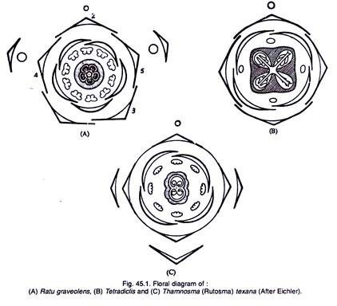
Floral formula:

Slide 20
Economic Importance of Rutaceae:
1. Fruits:
The genus Citrus provides a number of fruits:
(a) C. aurantifolia (H-Kaghzi nimbu) has citric acid in its fruits and used in bilous vomiting. The fruit wall has essential oils.
(b) C. aurantium var. bergamia (H-Nimbu). The ripe fruit is digestive and a tonic, fruit wall gives oil of bergamot.
(d) C. maxima (H-Chakotra) produces edible fruits.
(e) C. sinensis (H-Musumbi). The fruit is widely used during illness; it purifies blood, reduces thirst and improves appetite.
(f) C. reticulata (H-Santara or Narangi). The ripe fruit is highly nutritive and rich in assimilable calcium, the fruit wall also produces citrus oil.
(g) C. limettioides (H-Mitha Nimbu) is useful in fever and jaundice; oil also obtained from the wall.
(h) C. limon (H-Pahari Nimbu). The juice of ripe fruits is useful in rheumatism and dysentery.
(i) Aegle marmelos (H-Bel). This is normally edible. The fruit is particularly useful in stomach disorders.

Slide 21
2. Medicinal:
Citrus is not only edible but produces vitamins particularly vitamin C (ascorbic acid). Barosma betulina produces buchu from its leaves which is useful in urinary diseases.
Pilocarpus microphyllus:
The active principle is pilocarpine which causes contraction of the pupil – it is just opposite to atropine. Jaborandi is prepared from the leaflets of this plant; this is useful in kidney diseases.
Murraya koenigii. (H-Katnim) has several medicinal properties. The green leaf is eaten raw in dysentery while bark and roots are useful in bites of poisonous animals when applied externally. The leaves are also used in curry powder particularly by S. Indians.
3. Ornamental and miscellaneous:
Plants like Ruta, Luvunga scandens, Ptelea, Calodendrum, Limonia, Murraya are cultivated in gardens for their fragrant flowers.
Zanthoxylum piperitum gives Japan pepper. Ruta graveolous gives French oil of Rue; Galipea officinalis yields cusparia bark.

Slide 22
Rubiaceae
Distribution of Rubiaceae:
It is commonly known as Madder or Coffee family. It includes 6000 species and 500 genera. In India it is represented by 551 species. The members of this family are distributed in tropics, sub-tropics and temperate regions.
Characters of Rubiaceae:
Trees or herbs; leaves alternate or opposite; stipules interpetiolar or intrapetiolar, inflorescence cymose; flowers tetra or pentamerous, hermaphrodite, actinomorphic, epigynous, corolla, gamopetalous; stamens 4-5; epipetalous, introrse, dithecous; ovary inferior, bilocular with one or many ovules in each loculus; fruit capsule or berry.

Slide 23
Habit: Mostly shrubs (Gardenia, Ixora, Mussaenda, Hamelia); trees (Morinda, Adina) and a few herbs (Galium, Rubia).
Root: Much branched tap root system.
Stem: Erect, herbaceous or woody or twinning (Manettia), climbing by hooks (Uncaria), branched, cylindrical or angular, hairy or smooth.
Leaves: Cauline, ramal, opposite or verticillate, simple, entire or toothed, stipulate, stipules bristle like (Pentas) and leafy (Galium, Rubia), stipules mostly interpetiolar or sometimes intrapetiolar; unicostate reticulate venation.
Inflorescence: Solitary (Gardenia) usually cymose or globose head (Adina), or panicled cyme; may be axillary (Coffea arabica) or terminal cyme (Mussaenda glabra).

Slide 24
Flower: Actinomorphic, rarely zygomorphic (some what bilabiate as in Henriquezia), mostly hermaphrodite, rarely unisexual, epigynous, pedicellate or sessile (Greenia, Randia), bracteate or ebracteate, complete, tetra or pentamerous, cyclic, variously coloured.
Calyx: Sepals 4 or 5, gamosepalous, superior, sometimes one sepal modified into coloured bract like structure (Mussaenda), valvate.
Corolla: Petals 4 or 5, gamopetalous, lobed, generally funnel shaped (Asperula), tubular (Ixora), valvate to twisted or imbricate, superior.
Androecium: Stamens 4 or 5, rarely many (Gardenia), epipetalous, alternipetalous, inserted near the mouth of corolla tube, stamens dithecous, introrse, dehiscing longitudinally, superior.

Slide 25
Gynoecium: Bicarpellary, rarely polycarpellary, syncarpous, inferior rarely half inferior (Synaptanthera) or superior (Paganea), sometimes unilocular (Gardenia) with one to many anatropous ovules in each loculus, axile placentation (parietal placentation in Gardenia), style one sometimes bifid or multifid, stigma simple or bilobed.
Fruit: Capsular (Anotis), berry (Mussaenda, Hamelia, Ixora).
Seed: Endospermic, sometimes winged.
Pollination: Entomophilous; ant pollination is well known.

Slide 26
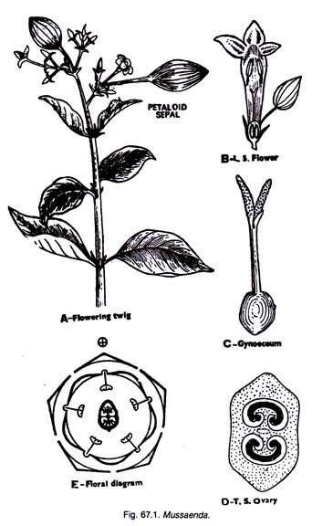


Slide 27
Economic Importance of Rubiaceae:
I. Medicinal plants:
Bark of Cinchona officinalis yields an alkaloid called Quinine which is the best remedy for malarial fever. The roots of Rubia cordifolia are also used as medicine.
II. Beverage plants:
The seeds of Coffea arabica, C. liberica and C. robusta are roasted and ground to give coffee powder.
III. Ornamental plants:
Rubia, Hamelia, Gardenia, Ixora, Mussaenda are cultivated in gardens for their beautiful flowers.

Slide 28
Solanaceae
Distribution of Solanaceae:
The family is commonly called ‘Potato family’. It is a large family well distributed in tropics and sub-tropics, though a few members are found in temperate zone. The family includes 2,000 species belonging to 90 genera. In India it is represented by 70 species of 21 genera. Several members are cultivated through out the world for their great economic importance Solarium tuberosum, Solarium melongena, Lycopersicurn esculentum. Characters of Solanaceae:
Plants herbs, shurbs rarely trees; leaves alternate, flowers solitary or in cymes; axillary or terminal; flowers pentamerous, actinomorphic, hypogynous, hermaphrodite, calyx persistent, gamosepalous, corolla gamopetalous, campanulate; stamens epipetalous; gynoecium bicarpellary, syncarpous, ovary obliquely placed, axile placentation; swollen placentae; ovules many in each locules; fruit capsule or berry.

Slide 29
Habit: Mostly herbs (Petunia, Withania), shrubs and trees.
Root: A branched tap root system.
Stem: Aerial, erect, climbing (Solanum jasminoides), herbaceous, or woody, cylindrical, branched, solid or hollow, hairy, or glabrous, underground stem in Solanum tuberosum.
Leaves: Cauline, ramal, exstipulate, petiolate or sessile, alternate sometimes opposite, simple, entire pinnatisect in Lycopersicurn, unicostate reticulate venation.
Inflorescence: Solitary axillary, umbellate cyme, or helicoid cyme in Solanum.
Flower: Bracteate or ebracteate, pedicellate, complete, hermaphrodite, actinomorphic, pentamerous, hypogynous.
Calyx: Sepals 5, gamosepalous, tubular or campanulate, valvate or imbricate, persistent, green or coloured, hairy, inferior.
Notes:
Habit:
Mostly herbs (Petunia, Withania), shrubs and trees.
Root:
A branched tap root system.

Slide 30
Corolla: Petals 5, gamopetalous, tubular or infundibuliform, valvate or imbricate aestivation, scale or hair-like outgrowth may arise from the throat of the corolla tube, coloured, inferior.
Androecium: Stamens 5, epipetalous, polyandrous, alternipetalous, filaments inserted deep in the corolla tube, anthers dithecous, usually basifixed or dorsifixed, introrse, inferior.
Gynoecium: Bicarpellary, syncarpous, ovary superior, bilocular, unilocular in Henoonia, axile placentation placentae swollen, many ovules in each loculus, ovary obliquely placed; in some cases nectariferous disc is present; style simple; stigma bifid or capitate.
Fruit: A capsule or beery.
Seed: Endospermic.

Slide 31
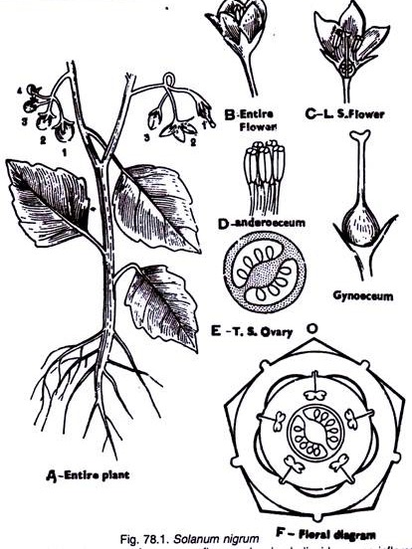


Slide 32
Economic Importance of Solanaceae:
The family is of great economic importance.
1. Food:
Many members viz., Solanum tuberosum (Potato), Solanum melongena (Brinjal), Lycopersicurn esculentum (Tomato), Capsicum (H. Mirch) etc. are used as vegetables. Physalis peruviana (H. Rasbhari) produces edible berries.
2. Medicinal:
Atropa belladona contains alkaloid Atropine; this is used in Belladona plaster. Atropine is used in eye testing. Nicotiana tabacum (tobacco) yields Nicotine. Hyoscyamus niger, Solanum nigrum, Datura (H. Dhatura), Withania somnifera (Ashwagandha) are used medicinally.
3. Narcotics:
Tobacco is obtained from leaves of Nicotiana tabacum and variously used in cigars, bidi, chewing, jarda etc.
4. Ornamentals:
Petunia, Cestrum, Lycium, Salpiglossis, Schizanthus are cultivated in gardens for ornamentals.

Slide 33
Euphorbiaceae
Distribution: This family includes 300 genera and about 5000 species. The members of this family are cosmopolitan in distribution but, they are more abundant in warmer parts or tropical regions of the world. They are almost absent in Arctic region. In India this family is represented by 61 genera and 336 species. All these species are distributed in tropical and sub-tropical Himalayas and mountain ranges of south India.
Habitat: Generally, plants belonging to this family are Mesophytic or xerophytic in habitat
Habit: This family shows a great range of characteristics in vegetative and floral structures. Members of this family are mostly shrubs (for example Jatropa, Ricinus, Euphorbia sps.) or trees (for example Emblica officinalis, Hevea brasiliensis) and rarely herbs (for example Acalypha, Phyllanthus).

Slide 34
Root system: These plants show tap root system. Exceptionally, Manihot has tuberous roots which are rich in starch. Few species of Manihot are edible.
Stem: Several species of Euphorbia are cactus-like in habit with thick and fleshy stems and leaves reduced to spines. These plants often contain milky latex with special laticiferous vessels.
Leaf: The leaves are usually alternate or rarely opposite (Choriophyllum) or whorled (Mischodon), simple, entire or deeply palmately lobed (Ricinus and Jatropa) or compound (Bischofia). The leaves are variegated in Croton.
The stipules are usually present and in Jatropa they are represented by ciliate glands. The venation is pinnate or palmate as in Ricinus. In species of Euphorbia, leaves fall off early and photosynthesis is carried by green stems.

Slide 35
Inflorescence: Inflorescence is complex and highly variable. In Phyllanthus, the flowers are solitary or auxiliary. In Croton, the inflorescence is panicle. In Acalypha, it is catkin and in Jatropa the flowers are arranged in terminal cymose clusters.
The first branching is usually racemose and the subsequent branchings are cymose. The partial inflorescence is a cyathium which appears as a single flower. Each cyathium is surrounded by an involucre of four or five connate bracts and between these large coloured glands a petaloid appendage is present (Splendens).
Flower: The flowers are unisexual, bracteates, actinomorphic, regular, pentamerous or trimerous (Phyllanthus), monochlamydeous and hypogynous. The flowers are rarely perigynous as in Bridelia.
In Croton the corolla is distinct in the male flowers whereas it is inconspicuous or absent in the female flowers. Flowers are often apetalous.

Slide 36
Perianth: Perianth is mostly in one whorl, green or rarely petaloid (Manihot). Rarely perianth is in two whorls as in Jatropa or absent as in Euphorbia. In Jatropa, both calyx and corolla are present. Both calyx and corolla are five membered with united petals. Aestivation is valvate or imbricate type.
Androecium: The Androecium show variable number of stamens. In male flowers they range from one to many arranged in one to ten whorls. Filaments are free or united. The anthers are monothecous or dithecous, erect and dehisce longitudinally or transversely.
Gynoecium: The gynoecium is tricarpellary, syncarpous with superior, trilocualr ovary. One or two collateral, pendulous, anatropous ovules in each locule in axile placentation are present. At the base of the ovaries nectarines are present.

Slide 37
Pollination: Unisexual flowers necessitate cross pollination and here pollination is entomophilous taking place with the help of insects. This is due to the presence of brightly coloured glands or bracts, petaloid calyx or nectar. Certain taxa, such as Mercurials with long thread like styles are anemophilous.
Fruit: Fruit is usually three chambered, schizocarpic splitting into three one-seeded cocci. Rarely drupe (Phyllanthus) or berry (Bischofia).
Seed: Seeds are with fleshy endosperm and straight embryo. The seeds are often with a conspicuous caruncle. Seeds are dispersed by birds and animals. Some seeds are also dispersed by explosive mechanism of the capsules

Slide 38
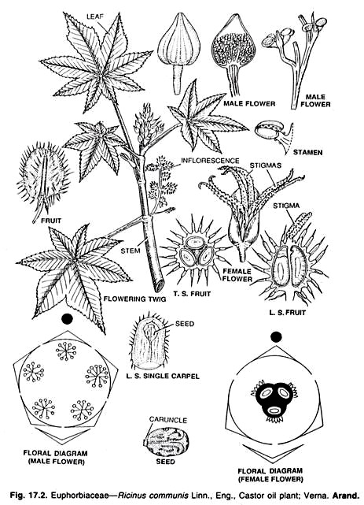

Slide 39
Economic Importance of Euphorbiaceae
Plants of Euphorbiaceae are economically very important. They provide food, drug, rubber and oil
Edible plants
The large and fleshy tuberous roots of Manihot are rich in starch and form valuable food stuff. It is extensively cultivated in tropics. Some cultivars are with high HCN content (Bitter cassava) and others which low content (Sweet cassava). The poisonous juice is squeezed outand is used as antiseptic and preserving meat.
The fruits of Emblica officinalis are rich source of vitamin-C. They are used to make pickle and in treatment of scurvy.
Rubber
Hevea brasiliensis (Para rubber tree) is the best natural source of rubber. The tree is tapped by making plant cuts on the trunk and the latex is coagulated. It is native of Brazil.
The latex of Spanium indicum also produces rubber.

Slide 40
Medicine
The castor oil obtained from the seeds of Ricinus communis is uses medicinally as cleansing agent.
The seeds of Croton tiglium are the source of croton oil used as purugative.
The fruits of Phyllanthus niruri (nela usiri) find their application in the treatment of jaundice and urinary troubles.
Dyes
A red dye is obtained from the fruits of Mallotus philippensis (Kumkuma), Chrozophora tinctoria, Sapium sps are used in dying silks
Candelila wax is extracted from the stems of Euphorbia antisyphylitica
Oils
Castor oil obtained from the seeds of Ricinus communis is used as lubricant and illumination oil
The oil obtained from the seeds of Aleurites foldii is called Tung oil. It is used in manufacture of varnishes and paints. The seeds contain oil which is used in paint and varnish industry. The seeds yield an oil used in soap industry and the oil cakes are used as a cattle feed and fertilizer.

Slide 41
Poaceae
Characters of Poaceae:
Mostly herbs, stem jointed, fistular, cylindrical; leaves simple, alternate, sheathing, sheath open, ligulate; inflorescence compound spike; flowers zygomorphic, hypogynous, protected by palea; perianth represented by 2 or 3 minute scales (lodicules); stamens 3, versatile; carpel one, style 2 or 3, stigmas feathery, basal placentation; fruit caryopsis; testa fused with pericarp.
Distribution of Poaceae:
The family is commonly known as grass family. It is one of the largest among the angiospermic families. It consists of 620 genera and 6,000 species. The members are cosmopolitan in distribution. The plants represent all the 3 ecological types as hydrophytes, xerophytes and mesophytes. In India it is represented by 850 species.

Slide 42
Habit: Herbs, annuals or perennials or shrubs, sometimes tree like (Bambusa, Dendrocalamus).
Root: Adventitious, fibrous, branched, fascicled or stilt (Zea mays).
Stem: Underground rhizome in all perennial grasses, cylindrical, culm with conspicuous nodes and internodes, internodes hollow, herbaceous or woody, glabrous or glaucous, vegetative shoots are arising from the base of aerial stem or from underground stems are called tillers.
Leaves: Alternate, simple, distichous, exstipulate, sessile, ligulate (absent in Echinochloa), leaf base forming tubular sheath, sheath open, surrounding internode incompletely, ligule is present at the junction of the lamina and sheath, entire, hairy or rough, linear, parallel venation.

Slide 43
Inflorescence:
Compound spike which may be sessile or stalked. Each unit of inflorescence is spikelet. The spikelets are arranged in various ways on the main axis called rachilla. A compound inflorescence may be spike of spikelets (Triticum), panicle of spikelets (Avena). The spikelet consists of a short axis called rachilla on which 1 to many sessile or short stalked flowers are borne. At the base of rachilla two sterile scales, called glumes, are present. The glumes are placed one above the other on opposite sides. The lower one is called first glume and the upper is called second glume. Both the glumes are boat shaped and sterile. Above the glumes a series of florets are present. Each floret has an inferior palea or lemma and above it a superior palea. The lemma frequently bears a long, stiff hair called awn.

Slide 44
lower: Bracteate and bracteolate, sessile, incomplete, hermaphrodite, or unisexual (Zea mays), irregular, zygomorphic, hypogynous, cyclic.
Perianth: Represented by membranous scales called the lodicules. The lodicules are situated above and opposite the superior palea or may be absent, or many (Ochlandra), or 2 or 3.
Androecium: Usually stamens 3, rarely 6 (Bambusa, Oryza) and one in various species of Anrostis, Lepturus; polyandrous, filaments long, anthers dithecous, versatile, linear, extrorse; pollen grains dry.
Gynoecium: Monocarpellary, according to some authors carpels 3, of which 2 are abortive, ovary superior, unilocular with single ovule, basal placentation, style short or absent; stigmas two feathery or papillate and branched.
Fruit: Caryopsis (achene with pericarp completely united or adherent with the seed coat) or rarely nut (Dendrocalamus) or berry (Bambusa).
Seed: Endospermic and containing a single cotyledon called scutellum, which is shield shaped and pressed against the endosperm.

Slide 45
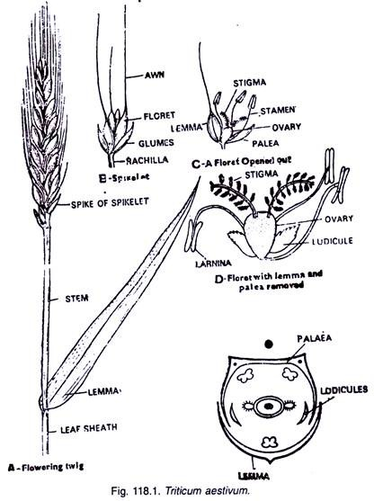

Slide 46
Economic importance
Food:
Triticum aestivum, Oryza sativa, Zea mays (Maize), Hordeum vulgare (Jaw), Sorghum vulgare (Jowar), Avena sativa (Oats), Pennisetum typhoides (Bajra) are cultivated for cereals and food grains.
Fooder:
Many grasses as Cynodon dactylon, Panicum, Cymbopogon, Agrostis, Poa are grown for fodder.
Sugar:
Saccharum officinarum (Sugarcane; H. Ganna) is cultivated for gur and sugar.
Building material:
Some species of Bambusa e.g. B. tulda, B. vulgaris are used for scaffolding, thatching huts etc.
Furniture:
Species of Dendrocalamus (H. Bent), Arundinaria, Melocalamus are used in manufacture of furniture.

Slide 47
Aromatic grasses:
Many grasses yield scented oils which are used in perfumery viz. Vetiveria zizanioides (H. Khus khus) yields vetiver oil from the roots. The roots are also woven into curtains. Andropogon odoratus (Ginger grass), Cymbopogon citratus (Lemon grass), Cymbopogon martini (Geranium grass), Cymbopogon jawarancusa etc. also yield oil.
Medicinal:
Phragmites karka, Cymbopogon schoenanthus etc. are medicinal.
Secale cereale is cultivated for infection of its inflorescence by Claviceps purpurea for production of Ergot and for extraction of ergotine. Ergotine is an excellent remedy for uterine contraction.
Paper:
It is manufactured from certain species of grasses and bamboos.
Ornamental:
Rhynchelytrum repens, Cortaderia selloana and some species of the tribe Bambusoideae are ornamentals. Besides these a number of grasses are grown to form fine lawns, play grounds etc.

