Slide 1
SEWING TECHNIQUES UNIT 3-SLEEVES
A.LAKSHIKA
ASSISTANT PROFFESSSOR
DEPARTMENT OF FASHION TECHNOLOGY AND COSTUME DESIGNING
BON SECOURS ARTS AND SCIENCE COLLEGE FOR WOMEN
MANNARGUDI

Slide 2
SLEEVES
Sleeves are both functional and design elements of a garment. As functional elements, sleeves must allow for freedom of movement and comfort and must enhance the overall purpose of the garment. As design elements, sleeves should compliment the bodice to which they are attached.

Slide 3
CLASSIFICATION OF SLEEVES
SET IN SLEEVES
NON SET IN SLEEVES
SLEEVELESS

Slide 4
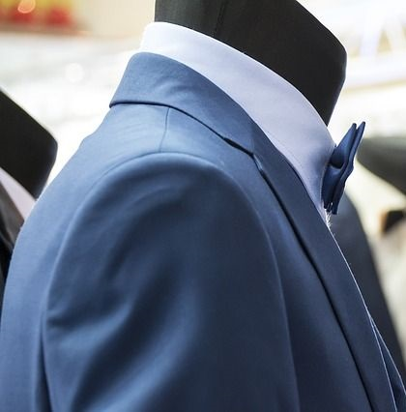
SET IN SLEEVES
A “Set in Sleeve” is a sleeve cut separately and stitched into the armhole of a finished bodice so that there is a comfortable sleeve cap ease for better fitting. The set in sleeve fits the armhole smoothly without puckers.

Slide 5
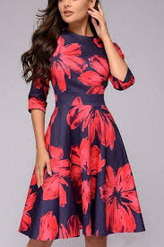
PLAIN SLEEVE
This is a sleeve which is set into the armscye with the sleeve head curved to adjust to the roundness of the shoulder.

Slide 6
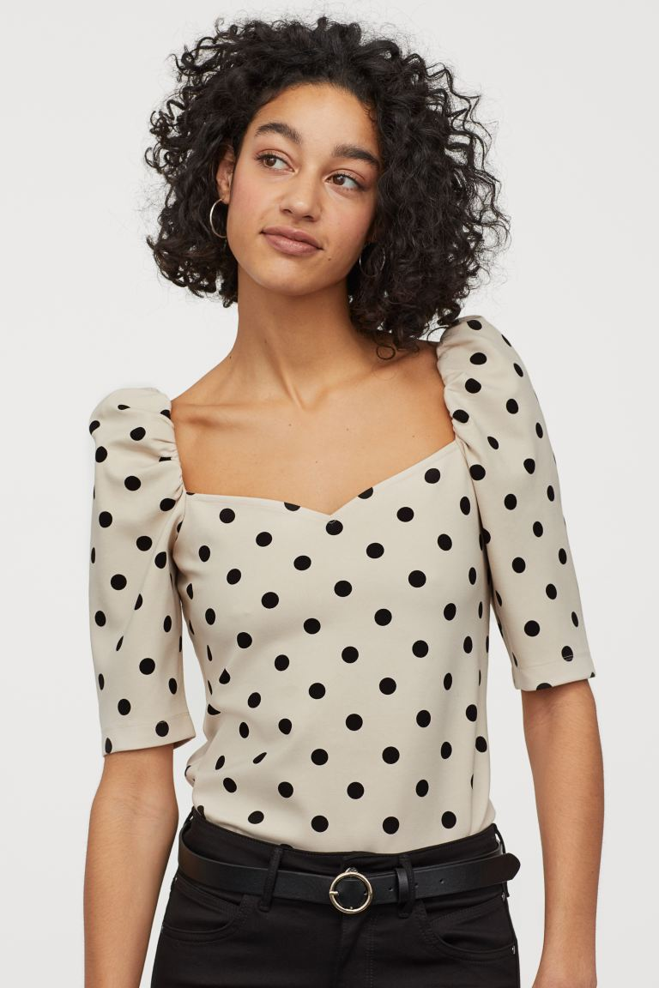
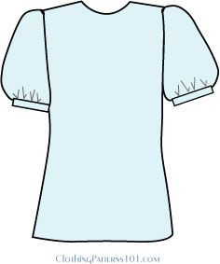
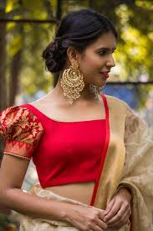
PUFF AT TOP
PUFF AT BOTTOM
PUFF AT TOP AND BOTTOM

Slide 7
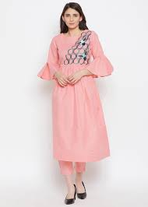
BELL SLEEVES
A bell sleeve can be either long or short and is usually set smoothly into the armscye and flares toward the bottom. Bell sleeves end anywhere from the elbow to the wrist.

Slide 8
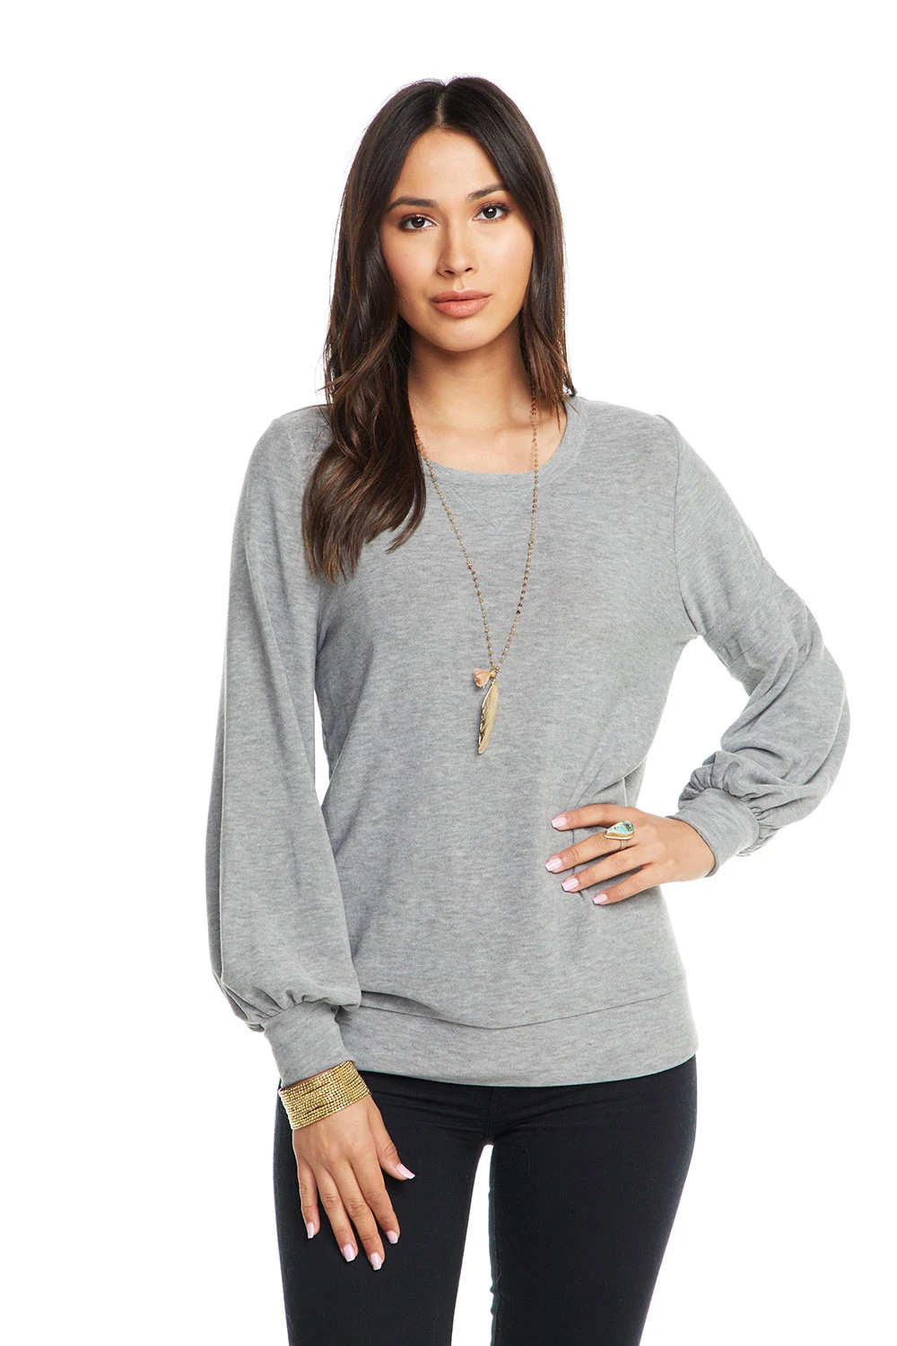
BISHOP SLEEVE
A bishop sleeve is a long sleeve that is gathered at the bottom with a button cuff, slit and facing. This lesson will teach you the principles of 'slashing and spreading' to add fullness to sleeves, as well as to other areas of a garment

Slide 9
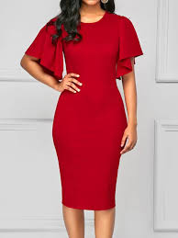
CIRCULAR SLEEVE
This is a sleeve which looks like a circle when it is cut. This is a sleeve which has lots of flare.

Slide 10
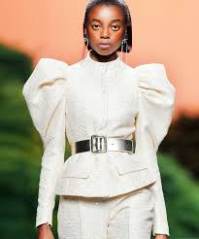
LEG O MUTTON SLEEVE
A sleeve that is extremely wide over the upper arm and narrow from the elbow to the wrist.

Slide 11
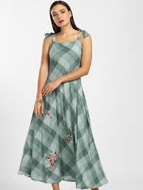
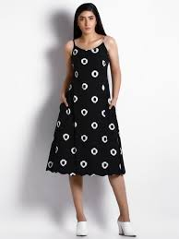
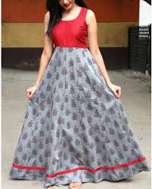
SLEEVE LESS STYLES

Slide 12
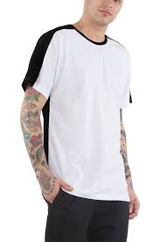
KIMONO SLEEVES
a sleeve cut in one piece with the bodice.

Slide 13
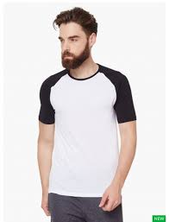
Raglan sleeves
A raglan sleeve is a sleeve that extends in one piece fully to the collar, leaving a diagonal seam from underarm to collarbone. It is named after Lord Raglan, the 1st Baron Raglan, who is said to have worn a coat with this style of sleeve after the loss of his arm in the Battle of Waterloo.

Slide 14
THANK YOU

