Slide 1
SEWING TECHNIQUES UNIT-2-FULLNESS
A.LAKSHIKA
ASSISTANT PROFFESSSOR
DEPARTMENT OF FASHION TECHNOLOGY AND COSTUME DESIGNING
BON SECOURS ARTS AND SCIENCE COLLEGE FOR WOMEN
MANNARGUDI

Slide 2
FULLNESS
Darts
Tucks
Pleats
Flares
Godets
Gathers
Shirrs
Frills

Slide 3
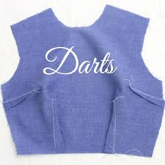
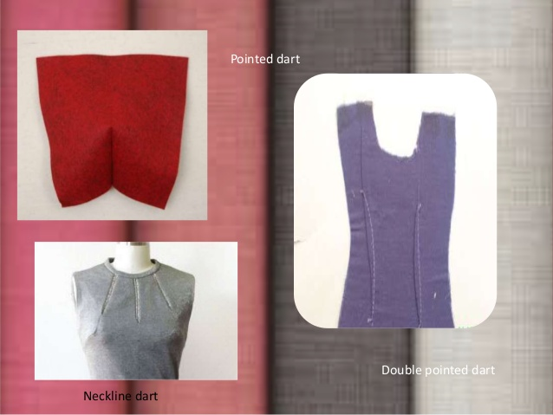
DARTS
Darts are folds (tucks coming to a point) and sewn into fabric to take in ease and provide shape to a garment, especially for a woman's bust. They are used frequently in all sorts of clothing to tailor the garment to the wearer's shape, or to make an innovative shape in the garment.

Slide 4
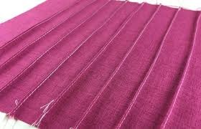
TUCKS
a tuck is a fold or pleat in fabric that is sewn in place. Small tucks, especially multiple parallel tucks, may be used to decorate clothing or household linens.
PIN TUCK
Pin tucks are parallel rows of raised fabric produced by stitching tight rows of stitches on sewing machines to push up the fabric between them. Pin tucks are common on formalwear and make a nice pattern along the front of a shirt or blouse.

Slide 5
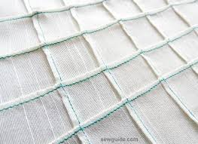
CROSS TUCK
Cross tucks are basically pin tucks sewn in two directions. Once stitched, the multiple rows of raised fabric tucks create a boxed pattern. Cross tucks are popular both for embellishing clothing and making home decor like pillows, drapes, and upholstery. Lattice tucks are similar to cross tucks but pressed and stitched closer to make the fabric resemble the look of windows or lattice.

Slide 6
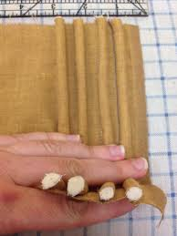
CORDED TUCK
Corded tucks are another version of regular pin tucks and made using sewing machines by first stitching standard pin tucks, then adding cord, yarn, ribbon, or other trim to the raised edges. The trim is sewn on using a zigzag stitch. Lace tucks are done using a similar method only with lace trim. This is stitched onto the back side of the tuck so only the edge of the lace shows.

Slide 7
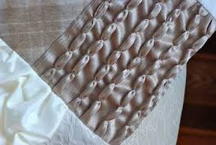
SHELL OR SCALLOPED TUCK
Shell tucks are wider pin tucks decorated with a wavy, contrasting colour thread stitch that resembles the look of a shell edge.

Slide 8
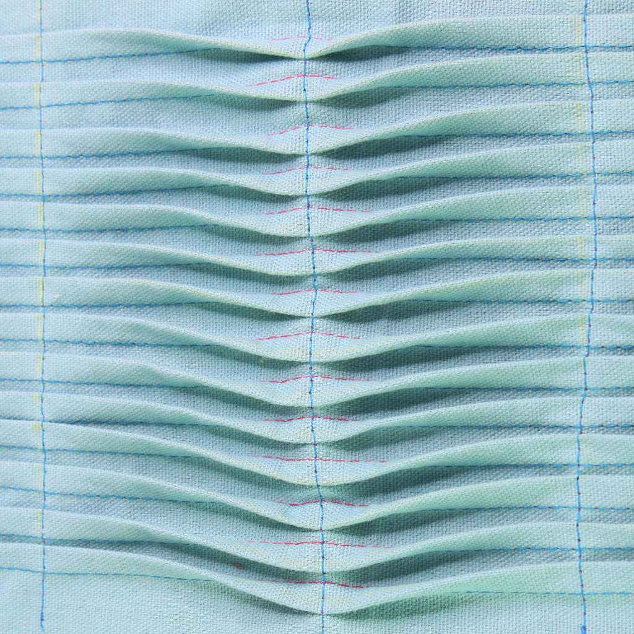
Grouped tuck with scalloped effect
Mark narrow tucks fairly close to each other stitch them and pressed to one side at right angles to the tucks ,mark lines at regular intervals for cross wise stitching on the first line stitch across the tucks in the direction they were pressed .

Slide 9
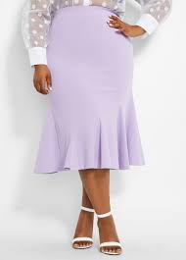
FLARES
Flares refers to a projection of volume in a silhouette, flares are also referred to as a type of trouser style. A flare can feature on dresses or tops, particularly seeing reference in peplum tops and skirts. The Flares trouser curves out between the calf and the ankle creating a flare.

Slide 10
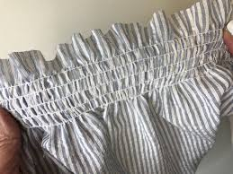
SHIRRING
In sewing, shirring is two or more rows of gathers that are used to decorate parts of garments, usually the sleeves, bodice or yoke.

Slide 11
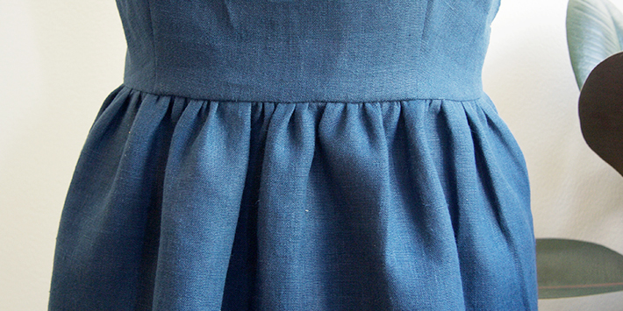
GATHERS
Gathers are visible fullness that is a part of the garment design. They may be functional or decorative. Gathers are used on sleeve caps, sleeve cuffs, waistlines, yokes, and ruffles

Slide 12
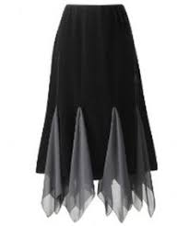
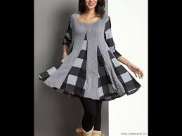
GODETS
a triangular piece of material inserted in a dress, shirt, or glove to make it flared or for ornamentation.

Slide 13
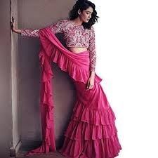
FRILL
a strip of gathered or pleated material sewn on to a garment or larger piece of material as a decorative edging or ornament.

Slide 14
PLEATS
Pleats can also be used to control fullness in a garment design. They may be pressed or unpressed, soft or crisp. When selecting fabric for a pleated design, be sure it has good drape and is resilient. Care should be taken when cutting and marking to see that pleats are on grain to ensure proper hang of the garment.
TYPES:
KNIFE PLEAT
BOX PLEAT
INVERTED BOX PLEAT
CARTRIDGE PLEAT
PINCH PLEAT
KICK PLEAT

Slide 15
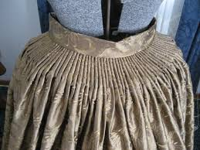
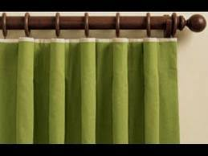
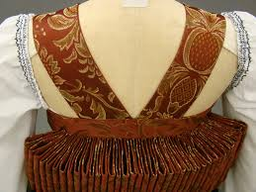
CARTRIDGE PLEAT
One of a series of small rounded standaway folds of cloth so stitched to a foundation cloth as to resemble the webbing for cartridges on a cartridge belt and used decoratively (as on clothes or curtains)

Slide 16
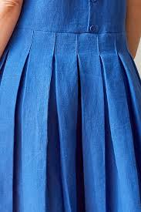
BOX PLEAT
a pleat made by forming two folded edges one facing right and the other left

Slide 17
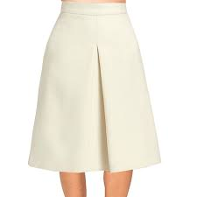
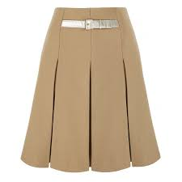
INVERTED BOX PLEAT
a pleat formed by bringing two folded edges toward or to a center point on the outside of the material to form a box pleat on the inside.

Slide 18
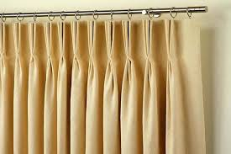
PINCH PLEAT
a narrow short pleat usually used in groups in the heading of curtains for controlling fullness.

Slide 19
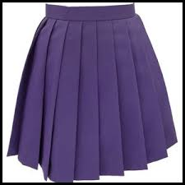
KNIFE PLEAT
a sharp, narrow pleat on a skirt, typically one of many folded in the same direction and overlapping each other.

Slide 20
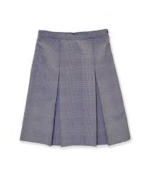
KICK PLEAT
an inverted pleat in a narrow skirt to allow freedom of movement.

Slide 21
THANK YOU

