Slide 1
A.LAKSHIKA,
ASSISTANT PROFFESSSOR,
DEPARTMENT OF FASHION TECHNOLOGY AND COSTUME DESIGNING,
BON SECOURS ARTS AND SCIENCE COLLEGE FOR WOMEN,
MANNARGUDI.
UNIT-4- COLLARS

Slide 2
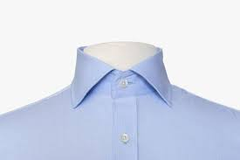
COLLARS
a collar is the part of a shirt, dress, coat or blouse that fastens around or frames the neck.

Slide 3
CLASSIFICATION OF COLLAR
Collars can generally be classified into two broad categories based on several specific characteristics:
Convertible collars
Non-convertible collars

Slide 4
Convertible collars
Collars that can be worn open or closed . When unfastened, the collar springs open, lying flat across the chest.
Basic shirt collar
Shawl collar

Slide 5
NON CONVERTIBLE COLLAR
Collars that stay in the same location whether the garment is buttoned or unbuttoned.
Ex: 1. Peter Pan collar
2. Mandarin collar
3. Roll and
4. Sailor collar

Slide 6
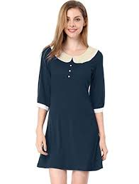
PETER PAN COLLAR
a flat collar with rounded points.

Slide 7
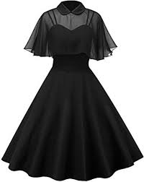
CAPE COLLAR
a soft, wide, circular collar that covers the shoulders and the upper arms like a cape.

Slide 8
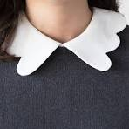
SCALLOP COLLAR
having a series of similar, decorative curves along the edge

Slide 9
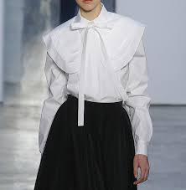
PURITAN COLLAR
A Puritan collar is a wide collar extending to the shoulders with squared corners at center front and out edges.

Slide 10
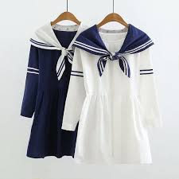
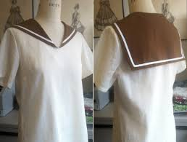
SAILORS COLLAR
a collar, as on a middy blouse, that is broad and square in the back and tapers to a V in the front.

Slide 11
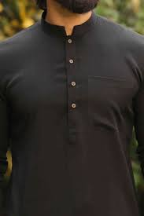
CHINESE COLLAR
A mandarin collar, standing collar, band collar or Chinese collar is a short unfolded stand-up collar style on a shirt or jacket. The style derives its Western name from the mandarin bureaucrats in Qing-era China that employed it as part of their uniform.

Slide 12
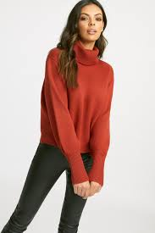
TURTLENECK COLLAR
a high, round, close-fitting neck on a knitted garment.

Slide 13
THANK YOU

