Slide 1
OPERATIONS RESEARCH
UNIT-I

Slide 2
Introduction to OR
Operations research, or operational research in British usage.
Operational Research (OR) is the use of advanced analytical techniques to improve decision making.
Operational research (OR) encompasses a wide range of problem-solving techniques and methods applied in the pursuit of improved decision-making and efficiency.
It is sometimes known as Operations Research, Management Science or Industrial Engineering.

Slide 3
WHAT IS OPERATIONAL RESEARCH?
Analytical methods used in OR include mathematical logic, simulation, network analysis, queuing theory , and game theory . The process can be broadly broken down into three steps.

Slide 4
WHY IS OR NEEDED?
Because it makes sense to make the best use of available resources.
Today’s global markets and instant communications mean that customers expect high-quality products and services when they need them, where they need them.
Organizations, whether public or private, need to provide these products and services as effectively and efficiently as possible.
This requires careful planning and analysis – the hallmarks of good OR.
This is usually based on process modeling, analysis of options or business analytics.

Slide 5
Linear Programming
The general Linear Programming Problem calls for optimizing (maximizing/minimizing) alinear function for variables called the ‘objective function’ subject to a set of linear equationsand/or inequalities called the ‘constraints or restrictions.’

Slide 6
Basic Requirements and their Relationships
1.Decision Variables and their Relationships: The decision variable refers to any candidate(person, service, projects, jobs, tasks) competing with other decision variables for limited resources. These variables are usually interrelated in terms of utilization of resources and need simultaneous solutions, i.e., the relationship among these variables should be linear.
2.Objective Function: The Linear Programming Problem must have a well defined objective function to optimize the results. For instance, minimization of cost or maximization of profits. It should be expressed as linear function of decision variables (Z = X1 + X2, where Z represents the objective, i.e., minimization/maximization, X1 and X2 are the decision variables directly affecting the Z value).
3.Constraints: There would be limitations on resources which are to be allocated among various competing activities. These must be capable of being expressed as linear equalities or inequalities in terms of decision variables.
4.Alternative Courses of Action: There must be presence of alternative solutions for the purpose of choosing the best or optimum one.

Slide 7
5.Non-Negativity Restrictions: All variables must assume non-negative values. If any of the variable is unrestricted in sign, a tool can be employed which will enforce the negativity without changing the original information of a problem.
6.Linearity and Divisibility: All relationships (objective function and constraints) must exhibit linearity i.e., relationship among decision variables must be directly proportional. It is assumed that decision variables are continuous, i.e., fractional values of variables must be permissible in obtaining the optimum solution.
7.Deterministic: In Linear Programming it is assumed that all model coefficients are completely known. For example: profit per unit.

Slide 8
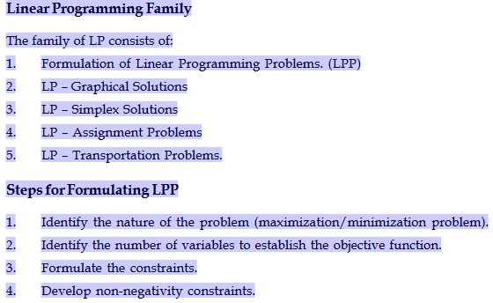
Formulation of LP Models

Slide 9
Linear programming problems with two variables can be represented and solved graphically with ease. Though in real-life, the two variable problems are practiced very little, the interpretation of this method will help to understand the simplex method.
Following is the portrayal of Cartesian plane.

Slide 10
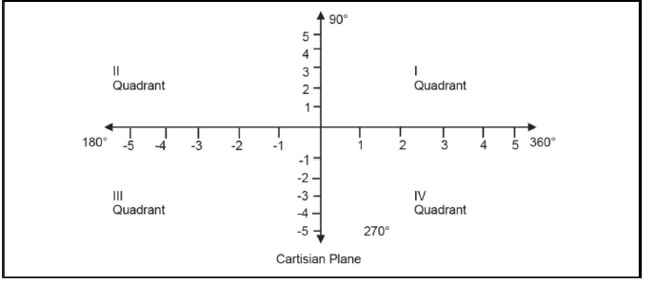
Graphical Solutions under Linear Programming

Slide 11
Steps:
1. Consider each inequality constraint as an equation.
2. Plot each equation on the graph as each will geometrically represent a straight line.
3. Plot the feasible region, every point on the line will satisfy the equation on the line.
4. If the inequality constraint corresponding to that line is less than or equal to, then the region below the line lying in the 1st quadrant (as shown in above graph) is shaded (due to non-negativity of variables); for the inequality constraint with greater than or equal to sign, the region above the line in the 1st quadrant is shaded. The points lying in common region will satisfy all the constraints simultaneously. Hence, it is called feasible region.
5. Identify the co-ordinates of the corner points.
6. Find the ‘Z’ value by substituting the co-ordinates of corner points to the objective functions.

Slide 12
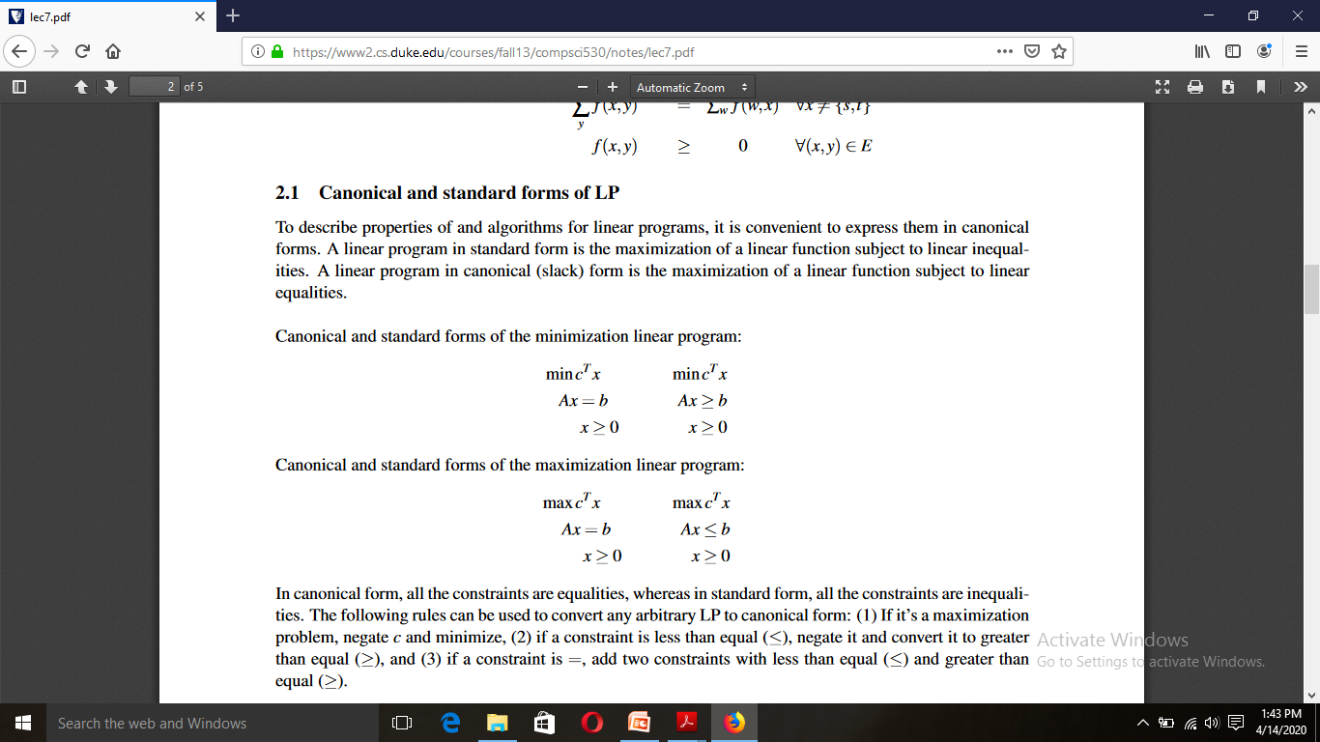

Canonical and standard forms of LP
To describe properties of and algorithms for linear programs, it is convenient to express them in canonical forms. A linear program in standard form is the maximization of a linear function subject to linear inequalities. A linear program in canonical (slack) form is the maximization of a linear function subject to linear equalities.
Canonical and standard forms of the minimization linear program:
Canonical and standard forms of the maximization linear program:

Slide 13
UNIT-II
Simplex Method

Slide 14
Simplex Method of Linear Programming
Under 'Graphical solutions' to LP, the objective function obviously should have not more than two decision variables. If the decision variables are more than two, the 'Cartesian Plane' cannot accommodate them. And hence, a most popular and widely used analysis called 'SIMPLEX METHOD', is used. This method of analysis was developed by one American Mathematician by name George B. Dantzig, during 1947.
This method provides an algorithm (a procedure which is iterative) which is based on fundamental theorems of Linear Programming. It helps in moving from one basic feasible solution to another in a prescribed manner such that the value of the objective function is improved. This procedure of jumping from one vertex to another vertex is repeated.

Slide 15
Steps
1. Convert the inequalities into equalities by adding slack variables, surplus variables or artificial variables, as the case may be.
2. Identify the coefficient of equalities and put them into a matrix form AX = B Where "A" represents a matrix of coefficient, "X" represents a vector of unknown quantities and B represents a vector of constants, leads to AX = B [This is according to system of equations].
3. Tabulate the data into the first iteration of Simplex Method.

Slide 16
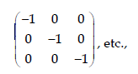
Charne’s method of penalities
When the Linear Programming problem has greater than or equal to types of equations as constraints, it is obvious that some quantity should be deducted to convert them into equalities. The variables attached to it are known as 'surplus variables'. If the inequality is of the type greater than or equal to then add surplus variables which carry a negative sign and their cost coefficients in the objective function would be zero. As they would be considering slack or artificial variables initially as basic variables, and as the surplus variables carry negative signs, they represent vectors of identify matrix of the form,

Slide 17
These artificial variables carry large negative values (-m) in the objective function. The artificial variables can also be added to the equation. This helps in choosing the initial variable or variables for the basis. The slack variables then would go to the basis whose cost coefficients are supposed to be zero (0) and the cost coefficients of artificial variables are supposed to be -M for maximization cases and +M for Minimization cases. The procedure for iteration follows when Simplex technique to obtain the optimum solution is used. Since the method involves artificial variables carrying -M as the cost coefficient, where M is a very large number which helps in the optimum solution finding and hence it is known as 'Big M Method'.

Slide 18
Steps
1. Express the problem in the standard form by using slack, surplus and artificial variables.
2. Select slack variables and artificial variables as the initial basic variables with the cost coefficients as '0' or '-M' respectively.
3. Use simplex procedure for iterations & obtain optimum solution. During the iterations, one can notice that the artificial variables leave the basis first and then the slack variables with improved value of objective function at each iteration to obtain the optimum solution.

Slide 19
Two Phase Method
For greater than or equal to constraint, the slack variable has a negative co efficient
Equality constraints do not have slack variables
If either of constraint is part of the model, there is no convenient IBFS and hence two phase method is used

Slide 20
Phase I
In this phase, we find an IBFS to the original problem, for this all artificial variable are to be driven to zero. To do this an artificial objective function (Z*) is created which is the sum of all artificial variables. The new objective function is then subjected to the constraints of the given original problem using the simplex method. At the end of Phase I, three cases arises.
If the minimum value of Z*=0, and no artificial variable appears in the basis at a positive level then the given problem has no feasible solution and procedure terminates.

Slide 21
If the minimum value of Z*=0, and no artificial variable appears in the basis, then a basic feasible solution to the given problem is obtained.
If the minimum value of the Z*=0 and one or more artificial variable appears in the basis at zero level, then a feasible solution to the original problem is obtained. However, we must take care of this artificial variable and see that it never become positive during Phase II computations.

Slide 22
Phase II
When Phase I results in (B) or (C), we go on for Phase II to find optimum solution to the given LP problem. The basic feasible solution found at the end of Phase I now used as a starting solution for the original LP problem. Mean that find table of Phase I becomes initial table for Phase II in which artificial (auxiliary) objective function is replaced by the original objective function. Simplex method is then applied to arrive at optimum solution.

Slide 23
Transportation Problem
Unit-III

Slide 24
Transportation Problem
Transportation problem is a particular class of linear programming, which is associated with day-to-day activities in our real life and mainly deals with logistics. It helps in solving problems on distribution and transportation of resources from one place to another. The goods are transported from a set of sources (e.g., factory) to a set of destinations (e.g., warehouse) to meet the specific requirements. In other words, transportation problems deal with the transportation of a product manufactured at different plants (supply origins) to a number of different warehouses (demand destinations). The objective is to satisfy the demand at destinations from the supply constraints at the minimum transportation cost possible. To achieve this objective, we must know the quantity of available supplies and the quantities demanded. In addition, we must also know the location, to find the cost of transporting one unit of commodity from the place of origin to the destination. The model is useful for making strategic decisions involved in selecting optimum transportation routes so as to allocate the production of various plants to several warehouses or distribution centers.

Slide 25
The transportation model can also be used in making location decisions. The model helps in locating a new facility, a manufacturing plant or an office when two or more number of locations is under consideration. The total transportation cost, distribution cost or shipping cost and production costs are to be minimized by applying the model.

Slide 26
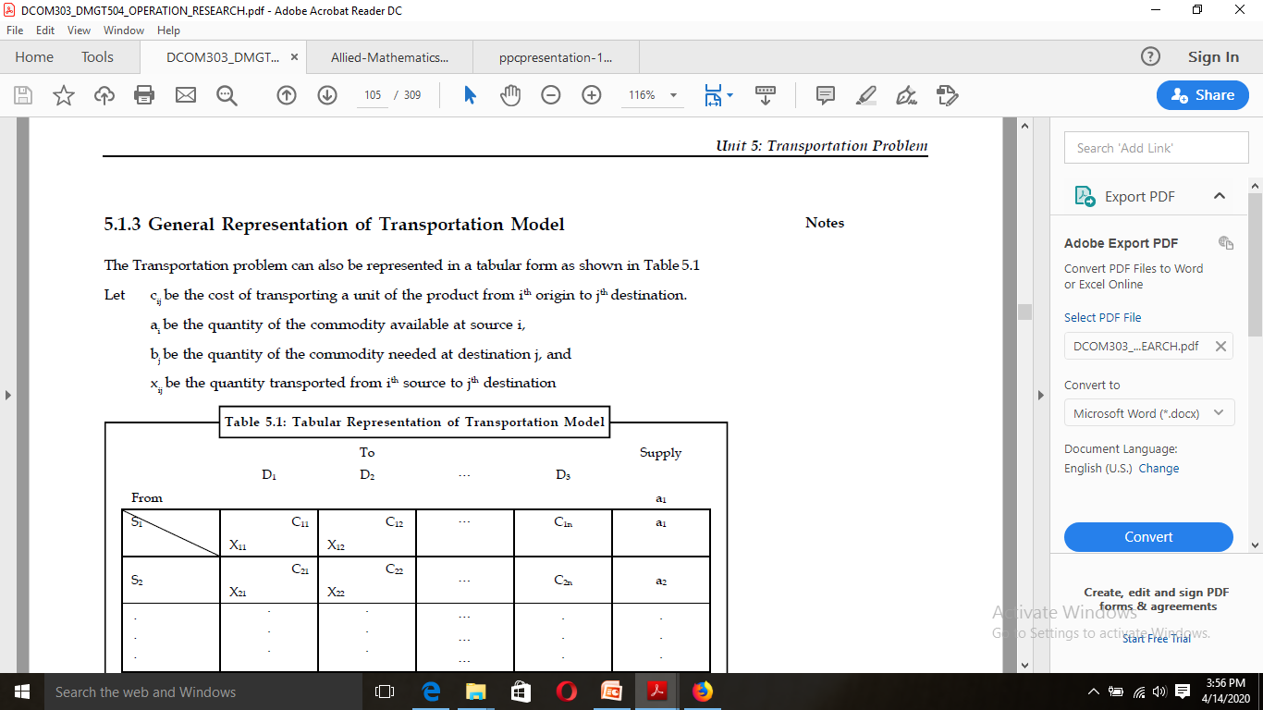
General representation

Slide 27
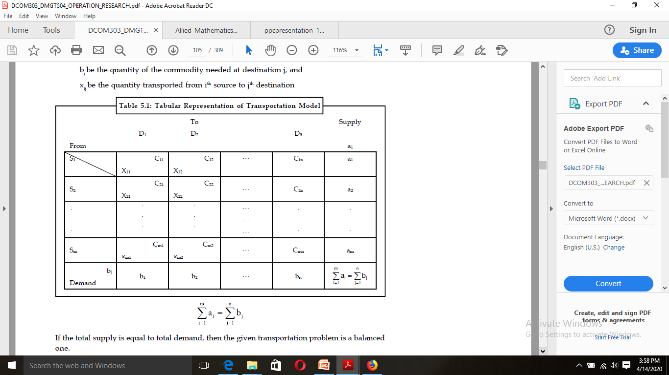

Slide 28
Degeneracy in Transportation Problems
Degeneracy involves two steps:
1. Check for degeneracy: The solution that satisfies the above said conditions N = m + n – 1 is
a non-degenerate basic feasible solution otherwise, it is a degenerate solution. Degeneracy
may occur either at the initial stage or at subsequent iterations.
If number of allocations, N = m + n – 1, then degeneracy does not exist, one has to go to the
next step.
If number of allocations, N = m + n – 1, then degeneracy does exist, and has to be resolved
before going to the next step.
2. Resolving Degeneracy: To resolve degeneracy at the initial solution, allocate a small positive
quantity e to one or more unoccupied cell that have lowest transportation costs, so as to
make m + n – 1 allocations (i.e., to satisfy the condition N = m + n – 1). The cell chosen for
allocating e must be of an independent position. In other words, the allocation of e should
avoid a closed loop and should not have a path.

Slide 29
UNBALANCED TRANSPORTATION PROBLEM
Unbalanced transportation problem is a transportation problem where the total availability at the origins is not equal to the total requirements at the destinations. For example, in case the total production of 4 factories is 1000 units and total requirements of 4 warehouses is 900 units or 1,100 units, the transportation problem is said to be an unbalanced one. To make an unbalanced transportation problem, a balanced one, a dummy origin(s) or a dummy destination (s) (as the case may be) is introduced with zero transportation cost per unit.

Slide 30
Assignment problem
The assignment problem is a fundamental combinatorial optimization problem. In its most general form, the problem is as follows:
The problem instance has a number of agents and a number of tasks. Any agent can be assigned to perform any task, incurring some cost that may vary depending on the agent-task assignment. It is required to perform as many tasks as possible by assigning at most one agent to each task and at most one task to each agent, in such a way that the total cost of the assignment is minimized. Alternatively, describing the problem using graph theory:
The assignment problem consists of finding, in a weighted bipartite graph, a matching of a given size, in which the sum of weights of the edges is a minimum.If the numbers of agents and tasks are equal, then the problem is called balanced assignment. Otherwise, it is called unbalanced assignment.^{[1]} If the total cost of the assignment for all tasks is equal to the sum of the costs for each agent (or the sum of the costs for each task, which is the same thing in this case), then the problem is called linear assignment. Commonly, when speaking of the assignment problem without any additional qualification, then the linear balanced assignment problem is meant.

Slide 31
Types of Assignment Problem
The assignment problems are of two types. It can be either
(i) Balanced or
(ii) Unbalanced.
If the number of rows is equal to the number of columns or if the given problem is a square matrix, the problem is termed as a balanced assignment problem. If the given problem is not a square matrix, the problem is termed as an unbalanced assignment problem.
If the problem is an unbalanced one, add dummy rows /dummy columns as required so that the matrix becomes a square matrix or a balanced one. The cost or time values for the dummy cells are assumed as zero.

Slide 32
Unbalanced Assignment Problem
In the unbalanced assignment problem, the larger part of the bipartite graph has n vertices and the smaller part has r<n vertices. There is also a constant s which is at most the maximum cardinality of a matching in the graph. The goal is to find a minimum-cost matching of size exactly s. The most common case is the case in which the graph admits a one-sided-perfect matching (i.e., a matching of size r), and s=r.

Slide 33
Unbalanced assignment can be reduced to a balanced assignment. The naive reduction is to add {\displaystyle n-r} new vertices to the smaller part and connect them to the larger part using edges of cost 0. However, this requires {\displaystyle n(n-r)} new edges. A more efficient reduction is called the doubling technique. Here, a new graph G' is built from two copies of the original graph G: a forward copy Gf and a backward copy Gb. The backward copy is "flipped", so that, in each side of G', there are now n+r vertices. Between the copies, we need to add two kinds of linking edges

Slide 34
Large-to-large: from each vertex in the larger part of Gf, add a zero-cost edge to the corresponding vertex in Gb.
Small-to-small: if the original graph does not have a one-sided-perfect matching, then from each vertex in the smaller part of Gf, add a very-high-cost edge to the corresponding vertex in Gb.

Slide 35
Sequencing Problems
UNIT-IV

Slide 36
Sequencing Problems
Sequencing deals with the selection of an optimum order for the number of jobs to be performed with a finite number of facilities. The objective of sequencing is to determine the sequence of performing jobs such that the total cost/time is minimized.
Sequencing problems arise in situation like a manufacturing plant for performing orders, in a hospital where the patients wait for different type of tests and in a bank where customers wait for different types of transactions, etc.

Slide 37
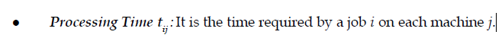
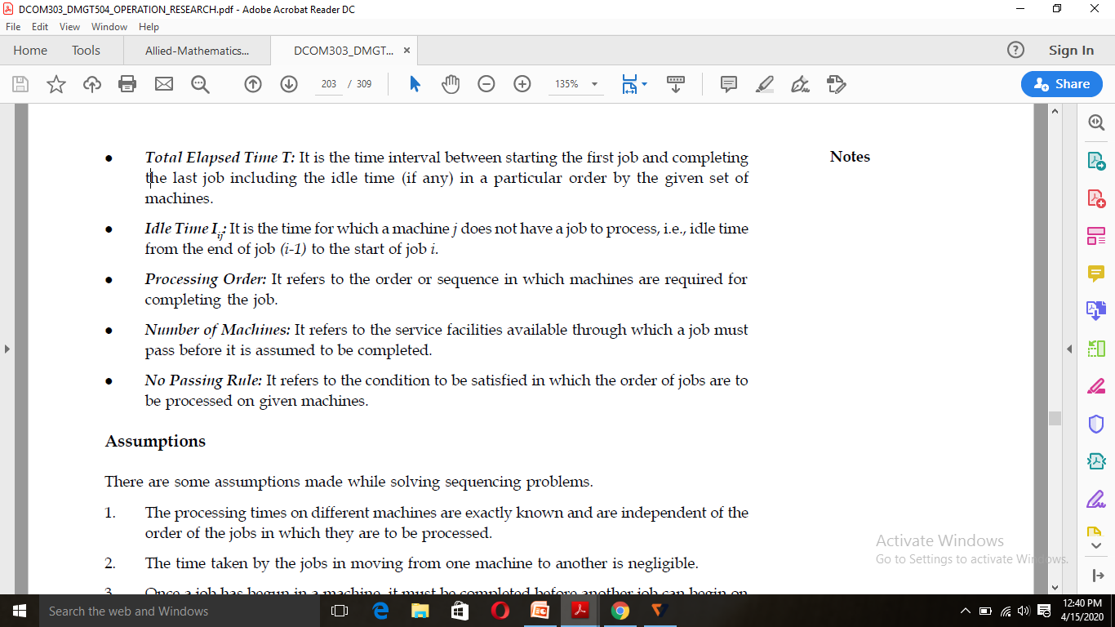
Terminology

Slide 38
Types of Sequencing Problems
Type I: Processing n jobs through two machines
Type II: Processing n jobs through three machines
Type III: Processing n jobs through m machines
Type IV: Processing two jobs through m machines

Slide 39
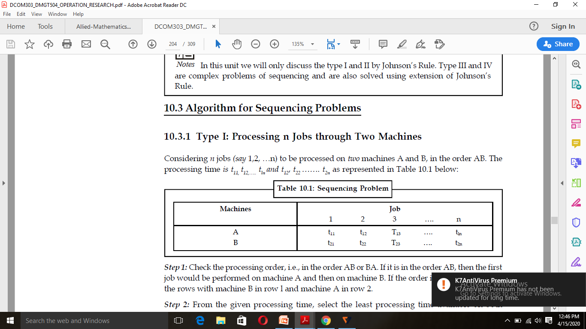
Type I: Processing n Jobs through Two Machines
Considering n jobs (say 1,2, …n) to be processed on two machines A and B, in the order AB. The processing time is t11, t12,….. tln and t12, t22 ……. t2n as represented in Table 10.1 below:

Slide 40
Steps
Step 1: Check the processing order, i.e., in the order AB or BA. If it is in the order AB, then the first job would be performed on machine A and then on machine B. If the order is of BA, interchange the rows with machine B in row l and machine A in row 2.
Step 2: From the given processing time, select the least processing time available on both machines A and B. If the least processing time exists in row l, place that job at the beginning of the sequence table (i.e., the sequence is from left to right of the sequence table). If the least processing time is on row 2, place the job at the end of sequence table (i.e., the sequence is from right to left of the sequence table).
Step 3: Delete the job which has been sequenced, and repeat step 2 until all the jobs are sequenced. Notes
Step 4: Establish a tabular column to determine the total elapsed time and also the idle time for both the machines A and B.

Slide 41
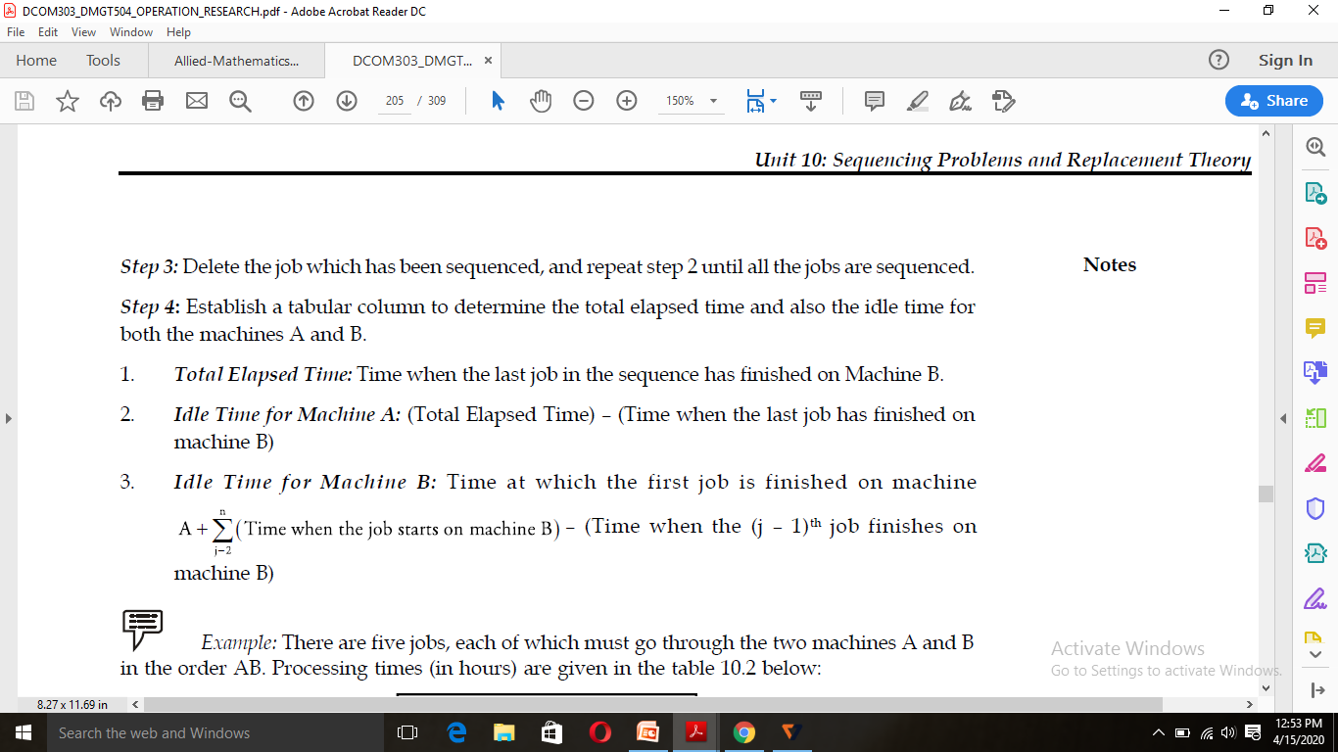

Slide 42
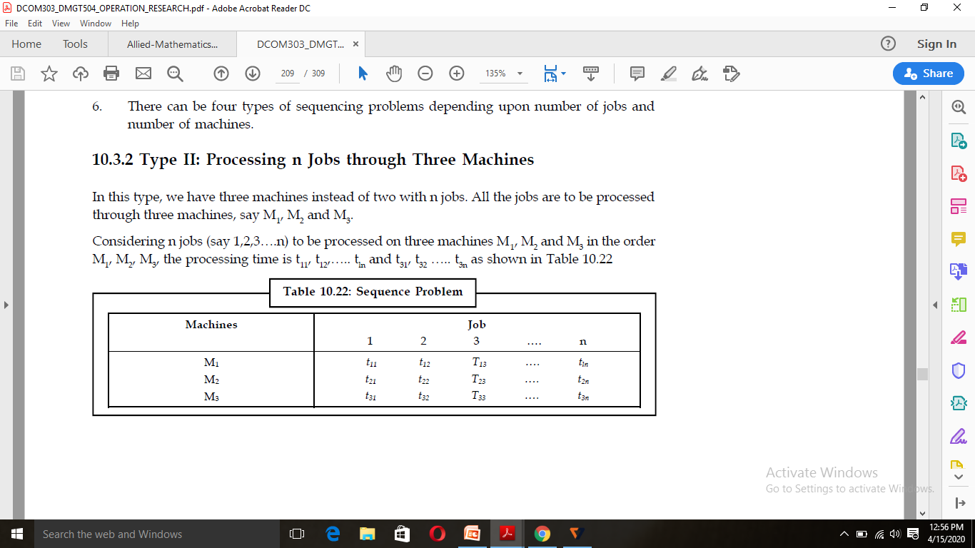
Type II: Processing n Jobs through Three Machines
In this type, we have three machines instead of two with n jobs. All the jobs are to be processed through three machines, say M1, M2 and M3.
Considering n jobs (say 1,2,3….n) to be processed on three machines M1, M2 and M3 in the order M1, M2, M3, the processing time is t11, t12,….. tln and t31, t32 ….. t3n as shown in Table 10.22

Slide 43
Steps
Step 1: Check whether the given processing time for all the three machines satisfy either one or both the conditions. If the condition is satisfied, go to Step 2, else the model fails.
Step 2: Convert the three machine types into two machines by introducing two imaginary machines Mx and My. Where, Mx = M1 + M2 and
My=M2 + M3
Step 3: For the imaginary machines Mx and My, determine the optimal sequence using the algorithm for Type 1 (i.e., n job and two machines).
Step 4: Find the total elapsed time and the idle time for all the three machines.

Slide 44
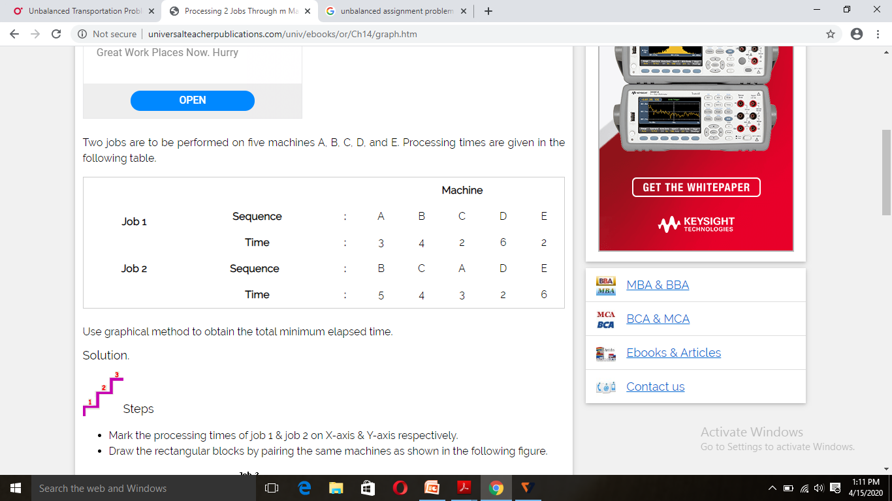
Processing 2 Jobs Through m Machines
This section focuses on the sequencing problem of processing two jobs through m machines. Problems under this category can be solved with the help of graphical method. The graphical method below is explained with the help of the following example.
Two jobs are to be performed on five machines A, B, C, D, and E. Processing times are given in the following table.

Slide 45
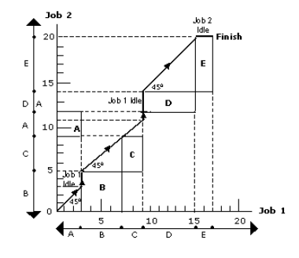
Steps
Mark the processing times of job 1 & job 2 on X-axis & Y-axis respectively.
Draw the rectangular blocks by pairing the same machines as shown in the following figure.

Slide 46
Starting from origin O, move through the 45⁰ line until a point marked finish is obtained.
The elapsed time can be calculated by adding the idle time for either job to the processing time for that job. In this illustration, idle time for job 1 is 5 (3+2) hours.
Elapsed time = Processing time of job 1 + Idle time of job 1
= (3 + 4 + 2 + 6 + 2) + 5 = 17 + 5 = 22 hours.
Likewise, idle time for job 2 is 2 hours.
Elapsed time = Processing time of job 2 + Idle time of job 1
= (5 + 4 + 3 + 2 + 6) + (2) = 20 + 2 = 22 hours.

Slide 47
Networks
UNIT-V

Slide 48
NETWORKS
Any project involves planning, scheduling and controlling a number of interrelated activities with use of limited resources, namely, men, machines, materials, money and time. The projects may be extremely large and complex such as construction of a power plant, a highway, a shopping complex, ships and aircraft, introduction of new products and research and development projects. It is required that managers must have a dynamic planning and scheduling system to produce the best possible results and also to react immediately to the changing conditions and make necessary changes in the plan and schedule. A convenient analytical and visual technique of PERT and CPM prove extremely valuable in assisting the managers in managing the projects.

Slide 49
Fulkerson’s rule
(1) The starting event, the event having no predecessor activity is numbered J’. Other events are numbered in increasing order from event to rightwards. If there are more than one initial event, found in diagram, anywhere they are to be numbered from top to bottom in increasing order. No two events can have the same number in any case.
(2) Over sight all the activities emerging out from event J’ in the diagram, one or more initial events having no predecessor activities are found. Number these events according to rule (1)
(3) Follow the rule (2) for newly numbered events and so on till the event having no activity emerging out from it is found. That event is numbered as highest one in diagram.

Slide 50
Example
1. Event a is the starting or initial event; hence number it as 1
2. Due to the activity K emerging out of a and ending at event h the end of activity will be the new initial event and number it as 2.
3. There are two arrows L and M emerging out of event 2. Now by neglecting ends these activities c and d, two more new initial events 3 and 4 are obtained
4. Following the same procedure and neglecting ends e, f, g, h of activities N, O, F, Q, R, S and T new events 5, 6, 7 and 8 are entered in circles and the numbered network diagram is shown in the Fig. 23.7.

Slide 51
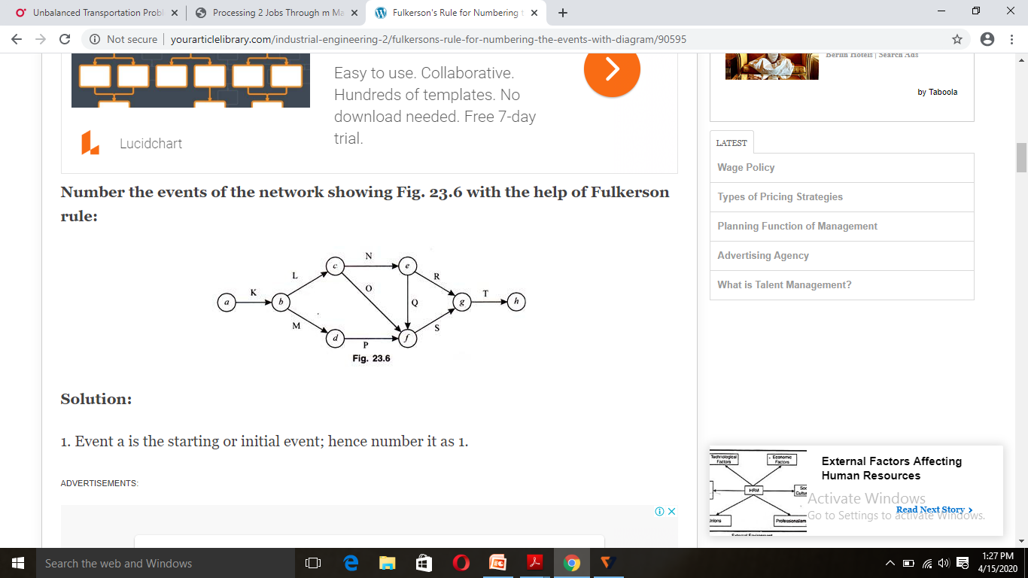
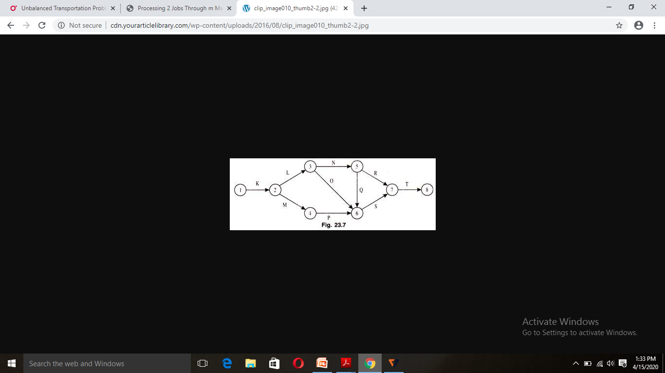

Slide 52
Measurement Of Activity
1. No single activity can be represented more than once in a network. The length of an arrow has no significance.
2. The event numbered 1 is the start event and an event with highest number is the end event. Before an activity can be undertaken, all activities preceding it must be completed. That is, the activities must follow a logical sequence (or interrelationship) between activities.
3. In assigning numbers to events, there should not be any duplication of event numbers in a network.
4. Dummy activities must be used only if it is necessary to reduce the complexity of a network.
5. A network should have only one start event and one end event.

Slide 53
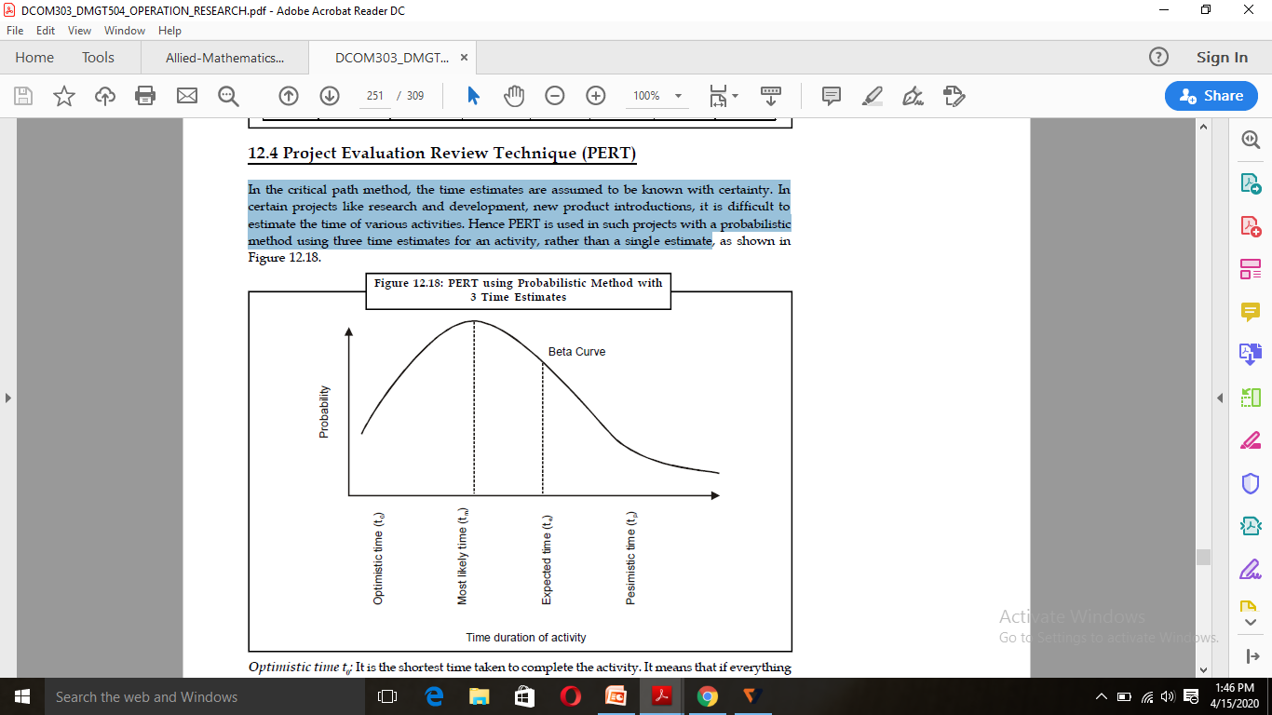
Project Evaluation Review Technique (PERT)
In the critical path method, the time estimates are assumed to be known with certainty. In certain projects like research and development, new product introductions, it is difficult to estimate the time of various activities. Hence PERT is used in such projects with a probabilistic method using three time estimates for an activity, rather than a single estimate.

Slide 54
Optimistic time t0: It is the shortest time taken to complete the activity. It means that if everything goes well then there is more chance of completing the activity within this time.
Most likely time tm: It is the normal time taken to complete an activity, if the activity were frequently repeated under the same conditions.
Pessimistic time tp: It is the longest time that an activity would take to complete. It is the worst time estimate that an activity would take if unexpected problems are faced.

Slide 55
Critical Path Method (CPM)
The critical path for any network is the longest path through the entire network. Since all activities must be completed to complete the entire project, the length of the critical path is also the shortest time allowable for completion of the project. Thus if the project is to be completed in that shortest time, all activities on the critical path must be started as soon as possible. These activities are called critical activities. If the project has to be completed ahead of the schedule, then the time required for at least one of the critical activity must be reduced. Further, any delay in completing the critical activities will increase the project duration.
The activity, which does not lie on the critical path, is called non-critical activity. These non-critical activities may have some slack time. The slack is the amount of time by which the start of an activity may be delayed without affecting the overall completion time of the project. But a critical activity has no slack. To reduce the overall project time, it would require more resources (at extra cost) to reduce the time taken by the critical activities to complete.

Slide 56
PROCEDURE
Step 1: Begin from the start event and move towards the end event.
Step 2: Put TE = 0 for the start event.
Step 3: Go to the next event (i.e. node 2) if there is an incoming activity for event 2, add calculate TE of previous event (i.e. event 1) and activity time. Note: If there are more than one incoming activities, calculate TE for all incoming activities and take the maximum value. This value is the TE for event 2.
Step 4: Repeat the same procedure from step 3 till the end event.

Slide 57
RESOURCE SCHEDULING
One of Visual Planning’s primary concepts is resource scheduling. Basically resource scheduling refers to the set of actions and methodology used by organizations to efficiently assign the resources they have to jobs, tasks or projects they need to complete, and schedule start and end dates for each task or project based on resource availability. Depending on industry, resources can be people (either employees or independent contractors), equipment and machines (this is frequent for construction, manufacturing or maintenance businesses) or rooms and facilities. They may also need for consumable resources (for instance, materials and parts for manufacturing).

Slide 58
Resource scheduling is a key step of project management indeed. When resource availability and work capacity are the primary factors that determine a project’s deadline, project managers sometimes speak of resource-constrained scheduling. But we can often use resource scheduling for simple operation management. It allows managers to outline completion dates for tasks assigned to their teams. Then they can report to stakeholders such as customers or a board of directors.

Slide 59

Steps in resource schduling

