Slide 1
ALGEBRA ,ANALYTICAL GEOMETRY (3D)AND TRIGNOMETRY
UNIT –I
UNIT –II
UNIT -III

Slide 2
BINOMIAL ,EXPONETIAL AND LOGARTHIMIC SERIES
BASIC FORMULA
DEFINITION
EXAMBLES

Slide 6
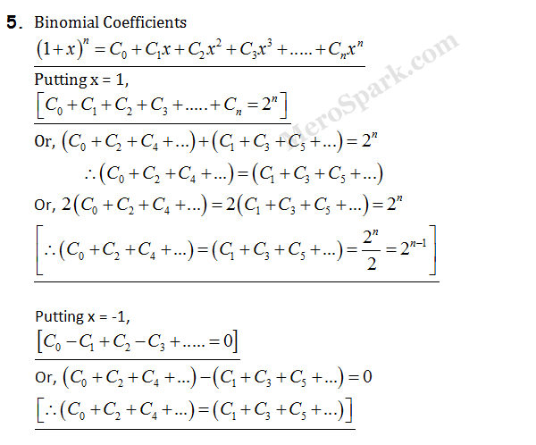

Slide 7
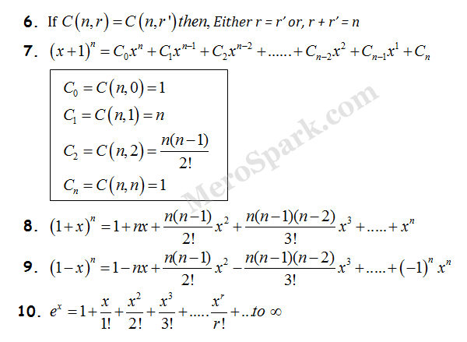

Slide 8
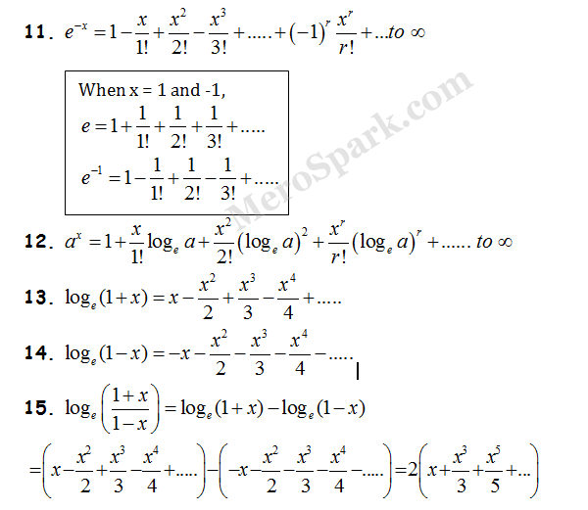

Slide 9
Non-singular Matrix
An n x n(square) matrix A is called non-singular if there exists an n x n matrix B such that AB = BA = I_{n}, where I_{n}, denotes the n x n identity matrix.
If the matrix is non-singular, then its inverse exists.
Properties of non-singular matrix:
If A and B are non-singular matrices of the same order, then AB is non-singular.
If A is non-singular, then Ak is non-singular for any positive integer k.
If A is non-singular and k is a non-zero scalar, then kA is non-singular.

Slide 10
Example of Non-singular Matrix
The determinant of
i.e.
= 6(3) – 5(2) = 18 - 10 = 8 ≠ 0,
so it is a non-singular matrix.

Slide 11
Invertible matrix
In linear algebra, an n-by-n square matrix A is called invertible (also nonsingular or nondegenerate) if there exists an n-by-n square matrix B such that
AB =BA=$I_{n}$
where I_{n} denotes the n-by-n identity matrix and the multiplication used is ordinary matrix multiplication. If this is the case, then the matrix B is uniquely determined by A and is called the inverse of A, denoted by A⁻¹.
A square matrix that is not invertible is called singular or degenerate.
A square matrix is singular if and only if its determinant is zero. Singular matrices are rare in the sense that the probability that a square matrix whose real or complex entries are randomly selected from any finite region in the number line or complex plane is singular is 0, that is, it will "almost never" be singular.

Slide 12
The invertible matrix theorem
Let A be a square n by n matrix over a field K (for example the field R of real numbers). The following statements are equivalent, that is, for any given matrix they are either all true or all false:
A is invertible, that is, A has an inverse, is nonsingular, or is nondegenerate.
A is row-equivalent to the n-by-n identity matrix I_{n}.
A is column-equivalent to the n-by-n identity matrix I_{n}.
A has n pivot positions.
det A ≠ 0. In general, a square matrix over a commutative ring is invertible if and only if its determinant is a unit in that ring.
A has full rank; that is, rank A = n.
The equation Ax = 0 has only the trivial solution x = 0.
The kernel of A is trivial, that is, it contains only the null vector as an element, ker(A) = {0}.
The equation Ax = b has exactly one solution for each b in K^{n}.
The columns of A are linearly independent.
The columns of A span K^{n}.
Col A = K^{n}.
The columns of A form a basis of K^{n}.
The linear transformation mapping x to Ax is a bijection from K^{n} to K^{n}.
There is an n-by-n matrix B such that AB = I_{n} = BA.
The transpose A^{T} is an invertible matrix (hence rows of A are linearly independent, span K^{n}, and form a basis of K^{n}).
The number 0 is not an eigenvalue of A.
The matrix A can be expressed as a finite product of elementary matrices.
The matrix A has a left inverse (that is, there exists a B such that BA = I) or a right inverse (that is, there exists a C such that AC = I), in which case both left and right inverses exist and B = C = A⁻¹.

Slide 13
properties
Furthermore, the following properties hold for an invertible matrix A:
(A⁻¹)⁻¹ = A;
(kA)⁻¹ = k⁻¹A⁻¹ for nonzero scalar k;
(Ax)⁺ = x⁺A⁻¹ if A has orthonormal columns, where ⁺ denotes the Moore–Penrose inverse and x is a vector;
(A^{T})⁻¹ = (A⁻¹)^{T};
For any invertible n-by-n matrices A and B, (AB)⁻¹ = B⁻¹A⁻¹. More generally, if A₁, ..., A_{k} are invertible n-by-n matrices, then (A₁A₂⋅⋅⋅A_{k−1}A_{k})⁻¹ = A⁻¹ _{k}A⁻¹ _{k−1}⋯A⁻¹ ₂A⁻¹ ₁;
det A⁻¹ = (det A)⁻¹.
The rows of the inverse matrix V of a matrix U are orthonormal to the columns of U (and vice versa interchanging rows for columns). To see this, suppose that UV = VU = I where we write the rows of V as and the columns of U as for . Then clearly, the Euclidean inner product of any two . This property can also be useful in constructing the inverse of a square matrix in some instances where a set of orthogonal vectors (but not necessarily orthonormal vectors) to the columns of U are known and then applying the iterative Gram–Schmidt process to this initial set to determine the rows of the inverse V.
A matrix that is its own inverse, that is, such that A = A⁻¹ and A² = I, is called an involutory matrix.

Slide 14
The Cayley-Hamilton Theorem) If p(t)p(t) is the characteristic polynomial for an n×n matrix A,
then the matrix p(A) is the n×n zero matrix.
Example
Let A=$\left(\begin{matrix}1 & 1 \\ 1 & 3\end{matrix}\right)$
Solution:
A=$\left(\begin{matrix}1 & 1 \\ 1 & 3\end{matrix}\right)$ . The characteristic polynomial p(t) of A is
p(t)=det(A−tI)
=$\left(\begin{matrix}1−t & 1 \\ 1 & 3−t\end{matrix}\right)$
=t²−4t+2
Then the Cayley-Hamilton theorem says that the matrix
p(A)=A²−4A+2I is the 2×2 zero matrix.
In fact, we can directly check this:
p(A)=A²−4A+2I

Slide 15
Circle Definition
A circle is a closed two-dimensional figure in which the set of all the points in the plane is equidistant from a given point called “centre”. Every line that passes through the circle forms the line of reflection symmetry. Also, it has rotational symmetry around the centre for every angle.
The circle formula in the plane is given as:
(x-h)² + (y-k)² = r²
where (x,y) are the coordinate points (h,k) is the coordinate of the centre of a circle and r is the radius of a circle.

Slide 16
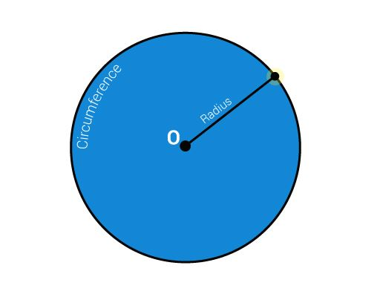
How to draw a circle
In maths projects for class 10 on circles, the construction of a circle and all the properties and terminologies are explained in detail. To understand what circles are in simple terms, go through circles for class 10, and also try the following exercise –
Take an empty sheet of paper and just mark a single point on the sheet, somewhere in the middle of the sheet, and name it to point O.
Select a random length for radius, for example, 3 cm.
Using a ruler, keep the reference zero mark on point O and randomly mark 3cm away from point O in all the direction.
Mark as many points as u want away from point O, but all of them should be exactly 3 cm away from point O.

Slide 17
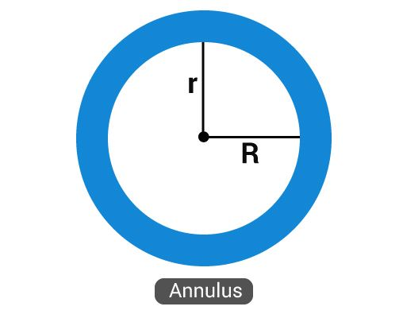
Circles Terminologies
Annulus-The region bounded by two concentric circles. It is basically a ring-shaped object. See the figure below.
. Arc – It is basically the connected curve of a circle
Sector – A region bounded by two radii and an arc.
Segment- A region bounded by a chord and an arc lying between the chord’s endpoints. It is to be noted that segments do not contain the centre.

Slide 18
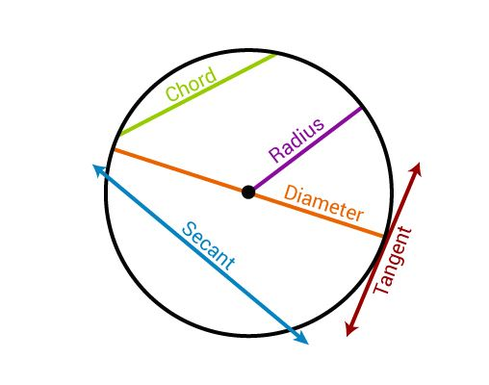
Centre – It is the midpoint of a circle.
Chord- A line segment whose endpoints lie on the circle
Diameter- A line segment having both the endpoints on the circle
Radius- A line segment connecting the centre of a circle to any point on the circle itself.
Secant- A straight line cutting the circle at two points. It is also called as an extended chord.
Tangent- A coplanar straight line touching the circle at a single point.
See the figure below-representing the centre, chord, diameter, radius, secant and tangent of a circle.

Slide 19
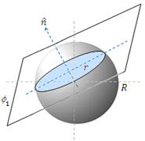
Spher and plane intersection
Plane:
Ax + By + Cz + D = 0
Spher:
(x - x_{s})² + (y - y_{s})² + (z - z_{s})² = R²
Note: the intersection of a plane and a sphere always forms a circle in the direction of the normal vector to the plane, and an ellipses on the projections on the x, y, z axes.

Slide 20
EXAMPLE
Find the radius of the circle intersected by the plane x + 4y + 5z + 6 = 0 and the sphere
(x − 1)² + (y + 1)² + (z − 3)² = 9
So the equation of the parametric line which passes through the sphere center and is normal to the plane is:
L = {(x, y, z): x = 1 + t y = − 1 + 4t z = 3 + 5t}
This line passes through the circle center formed by the plane and sphere intersection, in order to find the center point of the circle we substitute the line equation into the plane equation
1 + t + 4(− 1 + 4t) + 5(3 + 5t) + 6 = 0
After solving for t we get the value: t = − 0.43
And the circle center point is at: (1 − 0.43 , − 1 − 4*0.43 , 3 − 5*0.43) = (0.57 , − 2.71 , 0.86)
The vector normal to the plane is: | n = i + 4j + 5k
The center of the sphere is at point: | (1 , − 1 , 3)
The distance of this point to the sphere center is:
And the intersected circle radius is:

