Slide 1
Relational Model
Unit-II

Slide 2
Example of a Relation
s.no | name | age | mark
1 | x | 12 | 45
2 | y | 34 | 54
3 | z | 36 | 67
4 | w | 34 | 45
Attributes
Tuples

Slide 3
Attribute Types
The set of allowed values for each attribute is called the domain of the attribute
Attribute values are (normally) required to be atomic; that is, indivisible
The special value null is a member of every domain
The null value causes complications in the definition of many operations

Slide 4
Relation Schema and Instance
A₁, A₂, …, A_{n} are attributes
R = (A₁, A₂, …, A_{n} ) is a relation schema
Example: instructor = (ID, name, dept_name, salary)
Formally, given sets D₁, D₂, …. D_{n} a relation r is a subset of D₁ x D₂ x … x D_{n}
Thus, a relation is a set of n-tuples (a₁, a₂, …, a_{n}) where each a_{i} ∈ D_{i}
The current values (relation instance) of a relation are specified by a table
An element t of r is a tuple, represented by a row in a table

Slide 5
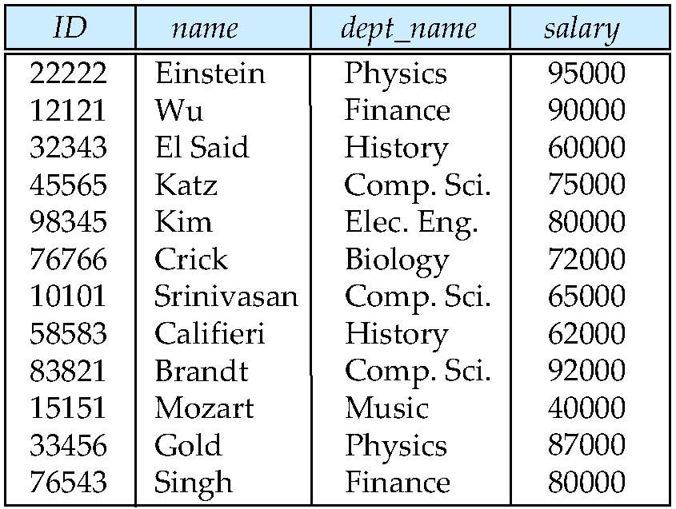
Relations are Unordered
Order of tuples is irrelevant (tuples may be stored in an arbitrary order)
Example: instructor relation with unordered tuples

Slide 6
Database
A database consists of multiple relations
Information about an enterprise is broken up into parts
instructor
student
advisor
Bad design:
univ (instructor -ID, name, dept_name, salary, student_Id, ..)
results in
  repetition of information (e.g., two students have the same instructor)
  the need for null values (e.g., represent an student with no advisor)

Slide 7
Keys
Let K ⊆ R
K is a superkey of R if values for K are sufficient to identify a unique tuple of each possible relation r(R)
  Example: {ID} and {ID,name} are both superkeys of instructor.
Superkey K is a candidate key if K is minimal
Example: {ID} is a candidate key for Instructor
One of the candidate keys is selected to be the primary key.
  Unique, Not Null
Foreign key constraint: Value in one relation must appear in another
  Referencing relation
  Referenced relation

Slide 8
Relational Query Languages
Procedural vs.non-procedural, or declarative
“Pure” languages:
  Relational algebra
  Tuple relational calculus
  Domain relational calculus
Relational operators

Slide 9
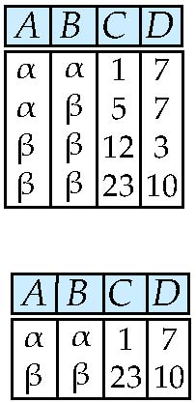
Selection of tuples
Relation r
Select tuples with A=B and D > 5
σ _{A=B and D > 5} (r)

Slide 10
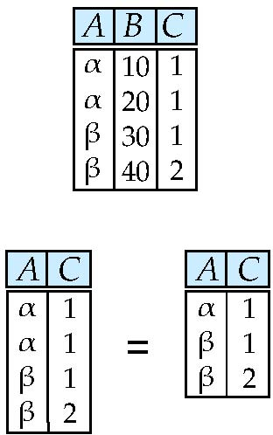
Selection of Columns (Attributes)
Relation r:
Select A and C
  Projection
  Π _{A, C} (r)

Slide 11
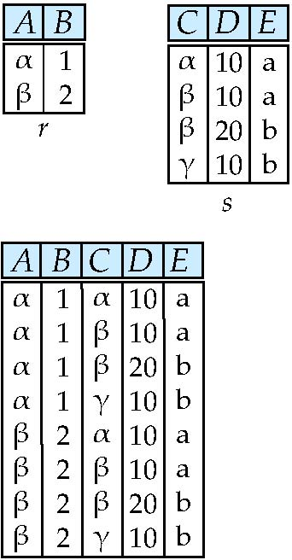
Joining two relations – Cartesian Product
Relations r, s:
r x s:

Slide 12
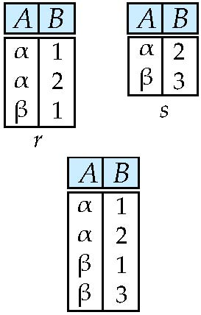
Union of two relations
Relations r, s:
r ∪ s:

Slide 13
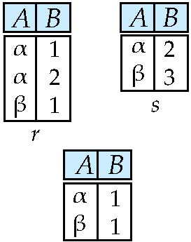
Set difference of two relations
Relations r, s:
r – s:

Slide 14
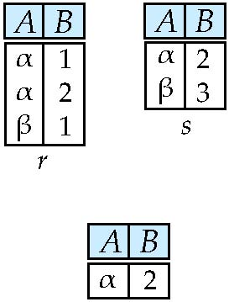
Set Intersection of two relations
Relation r, s:
r ∩ s

Slide 15
Joining two relations – Natural Join
Let r and s be relations on schemas R and S respectively.
Then, the “natural join” of relations R and S is a relation on schema R ∪ S obtained as follows:
  Consider each pair of tuples t_{r} from r and t_{s} from s.
  If t_{r} and t_{s} have the same value on each of the attributes in R ∩ S, add a tuple t to the result, where
    t has the same value as t_{r} on r
    t has the same value as t_{s} on s

Slide 16
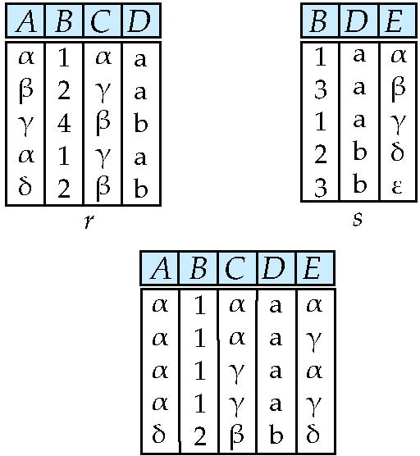
Natural Join Example
Relations r, s:
Natural Join
  r s

Slide 17
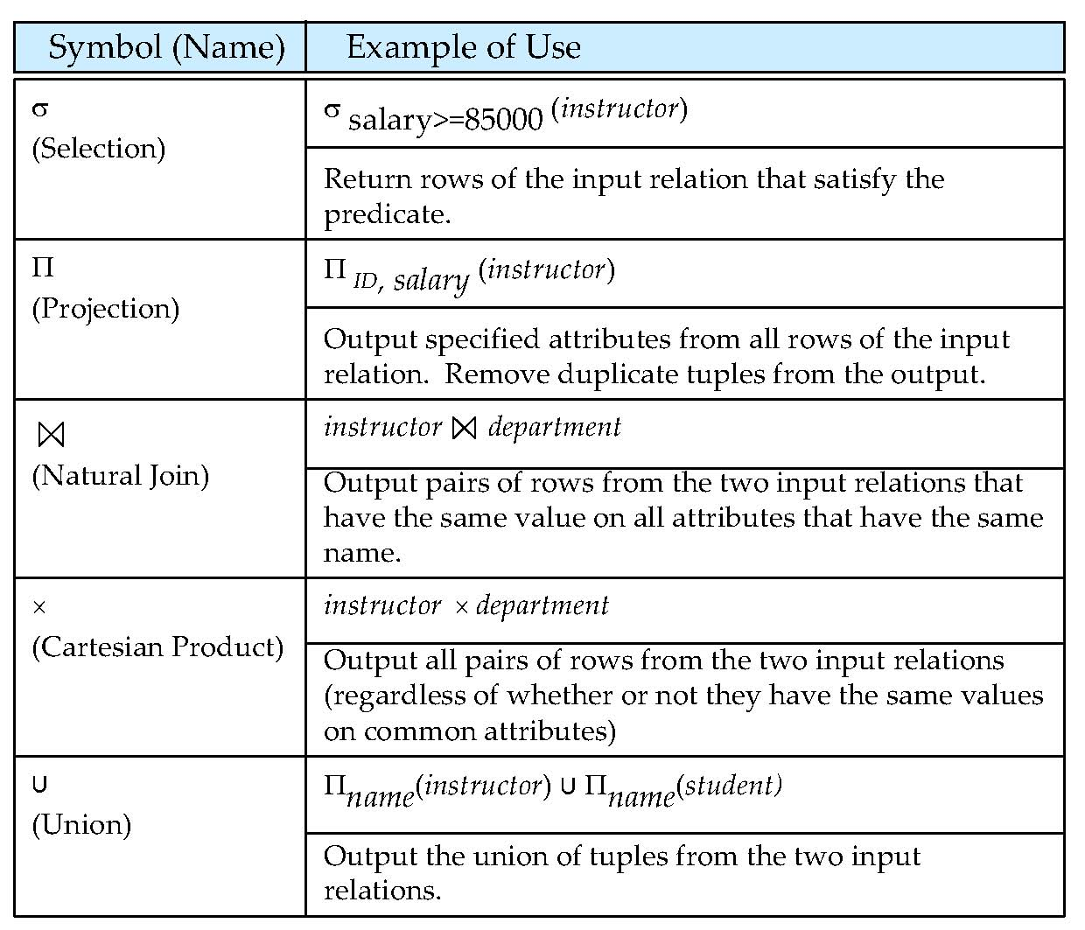
Relational operation

Slide 18
Formal Relational Query Languages

Slide 19
Formal Relational Query Languages Types
Relational Algebra
Tuple Relational Calculus
Domain Relational Calculus

Slide 20
Relational Algebra
Procedural language
Six basic operators
  select: σ
  project: ∏
  union: ∪
  set difference: –
  Cartesian product: x
  rename: ρ
The operators take one or two relations as inputs and produce a new relation as a result.

Slide 21
Select Operation – Example
Relation r
σ_{A=B ^ D > 5} (r)

Slide 22
Select Operation
Notation: σ _{p}(r)
p is called the selection predicate
Defined as:
σ_{p}(r) = {t | t ∈ r and p(t)}
Where p is a formula in propositional calculus consisting of terms connected by : ∧ (and), ∨ (or), ¬ (not)
Each term is one of:
<attribute> op <attribute> or <constant>
where op is one of: =, ≠, >, ≥. <. ≤
Example of selection:
σ _{dept_name=“Physics”}(instructor)

Slide 23
Project Operation – Example
Relation r:
∏_{A,C} (r)

Slide 24
Project Operation
Notation:
where A₁, A₂ are attribute names and r is a relation name.
The result is defined as the relation of k columns obtained by erasing the columns that are not listed
Duplicate rows removed from result, since relations are sets
Example: To eliminate the dept_name attribute of instructor ∏_{ID, name, salary} (instructor)

Slide 25
Union Operation – Example
Relations r, s:
r ∪ s:

Slide 26
Union Operation
Notation: r ∪ s
Defined as:
r ∪ s = {t | t ∈ r or t ∈ s}
For r ∪ s to be valid.
1. r, s must have the same arity (same number of attributes)
2. The attribute domains must be compatible (example: 2nd column
of r deals with the same type of values as does the 2nd
column of s)
Example: to find all courses taught in the Fall 2009 semester, or in the Spring 2010 semester, or in both
∏_{course_id} (σ _{semester=“Fall” Λ year=2009} (section)) ∪
∏_{course_id} (σ _{semester=“Spring” Λ year=2010} (section))

Slide 27
Set difference of two relations
Relations r, s:
r – s:

Slide 28
Set Difference Operation
Notation r – s
Defined as:
r – s = {t | t ∈ r and t ∉ s}
Set differences must be taken between compatible relations.
  r and s must have the same arity
  attribute domains of r and s must be compatible
Example: to find all courses taught in the Fall 2009 semester, but not in the Spring 2010 semester
∏_{course_id} (σ _{semester=“Fall” Λ year=2009} (section)) −
∏_{course_id} (σ _{semester=“Spring” Λ year=2010} (section))

Slide 29
Cartesian-Product Operation – Example
Relations r, s:
r x s:

Slide 30
Cartesian-Product Operation
Notation r x s
Defined as:
r x s = {t q | t ∈ r and q ∈ s}
Assume that attributes of r(R) and s(S) are disjoint. (That is, R ∩ S = ∅).
If attributes of r(R) and s(S) are not disjoint, then renaming must be used.

Slide 31
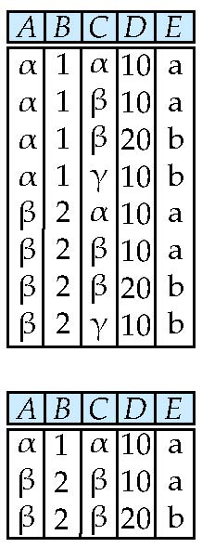
Composition of Operations
Can build expressions using multiple operations
Example: σ_{A=C}(r x s)
r x s
σ_{A=C}(r x s)

Slide 32
Rename Operation
Allows us to name, and therefore to refer to, the results of relational-algebra expressions.
Allows us to refer to a relation by more than one name.
Example:
ρ _{x} (E)
returns the expression E under the name X
If a relational-algebra expression E has arity n, then
returns the result of expression E under the name X, and with the
attributes renamed to A₁ , A₂ , …., A_{n} .

Slide 33
Example Query
Find the largest salary in the university
  Step 1: find instructor salaries that are less than some other instructor salary (i.e. not maximum)
      using a copy of instructor under a new name d
    ∏_{instructor.salary} (σ _{instructor.salary < d,salary}
    (instructor x ρ_{d} (instructor)))
  Step 2: Find the largest salary
    ∏_{salary} (instructor) –
    ∏_{instructor.salary} (σ _{instructor.salary < d,salary}
    (instructor x ρ_{d} (instructor)))

Slide 34
Example Queries
Find the names of all instructors in the Physics department, along with the course_id of all courses they have taught
  Query 1
  ∏_{instructor.ID,course_id} (σ_{dept_name=“Physics”} (
  σ _{instructor.ID=teaches.ID} (instructor x teaches)))
  Query 2
  ∏_{instructor.ID,course_id} (σ_{instructor.ID=teaches.ID} (
  σ _{dept_name=“Physics”} (instructor) x teaches))

Slide 35
Formal Definition
A basic expression in the relational algebra consists of either one of the following:
  A relation in the database
  A constant relation
Let E₁ and E₂ be relational-algebra expressions; the following are all relational-algebra expressions:
  E₁ ∪ E₂
  E₁ – E₂
  E₁ x E₂
  σ_{p} (E₁), P is a predicate on attributes in E₁
  ∏_{s}(E₁), S is a list consisting of some of the attributes in E₁
  ρ _{x} (E₁), x is the new name for the result of E₁

Slide 36
Additional Operations
We define additional operations that do not add any power to the
relational algebra, but that simplify common queries.
Set intersection
Natural join
Assignment
Outer join

Slide 37
Set-Intersection Operation
Notation: r ∩ s
Defined as:
r ∩ s = { t | t ∈ r and t ∈ s }
Assume:
  r, s have the same arity
  attributes of r and s are compatible
Note: r ∩ s = r – (r – s)

Slide 38
Set-Intersection Operation – Example
Relation r, s:
r ∩ s

Slide 39
Natural-Join Operation
Notation: r s
Let r and s be relations on schemas R and S respectively.
Then, r s is a relation on schema R ∪ S obtained as follows:
  Consider each pair of tuples t_{r} from r and t_{s} from s.
  If t_{r} and t_{s} have the same value on each of the attributes in R ∩ S, add a tuple t to the result, where
    t has the same value as t_{r} on r
    t has the same value as t_{s} on s
Example:
  R = (A, B, C, D)
  S = (E, B, D)
  Result schema = (A, B, C, D, E)
  r s is defined as:
  ∏_{r.A, r.B, r.C, r.D, s.E} (σ_{r.B = s.B ∧ r.D = s.D} (r x s))

Slide 40
Natural Join Example
Relations r, s:
r s

Slide 41
Natural Join and Theta Join
Find the names of all instructors in the Comp. Sci. department together with the course titles of all the courses that the instructors teach
  ∏ _{name, title} (σ _{dept_name=“Comp. Sci.”} (instructor teaches course))
Natural join is associative
  (instructor teaches) course is equivalent to
  instructor (teaches course)
Natural join is commutative
  instruct teaches is equivalent to
  teaches instructor
The theta join operation r _{θ} s is defined as
  r _{θ} s = σ_{θ} (r x s)

Slide 42
Assignment Operation
The assignment operation (←) provides a convenient way to express complex queries.
  Write query as a sequential program consisting of
    a series of assignments
    followed by an expression whose value is displayed as a result of the query.
  Assignment must always be made to a temporary relation variable.

Slide 43
Outer Join
An extension of the join operation that avoids loss of information.
Computes the join and then adds tuples form one relation that does not match tuples in the other relation to the result of the join.
Uses null values:
  null signifies that the value is unknown or does not exist
  All comparisons involving null are (roughly speaking) false by definition.
    We shall study precise meaning of comparisons with nulls later

Slide 44
Outer Join – Example
Relation instructor1
ID
name
dept_name
10101
12121
15151
Srinivasan
Wu
Mozart
Comp. Sci.
Finance
Music
Relation teaches1
ID
course_id
10101
12121
76766
CS-101
FIN-201
BIO-101

Slide 45
Outer Join – Example
Join
instructor teaches
ID
name
dept_name
course_id
10101
12121
Srinivasan
Wu
Comp. Sci.
Finance
CS-101
FIN-201
Left Outer Join
instructor teaches
ID
name
dept_name
course_id
10101
12121
15151
Srinivasan
Wu
Mozart
Comp. Sci.
Finance
Music
CS-101
FIN-201
null

Slide 46
Outer Join – Example
Right Outer Join
instructor teaches
ID
name
dept_name
course_id
10101
12121
76766
Srinivasan
Wu
null
Comp. Sci.
Finance
null
CS-101
FIN-201
BIO-101
Full Outer Join
instructor teaches
ID
name
dept_name
course_id
10101
12121
15151
76766
Srinivasan
Wu
Mozart
null
Comp. Sci.
Finance
Music
null
CS-101
FIN-201
null
BIO-101

Slide 47
Outer Join using Joins
Outer join can be expressed using basic operations
  e.g. r s can be written as
  (r s) U (r – ∏_{R}(r s) x {(null, …, null)}

Slide 48
Null Values
It is possible for tuples to have a null value, denoted by null, for some of their attributes
null signifies an unknown value or that a value does not exist.
The result of any arithmetic expression involving null is null.
Aggregate functions simply ignore null values (as in SQL)
For duplicate elimination and grouping, null is treated like any other value, and two nulls are assumed to be the same (as in SQL)

Slide 49
Null Values
Comparisons with null values return the special truth value: unknown
  If false was used instead of unknown, then not (A < 5)
  would not be equivalent to A >= 5
Three-valued logic using the truth value unknown:
  OR: (unknown or true) = true,
  (unknown or false) = unknown
  (unknown or unknown) = unknown
  AND: (true and unknown) = unknown,
  (false and unknown) = false,
  (unknown and unknown) = unknown
  NOT: (not unknown) = unknown
  In SQL “P is unknown” evaluates to true if predicate P evaluates to unknown
Result of select predicate is treated as false if it evaluates to unknown

Slide 50
Division Operator
Given relations r(R) and s(S), such that S ⊂ R, r ÷ s is the largest relation t(R-S) such that
t x s ⊆ r
E.g. let r(ID, course_id) = ∏_{ID, course_id} (takes ) and
s(course_id) = ∏_{course_id} (σ_{dept_name=“Biology”}(course )
then r ÷ s gives us students who have taken all courses in the Biology department
Can write r ÷ s as
temp1 ← ∏_{R-S} (r )
temp2 ← ∏_{R-S} ((temp1 x s ) – ∏_{R-S,S} (r ))
result = temp1 – temp2
  The result to the right of the ← is assigned to the relation variable on the left of the ←.
  May use variable in subsequent expressions.

Slide 51
Extended Relational-Algebra-Operations
Generalized Projection
Aggregate Functions

Slide 52
Generalized Projection
Extends the projection operation by allowing arithmetic functions to be used in the projection list.
E is any relational-algebra expression
Each of F₁, F₂, …, F_{n} are are arithmetic expressions involving constants and attributes in the schema of E.
Given relation instructor(ID, name, dept_name, salary) where salary is annual salary, get the same information but with monthly salary
∏_{ID, name, dept_name, salary/12} (instructor)

Slide 53

Aggregate Functions and Operations
Aggregation function takes a collection of values and returns a single value as a result.
avg: average value
min: minimum value
max: maximum value
sum: sum of values
count: number of values
Aggregate operation in relational algebra
E is any relational-algebra expression
  G₁, G₂ …, G_{n} is a list of attributes on which to group (can be empty)
  Each F_{i} is an aggregate function
  Each A_{i} is an attribute name
Note: Some books/articles use γ instead of (Calligraphic G)

Slide 54
Aggregate Operation – Example
A
B
C
Relation r:
α
α
β
β
α
β
β
β
7
7
3
10
_{sum(c)} (r)
sum(c )
27

Slide 55
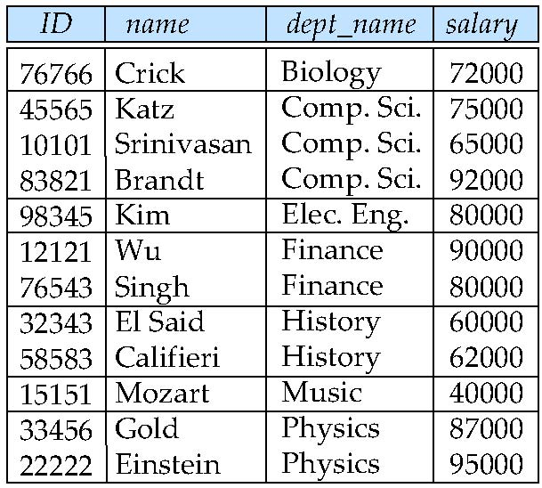
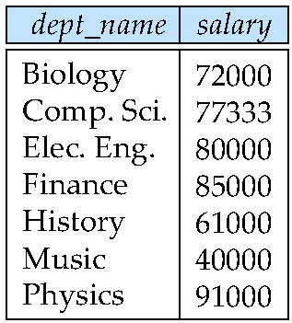
Aggregate Operation – Example
Find the average salary in each department
_{dept_name} _{avg(salary)} (instructor)
avg_salary

Slide 56
Aggregate Functions (Cont.)
Result of aggregation does not have a name
  Can use rename operation to give it a name
  For convenience, we permit renaming as part of aggregate operation
_{dept_name} _{avg(salary) as avg_sal} (instructor)

Slide 57
Modification of the Database
The content of the database may be modified using the following operations:
  Deletion
  Insertion
  Updating
All these operations can be expressed using the assignment operator

Slide 58
Multiset Relational Algebra
Pure relational algebra removes all duplicates
  e.g. after projection
Multiset relational algebra retains duplicates, to match SQL semantics
  SQL duplicate retention was initially for efficiency, but is now a feature
Multiset relational algebra defined as follows
  selection: has as many duplicates of a tuple as in the input, if the tuple satisfies the selection
  projection: one tuple per input tuple, even if it is a duplicate
  cross product: If there are m copies of t1 in r, and n copies of t2 in s, there are m x n copies of t1.t2 in r x s
  Other operators similarly defined
    E.g. union: m + n copies, intersection: min(m, n) copies
    difference: min(0, m – n) copies

Slide 59
SQL and Relational Algebra
select A1, A2, .. An
from r1, r2, …, rm
where P
is equivalent to the following expression in multiset relational algebra
∏ _{A1, .., An} (σ _{P} (r1 x r2 x .. x rm))
select A1, A2, sum(A3)
from r1, r2, …, rm
where P
group by A1, A2
is equivalent to the following expression in multiset relational algebra
_{A1, A2} _{sum(A3)} (σ _{P} (r1 x r2 x .. x rm)))

Slide 60
SQL and Relational Algebra
More generally, the non-aggregated attributes in the select clause may be a subset of the group by attributes, in which case the equivalence is as follows:
select A1, sum(A3)
from r1, r2, …, rm
where P
group by A1, A2
is equivalent to the following expression in multiset relational algebra
∏ _{A1,sumA3}( _{A1,A2} _{sum(A3)} _{as sumA3}(σ _{P} (r1 x r2 x .. x rm)))

Slide 61
Deletion
A delete request is expressed similarly to a query, except instead of displaying tuples to the user, the selected tuples are removed from the database.
Can delete only whole tuples; cannot delete values on only particular attributes
A deletion is expressed in relational algebra by:
r ← r – E
where r is a relation and E is a relational algebra query.

Slide 62
Deletion Examples
Delete all account records in the Perryridge branch.
account ← account – σ _{branch_name = “Perryridge”} (account )
Delete all loan records with amount in the range of 0 to 50
loan ← loan – σ _{amount ≥ 0 and amount ≤ 50} (loan)
Delete all accounts at branches located in Needham.
r₁ ← σ _{branch_city = “Needham”} (account branch )
r₂ ← ∏ _{account_number,} _{branch_name, balance} (r₁)
r₃ ← ∏ _{customer_name, account_number} (r₂ depositor)
account ← account – r₂
depositor ← depositor – r₃

Slide 63
Insertion
To insert data into a relation, we either:
  specify a tuple to be inserted
  write a query whose result is a set of tuples to be inserted
in relational algebra, an insertion is expressed by:
r ← r ∪ E
where r is a relation and E is a relational algebra expression.
The insertion of a single tuple is expressed by letting E be a constant relation containing one tuple.

Slide 64
Insertion Examples
Insert information in the database specifying that Smith has $1200 in account A-973 at the Perryridge branch.
account ← account ∪ {(“A-973”, “Perryridge”, 1200)}
depositor ← depositor ∪ {(“Smith”, “A-973”)}
Provide as a gift for all loan customers in the Perryridge
branch, a $200 savings account. Let the loan number serve
as the account number for the new savings account.
r₁ ← (σ_{branch_name = “Perryridge”} (borrower loan))
account ← account ∪ ∏_{loan_number, branch_name, 200} (r₁)
depositor ← depositor ∪ ∏_{customer_name, loan_number} (r₁)

Slide 65
Updating
A mechanism to change a value in a tuple without charging all values in the tuple
Use the generalized projection operator to do this task
Each F_{i} is either
  the I ^{th} attribute of r, if the I ^{th} attribute is not updated, or,
  if the attribute is to be updated F_{i} is an expression, involving only constants and the attributes of r, which gives the new value for the attribute

Slide 66
Update Examples
Make interest payments by increasing all balances by 5 percent.
account ← ∏ account_number, branch_name, balance * 1.05 (account)
Pay all accounts with balances over $10,000 6 percent interest
and pay all others 5 percent
account ← ∏ account_number, branch_name, balance * 1.06 (σ _{BAL > 10000} (account ))
∪ ∏ account_number, branch_name, balance * 1.05 (σ_{BAL ≤ 10000} (account))

Slide 67
Example Queries
Find the names of all customers who have a loan and an account at bank.
  ∏_{customer_name} (borrower) ∩ ∏_{customer_name} (depositor)
Find the name of all customers who have a loan at the bank and the loan amount
  ∏customer_name, loan_number, amount (borrower loan)

