Slide 1
Fashion clothing and psychology Unit-4 Fashion forecasting
A.LAKSHIKA, ASSISTANT PROFFESSSOR, DEPARTMENT OF FASHION TECHNOLOGY AND COSTUME DESIGNING, BON SECOURS ARTS AND SCIENCE COLLEGE FOR WOMEN, MANNARGUDI

Slide 2
WHAT IS FASHION FORECASTING?

Slide 3
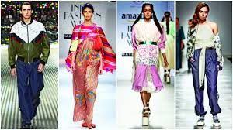
FASHION FORECASTING
Fashion forecasting is the prediction of mood, behaviour and buying habits of the consumer. It is no longer a question of identifying your customers by age, geography or income, but looking into how and why they buy, based on their mood, beliefs and the occasion.

Slide 4
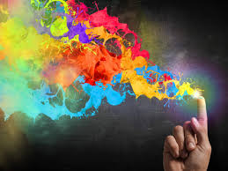
COLOUR
It’s an essential part of our daily life that we often we take for granted. Colour gives meaning and emotion to life, but it’s often the furthest thing from people’s minds. Believe it or not, professionals from around the world gather to chat and strategize about the ways colour defines our lives.

Slide 5
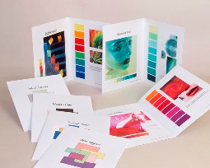
COLOUR FORECASTING
Colour forecasting is the practice of predicting the colours and colour stories that consumers will want to purchase in the near future. And it’s just not in the fashion realm where colour is king: manufacturers in the automotive, home décor, consumer goods, materials, and even food industries use colour forecasting.

Slide 6
COLOUR FORECASTING PROCESS
Designers and colour experts meet to collaborate on future colour trends
They use research from field reports, consumer surveys, and product split tests as a quantitative basis as their starting point.
Colour designers delve into tradeshow research, news media, economic temperature, POP culture, and more to support emerging colour stories two years ahead.
They create mood boards, which are a collection of images, words, or art that evoke a certain emotion supporting the emerging color’s story
Color, Materials, and Finishes (CMF) designers go a step further, creating certain finishes that complete their color stories, which they can use during the product design phase.

Slide 7
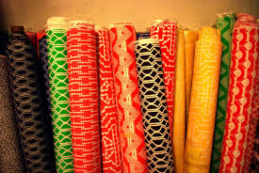
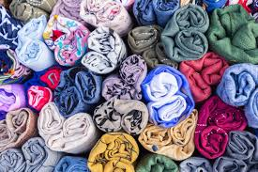
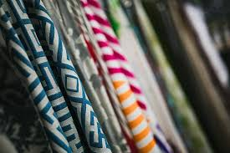
FABRICS

Slide 8
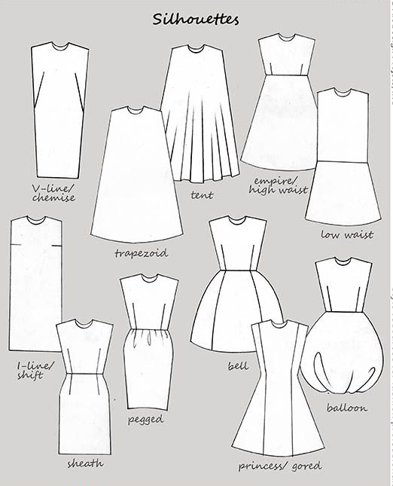
SILHOUTTES

Slide 9
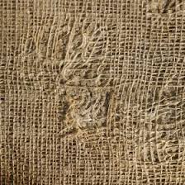
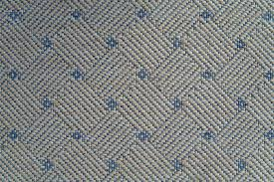
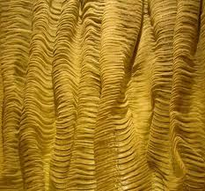
TEXTURE

Slide 10
