Slide 1
Differential equation and Laplace Transform
UNIT – IV
UNIT- V

Slide 2
PARTIAL DIFFERENTIAL EQUATIONS OF SECOND ORDER INTRODUCTION:
An equation is said to be of order two, if it involves at least one of the differential coefficients
r = (𝜕 ² z / 𝜕 ² x), s = (𝜕 ² z / 𝜕x 𝜕y), t =(𝜕 ² z / 𝜕 ² y),
but now of higher order; the quantities p and q may also enter into the equation
Thus the general form of a second order Partial differential equation is
𝑓( 𝑥, 𝑦, 𝑧, 𝑝, 𝑞, 𝑟, 𝑠,𝑡) = 0……….. ...(1)
The most general linear partial differential equation of order two in two independent variables x and y with variable coefficients is of the form
𝑅𝑟 + 𝑆𝑠 + 𝑇𝑡 + 𝑃𝑝 + 𝑄𝑞 + 𝑍𝑧 = 𝐹 ...... . (2)
where 𝑅, 𝑆, 𝑇, 𝑃,𝑄, 𝑍, 𝐹 are functions of 𝑥 and 𝑦 only and not all 𝑅, 𝑆, 𝑇 are zero. E where ∅₁(𝑦) is an arbitrary function of 𝑦.
Integrating (2)
w. r. t. we get
𝑥 𝑧 = 𝑥 ³ + 𝑥 ∅₁(𝑦) + ∅₂(𝑦)
where ∅₂(y) is an arbitrary function of y.

Slide 3
Example:
𝑎𝑟 = 𝑥𝑦
Sol: Given equation can be written as
𝜕 ² 𝑧/ 𝜕𝑥 ² = (1 /𝑎) (𝑥/𝑦) ……………...(1)
Integrating (1) w. r. t., 𝑥,
we get
𝜕𝑧/ 𝜕𝑥 = (𝑦/ 𝑎 )( 𝑥 ²/2) + ∅₁(y) ………..(2)
where ∅₁(y) is an arbitrary function of y Integrating (2)
w. r. t.X,
z = (𝑦/ 𝑎) 3/ 6 + x ∅₁(y) + ∅₂(y) w. r. t.Y
we get 𝑥 𝑧 = 𝑥 ³ + 𝑥 ∅₁(𝑦) + ∅₂(𝑦) where
∅²(Y) is an arbitrary function of y.

Slide 4
[𝐴_{𝑛}𝐷 ^{𝑛} + 𝐴_{𝑛−1}𝐷 _{𝑛−1}𝐷 ′ + 𝐴_{𝑛−2}𝐷 _{𝑛−2}𝐷′ ² + ⋯ + 𝐴₁𝐷′ ^{𝑛} ]𝑧 = 0 …(3) or
𝜑[ 𝐷,𝐷′ ]𝑧 = 0
Let 𝑧 = 𝐹 𝑦 + 𝑚𝑥 be the part of the solution
𝐷𝑧 = 𝜕𝑧/ 𝜕𝑥 = 𝑚𝐹 ′( 𝑦 + 𝑚𝑥) 𝐷 2 𝑧 = 𝜕 ² 𝑧/ 𝜕𝑥 2 = 𝑚₂𝐹 ′′ (𝑦 + 𝑚𝑥)
.. .. .. ...
.. .. .. ...
.. .. .. .
And
𝐷 ′ 𝑧 = 𝜕𝑧/ 𝜕𝑦 = 𝐹 ′( 𝑦 + 𝑚𝑥)
𝐷 ′² 𝑧 = 𝜕 ² 𝑧 /𝜕𝑦 ² = 𝐹 ′′( 𝑦 + 𝑚𝑥)
... ... ...
... ... ...
... ... ...
… ... ...
𝐷 ′^{𝑛} 𝑧 = 𝜕 ^{𝑛} 𝑧 /𝜕𝑦 ^{𝑛} = 𝐹 ^{𝑛} (𝑦 + 𝑚𝑥)
Substitute these values in (3),

Slide 5
we get
𝐴_{𝑛}𝑚^{𝑛} + 𝐴_{𝑛−1}𝑚^{𝑛−1} + 𝐴_{𝑛−2}𝑚_{𝑛−2} + . . . + 𝐴₁ 𝐹 ^{𝑛} (𝑦 + 𝑚𝑥) = 0
which is true if ′𝑚′ is a root of the equation If 𝑚₁ , 𝑚₂ , 𝑚_{𝑛} , are distinct roots,
then complementary functions is
𝑧 = 𝜑₁ 𝑦 + 𝑚₁𝑥 + 𝜑₂ 𝑦 + 𝑚₂𝑥 + . . . +𝜑_{𝑛} 𝑦 + 𝑚_{𝑛} 𝑥
where 𝜑₁ ,𝜑₂ , . . ., 𝜑_{𝑛} are arbitrary functions.
∴ 𝜑 [𝐷,𝐷′] 𝑧 = 0 we replace 𝐷 by m and 𝐷′ by 1 to get the auxiliary equation from which we get roots.
w. r. t. 𝑥
𝜕𝑧/ 𝜕𝑥 = 3𝑥 ² + ∅₁(𝑦) …………....(2)

Slide 6
Partial differential equations with constant coefficients:
We know that the general form of a linear partial differential equation
An ( 𝜕 ^{𝑛} 𝑧/ 𝜕𝑥 ^{𝑛} ) + 𝐴_{𝑛−1} 𝜕( 𝑛 𝑧 /𝜕𝑥 ^{𝑛−1} )𝜕𝑦 + 𝐴_{𝑛−2} (𝜕 ^{𝑛} 𝑧/ 𝜕𝑥 ^{𝑛 −2} )𝜕𝑦 ₂ + ⋯ + 𝐴₁( 𝜕 ^{𝑛} 𝑧/ 𝜕𝑦 ^{𝑛} )= 𝑓( 𝑥, 𝑦) …………………..…(1)
Where the coefficients
𝐴_{𝑛} , 𝐴_{𝑛−1} , 𝐴_{𝑛−2} , . . . , 𝐴₁ are constants or functions of 𝑥 and 𝑦.
If 𝐴𝑛 , 𝐴_{𝑛−1} , 𝐴_{𝑛−2} , . . . , 𝐴₁ are all constants,
then (1) is called a linear partial differential equation with constant coefficients
We denote 𝜕/ 𝜕𝑥 and 𝜕/ 𝜕𝑦 by 𝐷 𝑜𝑟 𝐷𝑥 and 𝐷 ′ 𝑜𝑟 𝐷𝑦 respectively.
Therefore (1) can be written as
[ 𝐴𝑛𝐷 ^{𝑛} + 𝐴_{𝑛−1}𝐷 _{𝑛−1}𝐷 ′ + 𝐴_{𝑛−2}𝐷 _{𝑛−2}𝐷′ ² + … + 𝐴₁𝐷′ ^{𝑛} ]𝑧 = 𝑓 (𝑥, 𝑦) ……… (2)
or
𝜑[ 𝐷,𝐷′] 𝑧 = 𝑓( 𝑥, 𝑦)
The complementary function of (2)

Slide 7
Formal definition
The Laplace transform of a function f(t), defined for all real numbers t ≥ 0, is the function F(s), which is a unilateral transform defined by
where s is a complex number frequency parametewith real numbers σ and ω.
An alternate notation for the Laplace transform is instead of F.
The meaning of the integral depends on types of functions of interest. A necessary condition for existence of the integral is that f must be locally integrable on [0, ∞). For locally integrable functions that decay at infinity or are of exponential type, the integral can be understood to be a (proper) Lebesgue integral.
However, for many applications it is necessary to regard it as a conditionally convergent improper integral at ∞. Still more generally, the integral can be understood in a weak sense, and this is dealt with below.
One can define the Laplace transform of a finite Borel measure μ by the Lebesgue integral^{[16]}
An important special case is where μ is a probability measure, for example, the Dirac delta function. In operational calculus, the Laplace transform of a measure is often treated as though the measure came from a probability density function f.
 |  |  | (Eq.1)

Slide 8
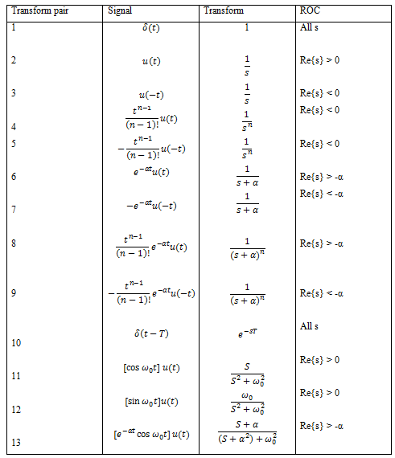

Slide 9

Conditions For Applicability of Laplace Transform
Laplace transforms are called integral transforms so there are necessary conditions for convergence of these transforms.
i.e. f must be locally integrable for the interval [0, ∞) and depending on whether σ is positive or negative, e^(-σt) may be decaying or growing. For bilateral Laplace transforms rather than a single value the integral converges over a certain range of values known as Region of Convergence.

Slide 10
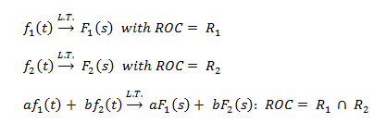
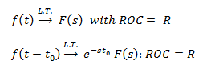
Properties of Laplace Transform:
Linearity
Time Shifting

Slide 11
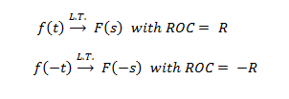


Time-reversal
Differentiation in S-domain
Convolution in Time

Slide 12


Initial Value Theorem
Initial value theorem is applied when in Laplace transform the degree of the numerator is less than the degree of the denominator
Inverse Laplace Transform
Due to convergence characteristic Laplace transform also have an inverse transform. Laplace transforms exhibit one-to-one mapping from one function space to another. The formula for Inverse Laplace transform is;

Slide 13
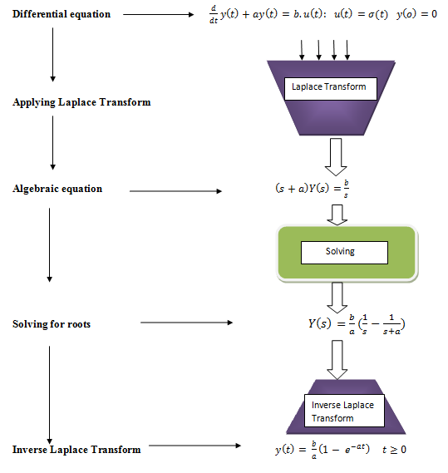
How to Calculate Laplace Transform?
Laplace transform makes the equations simpler to handle. When a higher order differential equation is given, Laplace transform is applied to it which converts the equation into an algebraic equation, thus making it easier to handle. Then we calculate the roots by simplification of this algebraic equation. Now inverse Laplace transform of simpler expression is found which solves the given higher order differential equation.

Slide 14
Applications of Laplace Transform
Analysis of electrical and electronic circuits.
Breaking down complex differential equations into simpler polynomial forms.Laplace transform gives information about steady as well as transient states.
In machine learning, the Laplace transform is used for making predictions and making analysis in data mining.
Laplace transform simplifies calculations in system modeling.
Application of Laplace Transform In Signal Processing
Laplace transforms are frequently opted for signal processing. Along with the Fourier transform, the Laplace transform is used to study signals in the frequency domain. When there are small frequencies in the signal in the frequency domain then one can expect the signal to be smooth in the time domain. Filtering of a signal is usually done in the frequency domain for which Laplace acts as an important tool for converting a signal from time domain to frequency domain.

Slide 15
Application of Laplace Transform In Control Systems
Control systems are usually designed to control the behavior of other devices. Example of control systems can range from a simple home heating controller to an industrial control system regulates the behavior of machinery.
Generally, control engineers use differential equations to describe the behavior of various closed loop functional blocks. Laplace transform is used here for solving these equations without the loss of crucial variable information.
Characterization of Linear Time-Invariant Systems Using Laplace Transform
For a casual system ROC associated with the system, the function is the right half plane. A system is anti-casual if its impulse response
h(t) =0 for t > 0.
If ROC of the system functions H(s) includes the jω axis then the L.T.I. the system is called a stable system. If a casual system with rational system functions H(s) have negative real parts for all of its poles then the system is stable.

Slide 16
Inverse Laplace Transforms
We are going to be given a transform, F(s), and ask what function (or functions) did we have originally. As you will see this can be a more complicated and lengthy process than taking transforms. In these cases we say that we are finding the Inverse Laplace Transform of F(s)and use the following notation.
f(t)=L−1{F(s)}
The Inverse Laplace Transform
If L{f(t)} = F(s), then the inverse Laplace transform of F(s) is
L ⁻¹ {F(s)} = f(t).
(1)The inverse transform L −1 is a linear operator:
L ⁻¹ {F(s) + G(s)} = L ⁻¹ {F(s)} + L ⁻¹ {G(s)},
(2) and L ⁻¹ {cF(s)} = cL ⁻¹ {F(s)},
(3) for any constant c

Slide 17
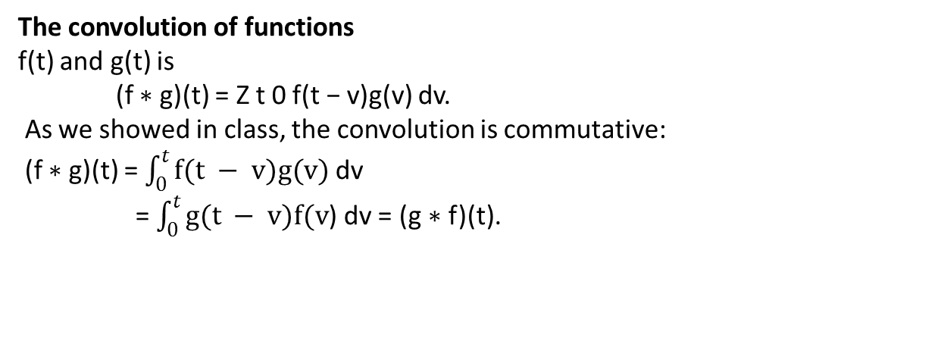
The convolution of functions
f(t) and g(t) is
(f ∗ g)(t) = Z t 0 f(t − v)g(v) dv.
As we showed in class, the convolution is commutative:
(f ∗ g)(t) = $\int_{0}^{t}{f(t − v)g(v) }$dv
= $\int_{0}^{t}{g(t − v)f(v}$) dv = (g ∗ f)(t).
Applications of Inverse Laplace Transformation
Introduction:
The Laplace transformation is applied indifferent areas of science, engineering and technology. The Laplace transformation is applicable in so many fields. The Laplace Transform was primary used and named after by Pierre Simon Laplace Pierre Simon Laplace was a French Mathematician an Astronomer, who had a lot of control in the growth of several theories in mathematics, statistics, physics, and astronomy. He contributed seriously to physical mechanics, by converting the previous geometrical analysis to one based on calculus, which opened up application of his formulas to a wider range of problems. It is effective in solving linear differential equation either ordinary or partial. It reduces an ordinary
differential equation into algebraic equation.

Slide 18
Applicationsof LaplaceTransforminScience and Engineering fields:
Analysis of electronic circuits: Laplace Transform is widely used by electronic engineers to solve quickly differential equations occurring in the analysis of electronic circuits.
System modeling: Laplace Transform is used to simplify calculations in system modeling, where large number of differential equations are used.
Digital signal processing: One can not imagine solving digital signal processing problems without employing Laplace Transform.
Nuclear Physics: In order to get the true form of radioactive decay a Laplace Transform is used. It makes easy to study analytic part of Nuclear physics possible.
Process Control: Laplace Transform is used for process controls. It helps to analyze the variables which when altered, produce desired manipulations in the result. Some of the examples in science and engineering fields in which Laplace Transforms are used to solve the differential equations occurred in this fields.The following examples highlights the importance of Laplace Transform in different engineering fields.

Slide 19
Second Shifting Theorem
The Second Shifting Theorem of Laplace Transform states that
if L[f(t)]=∅(s), then the Laplace Transform of thefollowing function,
𝑔( )𝑡 = 𝑓( 𝑡 –𝑎) 𝑤𝑕𝑒𝑛 𝑡 > 𝑎 𝑎𝑛𝑑 𝑔 (𝑡) = 0 𝑤𝑕𝑒𝑛 𝑡 < 𝑎.
Is expressed as
L[g(t)]=𝑒 ^{−𝑎𝑠}∅(𝑠)
Multiplication of powers of the variable
The variable that has been used so far is‘t’.
Thus, if we multiply powers of t with the original function f (t),
The Laplace transform can be expressed as
𝐿 𝑡 ^{𝑛} 𝑓( 𝑡) =( −1) ^{𝑛} (𝑑 ^{𝑛/} 𝑑𝑠 ^{𝑛} )∅[ 𝑠]
Division of variable If L[f(t)]=∅(s),
then the Laplace Transform when the function is divided by the variable can be expressed as
𝐿[ 𝑓( 𝑡)] 𝑡 = ∅ (𝑠)

Slide 20
IMPULSE FUNCTION (OR DIRAC DELTA FUNCTION)
The impulse function is obtained by taking the limit of the rectangular pulse as its width, tw, goes to zero but holding the area under the pulse constant at one. Solution of ODEs by Laplace Transforms Procedure:
Take the L of both sides of the ODE.
Rearrange the resulting algebraic equation in the s domain to solve for the L of the output variable, e.g., Y(s).
Perform a partial fraction expansion.
Use the L-1 to find y(t) from the expression for Y(s).

