Slide 1
FUNDAMENTALS OF INFORMATION TECHNOLOGY

Slide 2
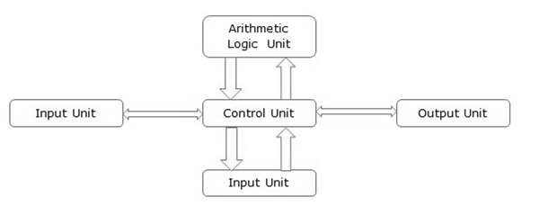
INTRODUCTION TO COMPUTER
A computer is an electronic device, operating under the control of instructions stored in its own memory that can accept data (input), process the data according to specified rules, produce information (output), and store the information for future use.

Slide 3
BASIC PARTS OF THE COMPUTER:
The basic parts of a computer are as follows −
Input Unit − Devices like keyboard and mouse that are used to input data and instructions to the computer are called input unit.
Output Unit − Devices like printer and visual display unit that are used to provide information to the user in desired format are called output unit.
Control Unit − As the name suggests, this unit controls all the functions of the computer. All devices or parts of computer interact through the control unit.
Arithmetic Logic Unit − This is the brain of the computer where all arithmetic operations and logical operations take place.
Memory − All input data, instructions and data interim to the processes are stored in the memory. Memory is of two types – primary memory and secondary memory. Primary memory resides within the CPU whereas secondary memory is external to it.

Slide 4
Characteristics of Computer
Speed − Typically, a computer can carry out 3-4 million instructions per second.
Accuracy − Computers exhibit a very high degree of accuracy. Errors that may occur are usually due to inaccurate data, wrong instructions or bug in chips – all human errors.
Reliability − Computers can carry out same type of work repeatedly without throwing up errors due to tiredness or boredom, which are very common among humans.
Versatility − Computers can carry out a wide range of work from data entry and ticket booking to complex mathematical calculations and continuous astronomical observations. If you can input the necessary data with correct instructions, computer will do the processing.
Storage Capacity − Computers can store a very large amount of data at a fraction of cost of traditional storage of files. Also, data is safe from normal wear and tear associated with paper.

Slide 5
Advantages of Using Computer
Computers can do the same task repetitively with same accuracy.
Computers do not get tired or bored.
Computers can take up routine tasks while releasing human resource for more intelligent functions.

Slide 6
Disadvantages of Using Computer
Computers have no intelligence; they follow the instructions blindly without considering the outcome.
Regular electric supply is necessary to make computers work, which could prove difficult everywhere especially in developing nations.

Slide 7
GENERATIONS OF COMPUTER
1940 – 1956: First Generation – Vacuum Tubes
These early computers used vacuum tubes as circuitry and magnetic drums for memory.
As a result they were enormous, literally taking up entire rooms and costing a fortune to run. These were inefficient materials which generated a lot of heat, sucked huge electricity and subsequently generated a lot of heat which caused ongoing breakdowns.
1956 – 1963: Second Generation – Transistors
The replacement of vacuum tubes by transistors saw the advent of the second generation of computing. Although first invented in 1947, transistors weren’t used significantly in computers until the end of the 1950s. They were a big improvement over the vacuum tube, despite still subjecting computers to damaging levels of heat.

Slide 8
Cont…
1964 – 1971: Third Generation – Integrated Circuits
By this phase, transistors were now being miniaturised and put on silicon chips (called semiconductors). This led to a massive increase in speed and efficiency of these machines. These were the first computers where users interacted using keyboards and monitors which interfaced with an operating system, a significant leap up from the punch cards and printouts.
1972 – 2010: Fourth Generation – Microprocessors
This revolution can be summed in one word: Intel. The chip-maker developed the Intel 4004 chip in 1971, which positioned all computer components (CPU, memory, input/output controls) onto a single chip. What filled a room in the 1940s now fit in the palm of the hand. The Intel chip housed thousands of integrated circuits.

Slide 9
Cont…
2010- : Fifth Generation – Artificial Intelligence
Computer devices with artificial intelligence are still in development, but some of these technologies are beginning to emerge and be used such as voice recognition.
AI is a reality made possible by using parallel processing and superconductors. Leaning to the future, computers will be radically transformed again by quantum computation, molecular and nano technology.
The essence of fifth generation will be using these technologies to ultimately create machines which can process and respond to natural language, and have capability to learn and organise themselves.

Slide 10
CLASSIFICATION DIGITAL COMPUTER
According to functionality, Type of computers are classified as :
Analog Computer
An analog computer (spelt analogue in British English) is a form of computer that uses continuous physical phenomena such as electrical, mechanical, or hydraulic quantities to model the problem being solved.
Digital Computer
A computer that performs calculations and logical operations with quantities represented as digits, usually in the binary number system

Slide 11
Cont..
Hybrid Computer (Analog + Digital)
A combination of computers those are capable of inputting and outputting in both digital and analog signals. A hybrid computer system setup offers a cost effective method of performing complex simulations.
On the basis of Size: Type of Computer
Super Computer
The fastest and most powerful type of computer Supercomputers are very expensive and are employed for specialized applications that require immense amounts of mathematical calculations. For example, weather forecasting requires a supercomputer. Other uses of supercomputers include animated graphics, fluid dynamic calculations, nuclear energy research, and petroleum exploration.

Slide 12
Cont…
Mainframe Computer
A very large and expensive computer capable of supporting hundreds, or even thousands, of users simultaneously.
In the hierarchy that starts with a simple microprocessor (in watches, for example) at the bottom and moves to supercomputers at the top, mainframes are just below supercomputers.
In some ways, mainframes are more powerful than supercomputers because they support more simultaneous programs.
But supercomputers can execute a single program faster than a mainframe.

Slide 13
Cont..
Mini Computer
A midsized computer.
In size and power, minicomputers lie between workstations and mainframes.
In the past decade, the distinction between large minicomputers and small mainframes has blurred, however, as has the distinction between small minicomputers and workstations.
But in general, a minicomputer is a multiprocessing system capable of supporting from 4 to about 200 users simultaneously.

Slide 14
Cont..
Micro Computer or Personal Computer
• Desktop Computer: a personal or micro-mini computer sufficient to fit on a desk.
• Laptop Computer: a portable computer complete with an integrated screen and keyboard. It is generally smaller in size than a desktop computer and larger than a notebook computer.
• Palmtop Computer/Digital Diary /Notebook /PDAs: a hand-sized computer. Palmtops have no keyboard but the screen serves both as an input and output device.

Slide 15
ANATOMY OF DIGITAL COMPUTER
Central Processing Unit: It consist of three main parts
Memory
Arithmetic and logical unit
Control Unit

Slide 16
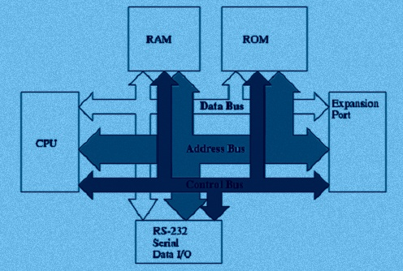
ARCHITECTURE

Slide 17
FUNCTIONS
Memory: It is term, which is used in data storage, and also stored important information of data for future use and also transfer to another device when needed. We can say that it is primary type of storage or internal memory. Internal memory is executed through two types of memory technology
RAM (Random-access-memory): It gives direct information on requirement.
ROM (Read-only-memory): By the name, it can read only not write, which means CPU can read from storage but cannot write.
Control Unit: It defines by controlling all operation of all parts of computer. It takes information from memory and determines where is to be taken. It gives result in the output form in memory section.

Slide 18
Cont…
Arithmetic and logical unit: Arithmetic means process like addition, subtraction, multiplication & division and all these operation is done by Arithmetic unit.
It solves any type of complex arithmetic operation. And in Logical part, all type of logical operations like comparing, selecting, etc.
It have few storage for an example registers, and which are basically made-up of electronic circuits.
Which having capacity to perform operations like addition, subtraction, multiplication etc.

Slide 19
CPU & MEMORY
Central Processing Unit (CPU) consists of the following features −
CPU is considered as the brain of the computer.
CPU performs all types of data processing operations.
It stores data, intermediate results, and instructions (program).
It controls the operation of all parts of the computer.

Slide 20
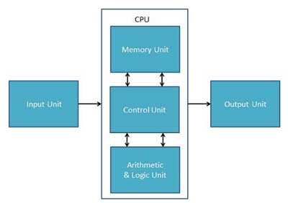
CPU LOGICAL FIGURE
CPU itself has following three components.
Memory or Storage Unit
Control Unit
ALU(Arithmetic Logic Unit)

Slide 21
Cont…
Memory or Storage Unit:
This unit can store instructions, data, and intermediate results. This unit supplies information to other units of the computer when needed. It is also known as internal storage unit or the main memory or the primary storage or Random Access Memory (RAM).
Its size affects speed, power, and capability. Primary memory and secondary memory are two types of memories in the computer. Functions of the memory unit are −
It stores all the data and the instructions required for processing.
It stores intermediate results of processing.
It stores the final results of processing before these results are released to an output device.
All inputs and outputs are transmitted through the main memory.

Slide 22
Cont..
Control Unit
This unit controls the operations of all parts of the computer but does not carry out any actual data processing operations.
Functions of this unit are −
It is responsible for controlling the transfer of data and instructions among other units of a computer.
It obtains the instructions from the memory, interprets them, and directs the operation of the computer.
It communicates with Input/Output devices for transfer of data or results from storage.
It does not process or store data.

Slide 23
Cont...
ALU (Arithmetic Logic Unit):
This unit consists of two subsections namely,
Arithmetic Section
Logic Section
Arithmetic Section:
Function of arithmetic section is to perform arithmetic operations like addition, subtraction, multiplication, and division. All complex operations are done by making repetitive use of the above operations.
Logic Section:
Function of logic section is to perform logic operations such as comparing, selecting, matching, and merging of data.

Slide 24
INPUT DEVICES
Following are some of the important input devices which are used in a computer −
Keyboard
Mouse
Joy Stick
Light pen
Track Ball
Scanner
Graphic Tablet
Microphone
Magnetic Ink Card Reader(MICR)
Optical Character Reader(OCR)
Bar Code Reader
Optical Mark Reader(OMR)

Slide 25
Keyboard & Mouse
Keyboard is the most common and very popular input device which helps to input data to the computer.
The layout of the keyboard is like that of traditional typewriter, although there are some additional keys provided for performing additional functions.
Mouse:
Mouse is the most popular pointing device.
It is a very famous cursor-control device having a small palm size box with a round ball at its base, which senses the movement of the mouse and sends corresponding signals to the CPU when the mouse buttons are pressed.

Slide 26
Joystick & Light Pen
Joystick is also a pointing device, which is used to move the cursor position on a monitor screen.
It is a stick having a spherical ball at its both lower and upper ends. The lower spherical ball moves in a socket. The joystick can be moved in all four directions.
Light Pen:
Light pen is a pointing device similar to a pen.
It is used to select a displayed menu item or draw pictures on the monitor screen.
It consists of a photocell and an optical system placed in a small tube.

Slide 27
Track Ball & Scanner
Track Ball:
Track ball is an input device that is mostly used in notebook or laptop computer, instead of a mouse.
This is a ball which is half inserted and by moving fingers on the ball, the pointer can be moved.
Scanner:
Scanner is an input device, which works more like a photocopy machine.
It is used when some information is available on paper and it is to be transferred to the hard disk of the computer for further manipulation.

Slide 28
Bar Code Readers & OMR
Bar Code Readers
Bar Code Reader is a device used for reading bar coded data (data in the form of light and dark lines).
Bar coded data is generally used in labelling goods, numbering the books, etc. It may be a handheld scanner or may be embedded in a stationary scanner.
Optical Mark Reader (OMR)
OMR is a special type of optical scanner used to recognize the type of mark made by pen or pencil. It is used where one out of a few alternatives is to be selected and marked.

Slide 29
OUTPUT DEVICES
Following are some of the important output devices used in a computer.
Monitors
Graphic Plotter
Printer

Slide 30
MONITERS
Monitors, commonly called as Visual Display Unit (VDU), are the main output device of a computer.
It forms images from tiny dots, called pixels that are arranged in a rectangular form.
The sharpness of the image depends upon the number of pixels.
There are two kinds of viewing screen used for monitors.
Cathode-Ray Tube (CRT)
Flat-Panel Display

Slide 31
Cathode-Ray Tube (CRT) Monitor
The CRT display is made up of small picture elements called pixels.
The smaller the pixels, the better the image clarity or resolution. It takes more than one illuminated pixel to form a whole character, such as the letter ‘e’ in the word help.
There are some disadvantages of CRT −
Large in Size
High power consumption

Slide 32
Flat-Panel Display Monitor
The flat-panel display refers to a class of video devices that have reduced volume, weight and power requirement in comparison to the CRT.
You can hang them on walls or wear them on your wrists. Current uses of flat-panel displays include calculators, video games, monitors, laptop computer, and graphics display.
The flat-panel display is divided into two categories −
Emissive Displays − Emissive displays are devices that convert electrical energy into light. For example, plasma panel and LED (Light-Emitting Diodes).
Non-Emissive Displays − Non-emissive displays use optical effects to convert sunlight or light from some other source into graphics patterns. For example, LCD (Liquid-Crystal Device).

Slide 33
Printers
Printer is an output device, which is used to print information on paper.
There are two types of printers −
Impact Printers
Non-Impact Printers
Impact Printers
Impact printers print the characters by striking them on the ribbon, which is then pressed on the paper.
Non-impact Printers
Non-impact printers print the characters without using the ribbon. These printers print a complete page at a time, thus they are also called as Page Printers.

Slide 34
MEMORY
A memory is just like a human brain.
It is used to store data and instructions. Computer memory is the storage space in the computer, where data is to be processed and instructions required for processing are stored.
The memory is divided into large number of small parts called cells. Each location or cell has a unique address, which varies from zero to memory size minus one.
Memory is primarily of three types −
Cache Memory
Primary Memory/Main Memory
Secondary Memory

Slide 35
COMPUTER SOFTWARES
Software is a set of programs, which is designed to perform a well-defined function.
A program is a sequence of instructions written to solve a particular problem.
There are two types of software −
System Software
Application Software

Slide 36
System Software
The system software is a collection of programs designed to operate, control, and extend the processing capabilities of the computer itself.
System software is generally prepared by the computer manufacturers.
These software products comprise of programs written in low-level languages, which interact with the hardware at a very basic level.
System software serves as the interface between the hardware and the end users.
Some examples of system software are Operating System, Compilers, Interpreter, Assemblers, etc.

Slide 37
Application Software
Application software products are designed to satisfy a particular need of a particular environment.
All software applications prepared in the computer lab can come under the category of Application software.
Application software may consist of a single program, such as Microsoft's notepad for writing and editing a simple text.
It may also consist of a collection of programs, often called a software package, which work together to accomplish a task, such as a spreadsheet package.

Slide 38
PROGRAMMING LANGUAGE
The computer system is simply a machine and hence it cannot perform any work; therefore, in order to make it functional different languages are developed, which are known as programming languages or simply computer languages.
Following are the major categories of Programming Languages −
Machine Language
Assembly Language
High Level Language
System Language
Scripting Language

Slide 39
LANGUAGES & ITS FUNCTIONS
Machine Language or Code
This is the language that is written for the computer hardware. Such language is effected directly by the central processing unit (CPU) of a computer system.
Assembly Language
It is a language of an encoding of machine code that makes simpler and readable.
High Level Language
The high level language is simple and easy to understand and it is similar to English language. For example, COBOL, FORTRAN, BASIC, C, C+, Python, etc.

Slide 40
OPERATING SYSTEM
An operating system is the fundamental basis of all other application programs. Operating system is an intermediary between the users and the hardware.
Operating system controls and coordinates the use of hardware among application programs.
The major services of an operating system are −
Memory management
Disk access
Creating user interface
Managing the different programs operating parallel
Likewise, it controls and manage the hardware’s working

Slide 41
Applications of Operating System
An operating system is accountable for the formation and deletion of files and directories.
An operating system manages the process of deletion, suspension, resumption, and synchronization.
An operating system manages memory space by allocation and de-allocation.
An operating system stores, organizes, and names and protects the existing files.
Further, an operating system manages all the components and devices of the computers system including modems, printers, plotters, etc.
An operating system facilitates the interface to user and hardware.

Slide 42
Types of Operating System
Following are the major types of operating system −
Disk Operating System (DOS)
Windows Operating System
Unix Operating System
Disk Operating System:
MS-DOS is one of the oldest and widely used operating system. DOS is a set of computer programs, the major functions of which are file management, allocation of system resources, providing essential features to control hardware devices.
DOS commands can be typed in either upper case or lower case.

Slide 43
Windows Operating System
The operating system window is the extension of the disk operating system.
It is the most popular and simplest operating system; it can be used by any person who can read and understand basic English, as it does not require any special training.
However, the Windows Operating System requires DOS to run the various application programs initially.
Because of this reason, DOS should be installed into the memory and then window can be executed.

Slide 44
Unix Operating System
The Unix Operating System is the earliest operating system developed in 1970s. Let us consider the following points relating to the Unix Operating System −
It is an operating system that has multitasking features.
It has multiuser computer operating systems.
It runs practically on every sort of hardware and provides stimulus to the open source movement.
It has comparative complex functionality and hence an untrained user cannot use it; only the one who has taken training can use this system.

Slide 45
INTRODUCTION TO DBMS
Database is a collection of related data and data is a collection of facts and figures that can be processed to produce information.
Mostly data represents recordable facts.
Data aids in producing information, which is based on facts.
For example, if we have data about marks obtained by all students, we can then conclude about toppers and average marks.
A database management system stores data in such a way that it becomes easier to retrieve, manipulate, and produce information.

Slide 46
Applications of DBMS
Database is a collection of related data and data is a collection of facts and figures that can be processed to produce information.
Mostly data represents recordable facts. Data aids in producing information, which is based on facts. For example, if we have data about marks obtained by all students, we can then conclude about toppers and average marks.
A database management system stores data in such a way that it becomes easier to retrieve, manipulate, and produce information. Following are the important characteristics and applications of DBMS.
ACID Properties − DBMS follows the concepts of Atomicity, Consistency, Isolation, and Durability (normally shortened as ACID). These concepts are applied on transactions, which manipulate data in a database.

Slide 47
Cont..
Multiuser and Concurrent Access − DBMS supports multi-user environment and allows them to access and manipulate data in parallel.
Though there are restrictions on transactions when users attempt to handle the same data item, but users are always unaware of them.
Multiple views − DBMS offers multiple views for different users.
A user who is in the Sales department will have a different view of database than a person working in the Production department.
This feature enables the users to have a concentrate view of the database according to their requirements.

Slide 48
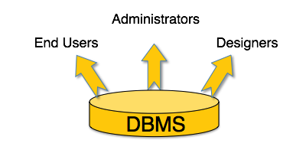
USERS
A typical DBMS has users with different rights and permissions who use it for different purposes.
Some users retrieve data and some back it up.
The users of a DBMS can be broadly categorized as follows −

Slide 49
Cont..
Administrators − Administrators maintain the DBMS and are responsible for administrating the database
They are responsible to look after its usage and by whom it should be used.
They create access profiles for users and apply limitations to maintain isolation and force security.
Administrators also look after DBMS resources like system license, required tools, and other software and hardware related maintenance.
Designers − Designers are the group of people who actually work on the designing part of the database. They keep a close watch on what data should be kept and in what format. They identify and design the whole set of entities, relations, constraints, and views.

Slide 50
WORLD WIDE WEB
WWW stands for World Wide Web. A technical definition of the World Wide Web is : all the resources and users on the Internet that are using the Hypertext Transfer Protocol (HTTP).
A broader definition comes from the organization that Web inventor Tim Berners-Lee helped found, the World Wide Web Consortium (W3C).
The World Wide Web is the universe of network-accessible information, an embodiment of human knowledge.
In simple terms, The World Wide Web is a way of exchanging information between computers on the Internet, tying them together into a vast collection of interactive multimedia resources.

Slide 51
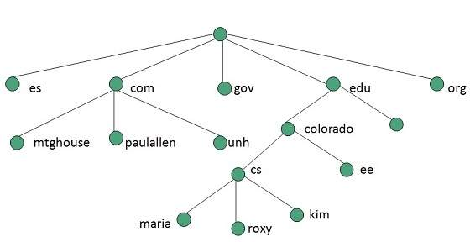
Cont…
Internet and Web is not the same thing: Web uses internet to pass over the information

Slide 52
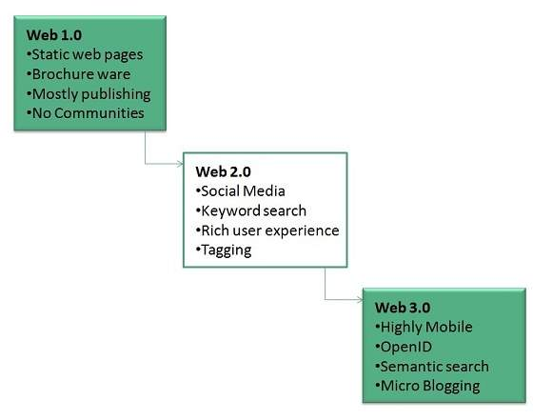
World Wide Web was created by Timothy Berners Lee in 1989 at CERN in Geneva. World Wide Web came into existence as a proposal by him, to allow researchers to work together effectively and efficiently at CERN. Eventually it became World Wide Web.
The following diagram briefly defines evolution of World Wide Web:

Slide 53
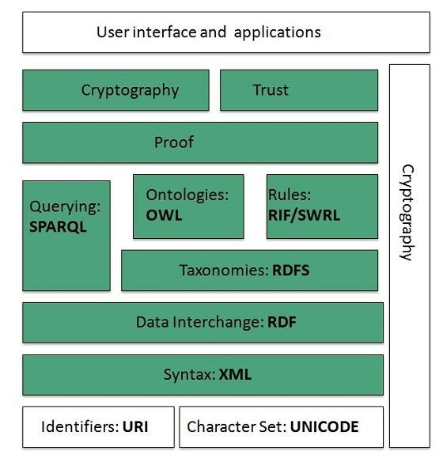
WWW Architecture

Slide 54
WWW Operation
WWW works on client- server approach. Following steps explains how the web works:
User enters the URL (say, http://www.tutorialspoint.com) of the web page in the address bar of web browser.
Then browser requests the Domain Name Server for the IP address corresponding to www.tutorialspoint.com.
After receiving IP address, browser sends the request for web page to the web server using HTTP protocol which specifies the way the browser and web server communicates.
Then web server receives request using HTTP protocol and checks its search for the requested web page. If found it returns it back to the web browser and close the HTTP connection.

Slide 55
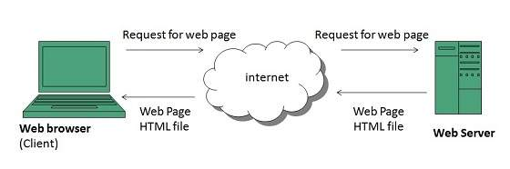
FUNCTION

Slide 56
Cont…
Future
There had been a rapid development in field of web. It has its impact in almost every area such as education, research, technology, commerce, marketing etc. So the future of web is almost unpredictable.
Apart from huge development in field of WWW, there are also some technical issues that W3 consortium has to cope up with.
User Interface
Work on higher quality presentation of 3-D information is under development. The W3 Consortium is also looking forward to enhance the web to full fill requirements of global communities which would include all regional languages and writing system.

Slide 57
ELECTRONIC MAILING
Email is a service which allows us to send the message in electronic mode over the internet. It offers an efficient, inexpensive and real time mean of distributing information among people.
E-Mail Address
Each user of email is assigned a unique name for his email account. This name is known as E-mail address. Different users can send and receive messages according to the e-mail address.
E-mail is generally of the form username@domainname. For example, webmaster@tutorialspoint.com is an e-mail address where webmaster is username and tutorialspoint.com is domain name.

Slide 58
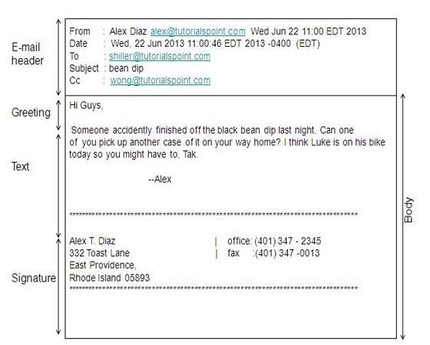
E-mail Message Components

Slide 59
COMPONENTS FUNCTIONS
E-mail Header
The first five lines of an E-mail message is called E-mail header. The header part comprises of following fields:
From
Date
To
Subject
CC
BCC

Slide 60
OPERATIONS
From
The From field indicates the sender’s address i.e. who sent the e-mail.
Date
The Date field indicates the date when the e-mail was sent.
To
The To field indicates the recipient’s address i.e. to whom the e-mail is sent.
Subject
The Subject field indicates the purpose of e-mail. It should be precise and to the point.

Slide 61
CC
CC stands for Carbon copy. It includes those recipient addresses whom we want to keep informed but not exactly the intended recipient.
BCC
BCC stands for Black Carbon Copy. It is used when we do not want one or more of the recipients to know that someone else was copied on the message.
Greeting
Greeting is the opening of the actual message. Eg. Hi Sir or Hi Guys etc.
Text
It represents the actual content of the message.

Slide 62
WORKING OF EMAIL
Email working follows the client server approach. In this client is the mailer i.e. the mail application or mail program and server is a device that manages emails.
Suppose person A wants to send an email message to person B.
Person A composes the messages using a mailer program i.e. mail client and then select Send option.
The message is routed to Simple Mail Transfer Protocol to person B’s mail server.
The mail server stores the email message on disk in an area designated for person B.

Slide 63
INTERNET
Internet is defined as an Information super Highway, to access information over the web. However, It can be defined in many ways as follows:
Internet is a world-wide global system of interconnected computer networks.
Internet uses the standard Internet Protocol (TCP/IP).
Every computer in internet is identified by a unique IP address.
IP Address is a unique set of numbers (such as 110.22.33.114) which identifies a computer location.
Internet is accessible to every user all over the world.

Slide 64
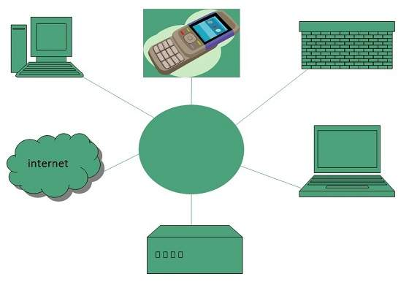
ARCHITECTURE

Slide 65
Evolution
The origin of Internet devised from the concept of Advanced Research Project Agency Network (ARPANET).
ARPANET was developed by United States Department of Defense.
Basic purpose of ARPANET was to provide communication among the various bodies of government.
Initially, there were only four nodes, formally called Hosts.
In 1972, the ARPANET spread over the globe with 23 nodes located at different countries and thus became known as Internet.

Slide 66
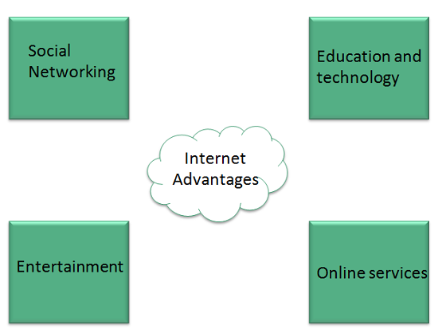
Advantages

Slide 67
Cont…
Internet allows us to communicate with the people sitting at remote locations. There are various apps available on the wed that uses Internet as a medium for communication.
  Facebook
  Twitter
  Yahoo
  Google+
  Flickr
  Orkut
Information regarding various topics such as Technology, Health & Science, Social Studies, Geographical Information, Information Technology, Products etc can be surfed with help of a search engine.

Slide 68
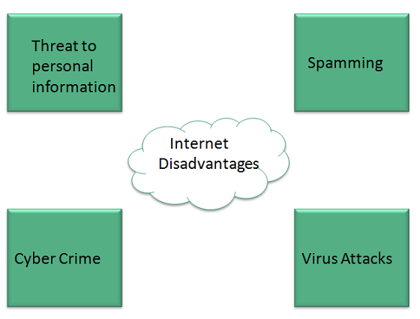
Disadvantages

Slide 69
Cont…
There are always chances to loose personal information such as name, address, credit card number. Therefore, one should be very careful while sharing such information. One should use credit cards only through authenticated sites.
Another disadvantage is the Spamming.Spamming corresponds to the unwanted e-mails in bulk. These e-mails serve no purpose and lead to obstruction of entire system.
Virus can easily be spread to the computers connected to internet. Such virus attacks may cause your system to crash or your important data may get deleted.
Also a biggest threat on internet is pornography. There are many pornographic sites that can be found, letting your children to use internet which indirectly affects the children healthy mental life.

Slide 70
WEB DESIGNING
Web designing has direct link to visual aspect of a web site. Effective web design is necessary to communicate ideas effectively.
Web desinging is subset of web development. However these terms are used interchangeably.
Key Points
Design Plan should include the following:
Details about information architecture.
Planned structure of site.
A site map of pages

Slide 71
COMPTERS @ HOME,EDUCATION,HEALTH
With the introduction of microcomputers, personal computers became popular and people started using computers in every field whether it is banking, health, education, entertainment or business and at present time when everything is going online, it is impossible to think about anything where computers are not involved.
Computers have become an important part of human life.
Therefore, the importance of computers has increased in every part of human life.

Slide 72
@EDUCATION
Education is an important part of human life and it plays the most important role in shaping the life of human beings and thus shaping the future of a nation and at present computers play an important role in the way education sector works.
Computers empower students with information:
The main purpose of education is to learn and to learn in detail about things. Computers provide access to the internet and the internet has the potential to provide information about anything and everything.
If a person has a computer, access to the internet, a will to learn, he can learn anything without going to school and without having a tutor.

Slide 73
@BUSINESS
The way business works have changed a lot with the introduction of computers.
No matter whether a business is small or large their computers are used to enhance the efficiency of a business to learn about the importance of computers in business.
The first importance of computers in business is managing finances. In business, several transactions take place in a day.
Businessman buys from various suppliers and sells products in order to make products.
To do this, they make the entry of products that they buy on the computer and with the help of computers assign selling prices to the goods.

Slide 74
@HEALTH
Computers are frequently used in hospitals because of their speed of processing information and because of the inbuilt intelligence of computers.
In a large hospital, the record of patients are needed to be recorded and day to day medical works and financial works are performed using computers.
One of the biggest importance of computers is in the fast sharing of medical information of patients so that quick treatment can be provided.
The reports of medical tests can be sent to any part of the world no matter how far it is using email. doctors can read reports and can share the opinion of the doctor and the treatment of the patient can be started without delay.

Slide 75
@ENTERTAINMENT
Entertainment is an integral and important part of human life.
We have always been looking for the means to entertain themselves and the methods of entertainment have changed and increased since the inception of computers and technology.
Music has always been one of the main sources of entertainment of humans and the music industry revolutionized with the introduction of computers.
There are so many types of software that musicians use to create music.
Using these software and tool the quality of music enhanced and now musicians can develop complex music which was not possible without computers.

Slide 76
@BANKING
The banking sector was one of the first sectors which were influenced by computers.
In the past, all the account-related information and data were kept by people on notebooks manually, which was very time consuming and error-prone.
With the introduction of computers, all the details related to the bank account of an individual is saved and stored in computers, which is stored in far placed servers.
Therefore, the information is not only saved from theft but also safe from natural calamities.

Slide 77
INTERNET SECURITY
Internet security refers to securing communication over the internet. It includes specific security protocols such as:
Internet Security Protocol (IPSec)
Secure Socket Layer (SSL)
Internet Security Protocol (IPSec)
It consists of a set of protocols designed by Internet Engineering Task Force (IETF). It provides security at network level and helps to create authenticated and confidential packets for IP layer.
Secure Socket Layer (SSL)
It is a security protocol developed by Netscape Communications Corporation. ).

Slide 78
Threats
Internet security threats impact the network, data security and other internet connected systems. Cyber criminals have evolved several techniques to threat privacy and integrity of bank accounts, businesses, and organizations.
Mobile worms Malware
PC and Mobile ransomware
Large scale attacks like Stuxnet that attempts to destroy infrastructure.
Hacking as a Service
Spam
Phishing

Slide 79
VIRUS
A computer virus is a type of malware that propagates by inserting a copy of itself into and becoming part of another program.
It spreads from one computer to another, leaving infections as it travels.
Viruses can range in severity from causing mildly annoying effects to damaging data or software and causing denial-of-service (DoS) conditions.
Almost all viruses are attached to an executable file, which means the virus may exist on a system but will not be active or able to spread until a user runs or opens the malicious host file or program.
Viruses spread when the software or document they are attached to is transferred from one computer to another using the network, a disk, file sharing, or infected email attachments.

Slide 80
Worms
Computer worms are similar to viruses in that they replicate functional copies of themselves and can cause the same type of damage.
In contrast to viruses, which require the spreading of an infected host file, worms are standalone software and do not require a host program or human help to propagate.
To spread, worms either exploit a vulnerability on the target system or use some kind of social engineering to trick users into executing them.
A worm enters a computer through a vulnerability in the system and takes advantage of file-transport or information-transport features on the system, allowing it to travel unaided. More advanced worms leverage encryption, wipers, and ransomware technologies to harm their targets.

