Slide 1
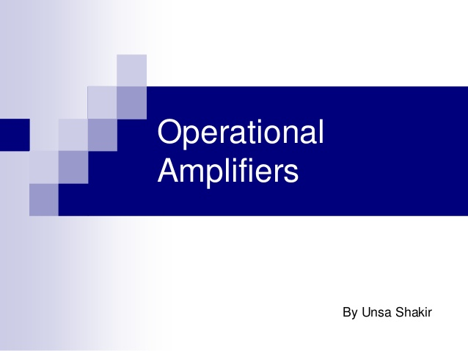

Slide 2
UNIT – V
OPERATIONAL AMPLIFIER
The basic operational amplifier. Inverting and Non inverting operational Amplifier, Differential operational amplifier, CMRR-Basic uses of operational amplifier as sign, CMRR-Basic uses of operational amplifier as scale and phase, Adder, Subtractor, Comparator, Differentiator - AC Successive approximation.

Slide 3
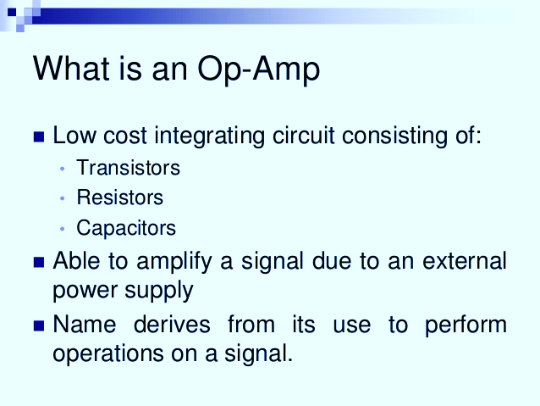

Slide 4
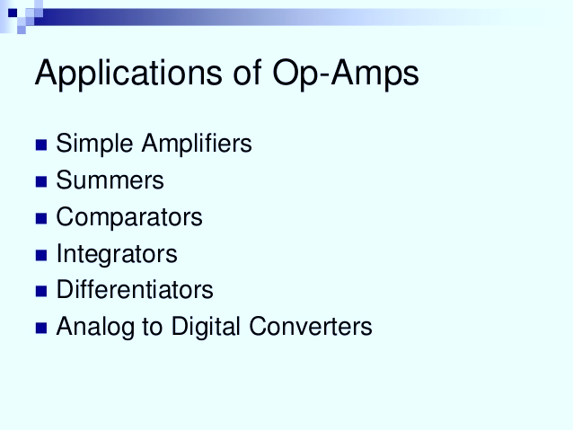

Slide 5
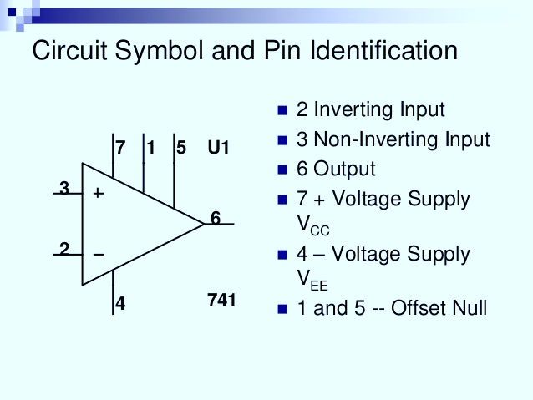

Slide 6
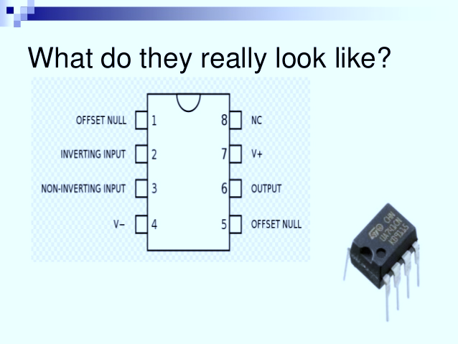

Slide 7
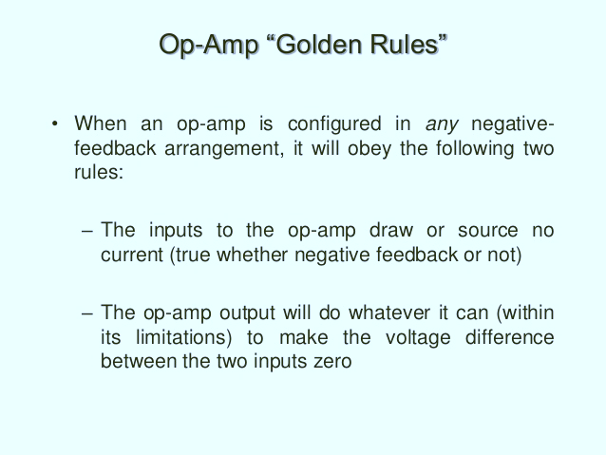

Slide 8
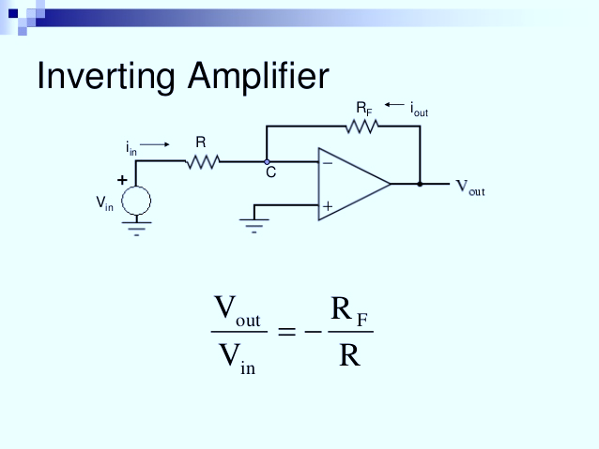

Slide 9
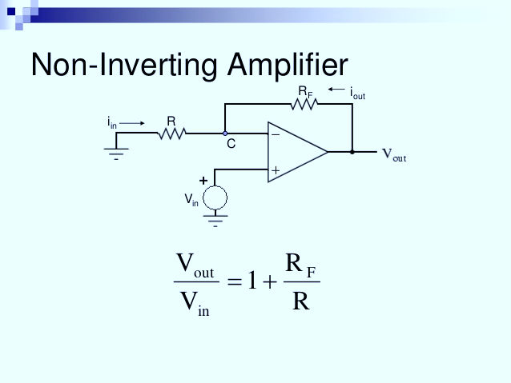

Slide 10
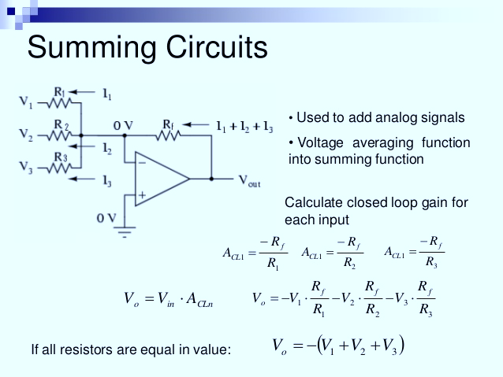

Slide 11
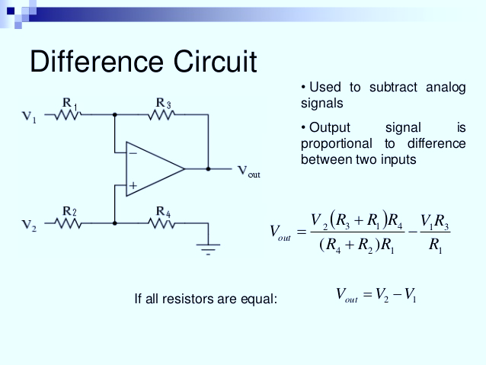

Slide 12
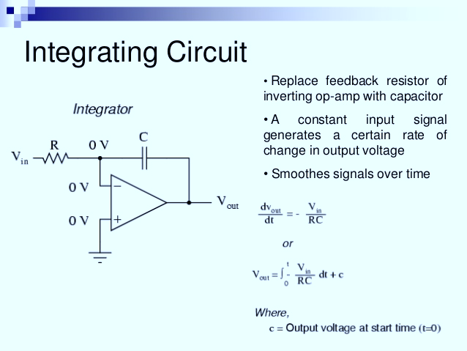

Slide 13
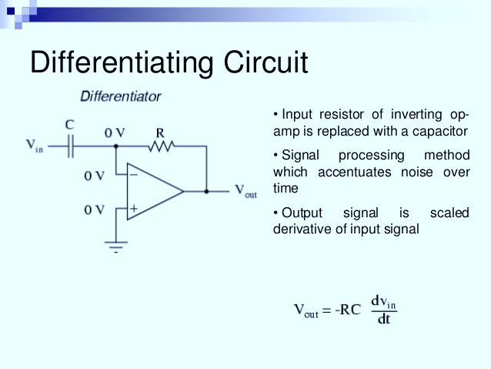

Slide 14
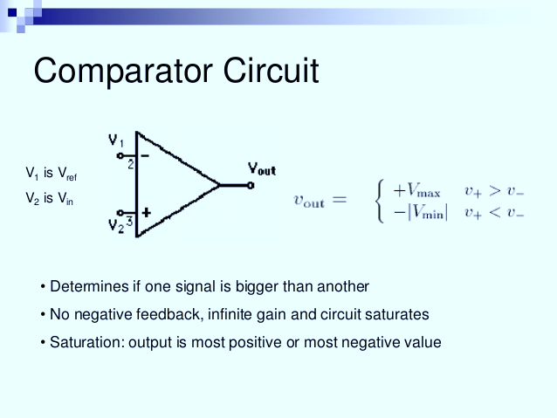

Slide 17
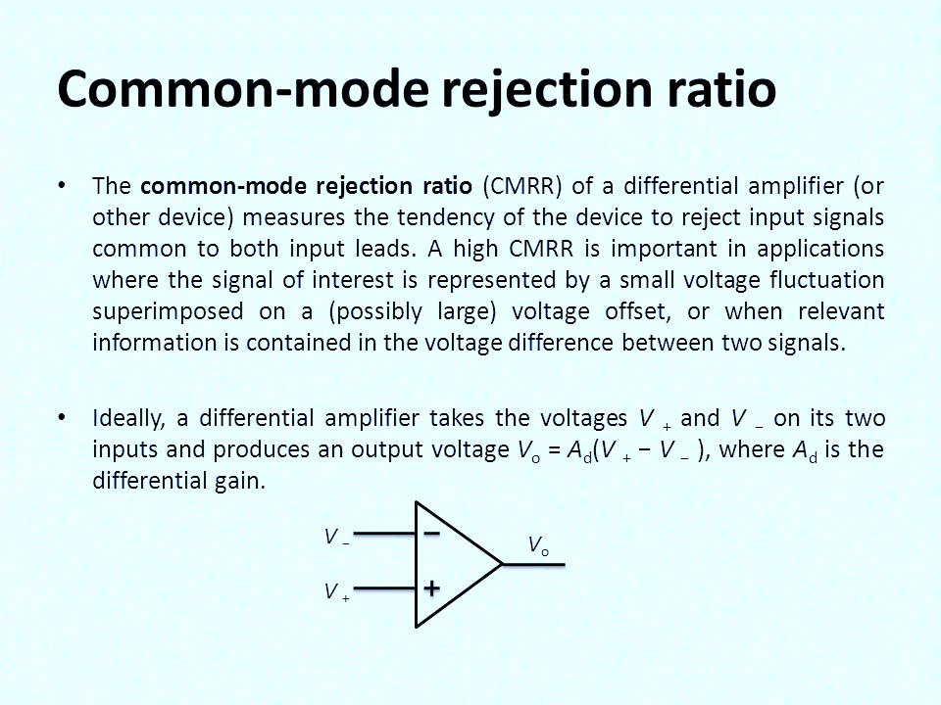

Slide 18
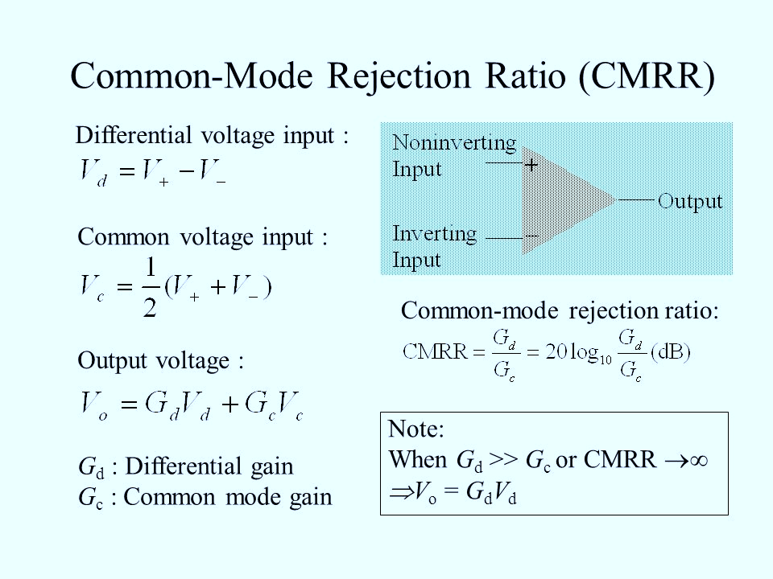

Slide 19
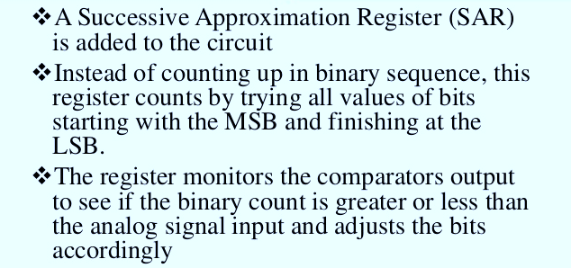
SUCCESSIVE APPROXIMATION

Slide 20
